Slide 1

Mini project Directed graph by adjacency matrix
Presented To:
Sadia Nur Amin
Lecturer,
Dept. of Computer Science and Engineering(CSE)
East West University(EWU)
Presented by:
JYOTIRMAY MONDAL ( 2024-1-60-080 )
MD. FIROZ KABIR (2025-1-60-193 )
ZAFIRUL ANAM SARKAR (2023-3-60-575 )
TASKIN BILLAH TAMIM(2025-1-60-050)

Slide 2
Welcome to our Presentation Randomly generate a Directed graph represented by adjacency matrix

Slide 3
What is an Adjacency Matrix?
An adjacency matrix is a table. It shows how nodes in a graph are connected.
Each row and column in the table stands for a node.
If two nodes are connected, we put a "1" where their row and column meet.
If they are not connected, we put a “0" there.
This matrix makes it easy to see the connections in a graph.

Slide 4
2
A
Vertex
B
A
1
Edge
3
1
3
1
C
 | A | B | C | D
A | 0 | 2 | 0 | 1
B | 1 | 0 | 3 | 0
C | 0 | 0 | 0 | 2
D | 3 | 1 | 0 | 0
2
D

Slide 5
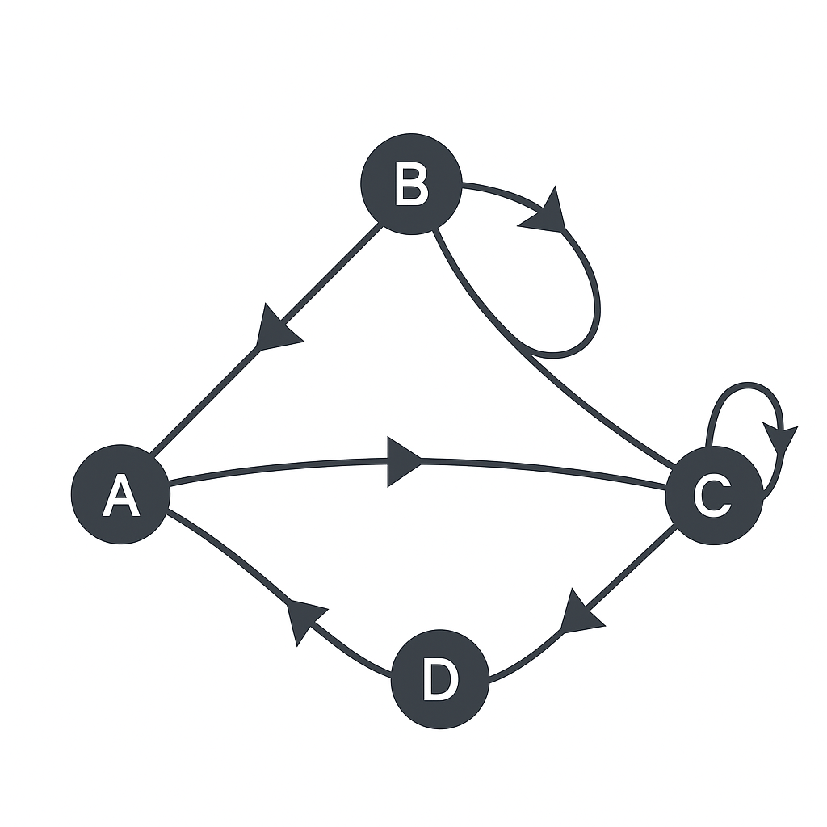
What is a Directed Graph?
A directed graph is a type of graph where the connections between nodes have a specific direction.
This means that if one node is connected to another, the connection only works one way, unless another arrow exists in the opposite direction.
The lines that connect the nodes are called directed edges or arcs, and they are drawn with arrows to show the direction.
In a directed graph, you can move from one node to another only in the direction of the arrow. To go back, there must be another arrow pointing the opposite way.

Slide 6
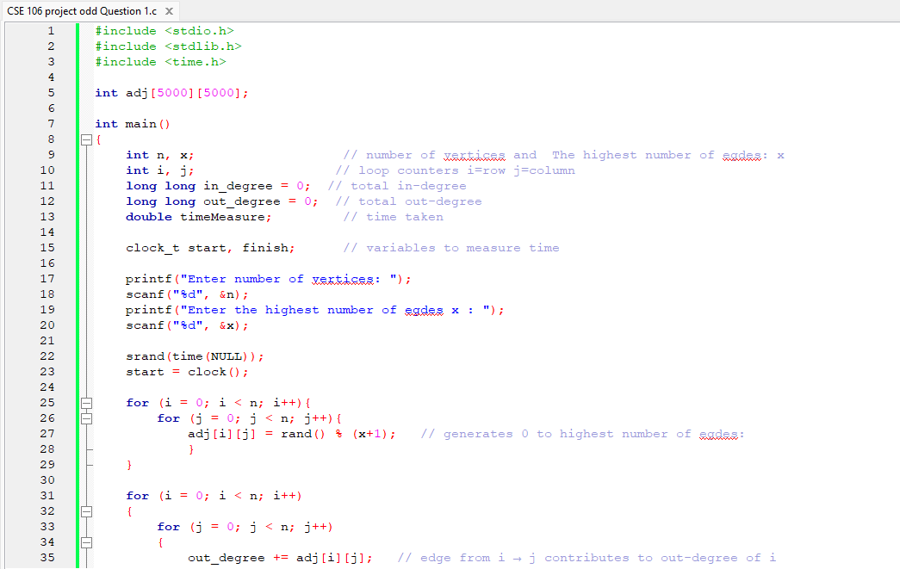
PSEUDO CODE

Slide 7
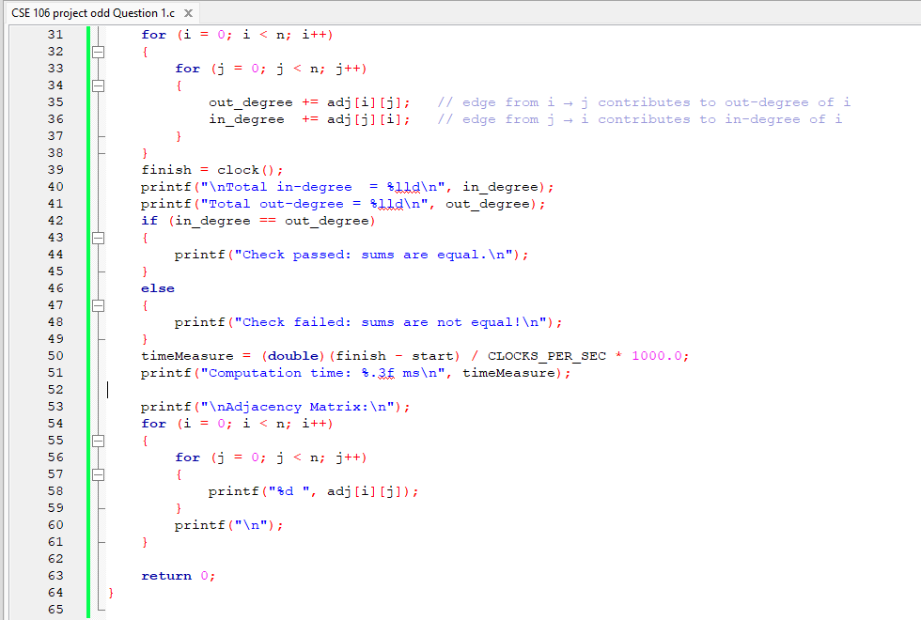

Slide 8
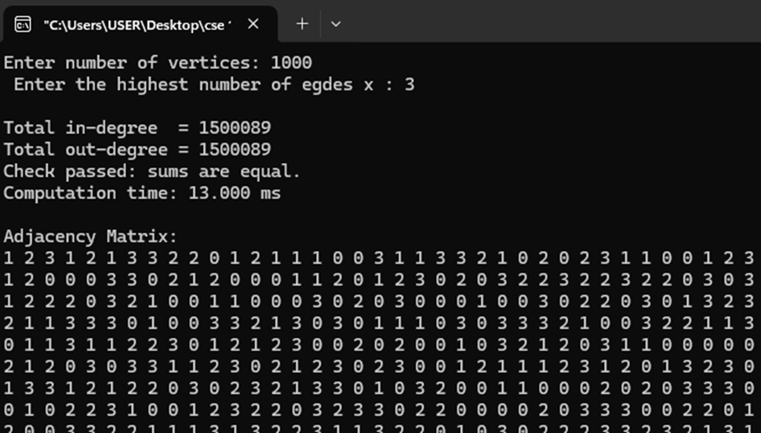
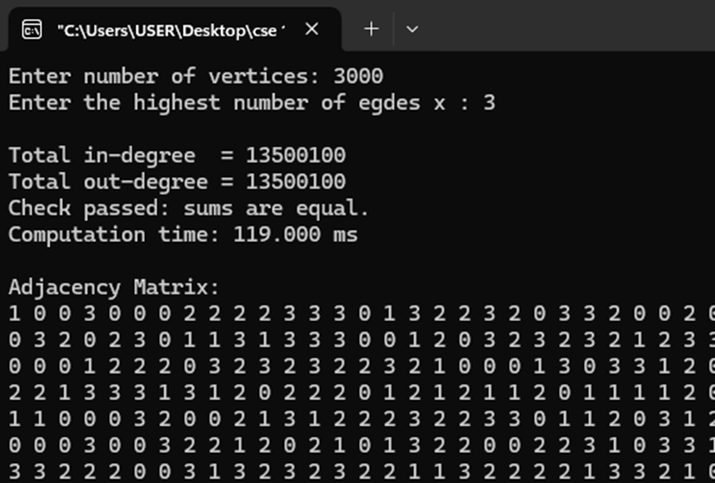
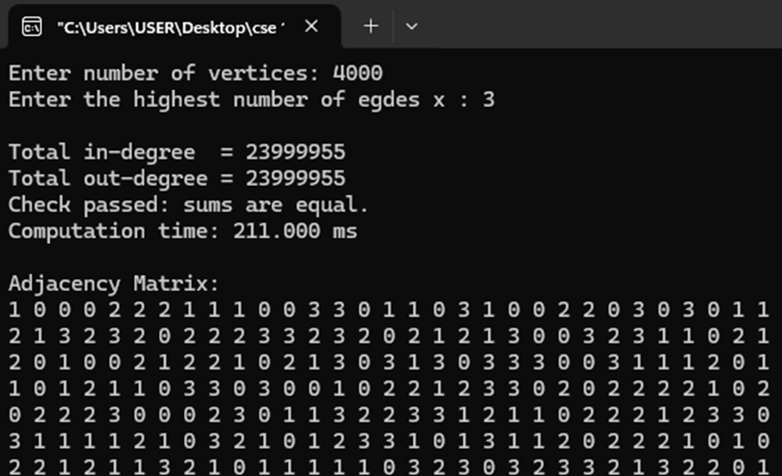
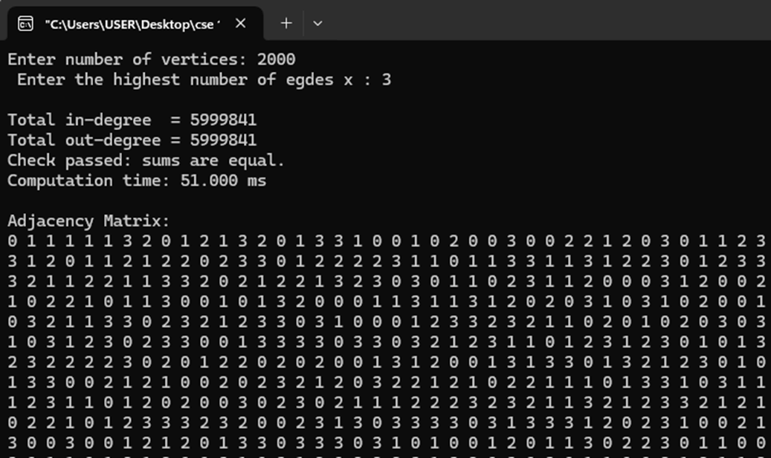
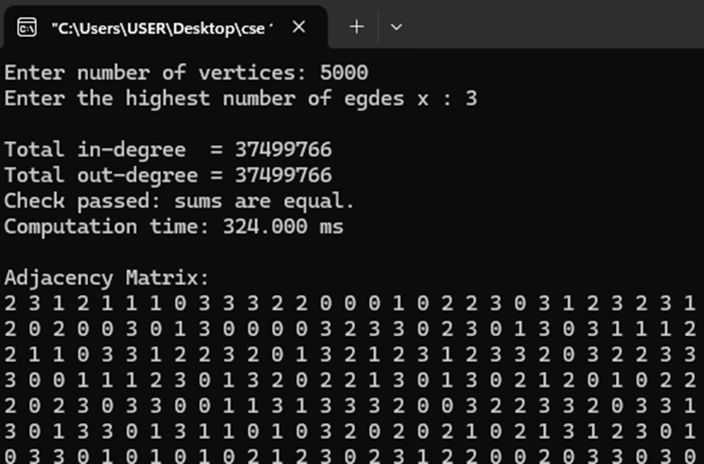
OUTPUTS

Slide 9
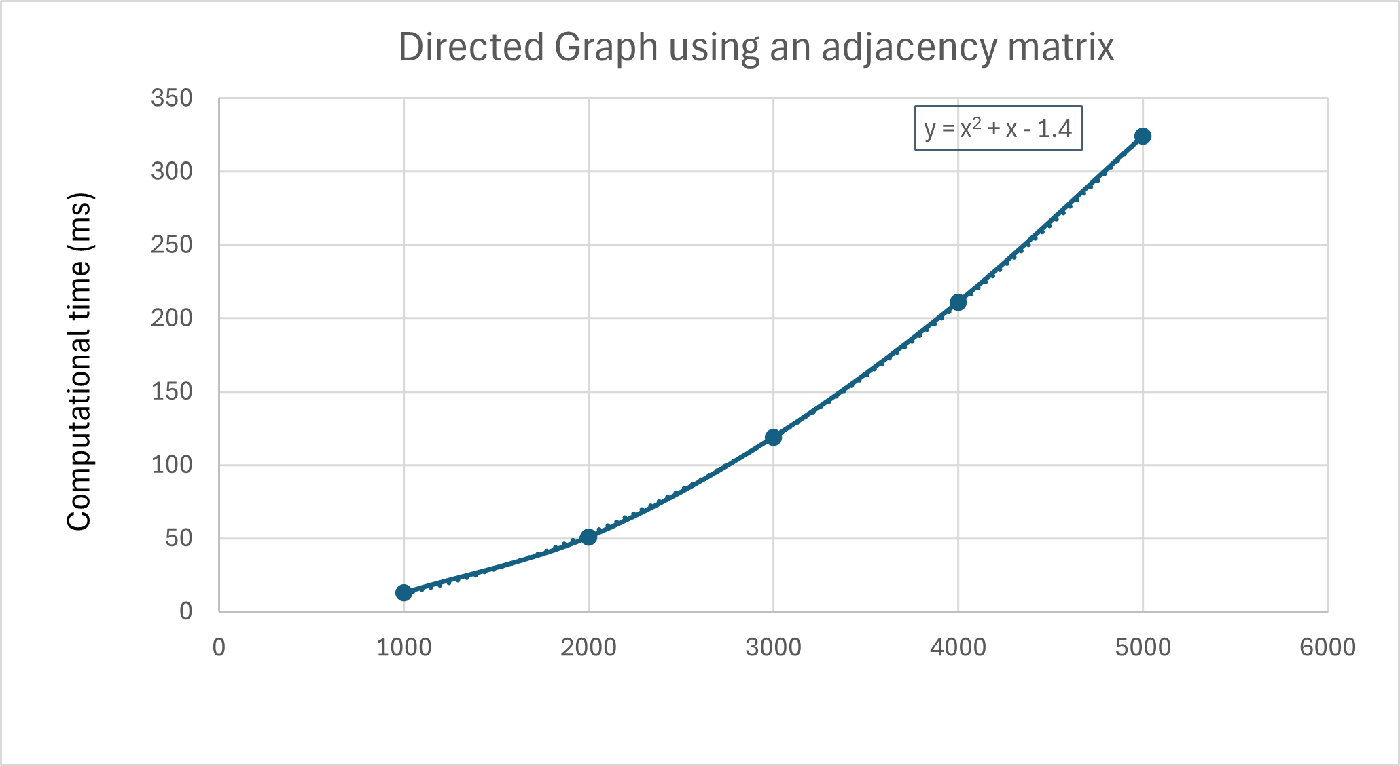
GRAPH: This chart illustrates the correlation between calculation time(ms) and variable n, revealing that as n values rise, calculation time consistently increases.
GRAPH
Number of vertices (n) | Computational time (ms)
1000 | 13.00
2000 | 51.00
3000 | 119.00
4000 | 211.00
5000 | 324.00

Slide 10
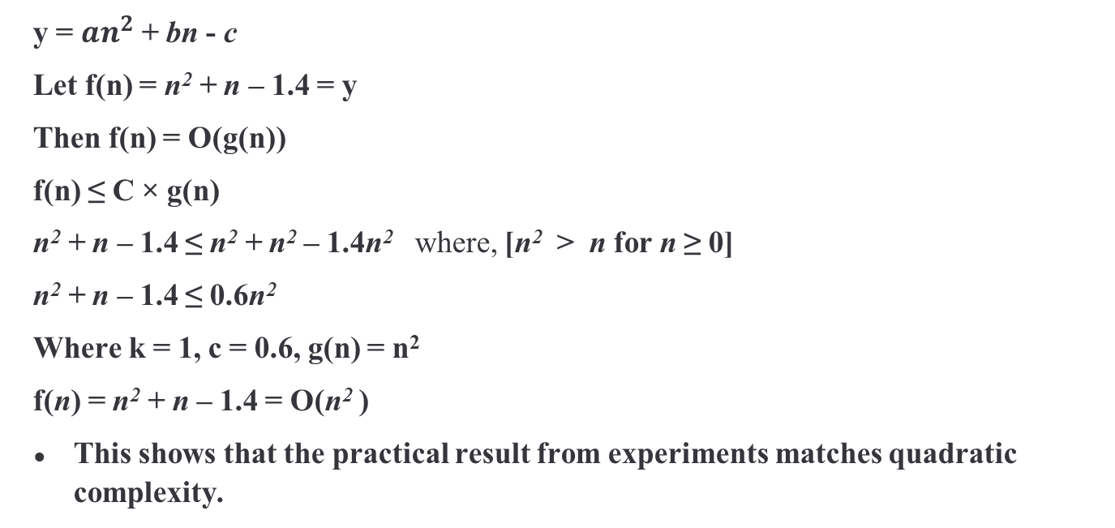
Time Complexity Determination (Practical)
y = $an^{2}$ + bn - c
Let f(n) = n² + n – 1.4 = y
Then f(n) = O(g(n))
f(n) ≤ C × g(n)
n² + n – 1.4 ≤ n² + n² – 1.4n² where, [n² > n for n ≥ 0]
n² + n – 1.4 ≤ 0.6n²
Where k = 1, c = 0.6, g(n) = n²
f(n) = n² + n – 1.4 = O(n² )
This shows that the practical result from experiments matches quadratic complexity.

Slide 11
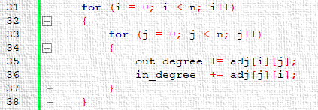
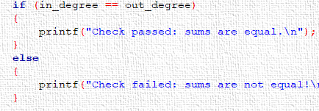
Time Complexity Determination (Theoretical)
f(n) = (n+1)(n+1)+1
Expanding:
f(n) = (n+1)(n+1)+1
= n² + n + n + 1 + 1
= n² + 2n + 2
f(n) = n² + 2n + 2 = O(n²)
Since the dominating term is 2n² :
f(n)= O(n²)

Slide 12
Comparison
From the Computational Time vs Number of Vertices graph’s equation, we determined the practical time complexity of our program. The practical time complexity of the program is O(n²).
On the other side, we also determined the time complexity of the program theoretically. The theoretical time complexity of the program is also O(n²).
Although the functions were not exactly the same in both cases, ultimately they both yield the same time complexity for the program, which is:
O(n²).

Slide 13

FUTURE WORK
Practical Applications
Weighted Directed Graphs
Add edge weights and sortest path dinding
Apply in traffic, web, and social networks
Effcient Storage
Visualization Tools
Use adjacency list for sparse graphs
Create clearer visual output for large graphs
Parallel processing
Dynamic Graphs
Speed up calculations using multi core CPUs
Support real-time graph updates and changes

Slide 14

Conclusion
Adjacency matrix is a simple way to represent directed graphs.
Easy to calculate in-degree and out-degree.
Verified in-degree = out-degree.
Both theoretical and practical analysis show O(n²) time complexity.
Useful for graph analysis, but memory heavy for large graphs.

Slide 15

THANK YOU

