Slide 1
Chapter 11 Inheritance and Polymorphism

Slide 2
Motivations
Suppose you will define classes to model circles, rectangles, and triangles. These classes have many common features. What is the best way to design these classes so to avoid redundancy? The answer is to use inheritance.

Slide 3
Objectives
    To define a subclass from a superclass through inheritance (§11.2).
    To invoke the superclass’s constructors and methods using the super keyword (§11.3).
    To override instance methods in the subclass (§11.4).
    To distinguish differences between overriding and overloading (§11.5).
    To explore the toString() method in the Object class (§11.6).
    To discover polymorphism and dynamic binding (§§11.7–11.8).
    To describe casting and explain why explicit downcasting is necessary (§11.9).
    To explore the equals method in the Object class (§11.10).
    To store, retrieve, and manipulate objects in an ArrayList (§11.11).
    To implement a Stack class using ArrayList (§11.12).
    To enable data and methods in a superclass accessible from subclasses using the protected visibility modifier (§11.13).
    To prevent class extending and method overriding using the final modifier (§11.14).

Slide 4
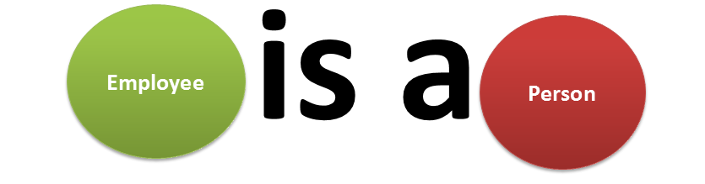


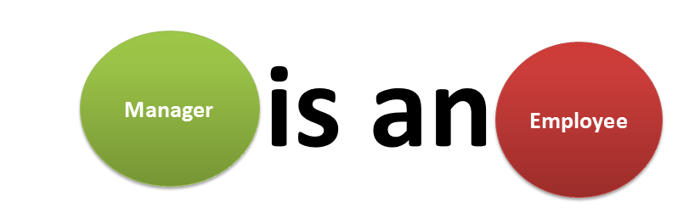


Inheritance

Slide 5
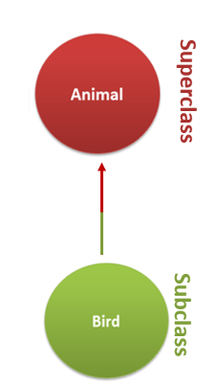
Superclasses and Subclasses
Inheritance enables you to define a general class (i.e., a superclass) and later extend it to more specialized classes (i.e., subclasses).

Slide 6
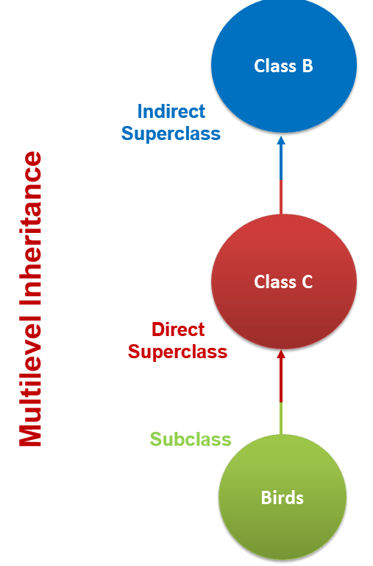
Multi-level Inheritance

Slide 7
Example
Geometric objects have many common properties and behaviors. They can be drawn in a certain color and be filled or unfilled. Thus a general class GeometricObject can be used to model all geometric objects such as Rectangle and Circle.

Slide 8

Superclasses and Subclasses

Slide 9
Superclasses and Subclasses
In Java terminology, a class C1 extended from another class C2 is called a subclass, and C2 is called a superclass. A superclass is also referred to as a parent class or a base class, and a subclass as a child class, an extended class, or a derived class. A subclass inherits accessible data fields and methods from its superclass and may also add new data fields and methods.
The Circle class inherits all accessible data fields and methods from the GeometricObject class. In addition, it has a new data field, radius, and its associated getter and setter methods and various others such as getArea().

Slide 10
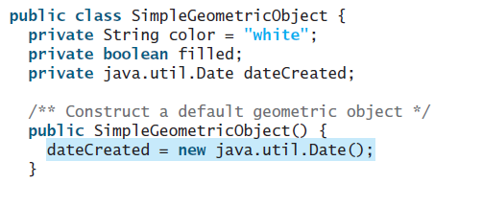
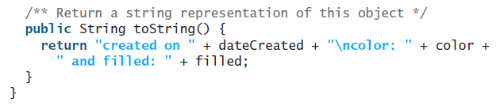
Implementation
.
.
.

Slide 11
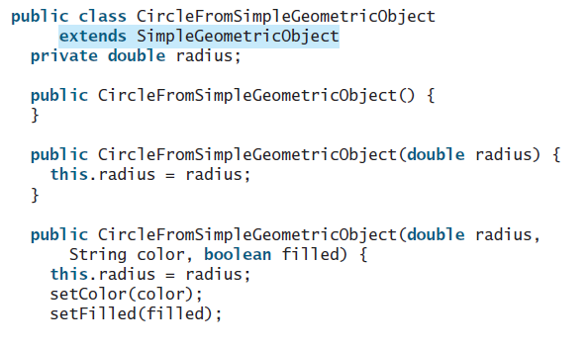
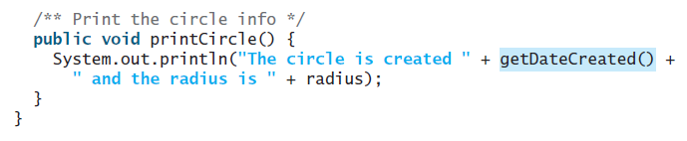
Implementation
the methods
getColor, setColor,
isFilled,setFilled,
and toString are inherited
keyword
Subclass
the private data fields color and filled in the superclass cannot be accessed in any other class
.
.
Superclass

Slide 12
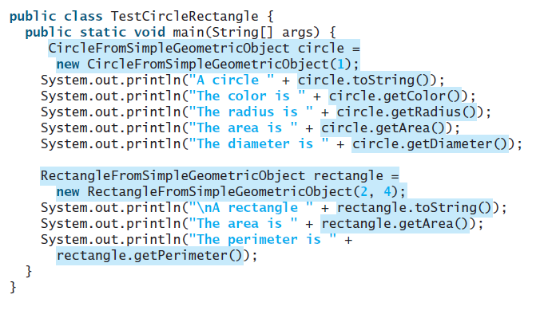
Implementation
A method in superclass
A method in subclass

Slide 13
REMARKS
A subclass is not a subset of its superclass. In fact, a subclass usually contains more information and methods than its superclass.
Private data fields in a superclass are not accessible outside the class. Therefore, they cannot be used directly in a subclass. They can, however, be accessed/mutated through public accessors and mutators if defined in the superclass.
Inheritance is used to model the is-a relationship. Do not blindly extend a class just for the sake of reusing methods. For example, it makes no sense for a Tree class to extend a Person class, even though they share common properties such as height and weight. A subclass and its superclass must have the is-a relationship.
A Java class may inherit directly from only one superclass. This restriction is known as single inheritance.

Slide 14
Inheritance of Constructors
Unlike properties and methods, the constructors of a superclass are not inherited by a subclass. They are invoked implicitly.
They can also be explicitly invoked from the subclasses' constructors, using the keyword super. If the keyword super is not explicitly used, the superclass's no-arg constructor is automatically invoked.
The syntax to call a superclass’s constructor is super(), or super(parameters), where the statement super() invokes the no-arg constructor of its superclass, and super(arguments) invokes the superclass constructor that matches the arguments.

Slide 15

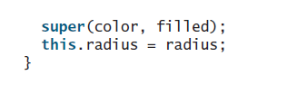
Inheritance of Constructors
Explicit call to a particular constructor in the superclass

Slide 16


Superclass’s Constructor Is Always Invoked
A constructor may invoke an overloaded constructor or its superclass’s constructor. If none of them is invoked explicitly, the compiler puts super() as the first statement in the constructor. For example,

Slide 17
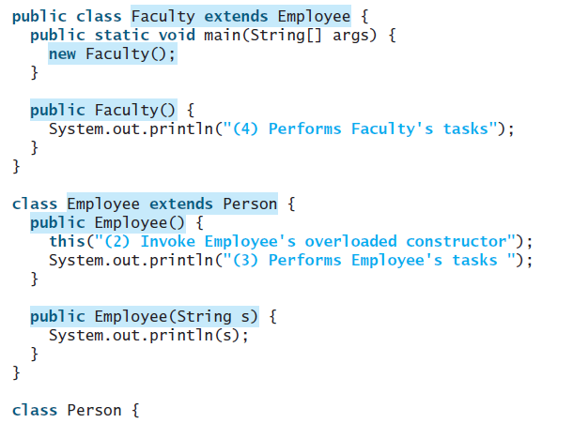

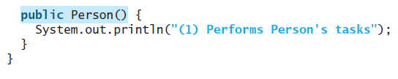
Example

Slide 18
Trace Execution
public class Faculty extends Employee {
public static void main(String[] args) {
new Faculty();
}
public Faculty() {
System.out.println("(4) Faculty's no-arg constructor is invoked");
}
}
class Employee extends Person {
public Employee() {
this("(2) Invoke Employee’s overloaded constructor");
System.out.println("(3) Employee's no-arg constructor is invoked");
}
public Employee(String s) {
System.out.println(s);
}
}
class Person {
public Person() {
System.out.println("(1) Person's no-arg constructor is invoked");
}
}
1. Start from the main method

Slide 19
Trace Execution
public class Faculty extends Employee {
public static void main(String[] args) {
new Faculty();
}
public Faculty() {
System.out.println("(4) Faculty's no-arg constructor is invoked");
}
}
class Employee extends Person {
public Employee() {
this("(2) Invoke Employee’s overloaded constructor");
System.out.println("(3) Employee's no-arg constructor is invoked");
}
public Employee(String s) {
System.out.println(s);
}
}
class Person {
public Person() {
System.out.println("(1) Person's no-arg constructor is invoked");
}
}
2. Invoke Faculty constructor

Slide 20
Trace Execution
public class Faculty extends Employee {
public static void main(String[] args) {
new Faculty();
}
public Faculty() {
System.out.println("(4) Faculty's no-arg constructor is invoked");
}
}
class Employee extends Person {
public Employee() {
this("(2) Invoke Employee’s overloaded constructor");
System.out.println("(3) Employee's no-arg constructor is invoked");
}
public Employee(String s) {
System.out.println(s);
}
}
class Person {
public Person() {
System.out.println("(1) Person's no-arg constructor is invoked");
}
}
3. Invoke Employee’s no-arg constructor

Slide 21
Trace Execution
public class Faculty extends Employee {
public static void main(String[] args) {
new Faculty();
}
public Faculty() {
System.out.println("(4) Faculty's no-arg constructor is invoked");
}
}
class Employee extends Person {
public Employee() {
this("(2) Invoke Employee’s overloaded constructor");
System.out.println("(3) Employee's no-arg constructor is invoked");
}
public Employee(String s) {
System.out.println(s);
}
}
class Person {
public Person() {
System.out.println("(1) Person's no-arg constructor is invoked");
}
}
4. Invoke Employee(String) constructor

Slide 22
Trace Execution
public class Faculty extends Employee {
public static void main(String[] args) {
new Faculty();
}
public Faculty() {
System.out.println("(4) Faculty's no-arg constructor is invoked");
}
}
class Employee extends Person {
public Employee() {
this("(2) Invoke Employee’s overloaded constructor");
System.out.println("(3) Employee's no-arg constructor is invoked");
}
public Employee(String s) {
System.out.println(s);
}
}
class Person {
public Person() {
System.out.println("(1) Person's no-arg constructor is invoked");
}
}
5. Invoke Person() constructor

Slide 23
Trace Execution
public class Faculty extends Employee {
public static void main(String[] args) {
new Faculty();
}
public Faculty() {
System.out.println("(4) Faculty's no-arg constructor is invoked");
}
}
class Employee extends Person {
public Employee() {
this("(2) Invoke Employee’s overloaded constructor");
System.out.println("(3) Employee's no-arg constructor is invoked");
}
public Employee(String s) {
System.out.println(s);
}
}
class Person {
public Person() {
System.out.println("(1) Person's no-arg constructor is invoked");
}
}
6. Execute println

Slide 24
Trace Execution
public class Faculty extends Employee {
public static void main(String[] args) {
new Faculty();
}
public Faculty() {
System.out.println("(4) Faculty's no-arg constructor is invoked");
}
}
class Employee extends Person {
public Employee() {
this("(2) Invoke Employee’s overloaded constructor");
System.out.println("(3) Employee's no-arg constructor is invoked");
}
public Employee(String s) {
System.out.println(s);
}
}
class Person {
public Person() {
System.out.println("(1) Person's no-arg constructor is invoked");
}
}
7. Execute println

Slide 25
Trace Execution
public class Faculty extends Employee {
public static void main(String[] args) {
new Faculty();
}
public Faculty() {
System.out.println("(4) Faculty's no-arg constructor is invoked");
}
}
class Employee extends Person {
public Employee() {
this("(2) Invoke Employee’s overloaded constructor");
System.out.println("(3) Employee's no-arg constructor is invoked");
}
public Employee(String s) {
System.out.println(s);
}
}
class Person {
public Person() {
System.out.println("(1) Person's no-arg constructor is invoked");
}
}
8. Execute println

Slide 26
Trace Execution
public class Faculty extends Employee {
public static void main(String[] args) {
new Faculty();
}
public Faculty() {
System.out.println("(4) Faculty's no-arg constructor is invoked");
}
}
class Employee extends Person {
public Employee() {
this("(2) Invoke Employee’s overloaded constructor");
System.out.println("(3) Employee's no-arg constructor is invoked");
}
public Employee(String s) {
System.out.println(s);
}
}
class Person {
public Person() {
System.out.println("(1) Person's no-arg constructor is invoked");
}
}
9. Execute println

Slide 27
CAUTION
You must use the keyword super to call the superclass constructor. Invoking a superclass constructor’s name in a subclass causes a syntax error.
Java requires that the statement that uses the keyword super appear first in the constructor.
The keyword super can also be used to call a method of the superclass as super.method(parameters)

Slide 28
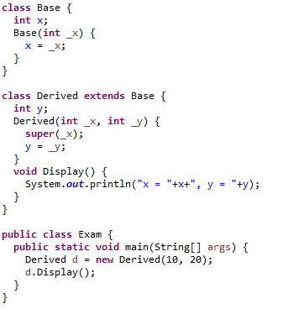
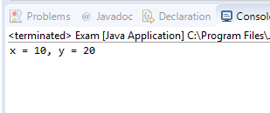
Example

Slide 29
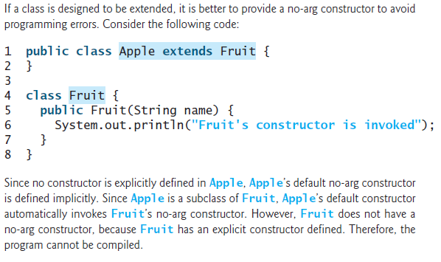
Example on the Impact of a Superclass without no-arg Constructor

Slide 30
Defining a Subclass
A subclass inherits from a superclass. You can also:
  Add new properties
  Add new methods
  Override the methods of the superclass

Slide 31
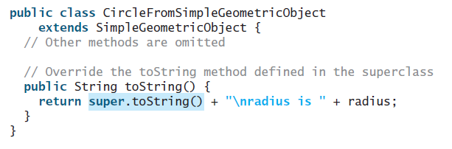
Overriding Methods in the Superclass
A subclass inherits methods from a superclass. Sometimes it is necessary for the subclass to modify the implementation of a method defined in the superclass. This is referred to as method overriding.
To override a method, the method must be defined in the subclass using the same signature and the same return type as in its superclass.

Slide 32
REMARKS
An instance method can be overridden only if it is accessible. Thus a private method cannot be overridden, because it is not accessible outside its own class. If a method defined in a subclass is private in its superclass, the two methods are completely unrelated.
Like an instance method, a static method can be inherited. However, a static method cannot be overridden. If a static method defined in the superclass is redefined in a subclass, the method defined in the superclass is hidden.

Slide 33

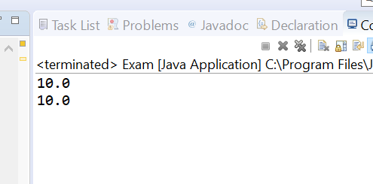
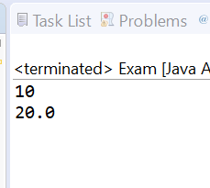
Overriding vs. Overloading
On the left, p(double i) in class A overrides the same method defined in class B. On the right, the class A has two overloaded methods: p(double i) and p(int i). The method p(double i) is inherited from B.

Slide 34
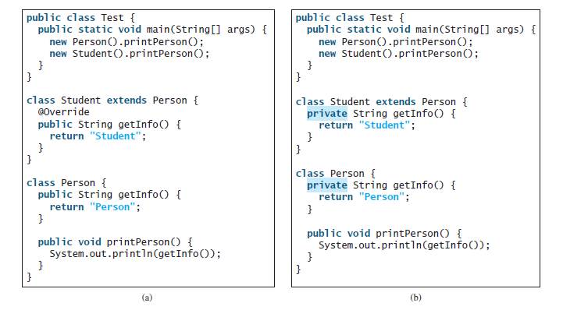
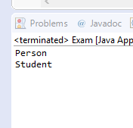
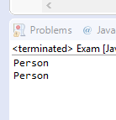
Examples

Slide 35
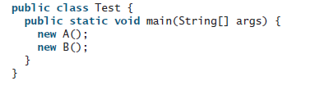
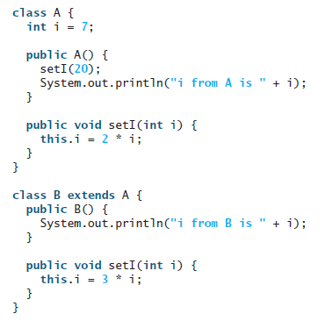
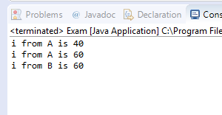
Examples

Slide 36

The Object Class and Its Methods
Every class in Java is descended from the java.lang.Object class. If no inheritance is specified when a class is defined, the superclass of the class is Object.

Slide 37
The Object Class and Its Methods
All classes in Java inherit directly or indirectly from the Object class (package java.lang), so its 11 methods are inherited by all other classes.
The Object class is the parent class of all the classes in java by default.

Slide 38
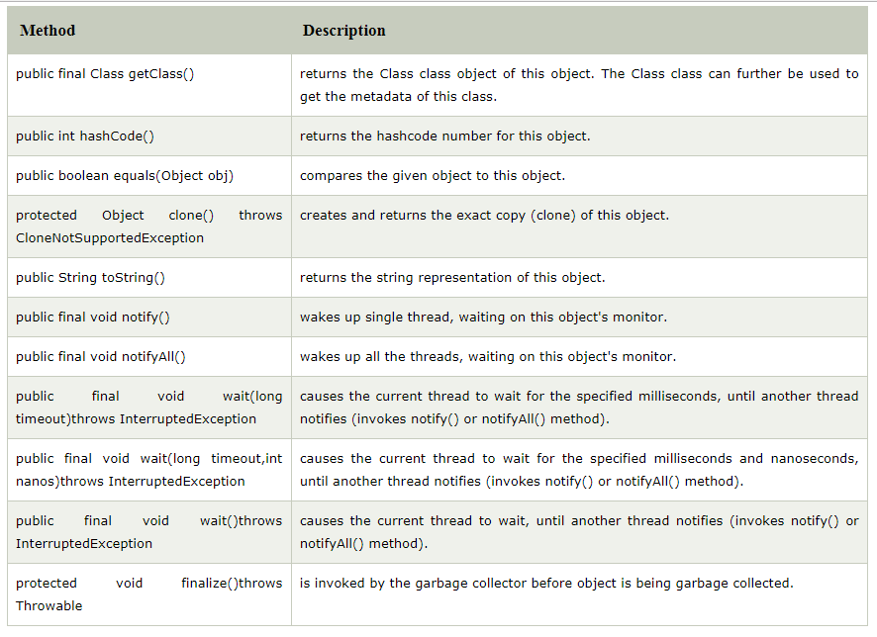
The Object Class and Its Methods
returns an integer that is unique for each instance
two objects are equal if and only if they are stored in the same memory address

Slide 39
The toString() method in Object
The toString() method returns a string representation of the object. The default implementation returns a string consisting of a class name of which the object is an instance, the at sign (@), and a number representing this object.
Loan loan = new Loan();
System.out.println(loan.toString());
The code displays something like Loan@15037e53. This message is not very helpful or informative. Usually you should override the toString method so that it returns a digestible string representation of the object.
System.out.println(loan.getClass()) displays class Loan

Slide 40
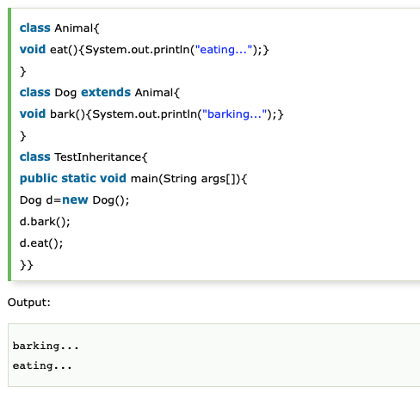
Example

Slide 41
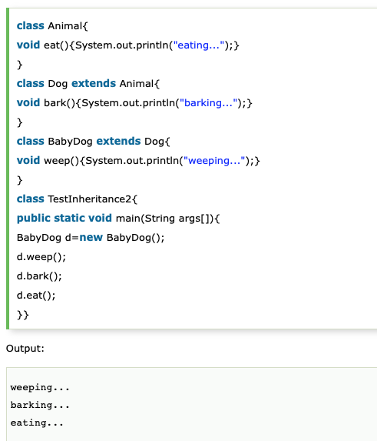
Example

Slide 42
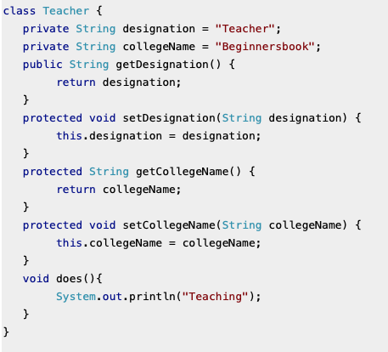
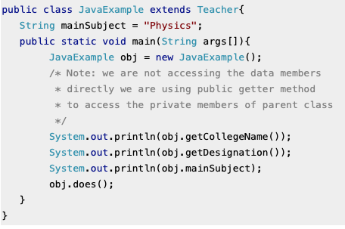
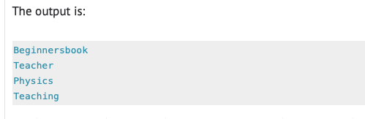
Example

Slide 43
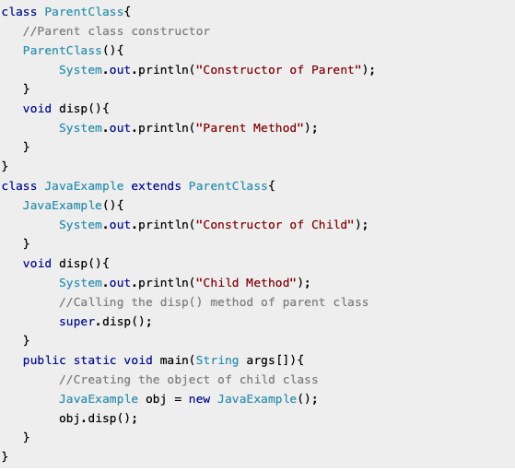
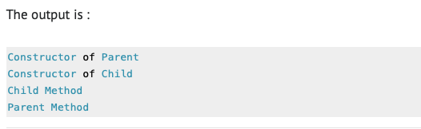
Example

Slide 44
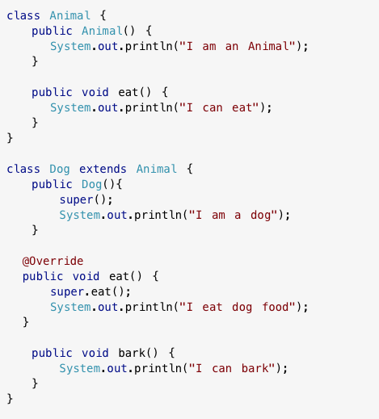
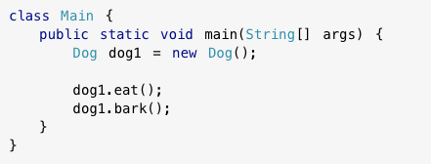
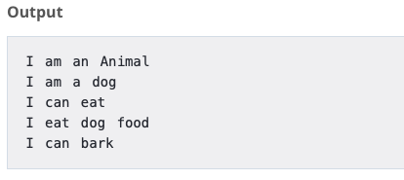
Example

Slide 45
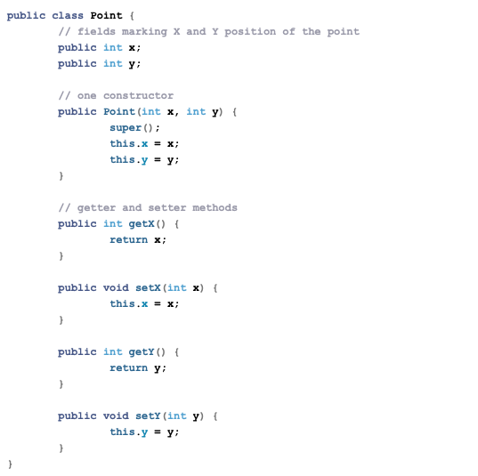
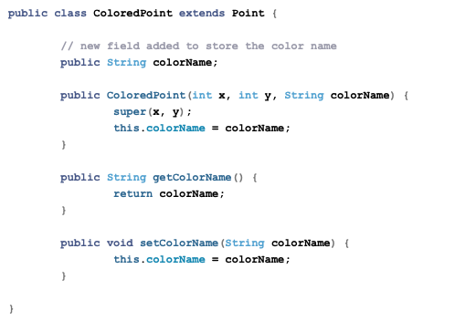
Example

Slide 46
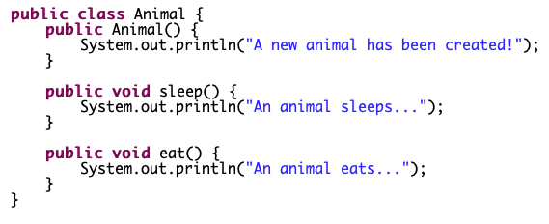
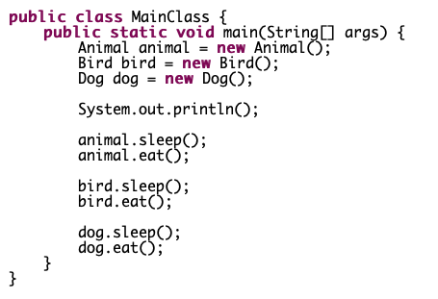
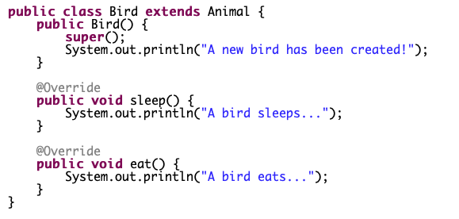
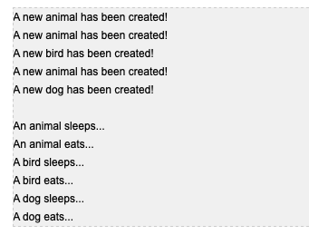
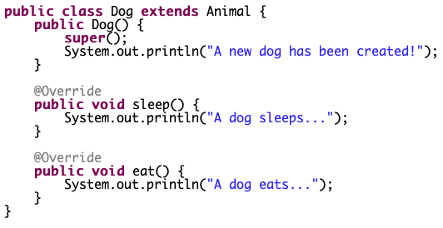
Example

Slide 47
Polymorphism
A class defines a type. A type defined by a subclass is called a subtype, and a type defined by its superclass is called a supertype. Therefore, you can say that Circle is a subtype of GeometricObject and GeometricObject is a supertype for Circle.
Polymorphism means that a variable of a supertype can refer to a subtype object.

Slide 48
Polymorphism
Suppose we create a program that simulates the movement of several types of animals for a biological study.
Classes Fish, Frog and Bird represent the three types of animals under investigation.
Imagine that each of these classes extends superclass Animal, which contains a method move.
Each subclass implements its method move.
We can maintain an array of Animal references to objects of the various Animal subclasses.
To simulate the animals’ movements, we can send each object the same message once per second—namely, move.

Slide 49
Polymorphism
However, each specific type of Animal responds to a move message in a unique way—a Fish might swim three feet, a Frog might jump five feet and a Bird might fly ten feet.
Although we issue the same message (i.e., move) to each animal object generically, each object knows how to modify its x-y coordinates appropriately for its specific type of movement.
Relying on each object to know how to “do the right thing” in response to the same method call is the key concept of polymorphism.
The same message sent to a variety of objects has “many forms” of results—hence the term Polymorphism

Slide 50

Polymorphism, Dynamic Binding and Generic Programming
public class PolymorphismDemo {
public static void main(String[] args) {
m(new GraduateStudent());
m(new Student());
m(new Person());
m(new Object());
}
public static void m(Object x) {
System.out.println(x.toString());
}
}
class GraduateStudent extends Student {
}
class Student extends Person {
public String toString() {
return "Student";
}
}
class Person extends Object {
public String toString() {
return "Person";
}
}
Method m takes a parameter of the Object type. You can invoke it with any object.
polymorphism occurs when a program invokes a method through a superclass variable. At execution time, the correct subclass version of the method is called, based on the type of the reference stored in the superclass variable.
When the method m(Object x) is executed, the argument x’s toString method is invoked. x may be an instance of GraduateStudent, Student, Person, or Object.
Classes GraduateStudent, Student, Person, and Object have their own implementation of the toString method. Which implementation is used will be determined dynamically by the Java Virtual Machine at runtime. This capability is known as dynamic binding.

Slide 51
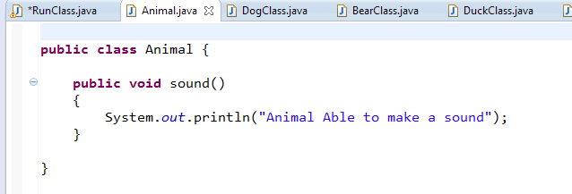
Example

Slide 52
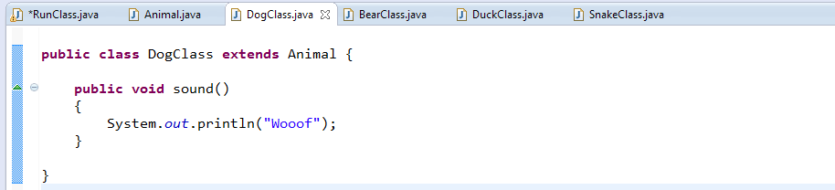
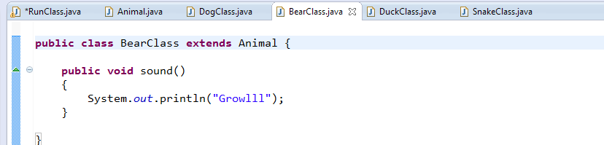
Example

Slide 53
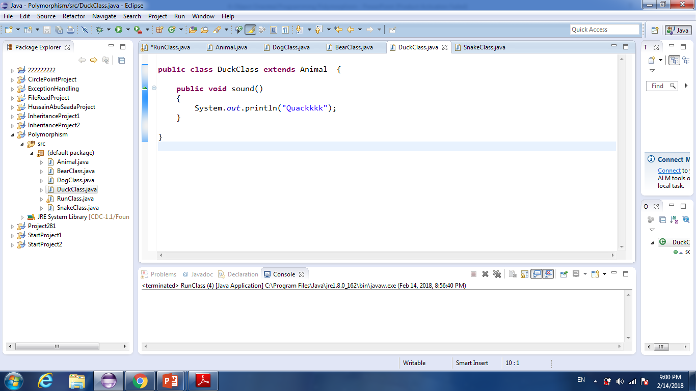
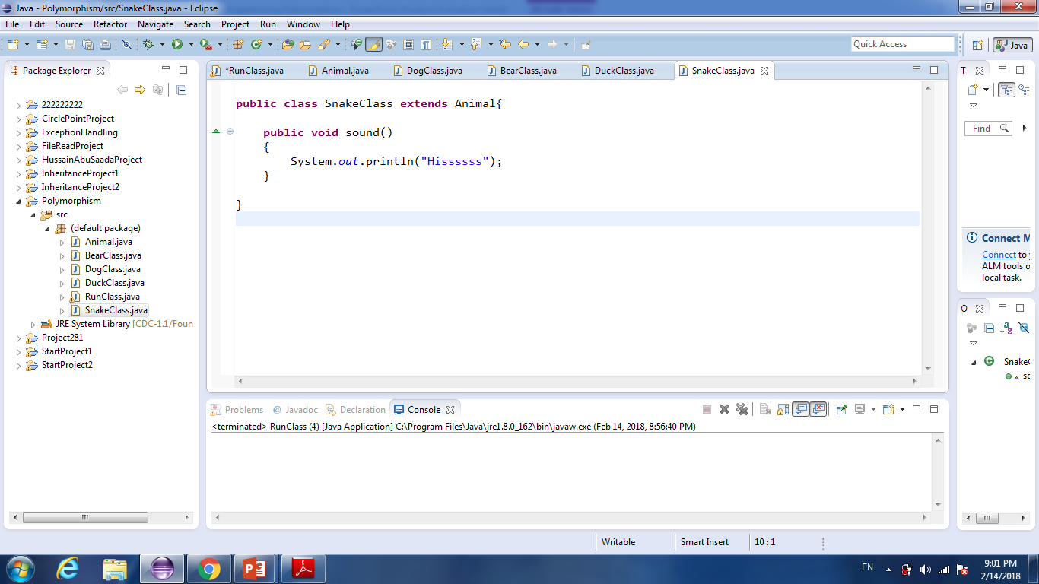
Example

Slide 54
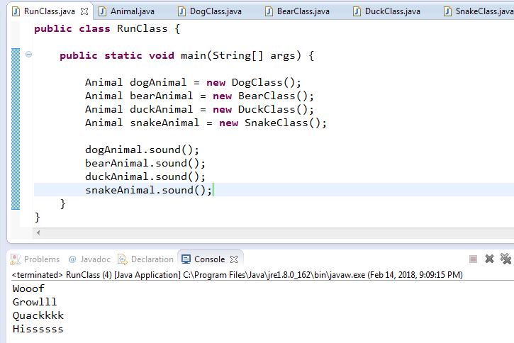
Example
SUMMARY
an object of a subclass can be treated as an object of its superclass.

Slide 55
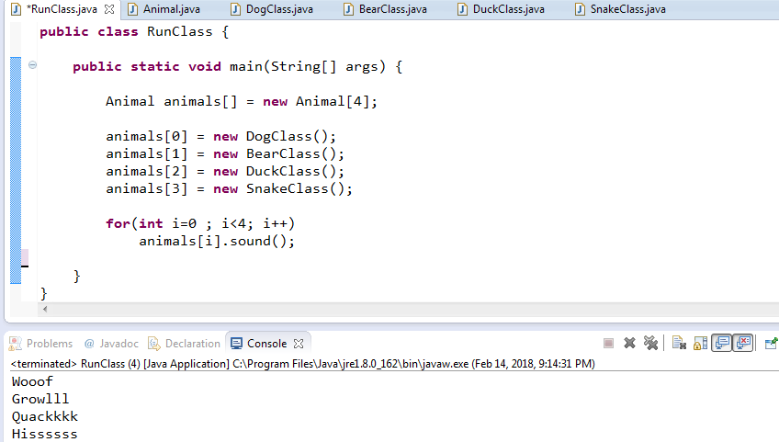
Example

Slide 56
Summary
Polymorphism occurs when a program invokes a method through a superclass variable
At execution time, the correct subclass version of the method is called, based on the type of the reference stored in the superclass variable.
Palestine Technical University, Java Course 2017/2018, Asst.Prof.Dima Badawi

Slide 57
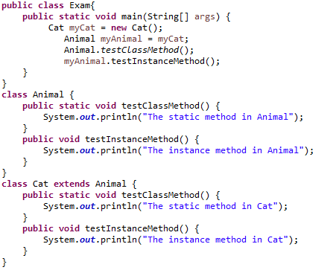

Example

Slide 58

Dynamic Binding
Dynamic binding works as follows: Suppose an object o is an instance of C_{1.} In fact, it is also an instance of C₂, ..., C_{n-1}, and C_{n}, where C₁ is a subclass of C₂, C₂ is a subclass of C₃, ..., and C_{n-1} is a subclass of C_{n}. That is, C_{n} is the most general class, and C₁ is the most specific class.
In Java, C_{n} is the Object class. If o invokes a method p, the JVM searches the implementation for the method p in C₁, C₂, ..., C_{n-1} and C_{n}, in this order, until it is found. Once an implementation is found, the search stops and the first-found implementation is invoked.

Slide 59
Method Matching vs. Binding
Matching a method signature and binding a method implementation are two issues. The compiler finds a matching method according to parameter type, number of parameters, and order of the parameters at compilation time.
A method may be implemented in several subclasses. The Java Virtual Machine dynamically binds the implementation of the method at runtime.

Slide 60
Generic Programming
public class PolymorphismDemo {
public static void main(String[] args) {
m(new GraduateStudent());
m(new Student());
m(new Person());
m(new Object());
}
public static void m(Object x) {
System.out.println(x.toString());
}
}
class GraduateStudent extends Student {
}
class Student extends Person {
public String toString() {
return "Student";
}
}
class Person extends Object {
public String toString() {
return "Person";
}
}
Polymorphism allows methods to be used generically for a wide range of object arguments. This is known as generic programming. If a method’s parameter type is a superclass (e.g., Object), you may pass an object to this method of any of the parameter’s subclasses (e.g., Student or String). When an object (e.g., a Student object or a String object) is used in the method, the particular implementation of the method of the object that is invoked (e.g., toString) is determined dynamically.

Slide 61


Example

Slide 62


Example

Slide 63
Casting Objects
You have already used the casting operator to convert variables of one primitive type to another. Casting can also be used to convert an object of one class type to another within an inheritance hierarchy. In the preceding section, the statement
  m(new Student());
assigns the object new Student() to a parameter of the Object type.
This statement is equivalent to:
  Object o = new Student(); // Implicit casting, upcasting
  m(o);
The statement Object o = new Student(), known as implicit casting, is legal because an instance of Student is automatically an instance of Object.

Slide 64
Why Casting Is Necessary?
Suppose you want to assign the object reference o to a variable of the Student type using the following statement:
  Student b = o;
A compile error would occur.
Why does the statement Object o = new Student() work and the statement Student b = o doesn’t? This is because a Student object is always an instance of Object, but an Object is not necessarily an instance of Student. Even though you can see that o is really a Student object, the compiler is not so clever to know it. To tell the compiler that o is a Student object, use an explicit casting as follows:
  Student b = (Student) o; // Explicit casting

Slide 65
Casting from Superclass to Subclass (Downcasting)
Explicit casting must be used when casting an object from a superclass to a subclass.
Apple x = (Apple)fruit;
  Orange x = (Orange)fruit;
This type of casting may not always succeed. For the casting to be successful, you must make sure that the superclass object to be downcasted is an instance of the subclass. If the superclass object is not an instance of the subclass, a runtime ClassCastException occurs

Slide 66

Example

Slide 67

Example

Slide 68

Example

Slide 69

Example

Slide 70


Example

Slide 71

Example
Casting does not change the object but labels in a different way. In particular, if you upcast a Cat to Animal, then the object is still a Cat. However, it's Cat properties are hidden. It gains its Cat properties back after being downcasted to Cat.

Slide 72

Example
ERROR!

Slide 73

Example

Slide 74
TIP
To help understand casting, you may also consider the analogy of fruit, apple, and orange with the Fruit class as the superclass for Apple and Orange.
  An apple is a fruit, so you can always safely assign an instance of Apple to a variable for Fruit.
  A fruit is not necessarily an apple, so you have to use explicit casting to assign an instance of Fruit to a variable of Apple.

Slide 75
The instanceof Operator
Use the instanceof operator to test whether an object is an instance of a class:
  Object myObject = new Circle();
  ... // Some lines of code
  /* Perform casting if myObject is an instance of Circle */
  if (myObject instanceof Circle) {
  System.out.println("The circle diameter is " +
  ((Circle)myObject).getDiameter());
  ...
  }

Slide 76
The equals Method
Another method defined in the Object class that is often used is the equals method. This method compares two objects. The default implementation of the equals method in the Object class is as follows:
public boolean equals(Object obj) {
return this == obj;
}
This implementation checks whether two reference variables point to the same object using the == operator.
The equals method can be overridden in the Circle class to make the test on radius values.
public boolean equals(Object o) {
if (o instanceof Circle) {
return radius == ((Circle)o).radius;
}
else
return false;
}

Slide 77

The equals Method

Slide 78
NOTE
The == comparison operator is used for comparing two primitive data type values or for determining whether two objects have the same references.
If the equals() method is intended to test whether two objects have the same contents, the method must be overridden in the defining class of the objects.

Slide 79

The protected Modifier
The protected modifier can be applied on data and methods in a class. A protected data or a protected method in a public class can be accessed by any class in the same package or its subclasses, even if the subclasses are in a different package.
private, default, protected, public

Slide 80

Accessibility Summary
in
a different package

Slide 81

Visibility Modifiers

Slide 82
A Subclass Cannot Weaken the Accessibility
A subclass may override a protected method in its superclass and change its visibility to public.
A subclass cannot weaken the accessibility of a method defined in the superclass. For example, if a method is defined as public in the superclass, it must be defined as public in the subclass.

Slide 83
NOTES
You may occasionally want to prevent classes from being extended. In such cases, use the final modifier to indicate that a class is final and cannot be a parent class. The Math class is a final class.

Slide 84
The final Modifier
The final class cannot be extended:
final class Math {
...
}
The final variable is a constant:
final static double PI = 3.14159;
The final method cannot be
overridden by its subclasses.

Slide 85

The final Modifier

Slide 86

The final Modifier

