Slide 1

Presented by :
MALNOURISHED CHILD IDENTIFICATION
CSE-499B
Section-11
Masrur Ahmed Santo - 1520469642 Sadman Alam - 1610544042 Tarak Mahmud - 1520198642 Hosne Ara – 1632267642
Submitted to:
DR. MD. SHAHRIAR KARIM

Slide 2
PRESANTATION FLOW
Presentation Flow
The Problem
Our Solution & Goals
Working Diagram
Features of Our Project
Methodology
Implementation & Results
Limitations
Conclusion & Future Plans

Slide 3

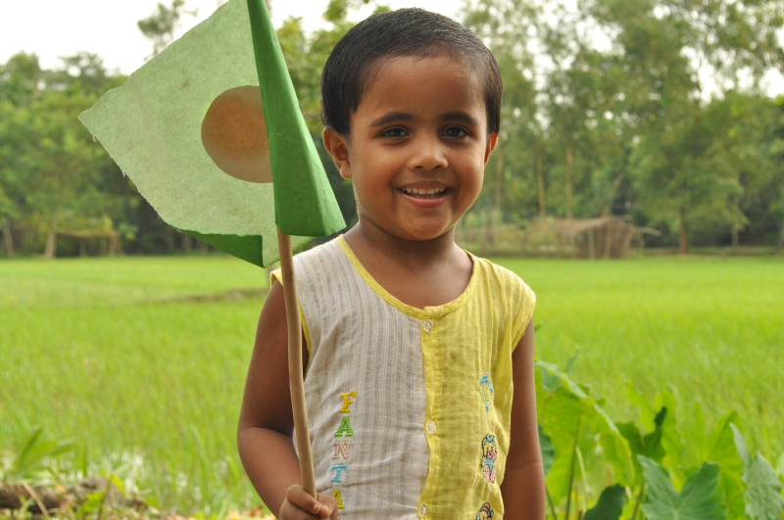
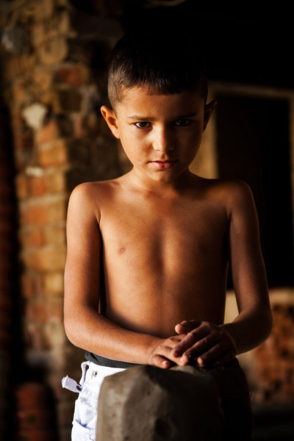
The Problem
Malnutrition is referred as the greatest single threat to the world’s public health. The number of children who are suffering from malnutrition in Bangladesh is very large. If they are detected at an early age then it will be possible to treat them and make them healthy.

Slide 4

Our Solution & Goals
We are building a machine learning based system to detect nourished and
malnourished children. The system will work on the basis of the data which will be given
as input. The job of the system is to find out whether a child is malnourished or not
when a new data will come applying machine learning algorithm. there will be two
options for the users. The users will be able to see the results based on the option they
choose.

Slide 5
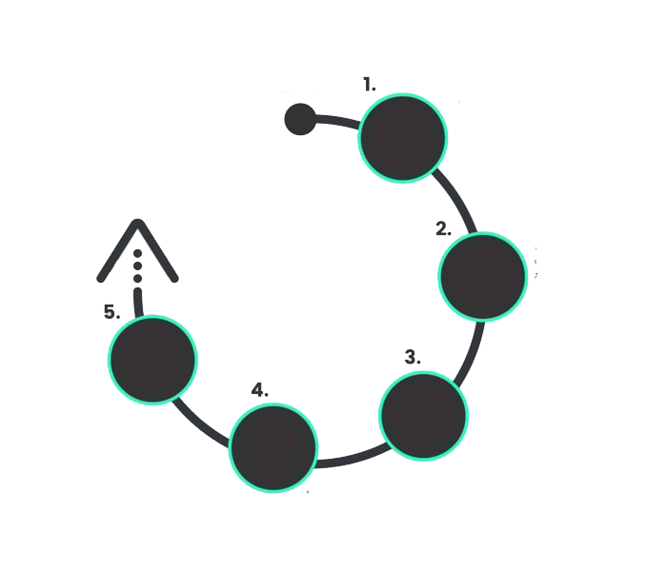
Working Diagram
Data Collection
Data Processing
Checking results
Splitting into test set and training set
Data training with different algorithms

Slide 6

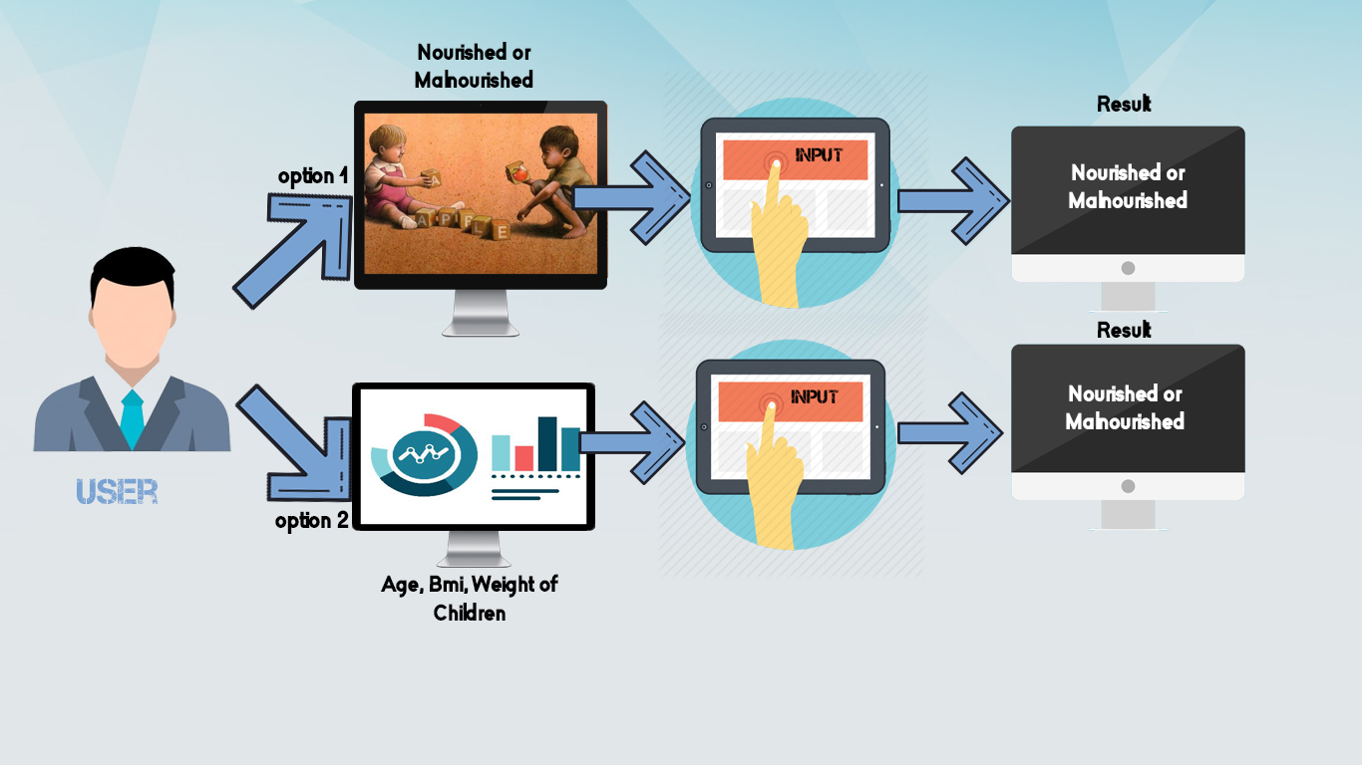
Features of Our Project

Slide 7

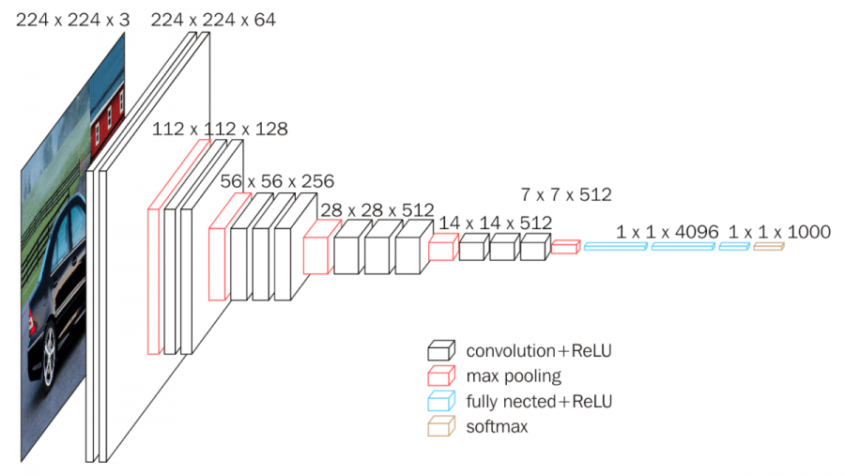
Methodology
We have removed the last two layers, which are classification layer FC-1000 and Softmax. After removal of the last layer, VGG-16 returns 4096-dimensional feature representative vectors. After getting the features vector we make our own classification layer.
Pre-trained model: VGG 16

Slide 8
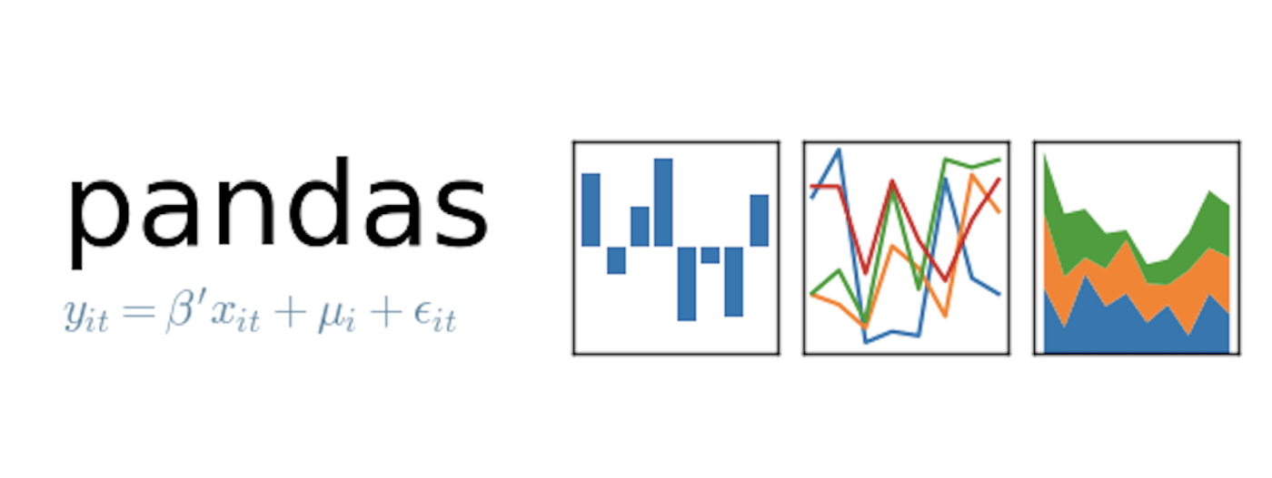
Methodology (continued)
In order to process the numerical data, at first we entered all the details into a CSV file. After that, we created a normal data frame. Then, we checked the type of the dataset. After checking the type, we converted the text data into binary and a new data frame was created using pandas library. The type of the dataset was also changed.
Pandas Library for numerical data processing

Slide 9
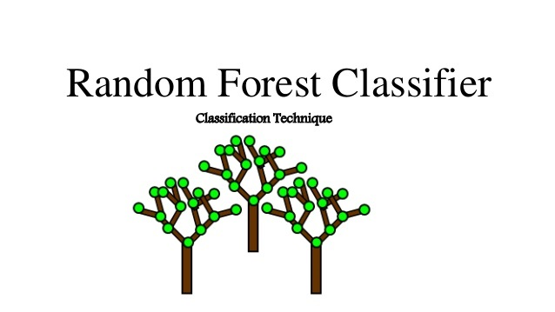
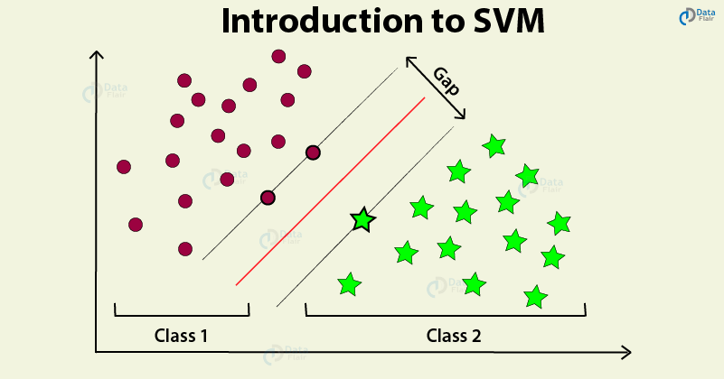
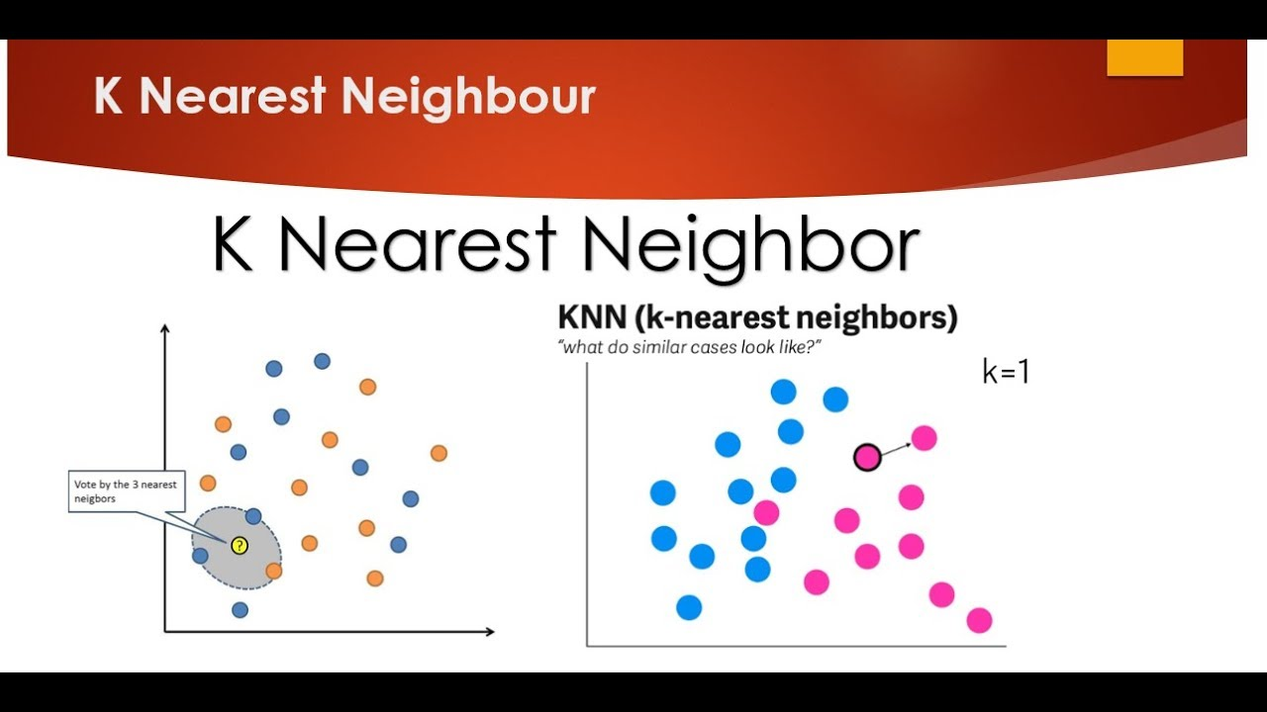
Methodology (continued)
Random forests or random decision forests are an ensemble learning method for classification, regression and other tasks that operate by constructing a multitude of decision trees at training time and outputting the class that is the mode of the classes or mean prediction of the individual trees.
In machine learning, support-vector machines are supervised learning models with associated learning algorithms that analyze data used for classification and regression analysis.
K-nearest neighbors (KNN) algorithm is a type of supervised ML algorithm which can be used for both classification as well as regression predictive problems. However, it is mainly used for classification predictive problems in industry.
Training Models

Slide 10
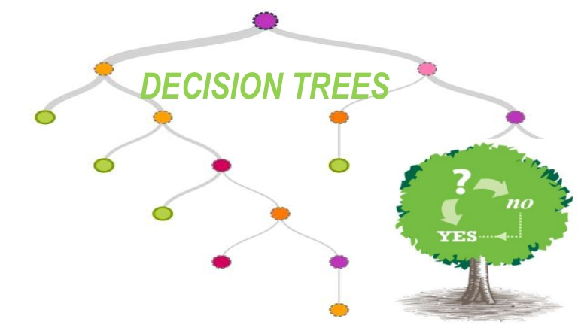
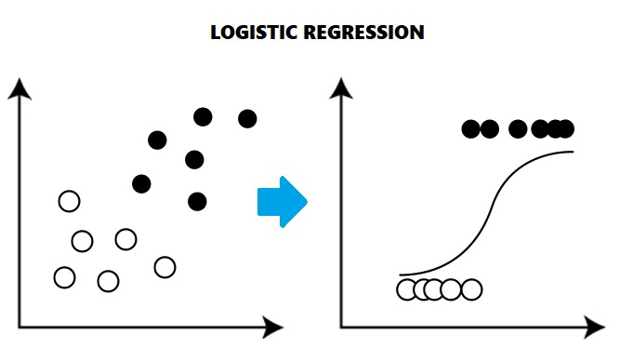
Methodology (continued)
Decision Tree algorithm belongs to the family of supervised learning algorithms. Unlike other supervised learning algorithms, decision tree algorithm can be used for solving regression and classification problems too
Logistic regression is a supervised learning classification algorithm used to predict the probability of a target variable. The nature of target or dependent variable is dichotomous, which means there would be only two possible classes.
Training Models

Slide 11

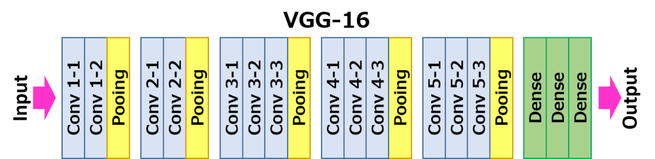
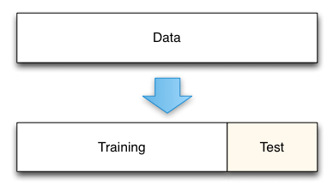
Implementation & Results Images
VGG-16 has been used for extracting features from every image. Every image is divided into 4096 vectors. So, after extracting features we have got 1500 different arrays (as we have total 1500 images in our dataset), each array consisting 4096 vectors as elements.
We have splitted our dataset into test part(60%) and training part(40%).

Slide 12
Implementation Update & Results Images (continued)
Algorithm Name | Accuracy
SUPPORT VECTOR MACHINE (SVM) | 82%
K NEAREST NEIGHBORS (KNN) | 80%
RANDOM FOREST (RF) | 84%
VGG16 | 89%

Slide 13

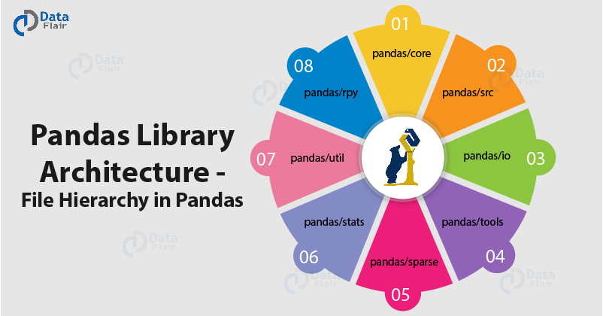
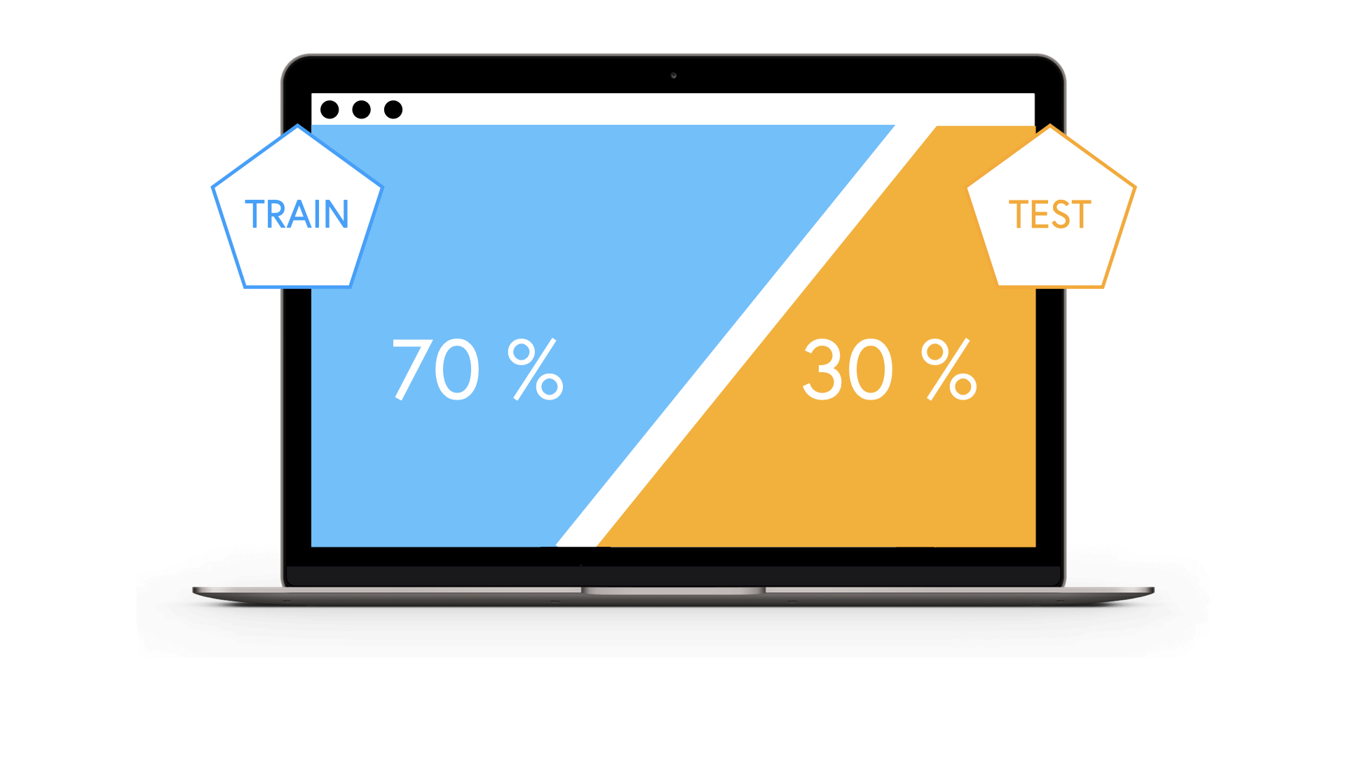
Implementation & Results Numerical values
In order to process the numerical data, at first we entered all the details into a CSV file. After that, we created a normal data frame. Then, we checked the type of the dataset. After checking the type, we converted the text data into binary and a new data frame was created by using PANDAS library. The type of the dataset was also changed.
We have splitted our dataset into test part(70%) and training part(30%).

Slide 14
Implementation & Results Numerical values (continued)
Algorithm Name | Accuracy
SUPPORT VECTOR MACHINE (SVM) | 88%
LOGISTIC REGRRESION (LG) | 94.58%
RANDOM FOREST (RF) | 90%
DECISION TREE (DT) | 95.49%

Slide 15


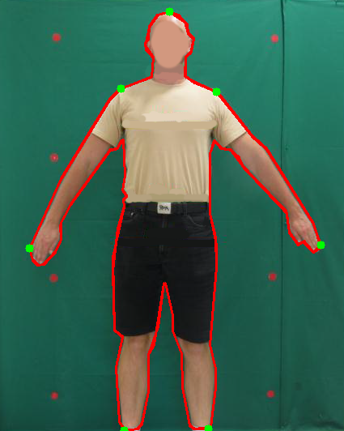

Limitations
We have followed the process of transfer learning rather than following the anthropometric approach for detecting malnourishment as the anthropometric approach was very challenging for us. Anthropometric approach is the most precise method of identifying malnourished children.
We’ve used a global numerical dataset which is not entirely appropriate for our region but it is good enough to show standard results.

Slide 16

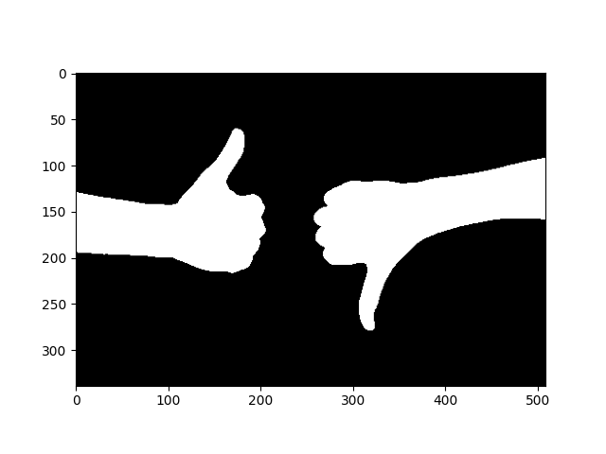
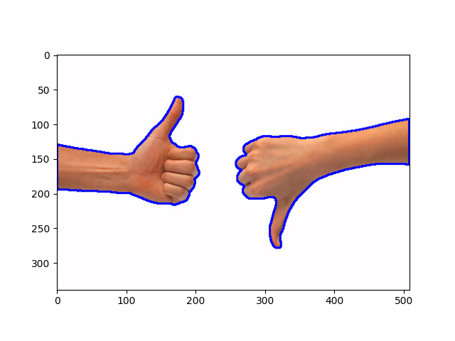
Conclusion & Future Plans
At the end we want to share that we’ve learnt about various machine learning algorithms and we’ve nearly reached our goal regarding this project.
For getting more accurate result we want to work on the basis of contour detection of the pictures. This is our initial thought for developing our project in future.

Slide 17


