Slide 1
malnourished child identification
CSE 499B – Section 11
Presented by :
Masrur Ahmed Santo - 1520469642 Sadman Alam - 1610544042
Tarak Mahmud - 1520198642
Hosne Ara – 1632267642
Faculty : DR. MD. SHAHRIAR KARIM

Slide 2
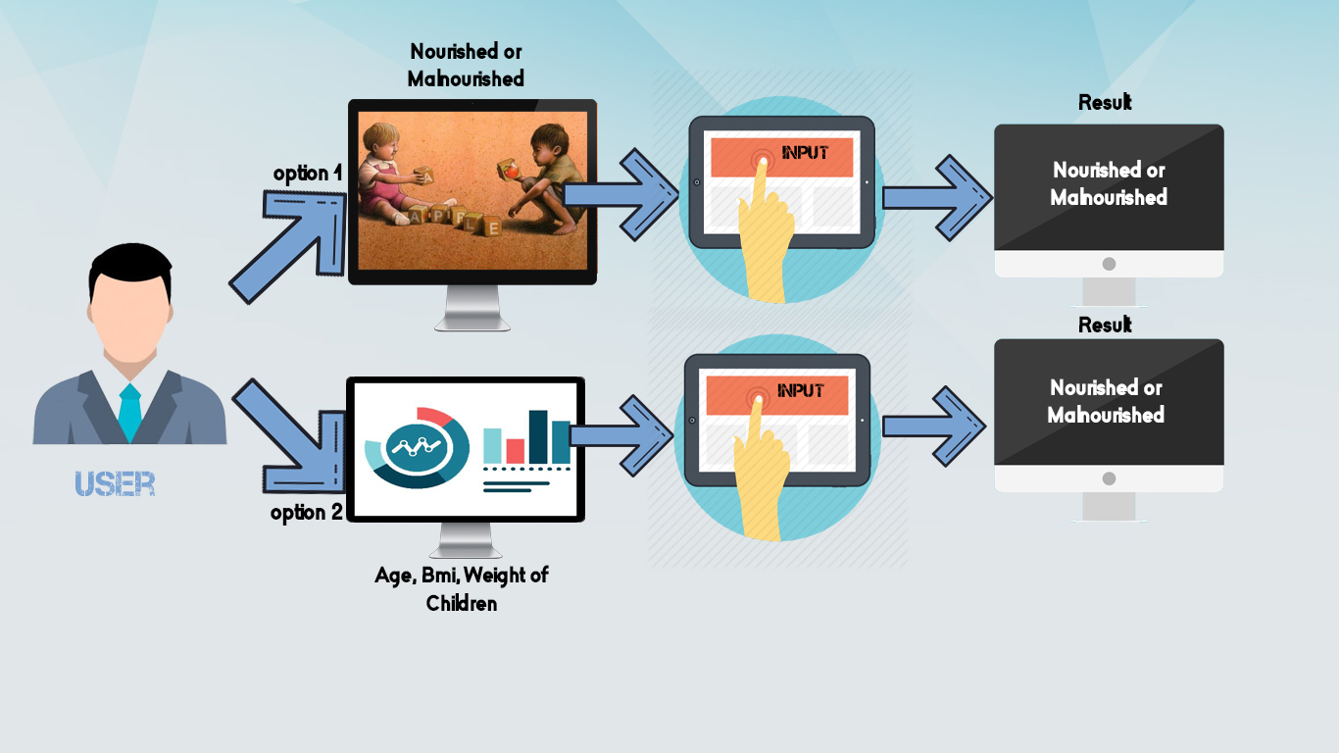
Project Diagram

Slide 3
Dataset Overview(Image)
The dataset used for the classification is one that we created manually and it consists of nourished and malnourished children.
Scraping the internet, we collected 1500 images of children. The images were handpicked from flickr, pinterest and google images.
The average dimensions of the images were 550 x 600.
The vgg-16 layer converts all images to 224 x 224 before feeding it as input.
We used the pictures without annotation so that we can absorb the genuine features from the image.

Slide 4
Dataset Overview(Numerical Value)
We have also used numerical values for the classification of malnourished and nourished children.
We have mainly focused on the children aged between 2 to 5
We have collected information like age, weight, height, bmi.
Also have gathered information about their gender and some facts (tiring, irritable , low energy)
We have entered total 1600 data.

Slide 5
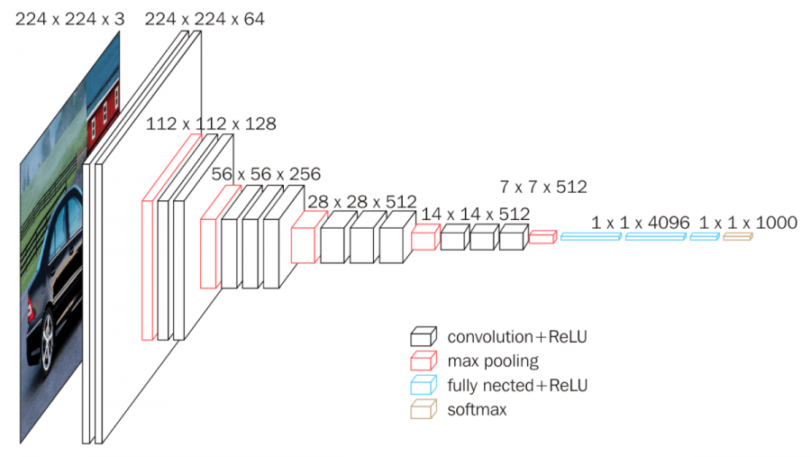
Methods And Formulas
VGG-16

Slide 6

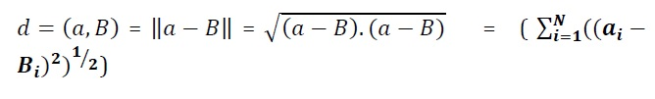

Methods And Formulas
Support Vector Machine (SVM)
K-Nearest Neighbor (KNN)
Random Forest(RF)

Slide 7
Why We Have Used VGG16 For Feature Extraction
For extracting features from the dataset we needed a pre-trained model. There are many pre-trained models available like VGG16, GoogLeNet, ResNet etc. Among this we have selected VGG16. Because-
Convolutional neural networks are now capable of outperforming humans on some computer vision tasks, such as classifying images.
That is, given a photograph of an object, answer the question as to which of 1,000 specific objects the photograph shows.
A competition-winning model for this task is the VGG model by researchers at Oxford. What is important about this model, besides its capability of classifying objects in photographs, is that the model weights are freely available and can be loaded and used in your own models and applications.
The reason behind VGG-16 is VGG release 16 layers and 19 layers CNN model. VGG-16 are no longer State-of-art by only few points. However, they are very powerful and useful for image classification and basement for new model which take image as input.

Slide 8
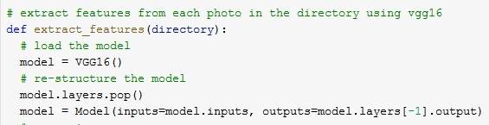
Customization Of VGG16
The method used for classification is a transfer learning technique where a pre-trained CNN is loaded with the last two layers modified. We propose a new model using VGG-16 networks as transfer learning techniques.

Slide 9
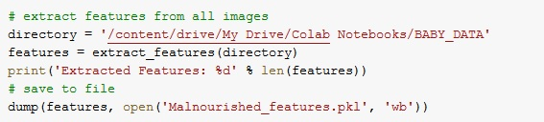
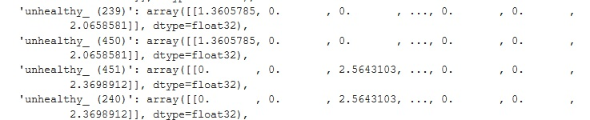
Feature Extraction From Image
VGG-16 has been used for extracting features from every image. Every image is divided into 4096 vectors. So, after extracting features we have got 1500 different arrays (as we have total 1500 images in our dataset), each array consisting 4096 vectors as elements.

Slide 10
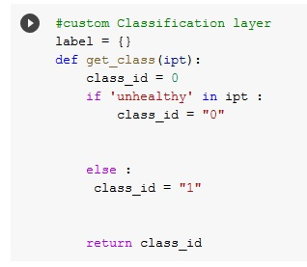
Labelling Of Pictures
We have labeled the pictures into two classes using the customized layer.

Slide 11
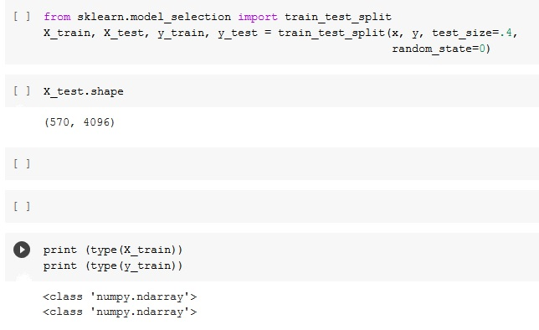
Splitting Of Dataset
We have splitted our dataset into test part and training part.

Slide 12
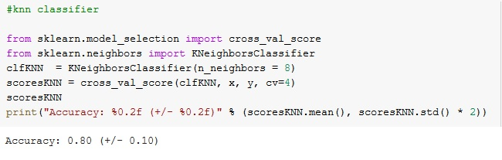
Algorithm Implementation (KNN)
k-nearest neighbors algorithm(Knn)

Slide 13
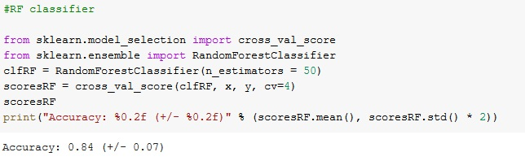
Algorithm Implementation (RF)
Random forest algorithm(RF)

Slide 14
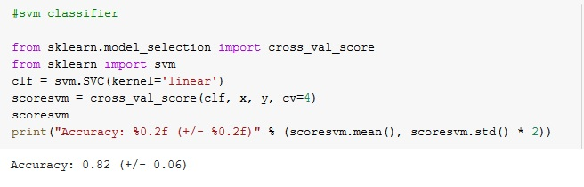
Algorithm Implementation (SVM)
Support vector machine(SVM)

Slide 15
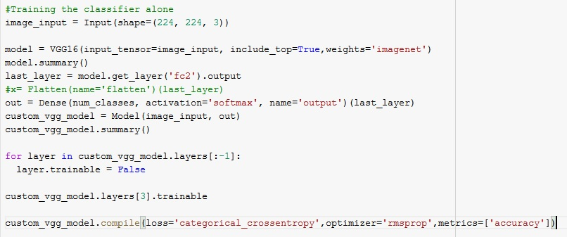

Algorithm Implementation (CNN of VGG16)

Slide 16
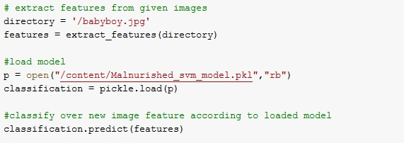
Identifying Nourished or Malnourished
Prediction Code For New Image:

Slide 17
Future Plan
For getting more accurate result we want to work on the basis of contour detection of the pictures. This is our initial thought for developing our project in future.
THANKS!

