Slide 1
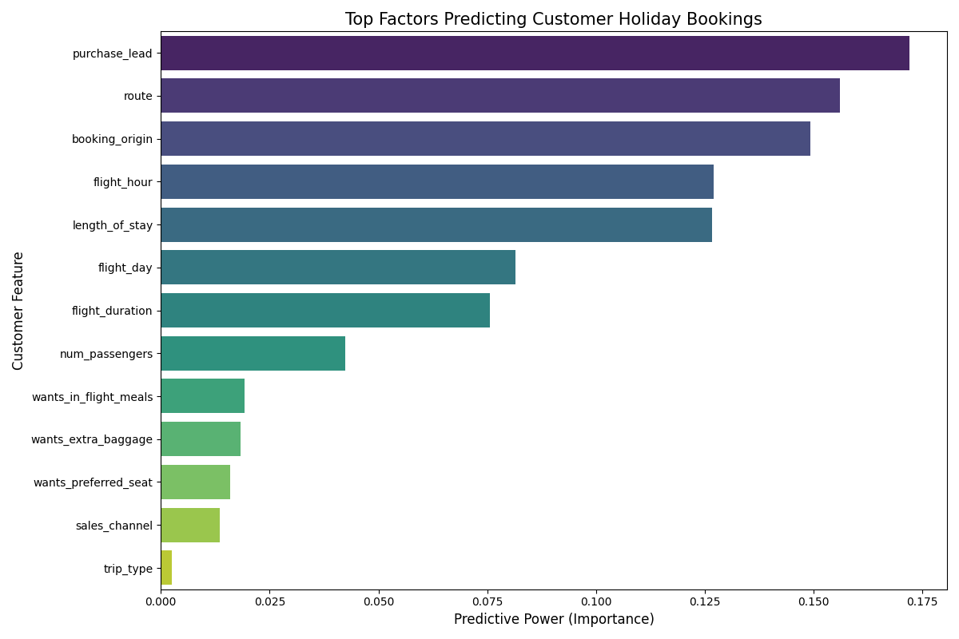
Executive Summary: Predicting Customer Booking Behavior
Model Accuracy: 96%
ROC-AUC Score: 0.997
Trip Type Preferences:
Circle Trips: Highest demand for extra baggage (78%).
Round Trips: 43% desire in-flight meals & preferred seats.
Groups (3-5): Strongest preference for seat selection.
Booking Insights:
Decisive Window: Conversions peak at ~80 days lead time.
Top Markets: Malaysia, Australia, and China.
Strategic Recommendation:
Target customers in the 60-80 day window with personalized bundles (Baggage + Seat).

