Slide 1
Flood Induced Economic Damage Assessment from Satellite Imagery using Vision Transformers
IEEE Region 10 Conference 2025 (TENCON 2025)
Md. Ashrif Rahman Arian
North South University,
Dhaka, Bangladesh
Md. Mehedi Hasan Shishir
North South University,
Dhaka, Bangladesh
Sadman Islam Chowdhury Samin
North South University,
Dhaka, Bangladesh
Shahnewaz Siddique
North South University,
Dhaka, Bangladesh

Slide 2
Table of contents
01
02
03
04
05
06
07
08
09
10
Introduction
Related Works & Research Gaps
Proposed Methodology
Dataset
Model Architecture
Training Setup
Results
Economic Damage Estimation
Limitations & Future Work
Conclusion

Slide 3
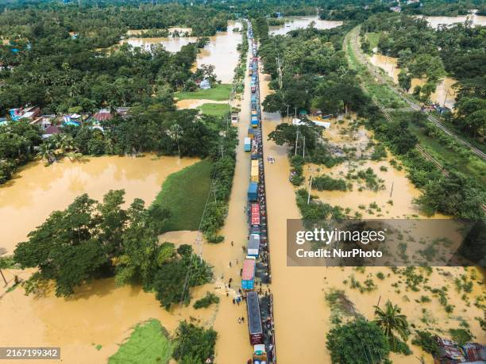
Introduction
Motivation
Floods severely impact lives, livelihoods, agriculture and infrastructure
Floods cause worldwide $40 billion damages annually
Traditional ground surveys are slow, costly, and infeasible in many regions
Image source: Getty Image (https://www.gettyimages.com/detail/news-photo/an-aerial-view-of-the-flooded-dhaka-chittagong-highway-in-news-photo/2167199159?adppopup=true)

Slide 4
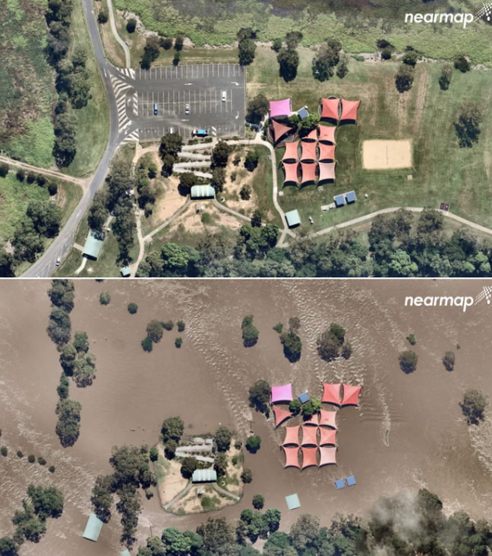
Introduction
Objective
To develop an automated framework using Vision Transformers (SegFormer B3) on satellite imagery to accurately segment land cover changes and provide reliable estimates of flood-induced economic damage.
Image source: The Guardian (https://www.theguardian.com/australia-news/2022/mar/04/before-and-after-aerial-pictures-show-how-floods-swept-through-queensland-and-nsw-towns)

Slide 5
Related Works
Sl no | Paper Title | Author | Published in | Work
1 | Semantic Segmentation using Vision Transformers: A survey | Hans Thisanke, Chamli Deshan, Kavindu Chamith, Sachith Seneviratne, Rajith Vidanaarachchi, Damayanthi Herath | Engineering Applications of Artificial Intelligence. | authors surveyed the viT in the semantic segmentation task and got an accuracy of 88.55% in ImageNet dataset and 94.55% on CIFAR-100 dataset
2 | MeViT: A Medium-Resolution Vision Transformer for Semantic Segmentation on Landsat Satellite Imagery for Agriculture in Thailand | Teerapong Panboonyuen, Chaiyut Charoenphon, Chalermchon Satirapod | Remote Sensing, volume 15, issue 21, article number 5124 | Medium-Resolution ViT was proposed for semantic segmentation on Landsat imagery which achieved higher value of precision (92.22%), recall (94.69%)
3 | Extended Vision Transformer (ExViT) for Land Use and Land Cover Classification: A Multimodal Deep Learning Framework | Jing Yao, Bing Zhang, Chenyu Li, Danfeng Hong, Jocelyn Chanussot | IEEE Transactions on Geoscience and Remote Sensing ( Volume: 61) | ExViT achieved state-of-the-art results in land-use and land-cover classification using multimodal data

Slide 6
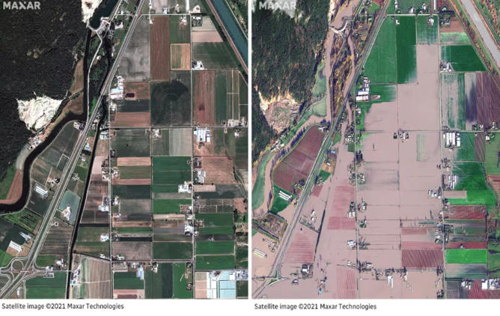
Research Gap
Prior studies focus mainly on classification or segmentation
No existing work directly estimates economic damage of floods from satellite imagery
Before and After Flood Image
Image source: CBC
(https://www.cbc.ca/news/canada/british-columbia/bc-floods-sumas-prairie-before-after-images-1.6258803 )

Slide 7
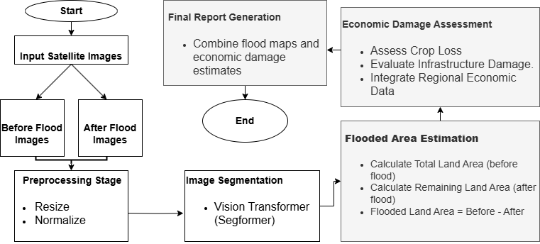
Proposed Methodology
Input before and after flood image
Preprocessing
Apply semantic segmentation using Segformer B3
Measure area loss per land cover class
Assign economic value to each class
Compute flood induced damage
Figure: Proposed Methodology

Slide 8
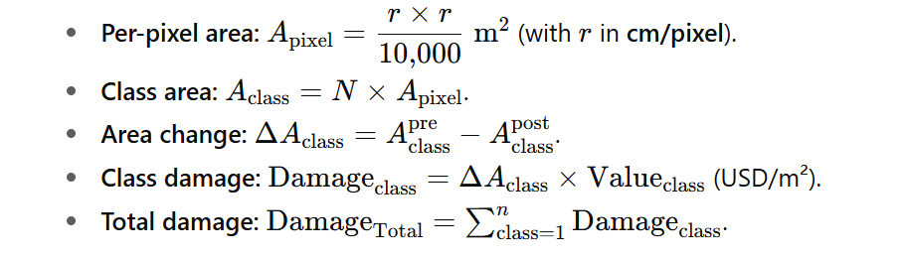
All the Formulas Used in Methodology

Slide 9
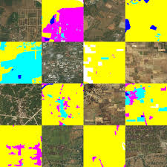
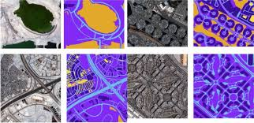
Datasets
DeepGlobe Land Cover Classification Dataset
Dubai Satellite Imagery Dataset
Total Images: 1,146 RGB images
Resolution: 2,448 × 2,448 pixels
Spatial Resolution: 50 cm per pixel
Source: Satellite imagery (DigitalGlobe)
Total Classes: 7
Total Images: 72 RGB images
Resolution: Different resolutions in each tile, there are 8 tiles
Spatial Resolution: 50 cm per pixel
Source: High-resolution satellite imagery
Total Classes: 6

Slide 10

Combined Dataset
Total Images: 875 RGB images
Total Classes: 12
Classes are: Urban_land (DeepGlobe), Agriculture_land (DeepGlobe), Range_land (DeepGlobe), Forest_land (DeepGlobe), Barren_land (DeepGlobe), Unknown (DeepGlobe), Building (Dubai), Land (Dubai), Road (Dubai), Vegetation (Dubai), Unlabeled (Dubai), Water (Common)

Slide 11
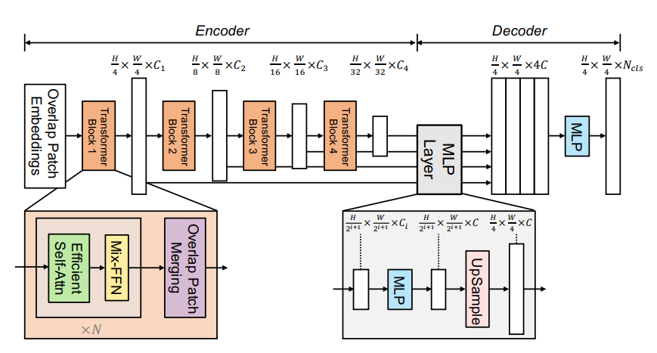
Model Architecture
Segformer B3
Hierarchical transformer encoder - captures both coarse & fine features
MLP decoder - fuses multi-scale features for segmentation
No positional encoding - robust to varying input size
Pretrained on ADE20K
Figure: Architecture of Segformer B3

Slide 12
Training Setup
Training Loop
Trained with Segformer B3
Trained for 30 epochs
Used early stopping technique
Applied learning rate optimization technique.
Data Preprocessing
Converted all images to 512X512 size.
Converted RGB colour codes of the masks to Class Indices.
Assigned weight to the Dubai dataset classes as they are less in number.
04
01
03
Augmentation
Applied Random horizontal flip, Random vertical flip, Random rotation.
Define Loss Function
Used a combined loss function with Focal loss and Dice loss.
Used class weights for calculating loss function.
02

Slide 13
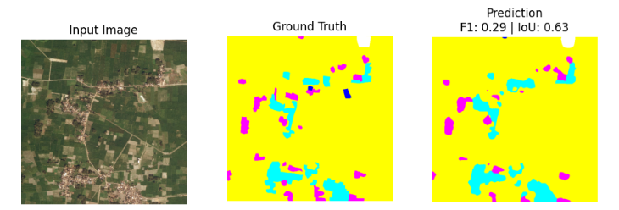
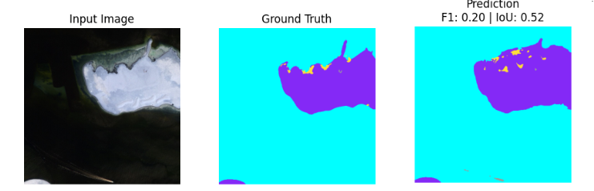
Segmentation Results
On the validation set we achieved:
Pixel Accuracy: 0.98
mIoU: 0.53
F1 Score: 0.38

Slide 14
Why ViT for segmentation?
Model Name | Pixel Accuracy | mIoU | F1 Score | Training Time/Epoch
Segformer | 0.98 | 0.53 | 0.38 | ~ 8 minutes
DeepLabV3+ | 0.85 | 0.50 | 0.44 | ~ 17 minutes
UNet | 0.75 | 0.31 | 0.31 | ~ 20 minutes

Slide 15
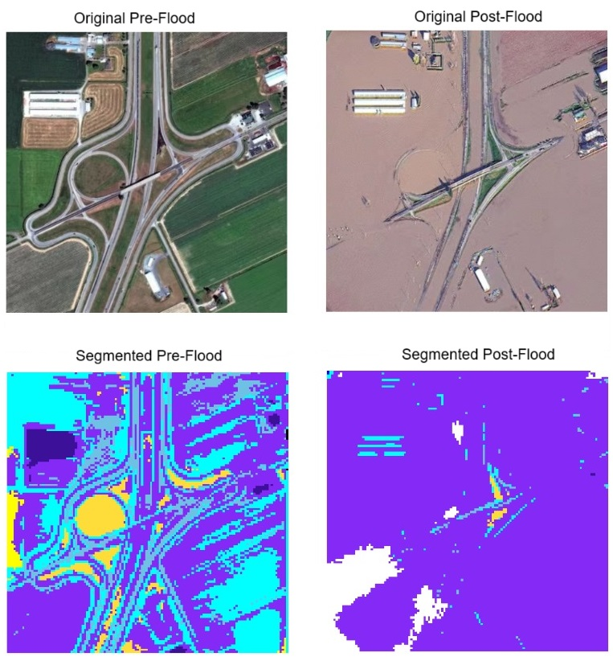
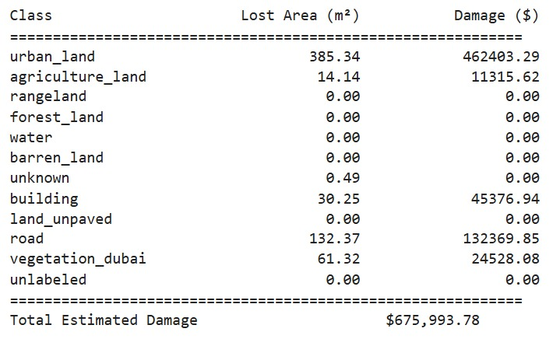
Economic Damage Estimation

Slide 16
Limitations & Future Improvements
Limitations
Future Works
Economic values for land classes were assigned arbitrarily (lack of real data)
Small training dataset limits generalization
Cannot determine crop type or seasonal variations
Use real-world economic datasets for valuation
Integrate crop type classification with temporal data
Extend framework to other disasters (wildfire, drought, etc.)

Slide 17
Conclusion
We developed a Vision Transformer-based framework for flood damage assessment using satellite imagery. Our SegFormer B3 model achieved high segmentation accuracy and enabled estimation of economic loss by comparing pre- and post-flood images. This approach offers a fast, automated solution for post-disaster analysis, with future work focusing on crop-specific damage and extension to other disasters.

Slide 18
Thank You
Questions are Welcome

Slide 19
References
H. Thisanke, C. Deshan, K. Chamith, S. Seneviratne, R. Vidanaarachchi, and D. Herath, “Semantic segmentation using vision transformers: A survey,” arXiv preprint arXiv:2305.03273, 2023. [Online]. Available: https://arxiv.org/abs/2305.03273
T. Panboonyuen, C. Charoenphon, and C. Satirapod, “Mevit: A medium resolution vision transformer for semantic segmentation on landsat satellite imagery for agriculture in thailand,” Remote Sensing, vol. 15, no. 5124, 2023.
J. Yao, B. Zhang, C. Li, D. Hong, and J. Chanussot, “Extended vision transformer (exvit) for land use and land cover classification: A multimodal deep learning framework,” in IEEE Transactions on Geoscience and Remote Sensing, vol. 61, 2023, pp. 1–12.

