Slide 1
Sudoku Solving App
Sadra Samadi
9312268122
samadi_s@live.com

Slide 2
Contents
Introduction
Algorithm
Project Structure
Usage (UI/UX)
Notes
Development
References

Slide 3
Introduction
Project is aimed to solve a Sudoku puzzle.
The algorithm that used is Backtracking.
The project is implemented in Node.js.
The framework that used is Ionic.
Ionic is a mobile app development framework on top of Cordova and Angular.
Cordova is a framework for making applications with web technologies.
Angular is a powerful framework for making any web application.
We’ll use Tailwind CSS and Animate CSS for styling and animating.

Slide 4
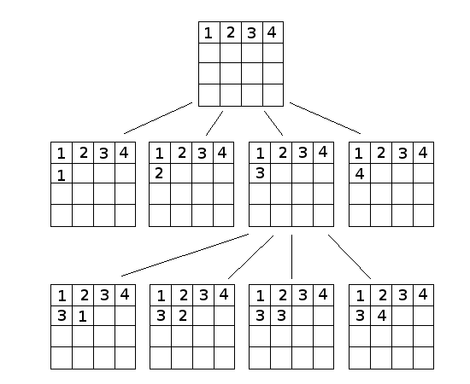
Algorithm
Backtracking Algorithm for Solving Sudoku Puzzle
Get the initial state.
Terminate if there is a conflict.
Return the state if it’s already solved.
For numbers in 1 to 9 do:
Find the next state with the number.
Recursively call the algorithm with the new state.
If a solution was found, return it and terminate.

Slide 5
Algorithm - cont’d
Finding conflict
Count the occurrence of each number (1-9) in all sections (rows, columns and regions).
If one of them is occurred more than once in each section, there is a conflict.
Checking solution
If there is no zero in the board (no empty cell), it means that a solution is found.
Finding the next state with a number
Find the first empty cell and fill it with the specified number.

Slide 6
Project Structure
Resources
Icon and splash-screen images and…
Sources
Components (home page, board cells)
View templates
Styles
Logics (solver, …)
Assets (images, fonts, …)
Configs
package.json (info, scripts, libs, …)
config.xml, (native modules configurations)

Slide 7
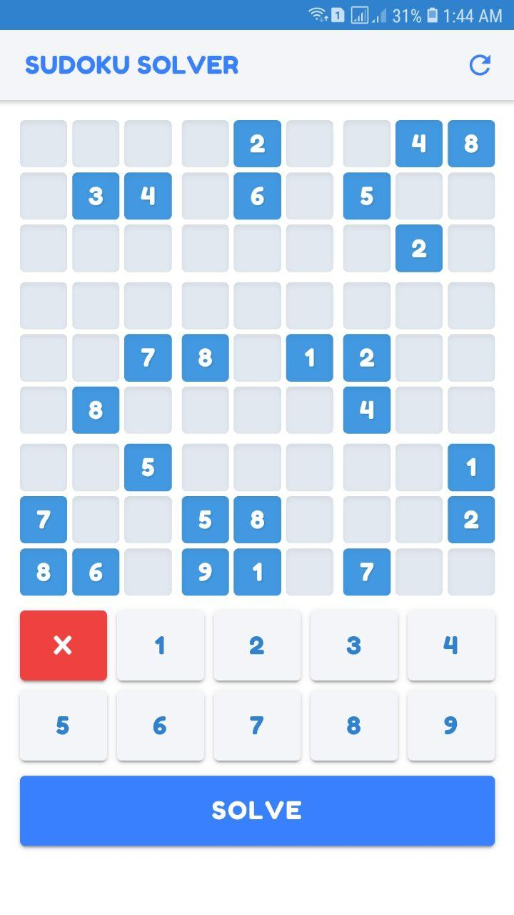

Usage (UI/UX)
First select a cell to turn its color to green.
Click on a number to change the selected cell value.
Click on ‘X’ to clear the selected cell value.
Click on ‘Solve’ button to start solving the puzzle.
Click on ‘ ’ icon to reset the board and clear all data.

Slide 8
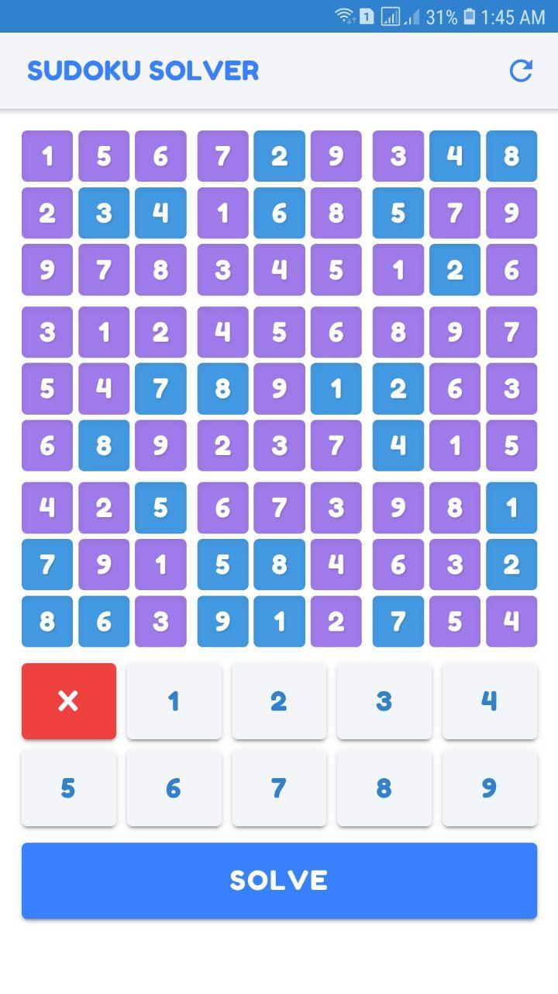
Usage (UI/UX) - cont’d
The algorithm execution time is variable.
In some cases it takes more time to solve the puzzle.
After finding a solution, found numbers will turn into purple color and the previous numbers will remain in blue color.
When the puzzle is solved, nothing changes until reset is clicked.

Slide 9
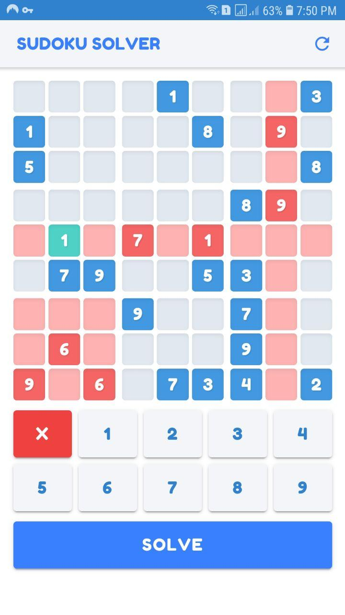
Usage (UI/UX) - cont’d
Each row, column or region that has a conflict will turn into red color.
The ‘Solve’ button will not work until all conflicts are resolved.

Slide 10
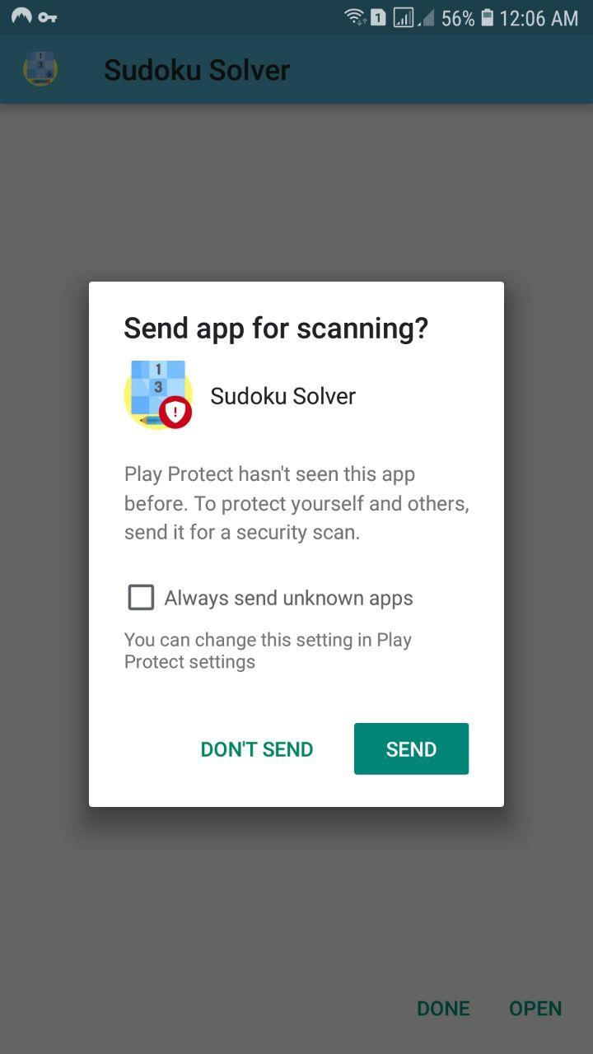
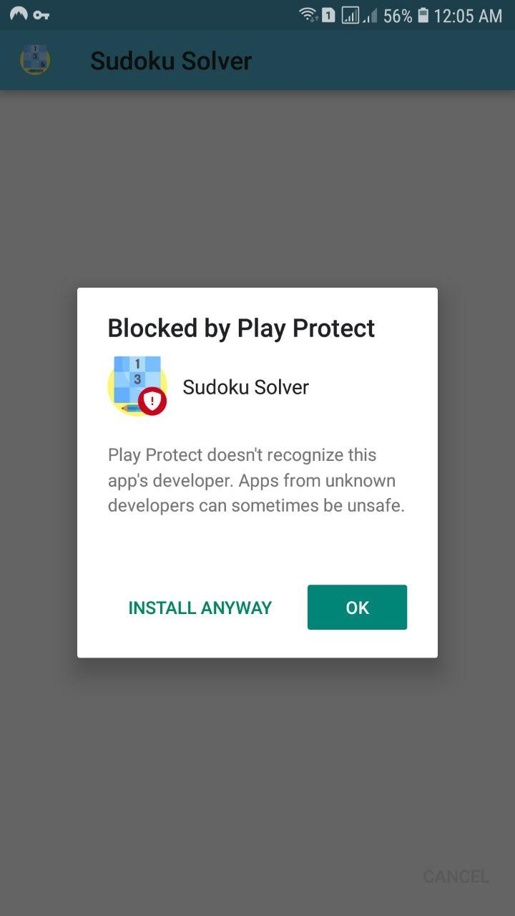
Notes
In newer android versions, dialogs like in the images may be shown during installation of APK file.
That’s because the APK file is not certificated in the Play Store, just ignore them and click on “INSTALL ANYWAY” and “DON’T SEND“ buttons.

Slide 11
Development
Requirements for changing, developing or building the project.
Install Node.js.
Install Ionic package globally.
Open a terminal in the project directory and run commands:
$ npm install (to install packages)
$ npm run req (to check that everything is ok)
$ npm run serve (to run a preview in the browser)
$ npm run build (to make a output APK)
The output APK file will be generated under this directory:
platforms\android\app\build\outputs\apk\release

Slide 12
References
Sudoku
Sudoku solving algorithms
Angular
Cordova
Ionic
Tailwind CSS
Animate CSS

