Slide 1
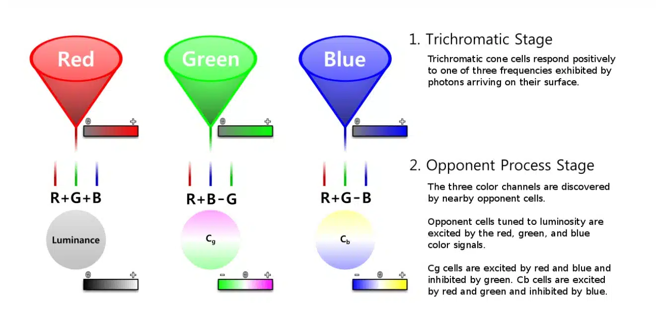
Keyence CZ-V1

Slide 2
Simulations of color vision deficiencies. A. Routine trichromatic color... | Download Scientific Diagram

Slide 3
Promotion of Color Sorting in Industrial Systems Using a Deep Learning Algorithm | MDPI

Slide 4
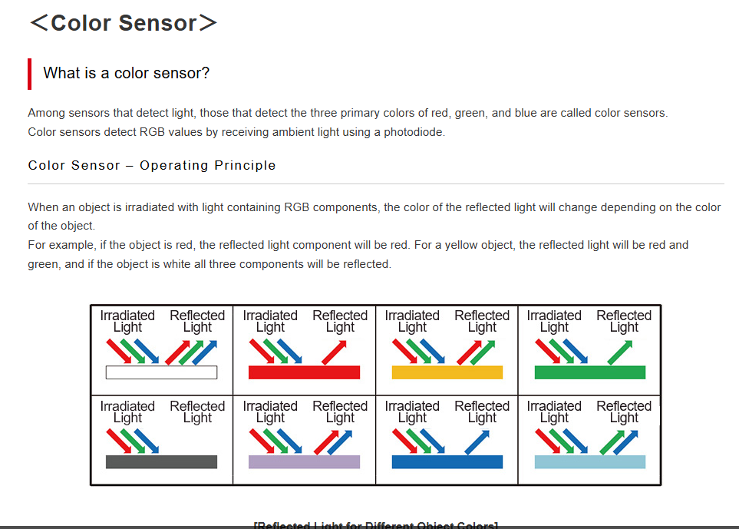
＜Color Sensor＞ | What is a sensor? | TechWeb

Slide 5
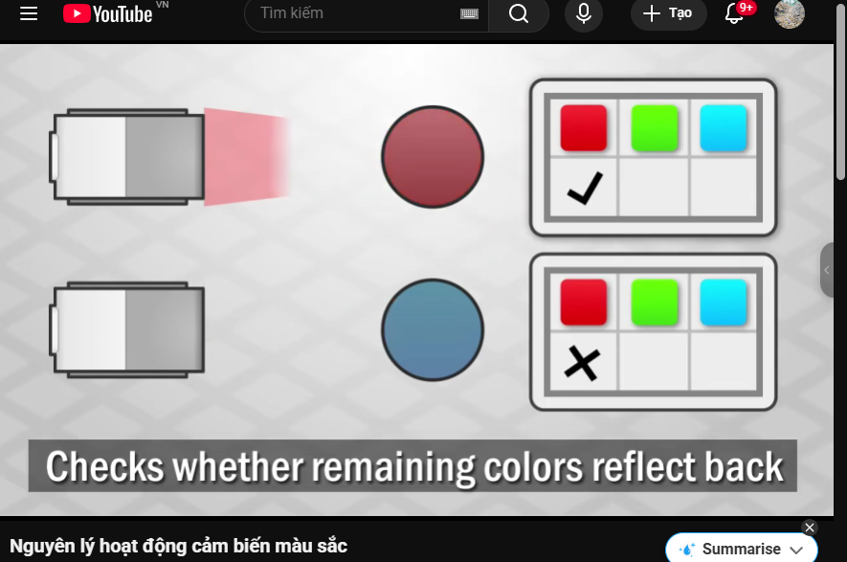
Nguyên lý hoạt động cảm biến màu sắc

Slide 6
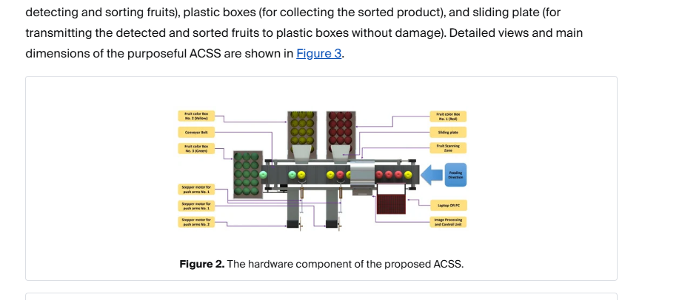
Designing, Optimizing, and Validating a Low-Cost, Multi-Purpose, Automatic System-Based RGB Color Sensor for Sorting Fruits | MDPI

