Slide 1
MEASURING DIMESIONS OF A ROOM USING ESP32
Course project submitted on a partial fulfillment of Internet of Things
BATCH NO : 03
S. Gopi Krishna 2003A52015
S. Siddhartha 2003A52016
V. Sairam 2003A52020
S.Vivek 2003A52076
Under the supervision of
Mr. Rajeshwar rao Arabelli
Asst prof. & Director, Centre for Embedded Systems and IOT
Under the guidance of
Dr .Sumit Gupta
Asst prof.(Department of ECE)

Slide 2
ABSTRACT:
This presentation deals with the verification of the of measurement distance ultrasonic sensor in the current environment. This fact makes it simple to create the sensor array. We will connect two servo motors to the ultrasonic sensor and it will rotate in all directions and calculates the dimensions of the room. Esp32 connect to the wifi and wifi is connected to the thingspeak then thinkspeak will display the dimensions , these helps the human effort and reduce man power.

Slide 3
INTRODUCTION :
Ultrasonic distance measurement is a useful tool in various application lately. It can be used in various applications such as positioning, locating , dimensioning , selecting, level measurement, controlling and profiling .By doing some mathematical calculations with the output values we can also measure the speed and various other physical dimensions. The device also has applications in the field of robotics

Slide 4
PROBLEM STATEMENT :
While measuring the dimensions of the room , we require man power and some human efforts . This device helps to find the Dimensions of the room easily

Slide 5
HARDWARE USED:
Ultrasonic Sensor
2 Servo Motors
Bread Board
Esp32
Connecting Wires

Slide 6
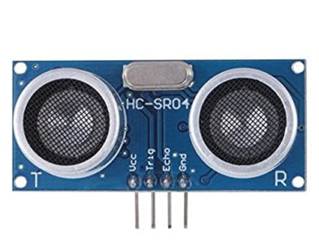
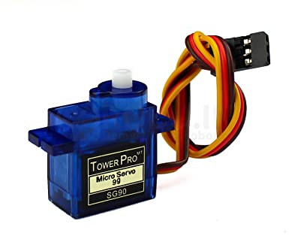
Ultrasonic senser
An Ultrasonic sensor is an electric device that measures the distance
of a target object by emitting ultrasonic sound waves ,and converts
the relected sound into an electrical signal.
Servo motor
A servo motor is an electrical device which can push or rotate an
object with great precision

Slide 7
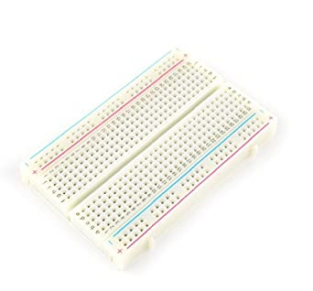
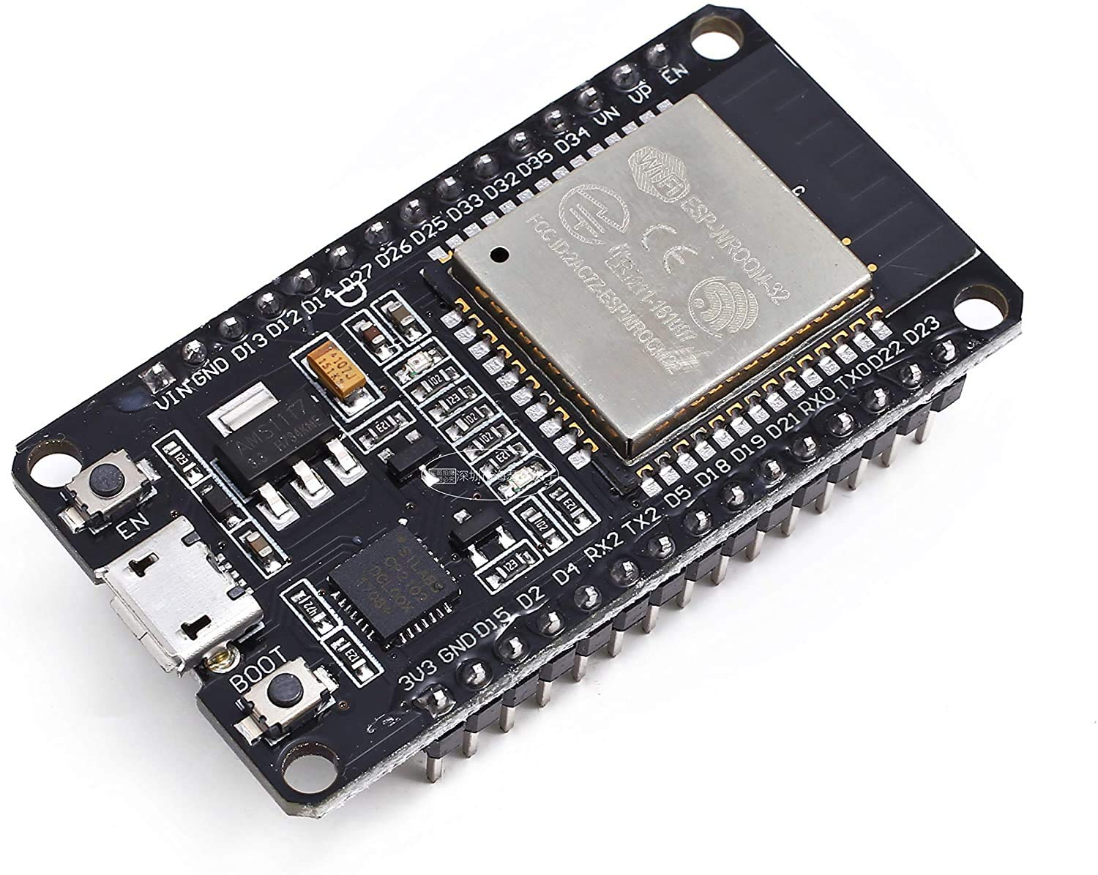
Breadboard
A Breadboard is a construction base used to build semi-permanent
prototype of electronic circuits.
Esp32
Esp32
Esp32 is a series of low-cost, low power system on a chip micro
controllers with integrated Wi-Fi and dual-mode Bluetooth

Slide 8
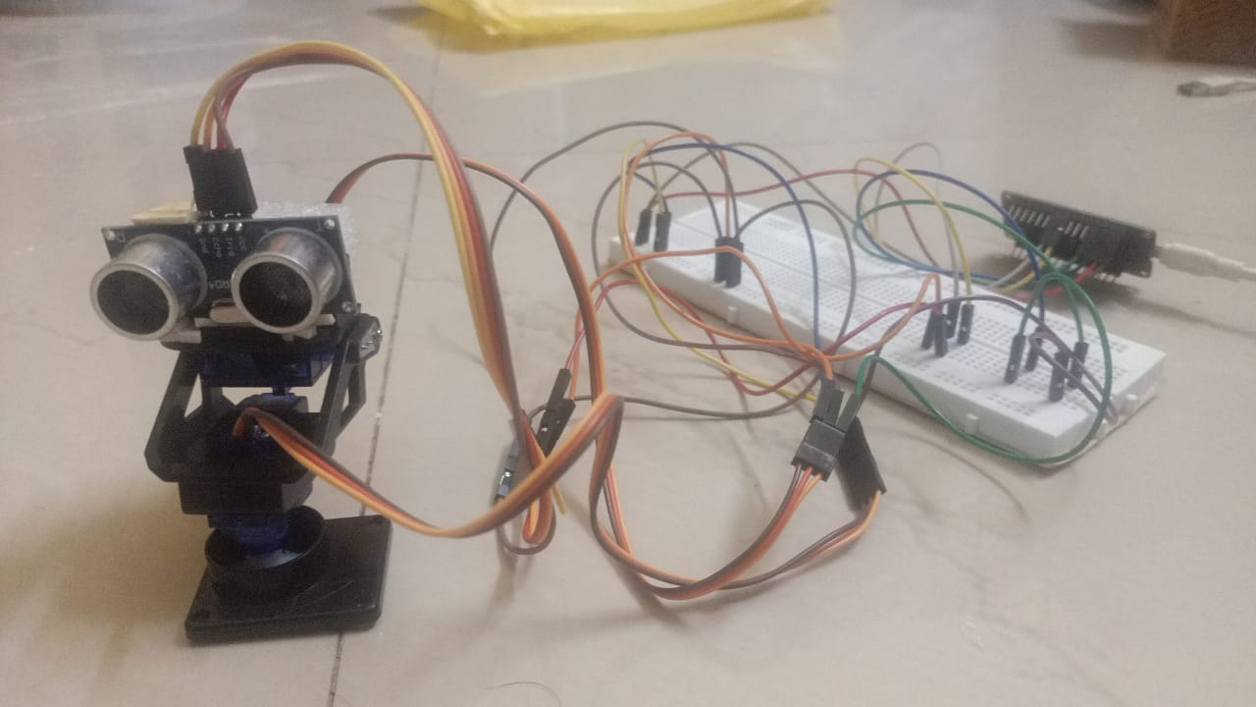

Slide 9
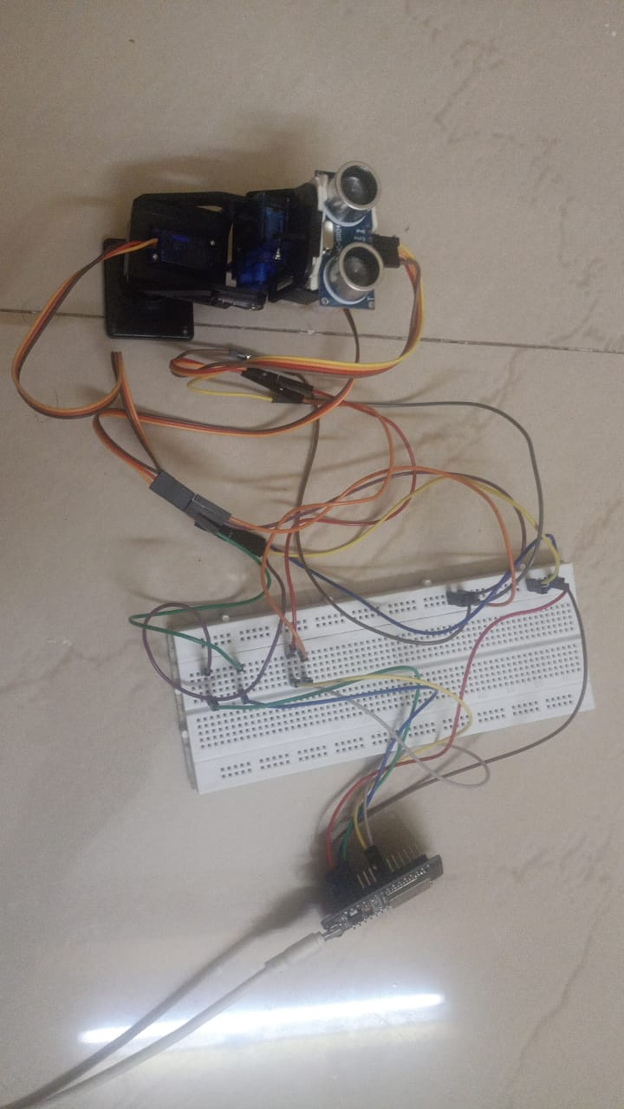

Slide 10
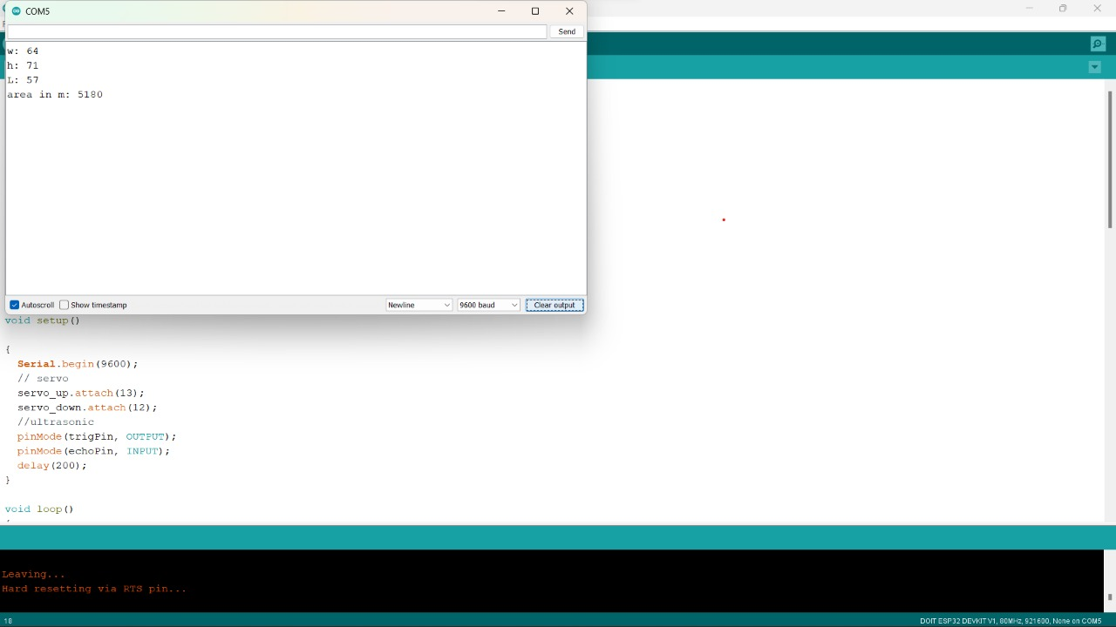

Slide 11
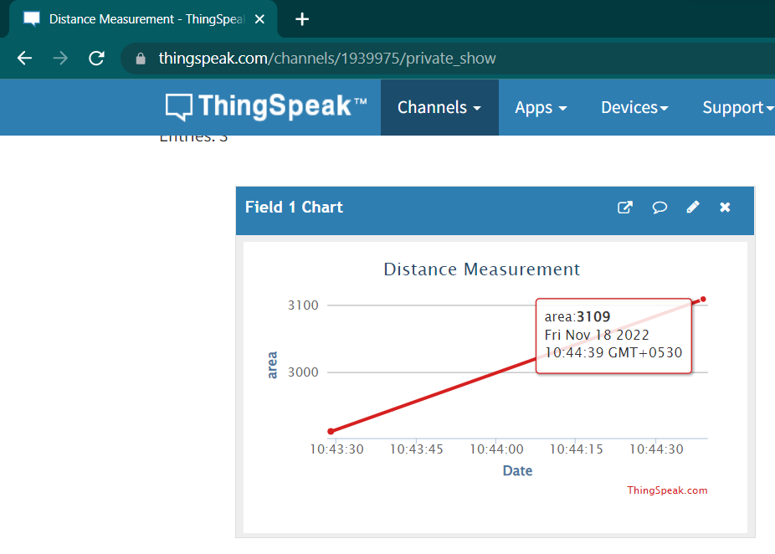
Execution :

Slide 12
CONCLUSION :
By using this device we can easily find dimensions of the room or area. Mainly these device help human efforts so, we can decrease man power.

Slide 13
REFERENCE :
Internet ,Books ,Maxizines etc..
https://youtu.be/bN3JPxvIMsk
https://youtu.be/_WqfNyE_pt8
https://youtu.be/6bvkTyNRSjI
https://youtu.be/Kn8_JAvAJsY
https://youtu.be/cgFVEk7z46U

Slide 14
THANK YOU

