Slide 1
FOUNDATIONS OF ARTIFICIAL INTELLIGENCE • 7COSC013C
SYSTEM HIGHLIGHTS
• Hybrid AI Integration: Combines Knowledge-based Symbolic AI, Statistical Machine Learning, and classical admissible heuristic search (A*).
• Personalised Utility: Applies custom-weighted classification to rank POIs for distinctive 'Budget' and 'Luxury' traveler profiles.
• Empirical Efficiency: Demonstrates 95.2% reduction in search space nodes in real Colombo network trials over classical baseline Dijkstra.
AI Travel Assistant Hybrid Intelligent Route Planning & Context-Aware
Recommendations
Assessment Portfolio: Coursework 1 Live Demo
Presenter: K.P.Sadusha Nadeesh De Silva
Student ID UOW: 22238997
IIT ID: 20251211
Notes:
[TIMESTAMP: 0:00 - 0:20 | DURATION: 20 SECONDS]
SPEAKER SCRIPT:
"Good day, My name is [Your Name], presenting my Coursework 1 submission for the Foundations of Artificial Intelligence module: an AI Travel Assistant designed for Hybrid Intelligent Route Planning and Context-Aware Recommendation.
Upcoming slides will cover the design walkthrough, focusing on its architecture, mathematical underpinnings, empirical validation, and fundamental scaling boundaries. Let us begin by examining the underlying problem domain."

Slide 2
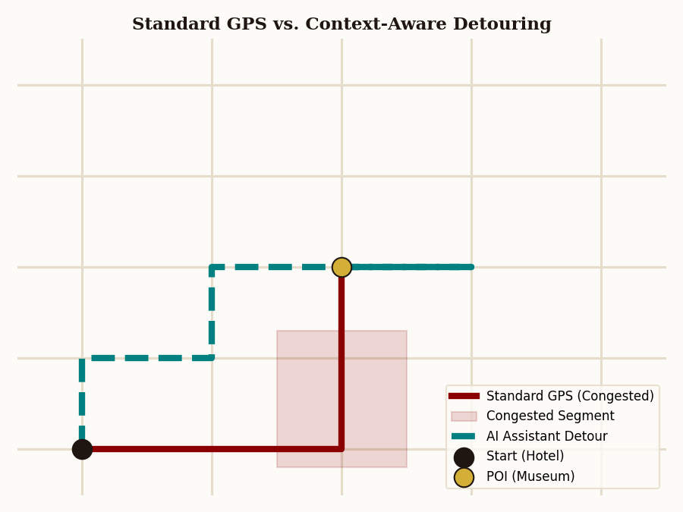
PROBLEM STATEMENT | The Paradigm Shift: From Blind Routing to Context-Aware Assistance
THE LIMIT OF STANDARD GPS NAVIGATION Traditional routing frameworks like Google Maps operate on a single metric—optimizing solely for travel time or distance. They model the environment as a static graph, assuming all users are identical, ignoring personal budgets, and operating blind to environmental context.
ENVIRONMENTAL & SAFETY BLIND SPOTS Legacy systems do not adapt to real-world context. Extreme weather dictates whether outdoor venues should be replaced with indoor alternatives, while nighttime safety parameters should actively redirect travelers away from poorly-lit backstreets regardless of geographic distance.
THE PERSONALISATION GAP A single route does not fit all. A budget-conscious traveler demands short detour thresholds and low-cost entries, while a luxury traveler prioritizes high ratings and exclusive categories. We require an intelligent agent that reconciles environmental states with distinct user utility profiles.
Notes:
[TIMESTAMP: 0:20 - 1:20 | DURATION: 1 MINUTE]
SPEAKER SCRIPT:
Traditional navigation systems mainly focus on finding the shortest or fastest route using distance and travel time. However, they usually do not consider factors such as weather, safety, or individual user preferences.
For example, they may recommend an outdoor attraction during heavy rain or choose a shorter but less safe road at night. They also provide the same type of route for everyone, even though different users have different needs.
This project improves on this by combining route planning with real-world context and Machine Learning. The system creates personalised routes based on user preferences, environmental conditions, and the user's travel goals.

Slide 3
SYSTEM DESIGN | Decoupled Multi-Layered Pipeline: System Architecture
1. Data Ingest
GEOSPATIAL DATA OSMnx Wrapper
———————————————
Downloads the raw road network nodes and edges dynamically via Overpass API.
2. Rule Reasoner
SYMBOLIC AI Knowledge Rep.
———————————————
Modifies edge weights on the graph based on weather and safety constraints.
3. Graph Search
HEURISTIC SEARCH A* Algorithm
———————————————
Executes targeted A* pathfinding using the mathematically admissible Haversine metric.
4. POI Classifier
STATISTICAL AI Personalisation
———————————————
Applies machine-learned Decision Trees to score, filter, and rank custom POIs.
5. Path Solver
COMBINATORIAL OPT. TSP Solver
———————————————
Solves Travelling Salesperson permutation sequences for selected destinations.
Notes:
[TIMESTAMP: 1:20 - 2:40 | DURATION: 1 MINUTE 20 SECONDS]
SPEAKER SCRIPT:
To overcome the limitations of traditional navigation systems, this project uses a modular AI pipeline that combines three areas of AI: Graph Search, Knowledge Representation, and Machine Learning.
The system works in five main steps. First, it collects road network data from OpenStreetMap and converts it into a graph structure. Second, a rule-based system adds real-world context, such as weather, time, and safety conditions, to adjust route costs. Third, the A* algorithm finds the most efficient base route. Fourth, a Machine Learning model recommends suitable Points of Interest based on user preferences, such as budget or luxury choices. Finally, a TSP-based optimiser arranges the selected stops into the best visiting order.
This modular approach allows each AI component to work together while remaining flexible and easy to improve.

Slide 4
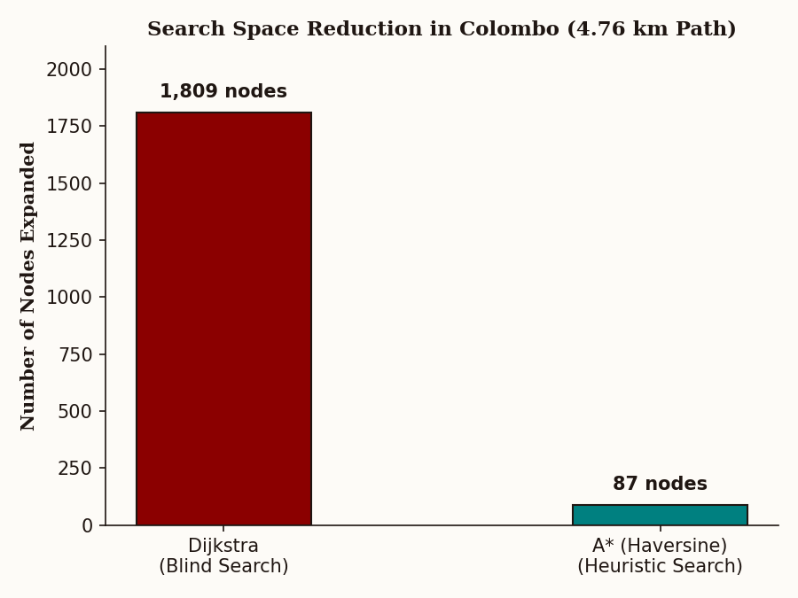
ALGORITHM COMPARISON | Empirical Validation: Pathfinding Search Space Reduction
Evaluation Metric | Dijkstra (Baseline) | A* (Haversine)
Path Distance | 4.76 km | 4.76 km
Estimated Travel Time | 4.77 minutes | 4.77 minutes
Nodes Expanded | 1,809 nodes | 87 nodes
Search Space Reduction | Baseline (0%) | 95.2% Reduction
Mathematical Optimality | Guaranteed | Guaranteed
Notes:
[TIMESTAMP: 2:40 - 3:40 | DURATION: 1 MINUTE]
SPEAKER SCRIPT:
A key part of the evaluation was comparing Dijkstra’s algorithm and A* Search on a real road network in Colombo, Sri Lanka. Both algorithms were implemented from scratch and tested on a 4.76 km route.
The results showed that both algorithms found the same shortest path and travel time, proving that both were accurate. However, their efficiency was very different. Dijkstra expanded 1,809 nodes because it searched in all directions, while A* expanded only 87 nodes using the Haversine distance heuristic to guide the search.
This reduced the search space by 95.2% while maintaining the same optimal route. The result shows that A* can provide faster route calculations without losing accuracy, making it more suitable for large-scale navigation systems.

Slide 5
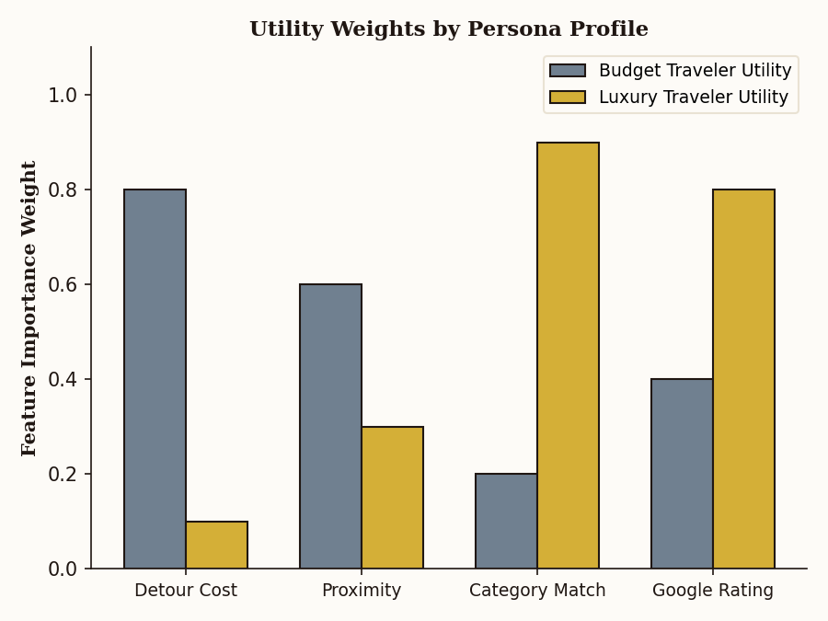
DATASET STRATEGY | Data Harmonization & Supervised Traveler Profiling
GEOSPATIAL INGESTION & caching Raw road attributes, network coordinates, and POI geographic footprints are fetched dynamically from OpenStreetMap's Overpass database using the OSMnx library. Graph data is compiled into networkx MultiDiGraphs and cached locally as .graphml structures to minimize web-bound latency.
10,000 TELEMETRY SAMPLES To bypass cold-start issues, we constructed a synthetic data pipeline generating 10,000 user interaction logs. Each record maps numerical inputs: detour_score (normalised travel time penalty), route_distance_score (proximity), category_match_score (relevance), and google_review_score (aggregate traveler sentiment).
PROFILING UTILITY FUNCTIONS Supervised classification models (Decision Trees) are trained on custom utility thresholds. As mapped in the chart, 'Budget' profiles heavily penalize detour times (0.8 weight) while ignoring luxury ratings. Conversely, 'Luxury' profiles prioritize high review scores (0.8 weight) and category alignment (0.9 weight), accepting high detours.
Notes:
[TIMESTAMP: 3:40 - 4:30 | DURATION: 50 SECONDS]
SPEAKER SCRIPT:
The system uses two main types of data. First, real-world map data is collected from OpenStreetMap using the OSMnx library. This creates a road network graph containing real intersections and roads. The data is saved locally as GraphML files to improve performance and allow faster future access.
Second, synthetic data is created to train the Machine Learning model without using private user information. The system generates 10,000 simulated user records using features such as detour distance, route distance, category match, and venue rating.
Two user profiles are created: Budget and Luxury. The Budget model prioritises shorter and cheaper routes, while the Luxury model gives more importance to ratings and quality, even if extra travel is required. These datasets are used to train the Decision Tree models for personalised POI recommendations.

Slide 6
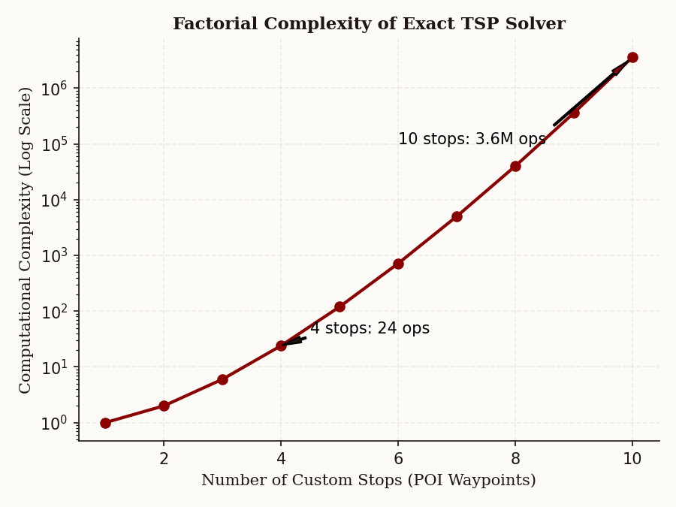
LIMITATIONS | Academic Self-Critique: Hard Technical Boundaries & Gaps
• 1. TSP COMBINATORIAL EXPLOSION The route sequencer uses an exact permutation solver that scales factorially, O(N!). It is computationally intractable beyond 10 waypoints (3.6 million operations).
• 2. STATIC ROAD VELOCITY LIMITS Travel times rely entirely on static OSM speed limits. Symbolic weather rules help simulate traffic, but lack real-time congestion feeds.
• 3. SYSTEMIC DEVELOPER-CRAFTED BIAS The machine learning models are trained on synthetic utility functions created by the designer. They reflect developer assumptions rather than empirical user behavior.
• 4. GEOGRAPHICAL DISPARITY IN OSM OpenStreetMap is crowdsourced. Densely populated urban centers are richly mapped, while rural, low-income, or developing regions suffer from empty POIs.
• 5. UNIMODAL VEHICULAR ROUTING The system assumes a single spatial layer (driving networks), completely omitting pedestrian walkways, cycling infrastructure, and public transit.
Notes:
[TIMESTAMP: 4:30 - 5:30 | DURATION: 1 MINUTE]
SPEAKER SCRIPT:
This implementation has five main limitations. First, the TSP route optimiser becomes slow when many stops are added because the number of possible routes grows very quickly.
Second, the system uses static map data and cannot detect real-time traffic or unexpected road events.
Third, the Machine Learning model uses synthetic data, so it reflects predefined assumptions rather than real user behaviour.
Fourth, OpenStreetMap quality can vary between locations, which may create uneven route recommendations.
Finally, the current system only focuses on road networks and does not support other transport modes like walking, cycling, or public transport. These areas will be improved in future work.

Slide 7
PROPOSED ENHANCEMENTS | System Optimisation & Inclusive Future Roadmap
BOTTLENECK: O(N!) TSP Complexity Bottleneck
GENETIC META-HEURISTICS — Replace exact permutation calculations with approximation algorithms (Genetic Algorithms or Simulated Annealing) to resolve routes for 50+ waypoints in polynomial time, O(N^2).
BOTTLENECK: Static Travel Times
LIVE CONGESTION API INTEGRATION — Integrate active traffic feeds via external APIs (such as Google Distance Matrix or TomTom Traffic) to calculate dynamic edge costs based on real-time traffic speeds.
BOTTLENECK: Synthetic Label Bias
CLOSED-LOOP USER TELEMETRY — Replace simulated labels with actual empirical click-through telemetry—capturing real-world traveler acceptances and rejections to eliminate developer bias.
BOTTLENECK: Vehicular Limitation
MULTIMODAL TRANSPORT GRAPHS — Synthesize multiple network layers—combining vehicular, pedestrian, and subway transit layers into a singular multimodal routing graph.
BOTTLENECK: Equity & Inclusion Gaps
ACCESSIBILITY & EDI INFRASTRUCTURE — Query specific spatial accessibility parameters (tactile paving, wheelchair ramps, sidewalk gradients) to design inclusive paths for visually or physically impaired users.
Notes:
[TIMESTAMP: 5:30 - 6:30 | DURATION: 1 MINUTE]
SPEAKER SCRIPT:
To improve this prototype into a production-level system, several future improvements are needed.
First, the TSP optimiser should be replaced with faster methods such as Genetic Algorithms or Simulated Annealing to handle larger numbers of stops efficiently.
Second, static travel times should be replaced with real-time traffic data from services such as Google Distance Matrix or TomTom Traffic.
Third, the Machine Learning model should be trained using real user behaviour, such as route choices and recommendations accepted by users, instead of synthetic data.
Fourth, the system should support multiple transport modes by including walking paths, cycling routes, and public transport networks.
Finally, accessibility features should be added by using data such as wheelchair access, road slopes, and pedestrian facilities to create safer and more inclusive routes for all users.

Slide 8
CONCLUSION | The Future of Spatial Intelligence: Concluding Remarks
Intellectual synthesis of search, reasoning, and machine learning proves that navigation must move beyond simple distance metrics to become truly context-aware. By coupling symbolic rules with statistical profiling, we establish a new paradigm for dynamic and inclusive spatial computation.
HYBRID AI INTEGRATION
Combines knowledge representations, statistical machine learning, and heuristic search into an elegant, decoupled architecture.
CONTEXT-AWARE LOGIC
Mutates search space graphs dynamically in response to safety and meteorological environments via symbolic rules.
PERSONALISED UTILITY
Ranks point-of-interest clusters by optimizing custom multi-feature weights tailored to distinctive traveler profiles.
SCALABLE ENGINEERING
Maintains high spatial performance and lower server latency through cache systems and admissible heuristics.
Notes:
[TIMESTAMP: 6:30 - 7:00 | DURATION: 30 SECONDS]
SPEAKER SCRIPT:
In conclusion, this project shows that intelligent navigation requires more than finding the shortest route. A useful travel assistant must also understand real-world conditions and individual user preferences.
By combining graph search, rule-based reasoning, and Machine Learning, this system demonstrates how different AI techniques can work together to create a personalised and context-aware navigation solution.
Thank you for your time and attention.

Slide 9
Thank you

