Slide 1
Predicting car accident severity

Slide 2
Introduction
Predicting accident severity is valuable for Seattle department of transportation.
Knowing the severity of accident helps to control factors that affect accident.

Slide 3
Data acquisition and cleaning
Dataset comes from Transportation SeattleCityGIS.
Dataset has data of accidents in Seattle from 2004 until 2020.
In total, 194673 rows and 38 features.
After cleaned data, I got 187504 rows and 19 features.
Then, I reduced features to 7 features.

Slide 4

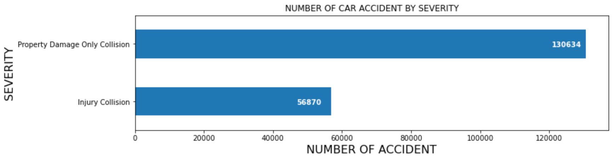
analysis
Number of Property only collision is 130634.
Number of Injury Collision is 56870.

Slide 5

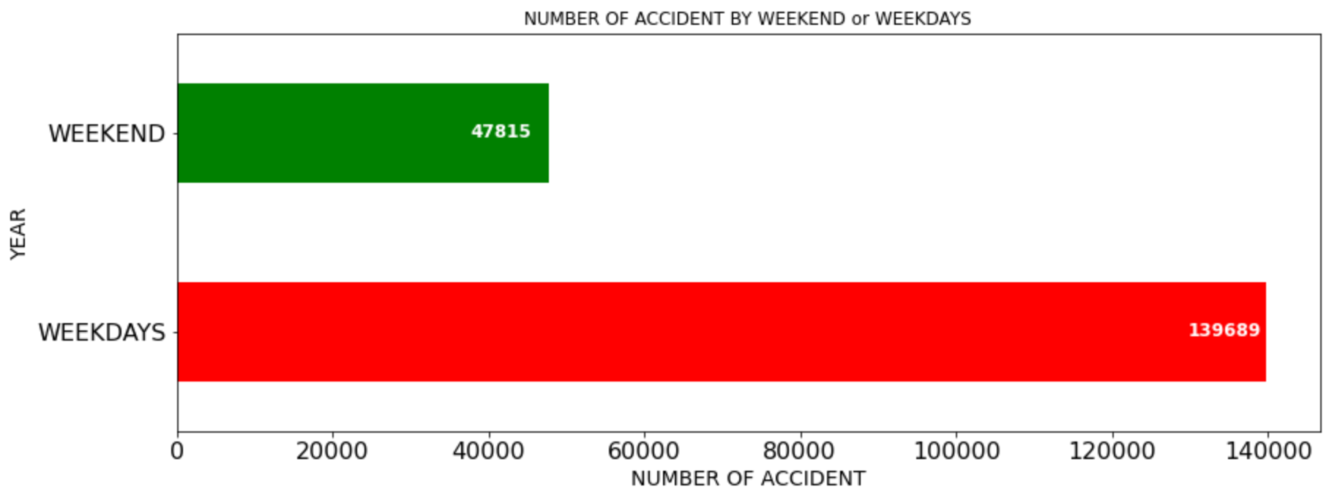
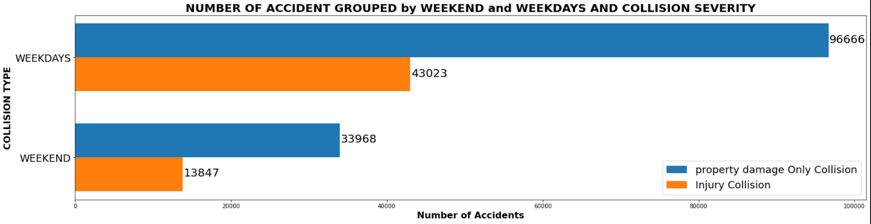
analysis
Number of Weekend and Weekday.
Most of accidents at weekdays.

Slide 6
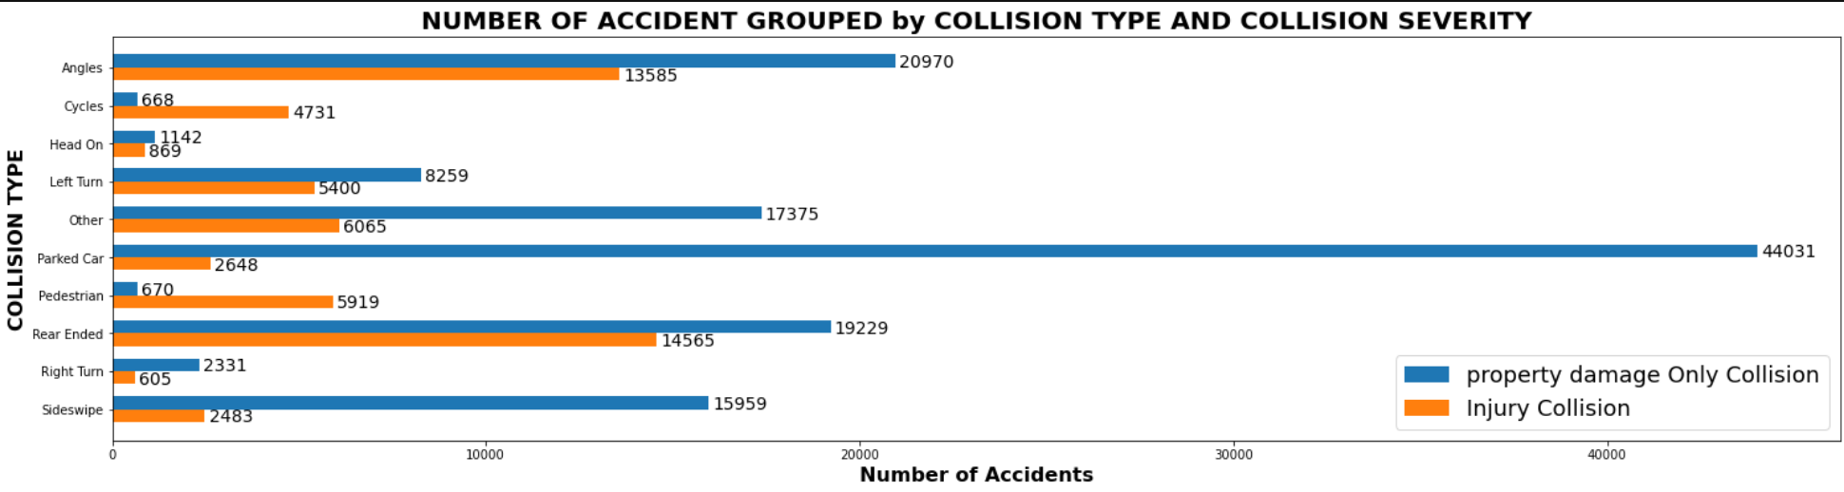
Analysis
The most dangerous type of collision is Rear Ended.

Slide 7
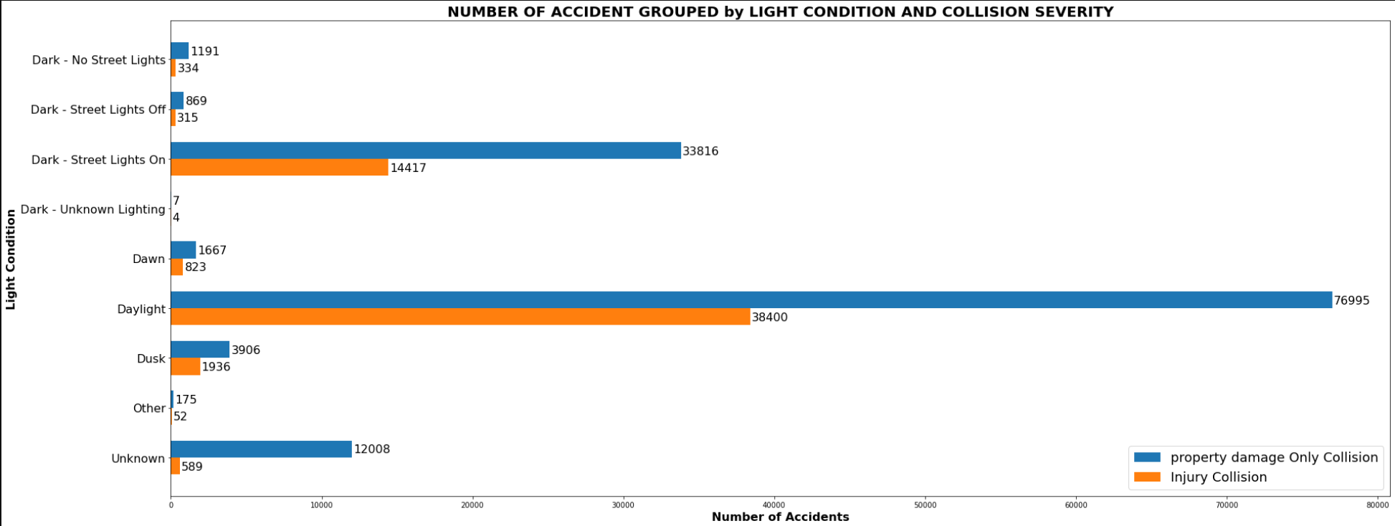
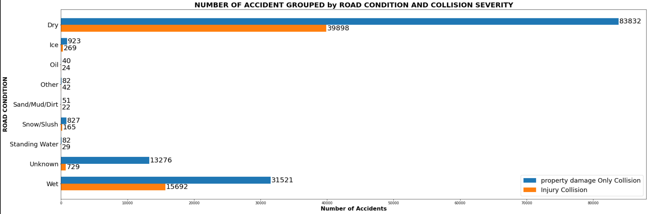
Analysis
Most of accidents in daylight and dry road.

Slide 8
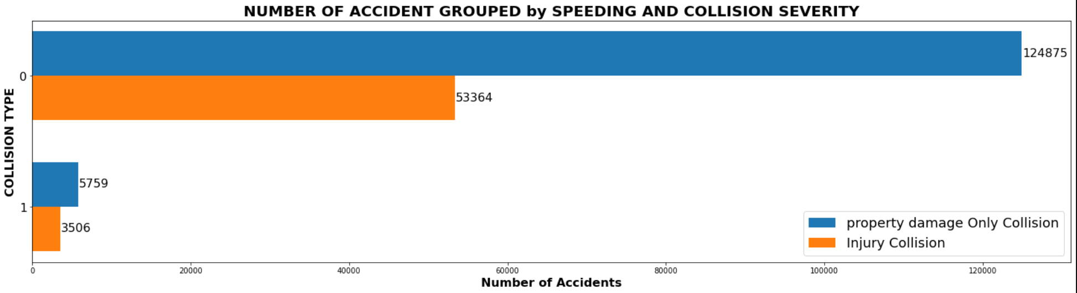
analysis
Speeding is not a high factor that influencing accidents.

Slide 9
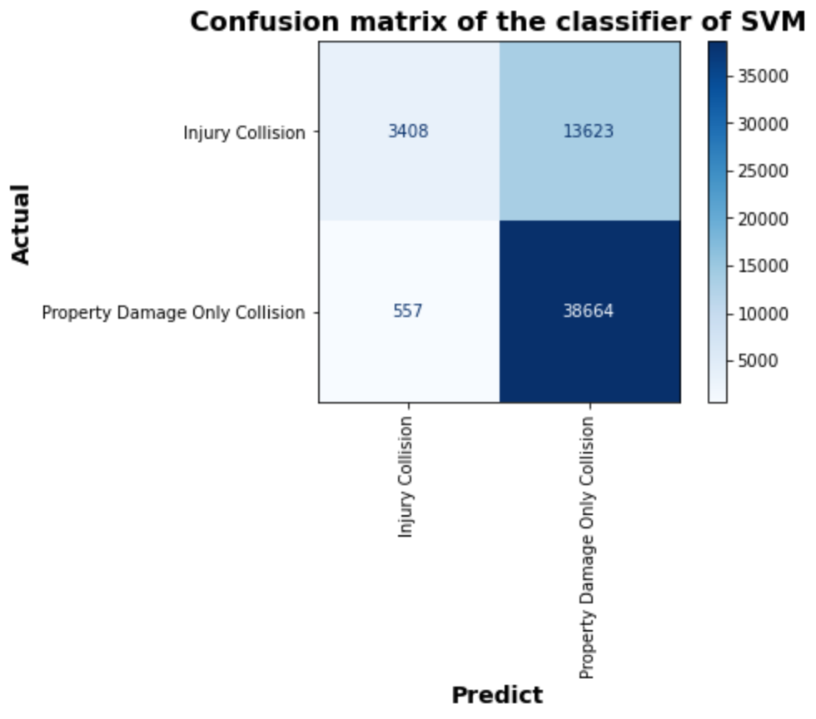
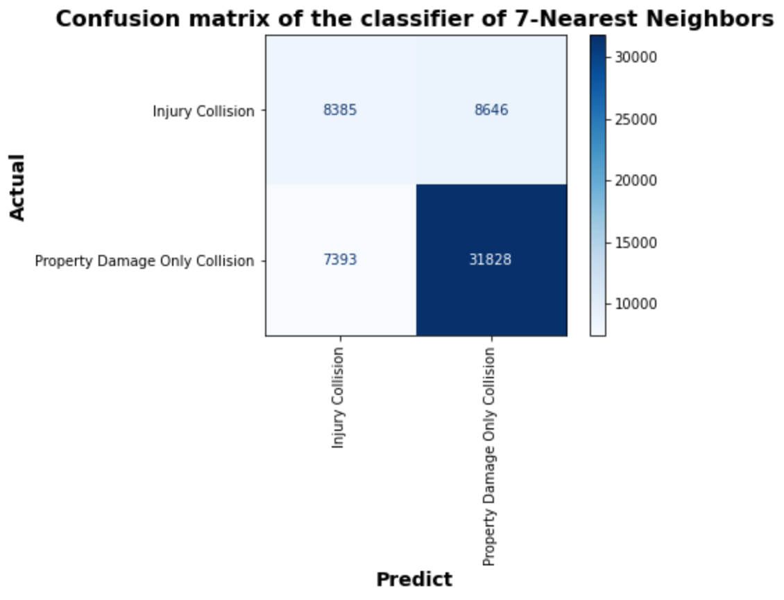
Classification models
The accuracy of 6 models are between 0.6207 - 0.7479.
The F1-Score of 6 models are between 0.6317 - 0.7116.
The highest accuracy is for SVM.
The highest F1-Score is for 7-Nearest Neighbours.

Slide 10
Conclusion and future
Useful models are built to predict severity of accidents.
The accuracy and F1-score for Models could be improved by add more data to built balanced dataset.

