Slide 1
Understanding Recommender Systems
In today's world of endless choices, people often feel overwhelmed when selecting movies, products, or music. Recommender systems solve this problem by providing personalized suggestions based on individual preferences and behaviors.
These intelligent systems analyze user data to predict what you might like next, creating a tailored experience that cuts through the noise of too many options. Whether you're shopping online, streaming media, or browsing social networks, recommendation engines are quietly guiding your journey.
Muhammad Saeed

Slide 2
What Are Recommender Systems?
Definition
Purpose
Function
Information filtering systems that predict user preferences and ratings for items they haven't yet considered.
Help users navigate overwhelming choices by providing personalized suggestions based on their unique preferences.
Analyze user data including past purchases, reviews, and browsing history to identify patterns and make relevant recommendations.

Slide 3
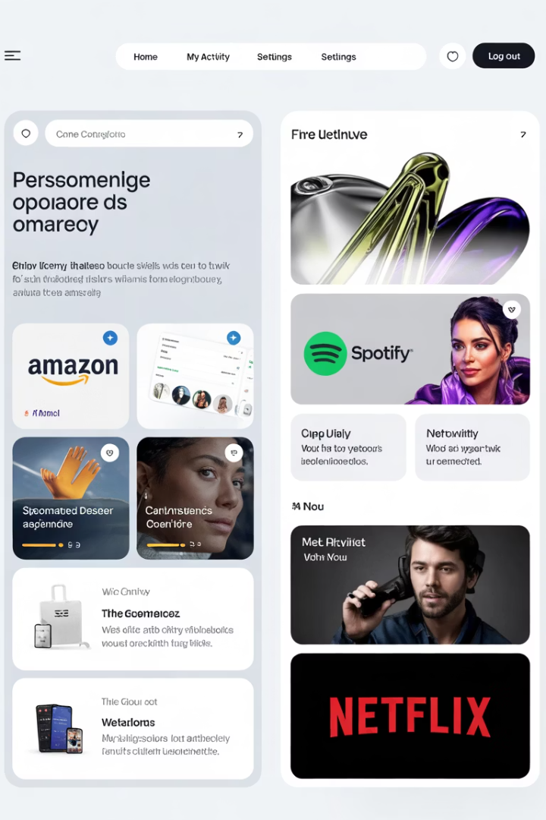



Common Examples in Daily Life
E-commerce
Music Streaming
Video Streaming
Amazon recommends products based on your browsing and purchase history, showing items that complement your interests and previous buys.
Spotify suggests songs and artists based on your listening patterns, creating personalized playlists that match your musical taste.
Netflix recommends movies and TV series based on your watching history, helping you discover new content aligned with your preferences.

Slide 4






Three Main Recommendation Methodologies
Hybrid Systems
Combining multiple approaches
Content-based Filtering
Based on item attributes
Collaborative Filtering
Based on user similarities
Each methodology offers unique strengths in generating recommendations. Collaborative filtering leverages user behavior patterns, content-based filtering focuses on item characteristics, while hybrid systems combine these approaches to overcome individual limitations and provide more robust suggestions.

Slide 5
Collaborative Filtering Explained
What It Is
How It Works
Collaborative filtering predicts what users might like based on preferences of similar users. It operates on the principle that people who agreed in the past will likely agree in the future.
The system analyzes user interactions and identifies similarities between individuals (user-based) or objects (item-based). It then uses these patterns to make predictions about what a user might enjoy next.
For example, if User A and User B both enjoy the same movies, User A might like other films that User B enjoys, even without analyzing the movie content itself.
This approach is particularly powerful because it can discover complex preference patterns that might not be obvious from item attributes alone.

Slide 6
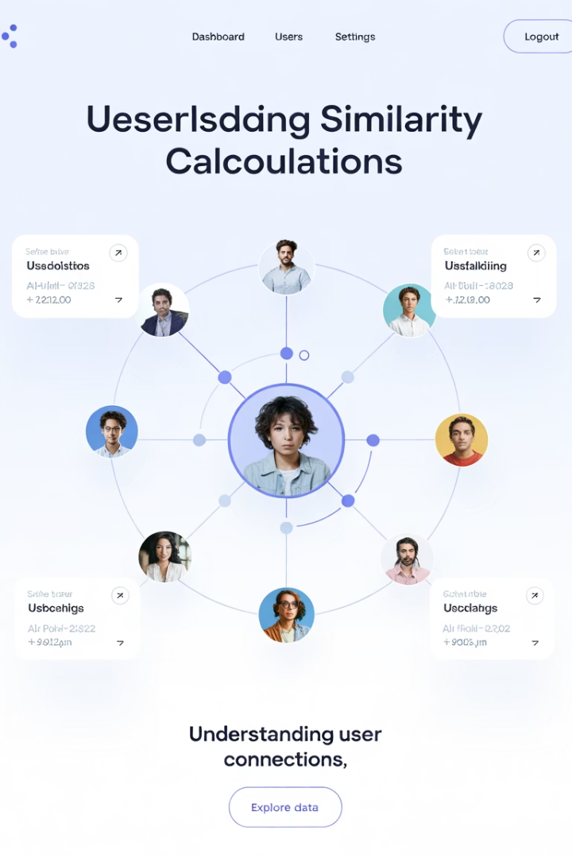
User-based Collaborative Filtering
Finding User Similarities
The system identifies users with similar preferences to the target user by analyzing ratings given to common items. This creates a "neighborhood" of like-minded users.
Weighting Similar Users
Ratings from users who are more similar to the target user receive higher weight in the recommendation algorithm, ensuring more relevant suggestions.
Predicting Missing Ratings
Using weighted average methods, the system predicts how the target user would rate items they haven't yet encountered based on ratings from similar users.

Slide 7




Item-based Collaborative Filtering
Calculate Item Similarity
Determine how similar items are to each other using methods like cosine similarity, creating an item-to-item similarity matrix.
Analyze User History
Examine items the user has previously rated or interacted with to establish their preference patterns.
Compute Predictions
Generate ratings for new items using a weighted sum of the user's ratings for similar items they've already rated.
Recommend Similar Items
Present the user with items most similar to those they've positively rated in the past.

Slide 8



Content-based Filtering
Item Attributes Focus
User Profile Creation
Feature Matching
Content-based filtering recommends items similar to those a user has previously liked, based on the inherent characteristics of the items themselves rather than user behavior.
The system builds a profile of user preferences based on the attributes of items they've interacted with, creating a feature-based representation of their tastes.
New items are recommended by matching their attributes to the user's preference profile, using techniques like vector space models and classification algorithms.

Slide 9
Content-based Implementation Methods
Vector Space Method
Classification Models
Items and users are represented as vectors in a multi-dimensional feature space. The similarity between a user and an item is calculated using statistical metrics like dot product, which reflects how many features they share.
Machine learning algorithms like decision trees analyze item features to classify them according to user preferences. These models learn to predict whether a user will like an item based on its attributes.
This approach is particularly effective for capturing complex relationships between item features and user preferences.
A high dot product suggests more common features, resulting in a higher similarity score and stronger recommendation.

Slide 10








Hybrid Recommendation Systems
Combine Approaches
Analyze New Users
Integrate collaborative and content-based methods to leverage strengths of each
Start with content-based filtering for users with limited history
Incorporate Interaction Data
Refine Recommendations
Continuously improve suggestions using combined insights
Gradually integrate collaborative filtering as more user data becomes available

Slide 11



How Recommendation Systems Work
Build User Profiles
Collect explicit data (ratings, reviews) and implicit data (browsing history, clicks)
Create Item Profiles
Catalog item attributes (genre, actors, keywords for movies)
Apply Recommendation Algorithms
Use matrix factorization or deep learning to identify patterns
The recommendation process involves sophisticated data analysis that transforms raw user interactions and item characteristics into personalized suggestions. These systems continuously learn and adapt as they gather more information about user preferences and behaviors.

Slide 12
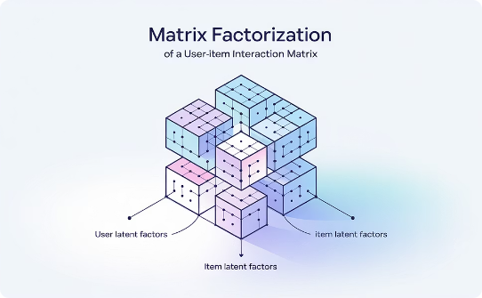


Matrix Factorization in Recommender Systems
Decomposition Process
Latent Factor Mapping
Prediction Generation
Matrix factorization breaks down the large user-item interaction matrix into smaller matrices representing latent factors. These factors capture underlying patterns in user preferences that might not be immediately obvious.
Users and items are mapped to the same latent feature space, allowing the system to identify relationships between them based on these hidden factors rather than explicit ratings alone.
The system generates predictions by calculating the dot product of user and item vectors in the latent space, effectively measuring their compatibility based on these underlying factors.

Slide 13




Deep Neural Network Models
Autoencoders
Deep Neural Networks (DNNs)
Neural networks that learn efficient representations of user preferences by compressing them into a smaller latent space and then reconstructing the original preferences, capturing complex patterns in the process.
Multiple layers of interconnected neurons transform input data into higher-level representations, modeling intricate relationships between users and items by considering various features and historical interactions.
Convolutional Neural Networks (CNNs)
Recurrent Neural Networks (RNNs)
Primarily used for image and video processing, CNNs extract high-level features from visual content to recommend similar items based on visual similarity rather than just metadata.
Designed for sequential data, RNNs model temporal dependencies in user behavior to provide recommendations based on the sequence of actions, ideal for session-based recommendations.

Slide 14
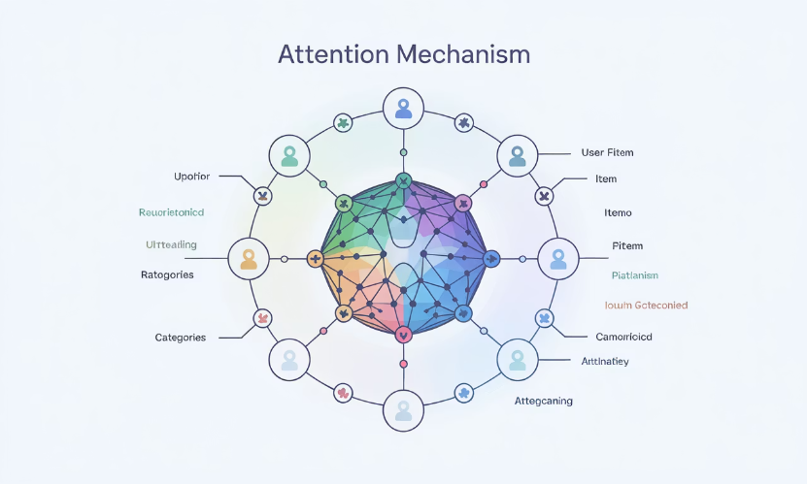
Attention Mechanisms in Recommender Systems
Dynamic Feature Weighting
Attention mechanisms allow models to focus on the most relevant parts of the input data by dynamically weighting different features or interactions. This mimics how humans pay attention to certain aspects of information while ignoring others.
In recommendation systems, these mechanisms identify and prioritize the features or interactions that most strongly influence a user's preferences, leading to more accurate predictions.
By concentrating on the crucial parts of the input, attention mechanisms help models make more nuanced recommendations that better reflect user interests and behaviors.

Slide 15
Business Importance of Recommender Systems
35%
75%
60%
Revenue Increase
Netflix Views
User Engagement
Average boost in sales from personalized recommendations
Percentage of Netflix viewing driven by recommendations
Increase in click-through rates with personalized suggestions
Recommender systems have become essential business tools that significantly boost revenue through personalized suggestions. By helping users discover relevant products and content, these systems increase conversion rates, customer satisfaction, and overall engagement with digital platforms.

Slide 16








Benefits for Users and Businesses
Personalized Experience
Increased Engagement
Creates tailored interactions that increase satisfaction
Keeps users active and interested in the platform
Faster Decision-making
Higher Conversion
Reduces choice paralysis by presenting relevant options
Boosts purchase likelihood through relevant suggestions

Slide 17
Challenges in Recommendation Systems
Cold Start Problem
Difficulty in making recommendations for new users or items with limited interaction history
Filter Bubbles
Risk of trapping users in an echo chamber of similar content, limiting discovery
Data Sparsity
Most users interact with only a small fraction of available items, creating sparse datasets
Scalability
Processing millions of users and items requires efficient algorithms and infrastructure
Privacy Concerns
Balancing personalization with user privacy and data protection regulations

Slide 18




Future Trends in Recommendation Systems
Context-Aware
Incorporating situational factors like time, location, and device
Explainable AI
Transparent recommendations with clear reasoning
Federated Learning
Privacy-preserving models trained across distributed devices
Multimodal Systems
Combining text, image, audio, and behavioral data

Slide 19
Key Takeaways
Diverse Approaches
Advanced Technologies
Recommendation systems employ collaborative filtering, content-based filtering, and hybrid approaches to generate personalized suggestions based on different data sources and methodologies.
Deep learning models like autoencoders, CNNs, RNNs, and attention mechanisms are revolutionizing recommendation systems by capturing complex patterns in user behavior and item features.
Business Critical
Evolving Field
These systems have become essential for digital platforms, enhancing user experiences, driving engagement, and providing significant business value through increased conversions and customer satisfaction.
The future of recommendation systems lies in context-awareness, explainability, privacy preservation, and multimodal approaches that combine diverse data types for even more relevant suggestions.

