Slide 1
Introduction to Natural Language Processing (NLP)
Natural Language Processing (NLP) is a field of Artificial Intelligence that teaches computers to understand, read, write, and speak human languages like English, Urdu, or Chinese.
In our daily lives, we interact with NLP through various applications such as ChatGPT, Google Translate, voice assistants like Siri or Alexa that understand our commands, and even Gmail's spam detection system.
This presentation will explore the fundamentals of NLP, its components, applications, and the techniques used to process and understand human language.

Slide 2
Syntax, Semantics, Pragmatics, and Discourse
Syntax
Semantics
Rules of grammar that tell how words are arranged to form correct sentences. For example, "She eat apple" is incorrect, while "She eats an apple" follows proper syntactic rules.
The meaning of words and sentences. For instance, the phrase "He kicked the bucket" semantically means "he died" rather than literally kicking a physical bucket.
Pragmatics
Discourse
The meaning based on context or situation. When someone asks "Can you open the window?", pragmatically it's a request to open the window, not a question about your ability.
How sentences connect in longer texts or conversations, such as storytelling or maintaining a conversation flow between speakers.

Slide 3




NLP Curves and Future Directions
1950s: Rule-based Systems
Early NLP relied on handcrafted rules and dictionaries.
1990s: Statistical Methods
Shift to probability and corpus-based approaches.
2010s: Neural Networks
Deep learning revolutionized NLP performance.
2020s: Deep Learning Models
Transformer architectures like GPT and BERT dominate.
Future directions in NLP include better understanding of emotions and cultural contexts, improved support for low-resource languages (regional dialects), and development of safer and fairer AI language models that reduce bias and harmful outputs.

Slide 4
Data Preprocessing for NLP
Raw Text Collection
Gather unstructured text data from various sources like websites, documents, or social media.
Text Cleaning
Remove irrelevant information, fix formatting issues, and standardize text structure.
Text Transformation
Convert cleaned text into a format suitable for machine learning algorithms.
Before using text for AI, it must be cleaned and prepared. Raw text is like a messy room — we need to tidy it up first! This preprocessing stage is crucial as the quality of your NLP model depends heavily on how well the input data is prepared.

Slide 5
Introduction to NLTK and SpaCy
NLTK (Natural Language Toolkit)
SpaCy
A comprehensive Python library designed for processing text and language analysis. It's particularly well-suited for learning and research purposes, offering a wide range of tools and resources.
A more modern, faster, and more powerful NLP library optimized for production use. It's designed to be used in real-world applications and companies where performance matters.
NLTK includes corpora, lexical resources like WordNet, and text processing libraries for classification, tokenization, stemming, tagging, and parsing.
SpaCy offers pre-trained models, efficient tokenization, part-of-speech tagging, named entity recognition, and dependency parsing with a focus on speed and practical applications.
Both libraries are imported in Python with simple commands: import nltk for NLTK and import spacy for SpaCy.

Slide 6



Noise Removal (Stopwords, Punctuation, etc.)
Stopwords Removal
Punctuation Removal
Numbers and Special Characters
Common words like "the", "is", "a", etc. that appear frequently but add little meaning to the analysis. These are typically filtered out to reduce noise and focus on meaningful content.
Removing punctuation marks like periods, commas, and exclamation points that may interfere with text analysis unless specifically needed for sentiment analysis.
Depending on the application, numbers and special characters might be considered noise and removed to simplify text processing.
In NLTK, stopwords can be accessed using: from nltk.corpus import stopwords followed by stopwords.words('english') to get a list of English stopwords.

Slide 7








Word and Sentence Tokenization
Raw Text
Sentence Tokenization
Unprocessed text document or string
Split text into individual sentences
Further Processing
Word Tokenization
Analyze tokens for NLP tasks
Split sentences into individual words
Tokenization is the process of splitting text into smaller pieces (tokens) such as words or sentences. This is a fundamental step in NLP that prepares text for further analysis.
In NLTK, you can tokenize text using: from nltk.tokenize import word_tokenize, sent_tokenize. For example, word_tokenize("AI is amazing!") produces ['AI', 'is', 'amazing', '!'].

Slide 8



Word Segmentation
Unsegmented Text
Segmentation Algorithm
Segmented Words
Raw string without word boundaries
Apply language-specific rules
Individual words identified
Word segmentation is the process of splitting a string of characters into individual words. This is particularly important for languages like Chinese, Japanese, or Thai that don't use spaces between words.
For example, the Chinese text "我喜欢你" (I like you) needs to be segmented into the individual words "我" (I), "喜欢" (like), and "你" (you) for proper processing and understanding.

Slide 9



Stemming
Word Variants
running, runs, runner
Stemming Process
Remove suffixes
Root Form
run
Stemming is the process of cutting words down to their root form by removing suffixes. This helps in treating different forms of the same word as a single item, reducing the vocabulary size and simplifying text analysis.
In NLTK, the Porter Stemmer is commonly used: from nltk.stem import PorterStemmer followed by ps = PorterStemmer(). Then ps.stem("running") would return "run".
Note that stemming can sometimes produce non-dictionary words, as it follows algorithmic rules rather than linguistic ones.

Slide 10




Text Normalization
Lowercase Conversion
Whitespace Removal
Spelling Correction
Format Standardization
Convert all text to lowercase to ensure consistency (e.g., "Hello" → "hello")
Remove extra spaces, tabs, and newlines to standardize spacing
Fix common misspellings to improve text quality
Standardize formats for dates, numbers, and other structured data
Text normalization is the process of converting text to a standard form to ensure consistency. This is crucial for effective text analysis as it reduces variations that don't add meaning.
A simple example in Python: text = "HELLO World!!" normalized to text.lower().strip() would produce 'hello world!!'

Slide 11
Regular Expressions for String Parsing
Pattern
Description
Example
\d+
One or more digits
Matches "123" in "abc123"
[A-Za-z]+
One or more letters
Matches "Hello" in "Hello123"
\w+
Word characters
Matches "Test_123" in "Test_123!"
\s+
Whitespace
Matches spaces between words
Regular expressions (regex) are special sequences of characters that define search patterns in text. They're powerful tools for finding, extracting, or replacing specific patterns within strings.
In Python, the re module provides regex functionality: import re followed by re.findall(r'\d+', "My phone number is 12345") would return ['12345'], extracting the numeric sequence.

Slide 12
POS Tagging (Part of Speech Tagging)
Part of Speech (POS) tagging is the process of labeling each word in a text with its grammatical role: noun, verb, adjective, adverb, etc. This helps computers understand the structure and meaning of sentences.
In NLTK, POS tagging is done with: nltk.pos_tag(word_tokenize("The dog runs fast")) which returns [('The', 'DT'), ('dog', 'NN'), ('runs', 'VBZ'), ('fast', 'RB')], where DT is determiner, NN is noun, VBZ is verb, and RB is adverb.
POS tagging is essential for many advanced NLP tasks like parsing, information extraction, and machine translation.

Slide 13
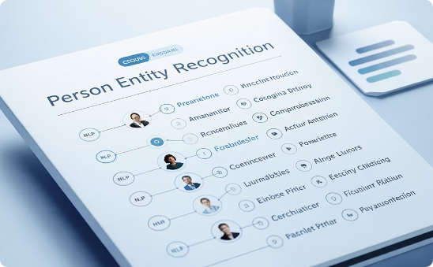

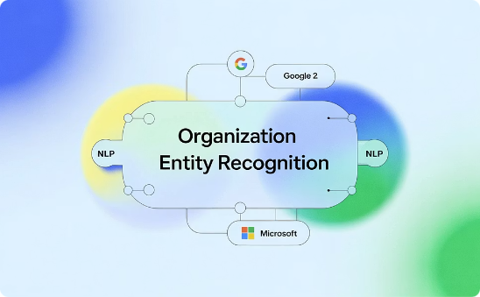
NER Tagging (Named Entity Recognition)
Person Entities
Location Entities
Organization Entities
Names of individuals (e.g., "Barack Obama", "Marie Curie")
Names of places (e.g., "Hawaii", "Paris", "Mount Everest")
Names of companies, agencies, institutions (e.g., "Google", "United Nations")
Named Entity Recognition (NER) identifies and classifies named entities in text into predefined categories such as people, organizations, locations, dates, and more. This helps extract structured information from unstructured text.
In SpaCy, NER is performed with: import spacy, nlp = spacy.load("en_core_web_sm"), doc = nlp("Barack Obama was born in Hawaii."), then [(ent.text, ent.label_) for ent in doc.ents] would identify "Barack Obama" as a person and "Hawaii" as a location.

Slide 14
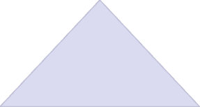





Chunking and Chinking
Full Text
Complete sentence or document
Chunks
Meaningful word groups
Phrases
Specific linguistic units
Chunking is the process of grouping words into meaningful phrases or "chunks" based on their part of speech tags. For example, identifying noun phrases like "the red car" or verb phrases like "is running quickly".
Chinking is the complementary process of removing certain words from chunks, allowing for more precise phrase extraction.
In NLTK, chunking is defined using grammar patterns like grammar = "NP: {
?*}" which identifies noun phrases consisting of an optional determiner, zero or more adjectives, and a noun.

Slide 15
Lemmatization
1
2
3
Input Word
Process
Output
"running" (verb form)
Apply linguistic rules
"run" (dictionary form)
Lemmatization is similar to stemming but produces real dictionary words (lemmas) by considering the word's part of speech and applying linguistic knowledge. While stemming might reduce "better" to "bett", lemmatization would correctly produce "good".
In NLTK, lemmatization is performed with WordNet Lemmatizer: from nltk.stem import WordNetLemmatizer, lemmatizer = WordNetLemmatizer(), then lemmatizer.lemmatize("running", pos="v") would return "run".
The pos parameter is important as it specifies the part of speech, allowing for more accurate lemmatization.

Slide 16


WordNet
Lexical Database
Synsets
Semantic Relations
A comprehensive dictionary containing words, their meanings, and relationships between words.
Groups of synonymous words that express the same concept, helping identify related terms.
Connections between words including hypernyms (is-a), hyponyms (types), meronyms (part-of), and antonyms.
WordNet is a lexical database for English that groups words into sets of synonyms (synsets), provides short definitions, and records various semantic relations between these synonym sets. It's like a dictionary and thesaurus combined, designed specifically for natural language processing.
In NLTK, WordNet is accessed with: from nltk.corpus import wordnet, then wordnet.synsets("happy") returns all synsets containing the word "happy".

Slide 17
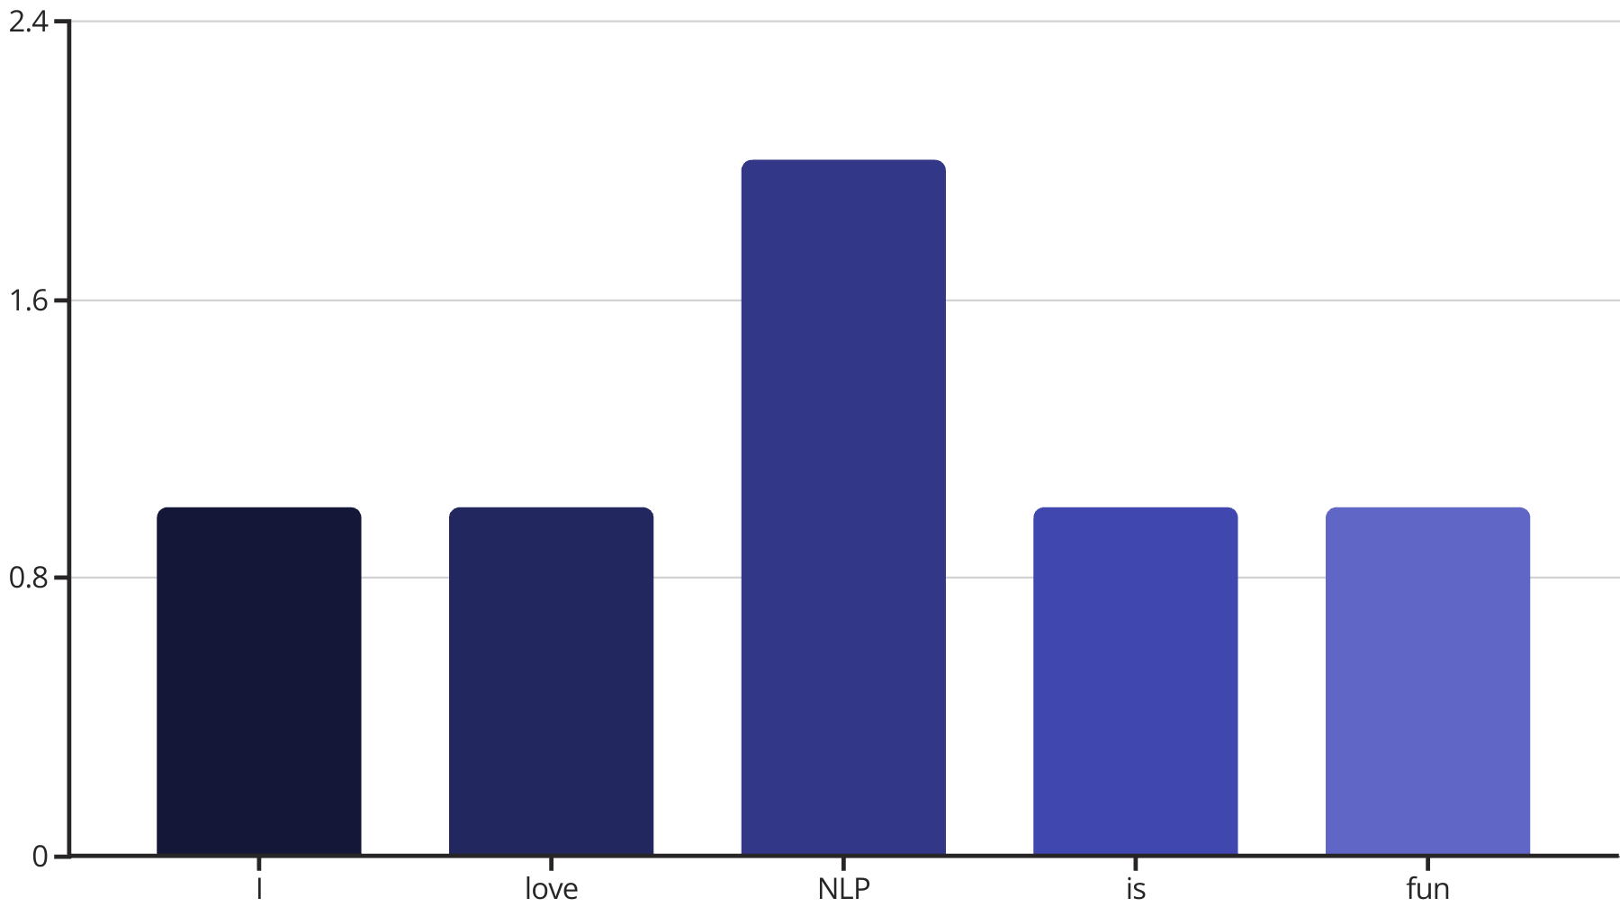
Words as Features (BoW Model)
The Bag of Words (BoW) model is a simple yet effective way to represent text as numerical features. It counts how many times each word appears in a document, creating a word frequency vector that machine learning algorithms can process.
In scikit-learn, BoW is implemented with CountVectorizer: from sklearn.feature_extraction.text import CountVectorizer, vectorizer = CountVectorizer(), X = vectorizer.fit_transform(["I love NLP", "NLP is fun"])
This approach ignores word order but captures the essential content of documents, making it useful for text classification and document similarity tasks.

Slide 18


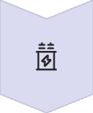

Feature Selection and Extraction
Raw Text Features
All words from the corpus
Feature Selection
Choose important words based on statistics
Feature Extraction
Create new features from existing ones
Optimized Feature Set
Reduced dimensionality, improved performance
Feature selection involves choosing the most important words or phrases from text, removing useless or rare words that add noise rather than signal. This helps models learn better and faster by focusing on meaningful features.
Common techniques include removing low-frequency terms, using statistical measures like chi-squared or information gain to identify discriminative features, and applying domain knowledge to select relevant terms.
Feature extraction creates new features from existing ones, often reducing dimensionality while preserving important information.

Slide 19
Document Similarity
Document similarity measures how alike two texts are, which is fundamental for many NLP applications. After converting documents to numerical vectors using techniques like BoW or TF-IDF, similarity can be calculated using various metrics.
In scikit-learn, cosine similarity is commonly used: from sklearn.metrics.pairwise import cosine_similarity to compare document vectors and determine their similarity.

Slide 20





Testing in NLP
Accuracy
Data Splitting
Percentage of correctly classified instances out of all instances.
Divide dataset into training (80%) and testing (20%) sets to evaluate model performance on unseen data.
Precision
Proportion of true positives among all positive predictions, measuring exactness.
F1-Score
Harmonic mean of precision and recall, providing a balanced measure.
Recall
Proportion of true positives identified among all actual positives, measuring completeness.
After training an NLP model, thorough testing is essential to evaluate its performance. The standard approach is to split data into training (80%) and testing (20%) sets using from sklearn.model_selection import train_test_split.
Multiple metrics provide a comprehensive view of model performance, as different applications may prioritize precision (minimizing false positives) or recall (minimizing false negatives) depending on their requirements.

