Slide 1
Rising Sun
Sports Facilities Management — Frontend prototype
Screen catalog · 9 May 2026

Slide 2
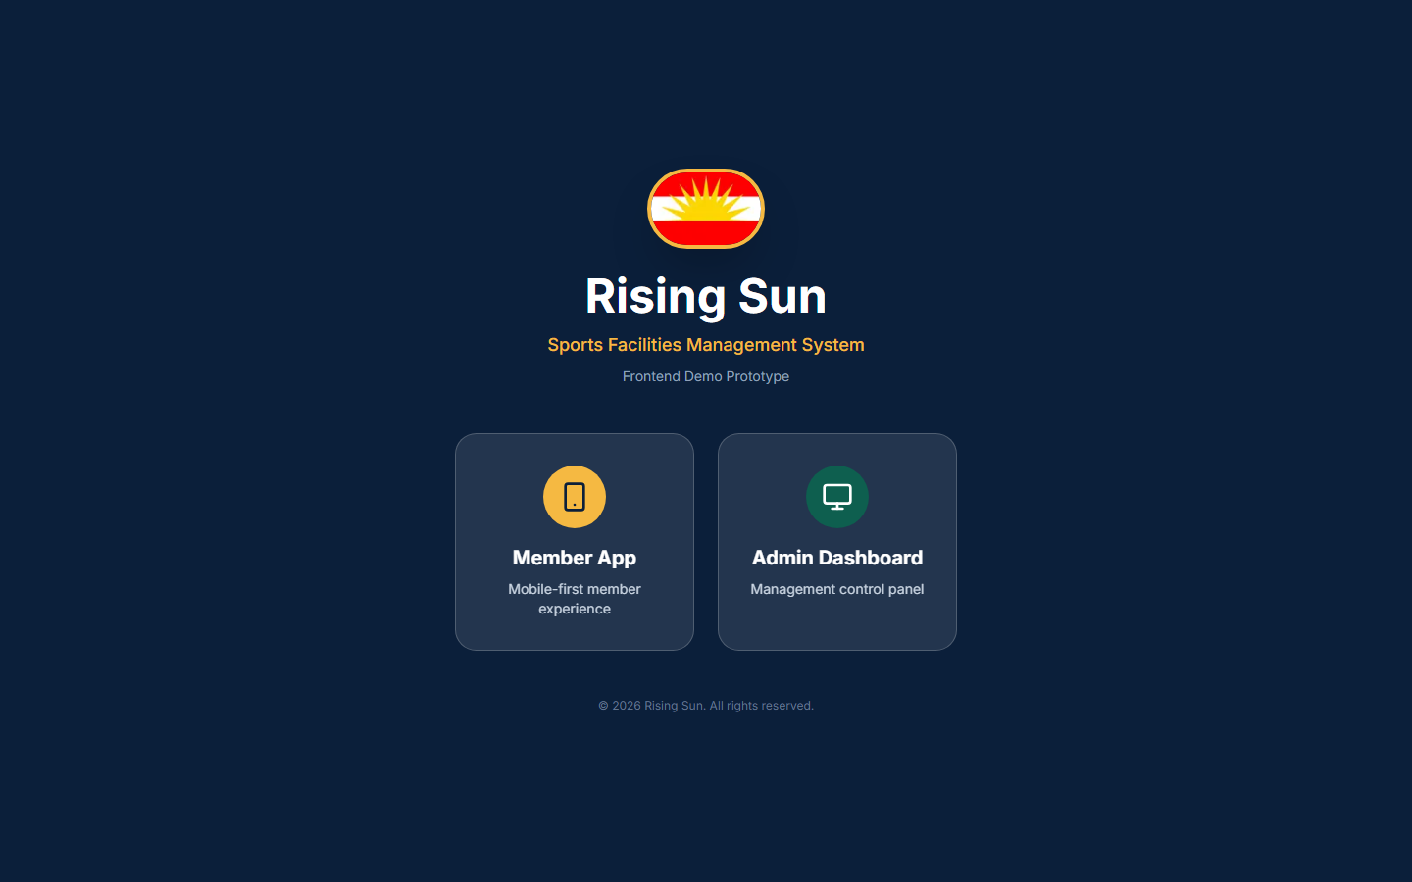
Landing — Choose Member App or Admin

Slide 3
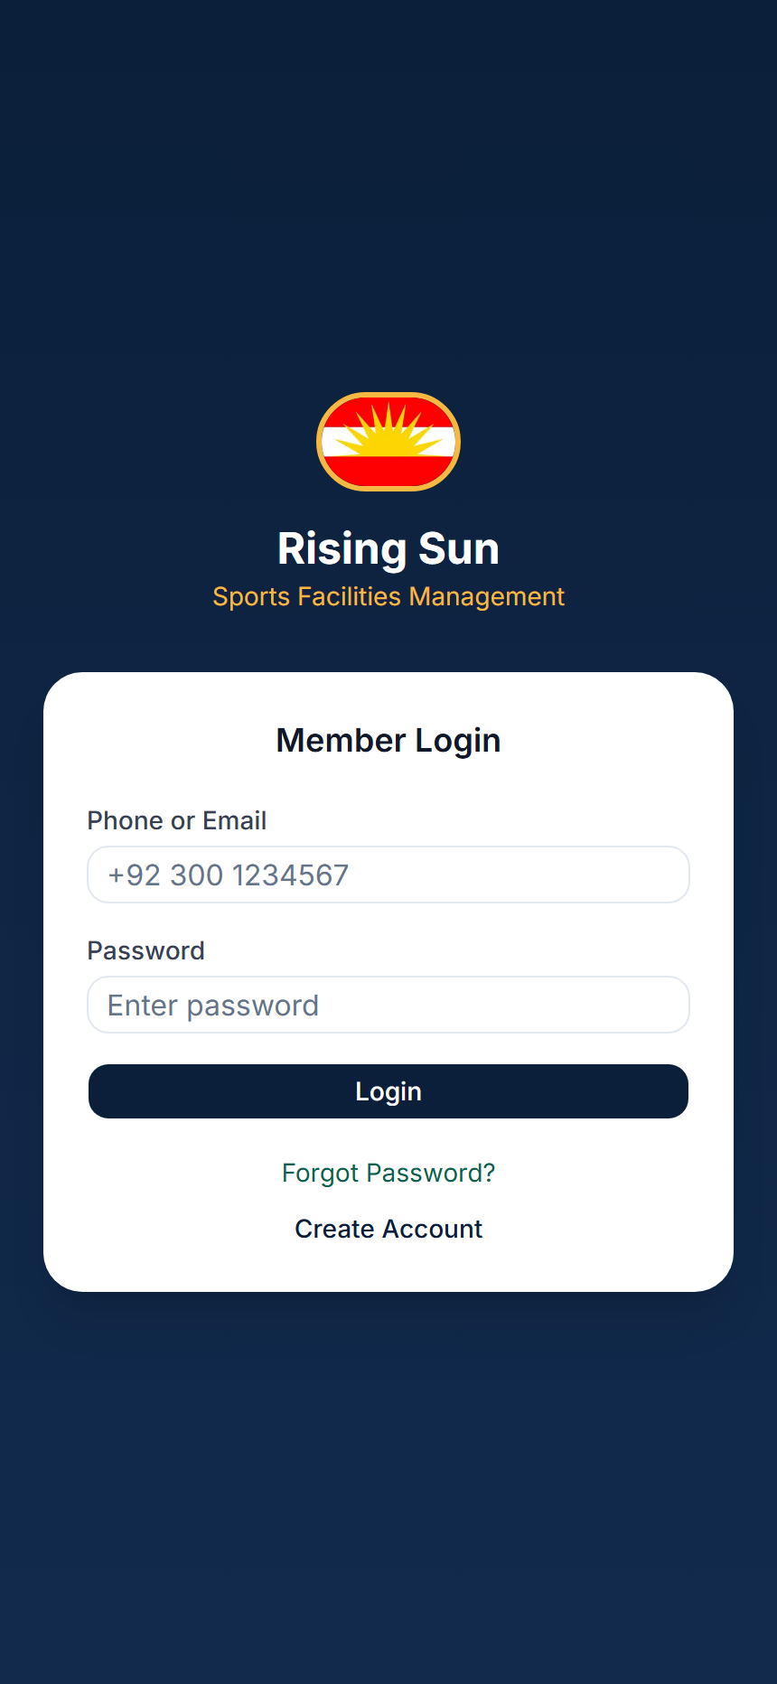
Member — Login

Slide 4
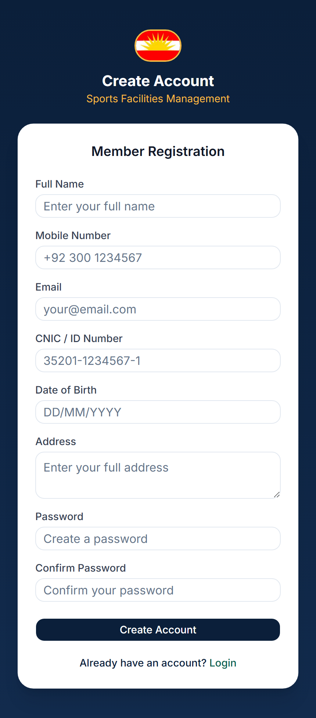
Member — Registration

Slide 5
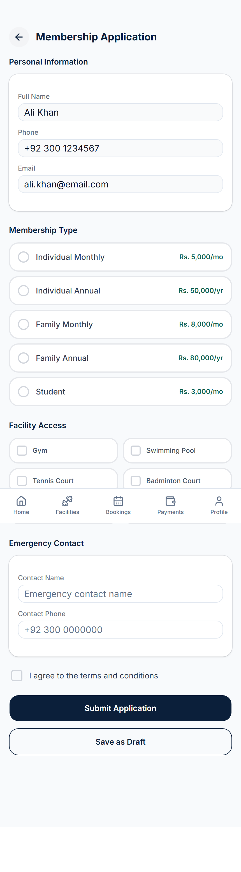
Member — Membership Application

Slide 6
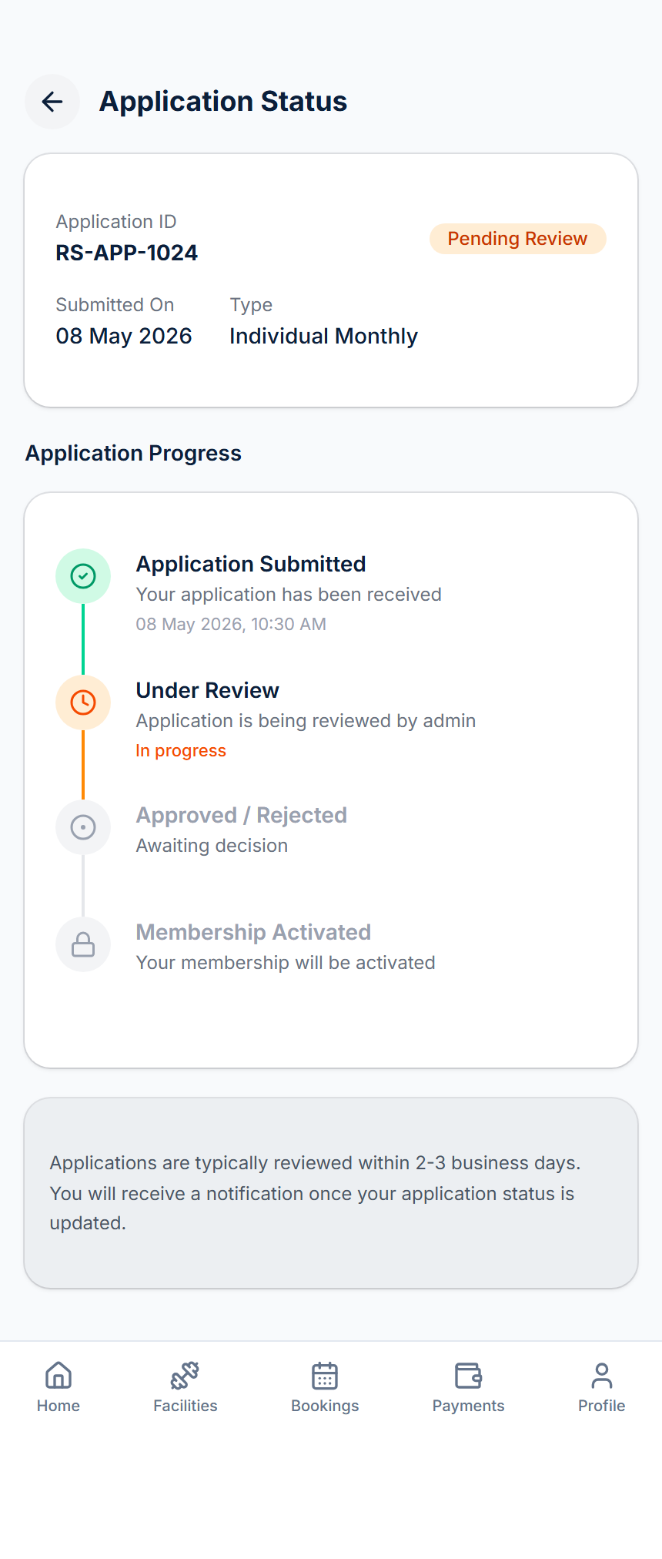
Member — Application Status

Slide 7
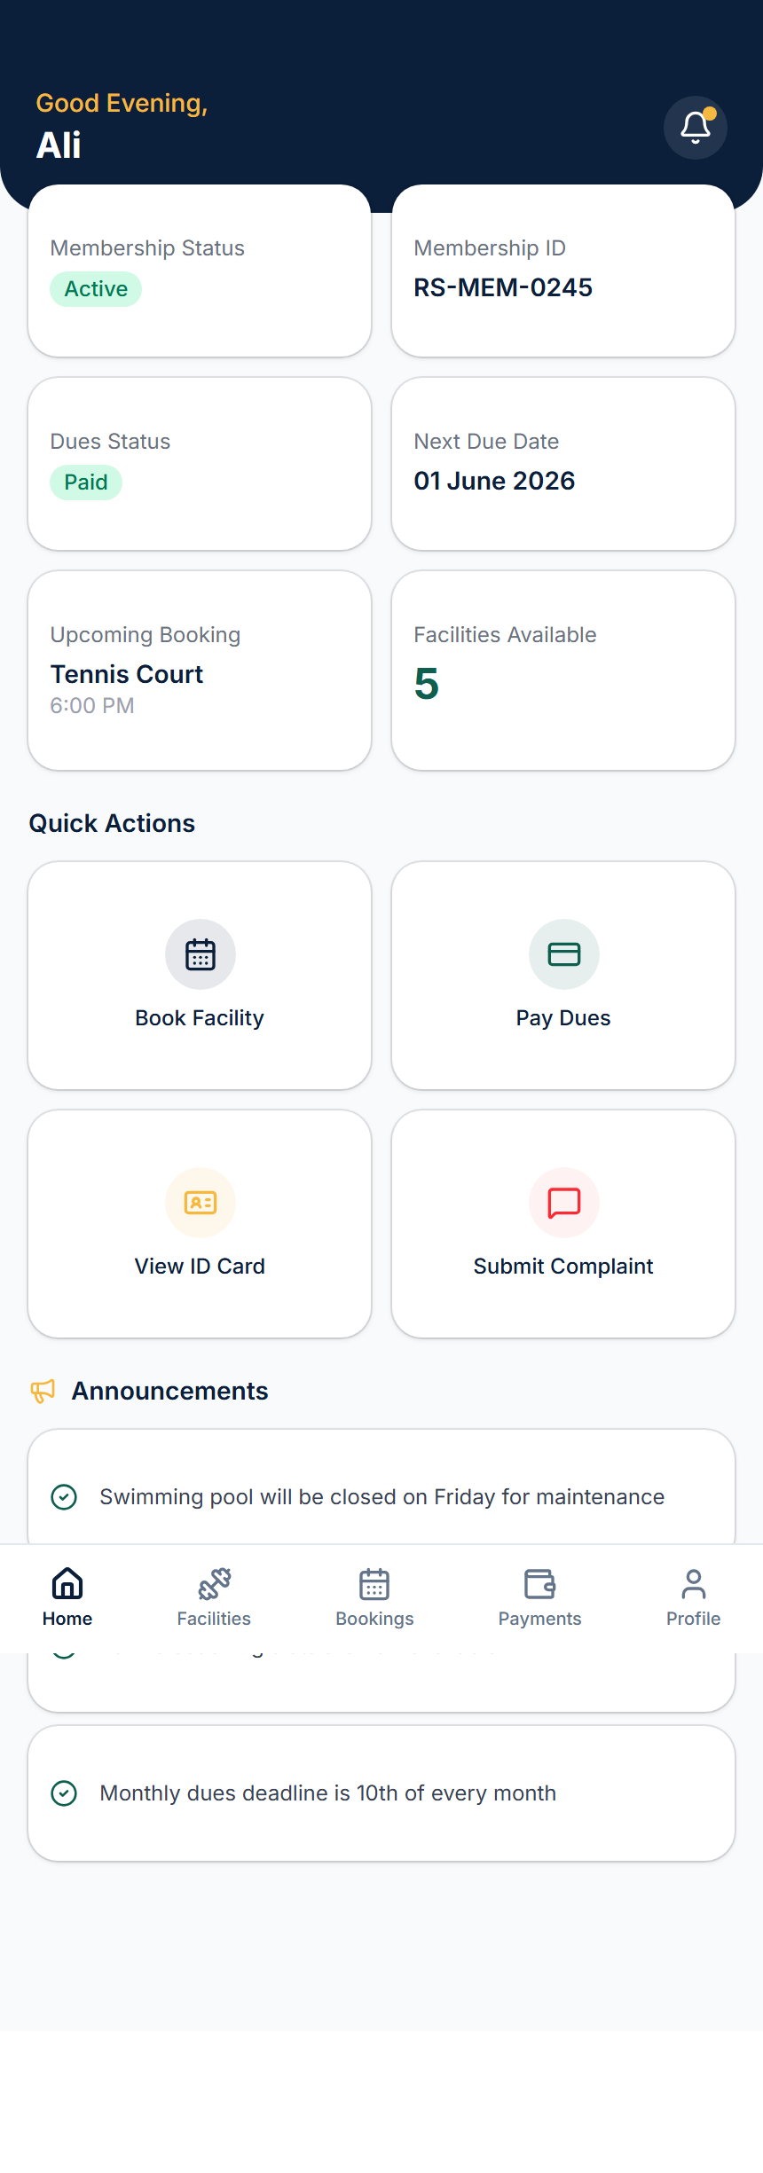
Member — Home

Slide 8
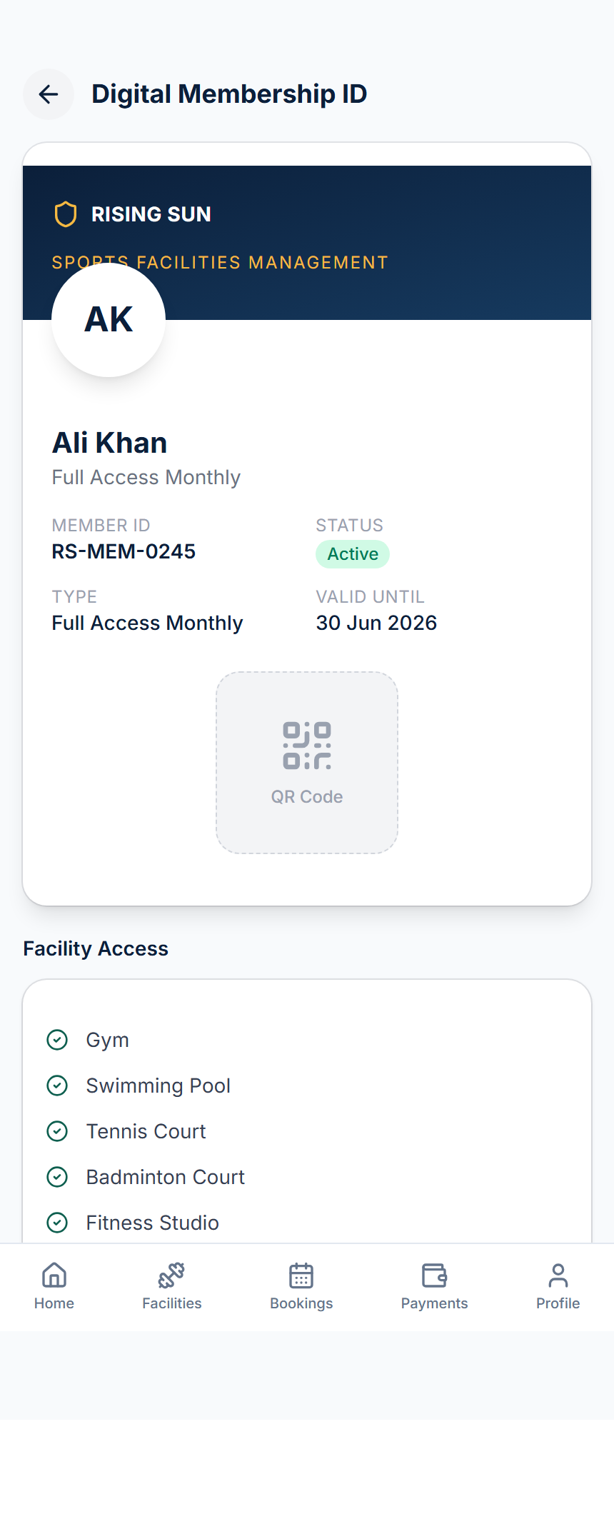
Member — Digital Membership ID

Slide 9
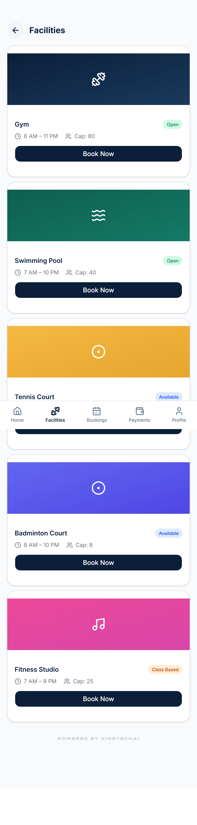
Member — Facilities List

Slide 10
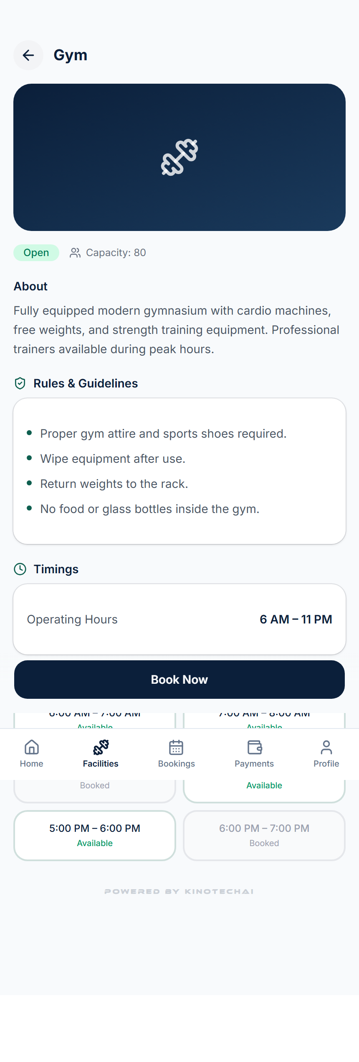
Member — Facility Detail (Gym)

Slide 11
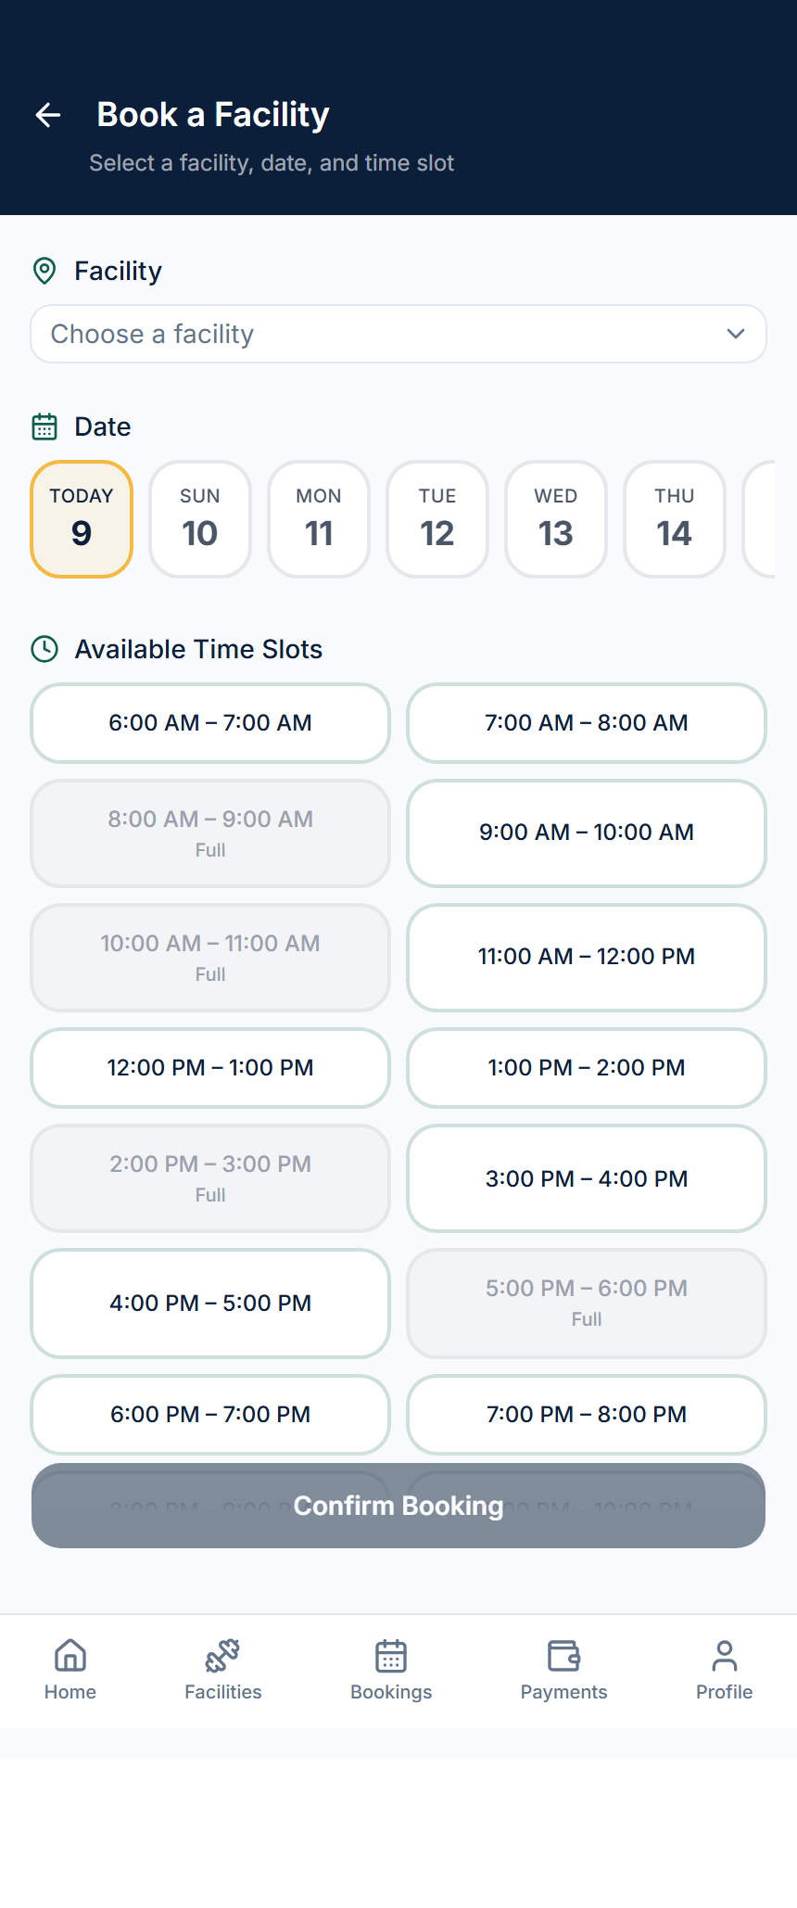
Member — Book Facility

Slide 12
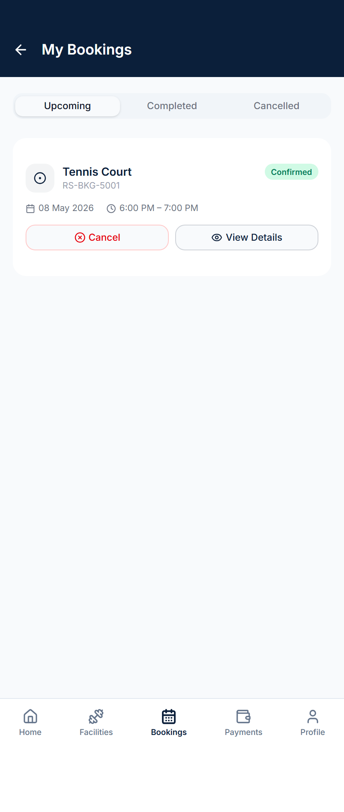
Member — My Bookings

Slide 13
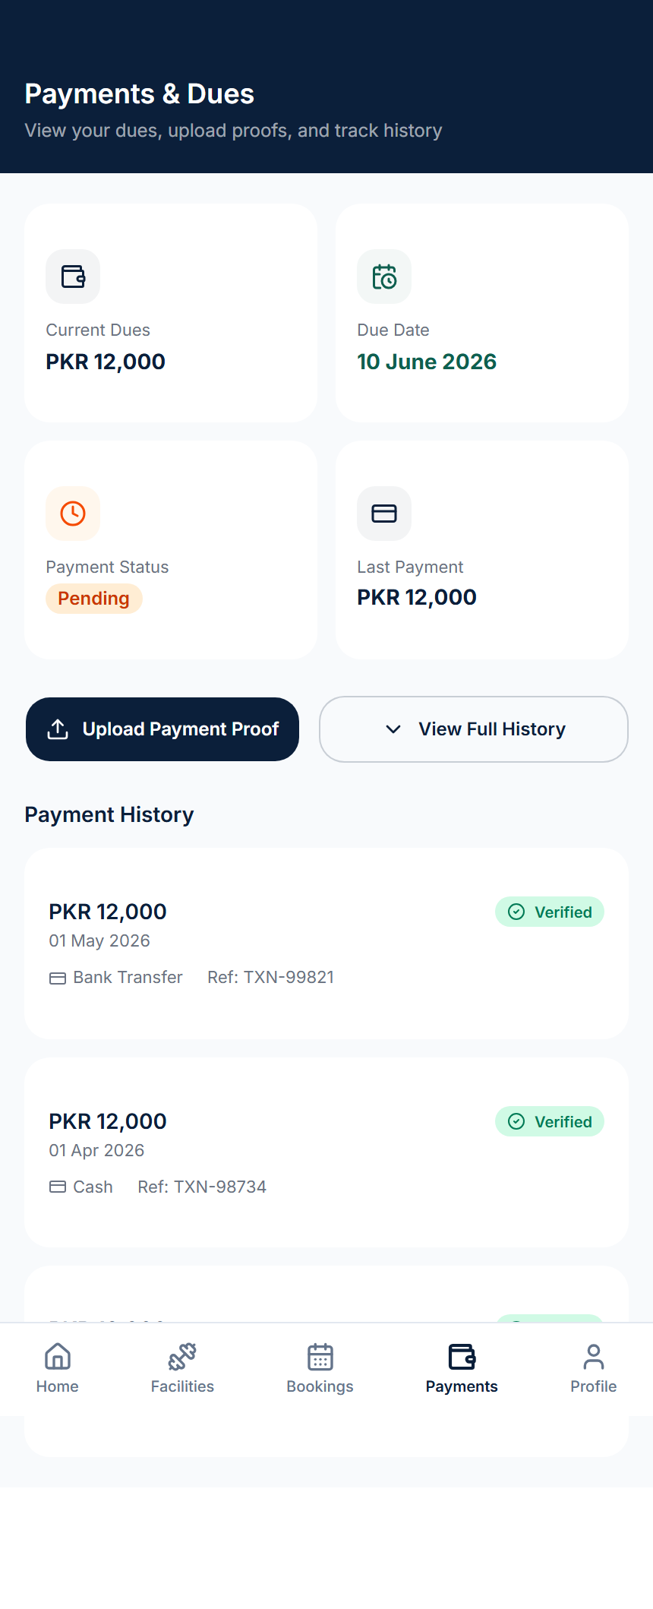
Member — Payments & Dues

Slide 14
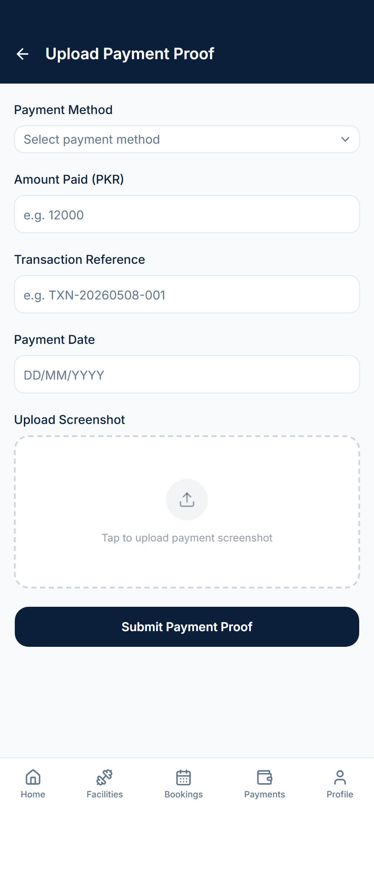
Member — Upload Payment Proof

Slide 15
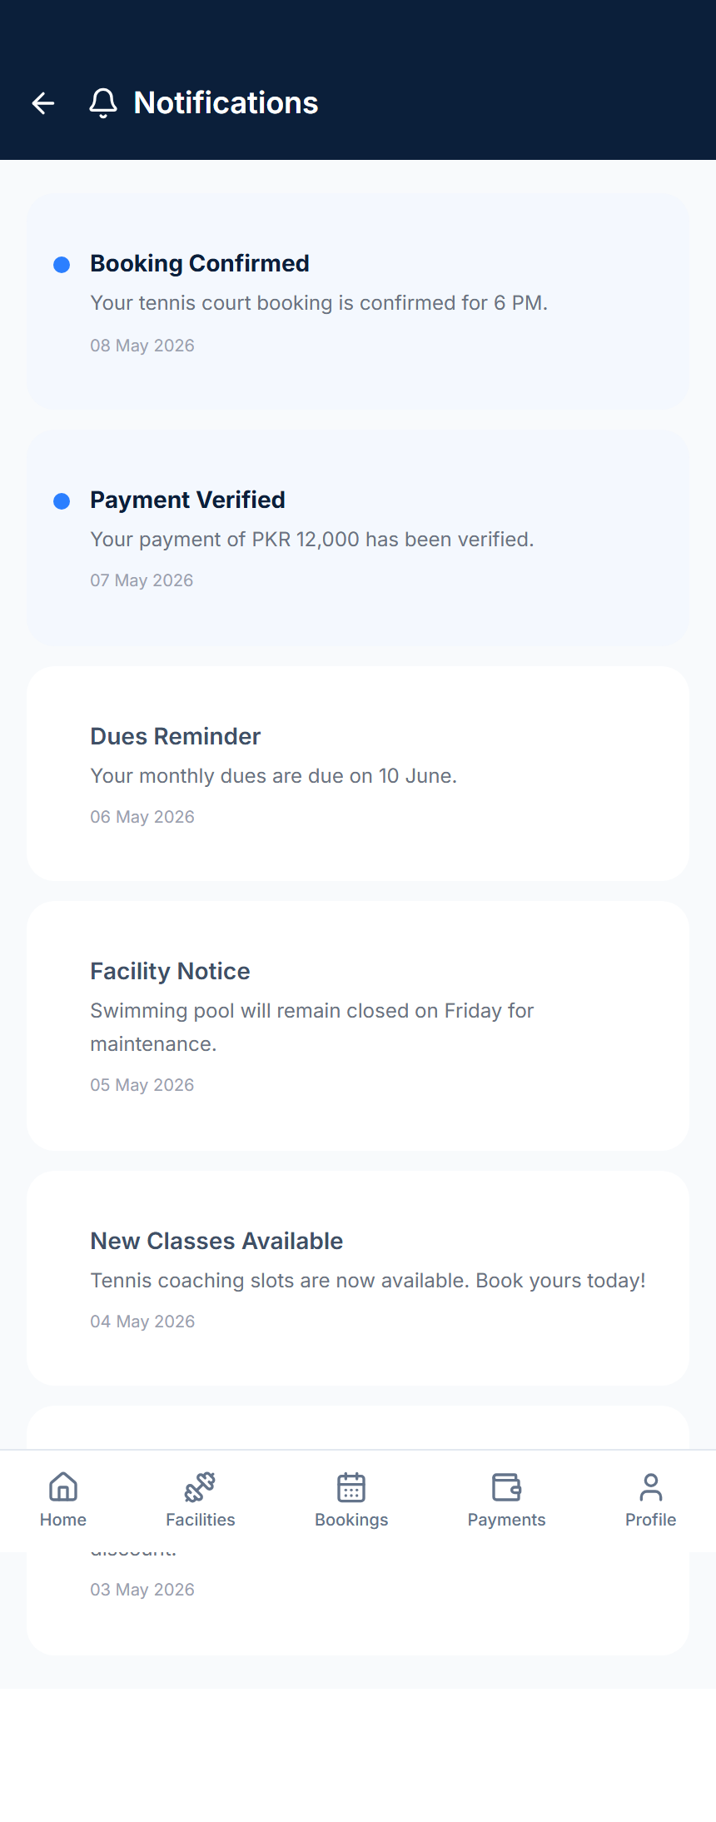
Member — Notifications

Slide 16
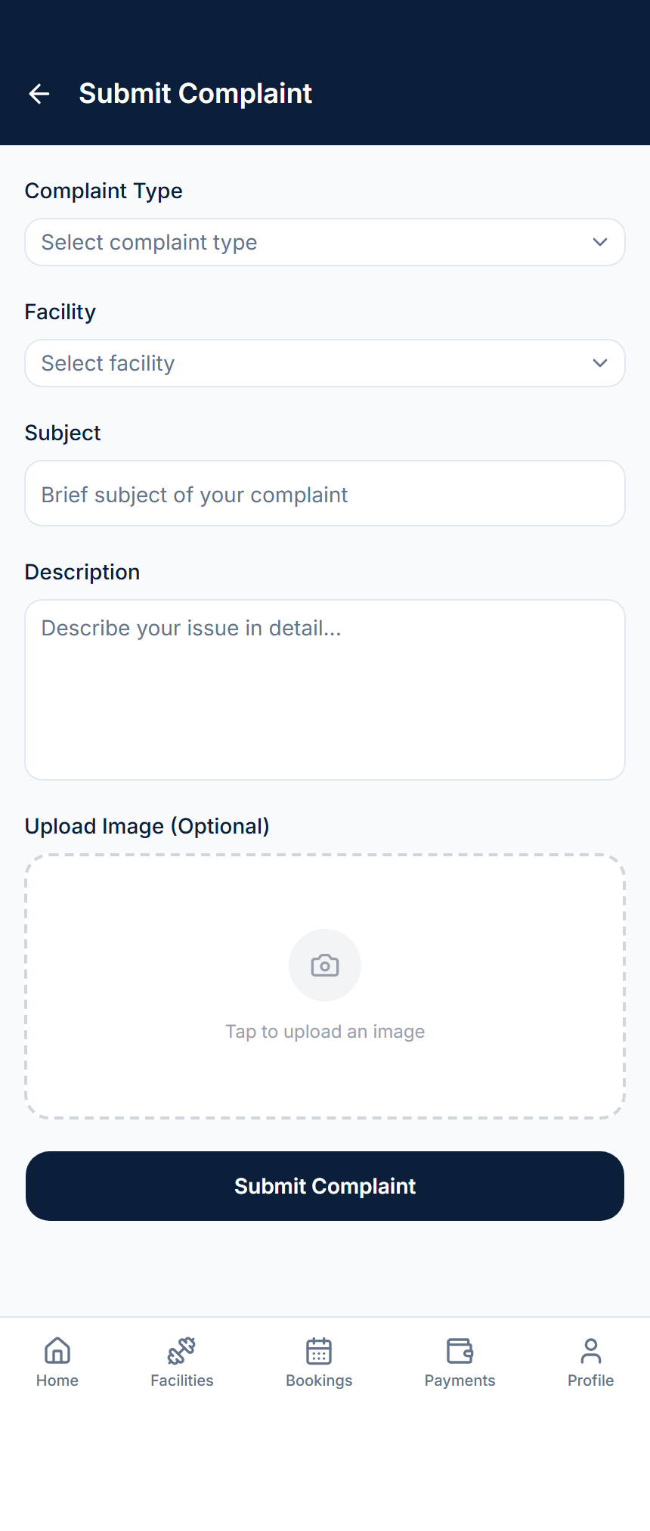
Member — Complaint / Feedback

Slide 17
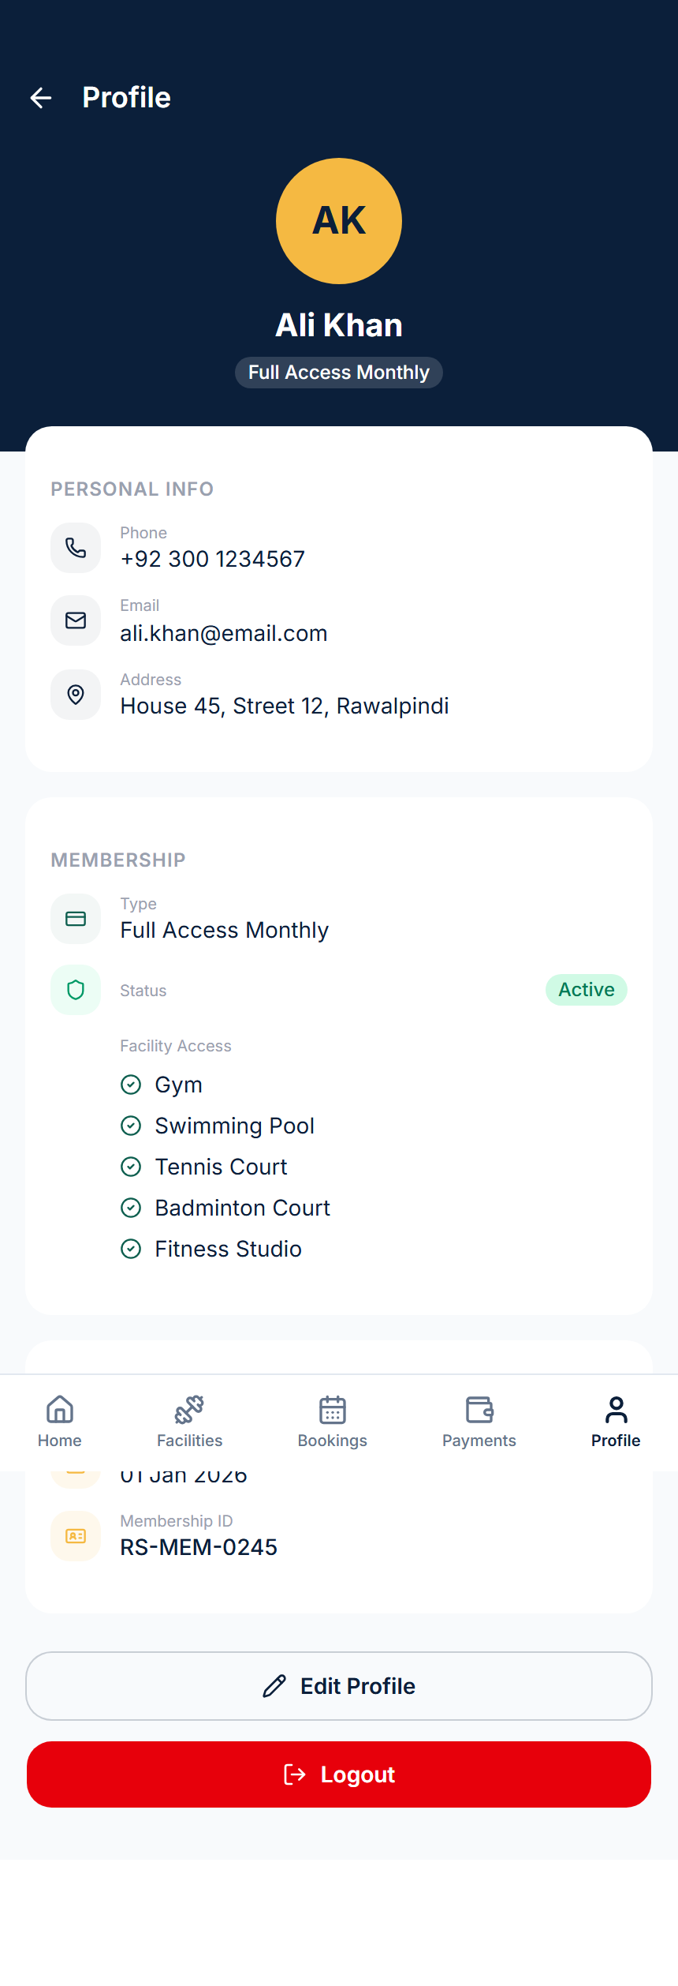
Member — Profile

Slide 18
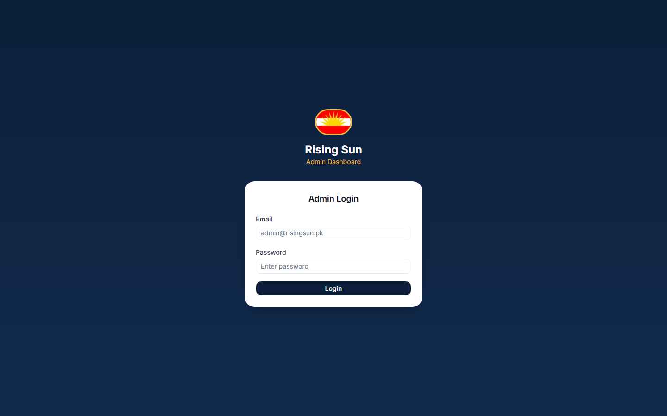
Admin — Login

Slide 19
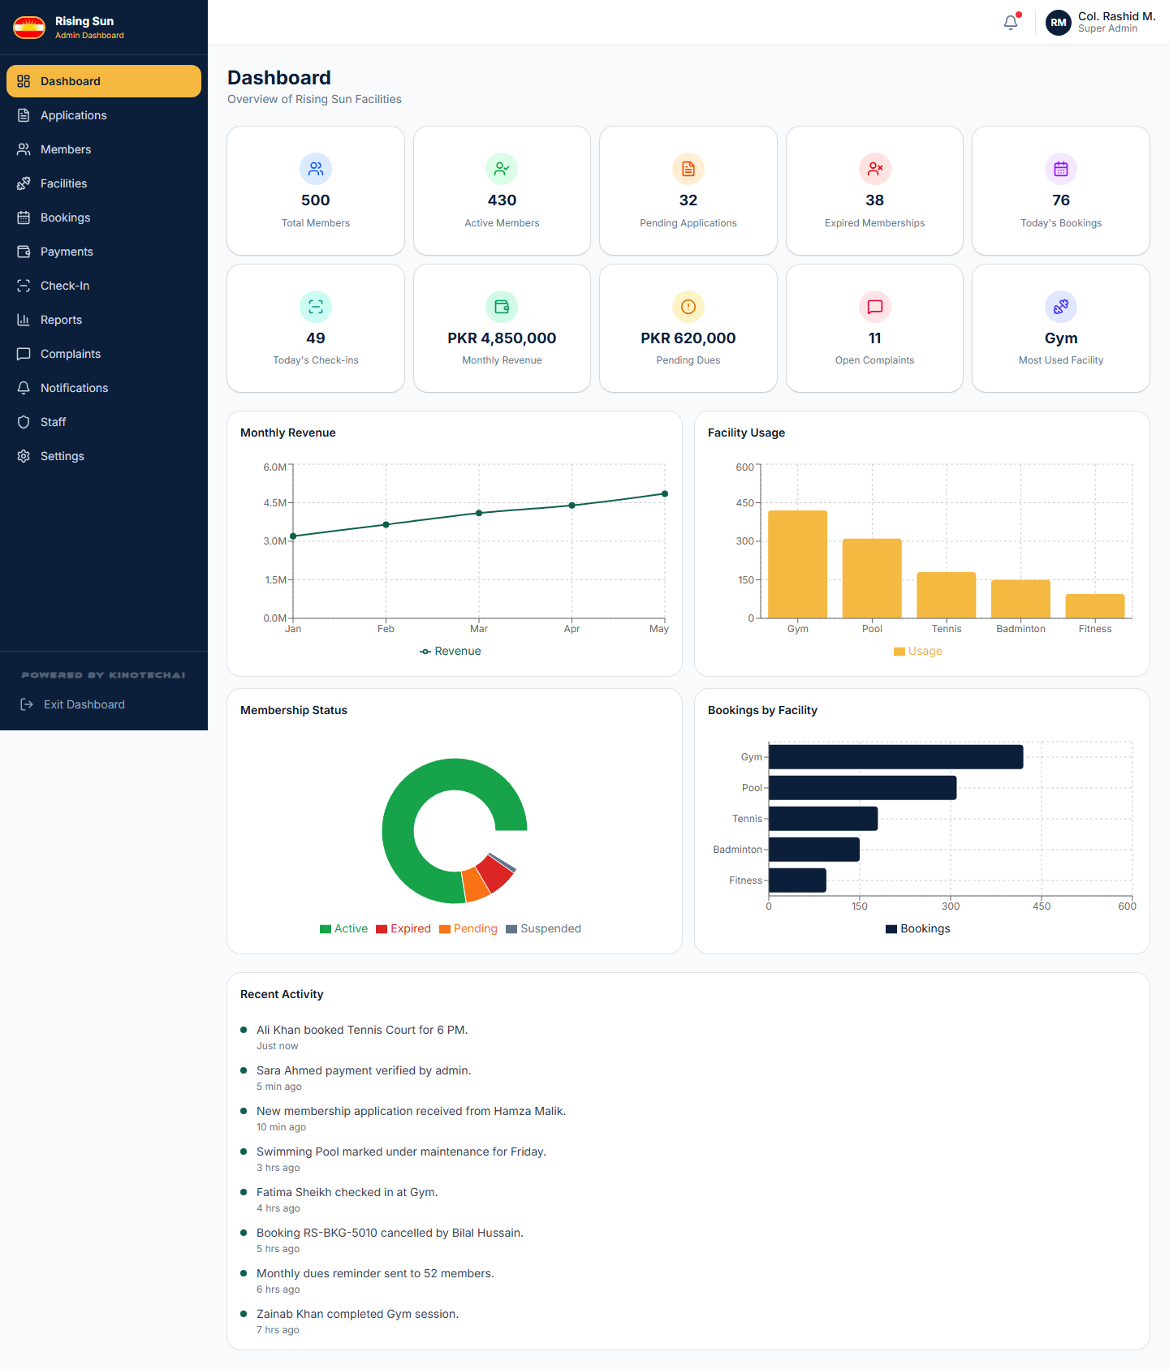
Admin — Dashboard Home

Slide 20
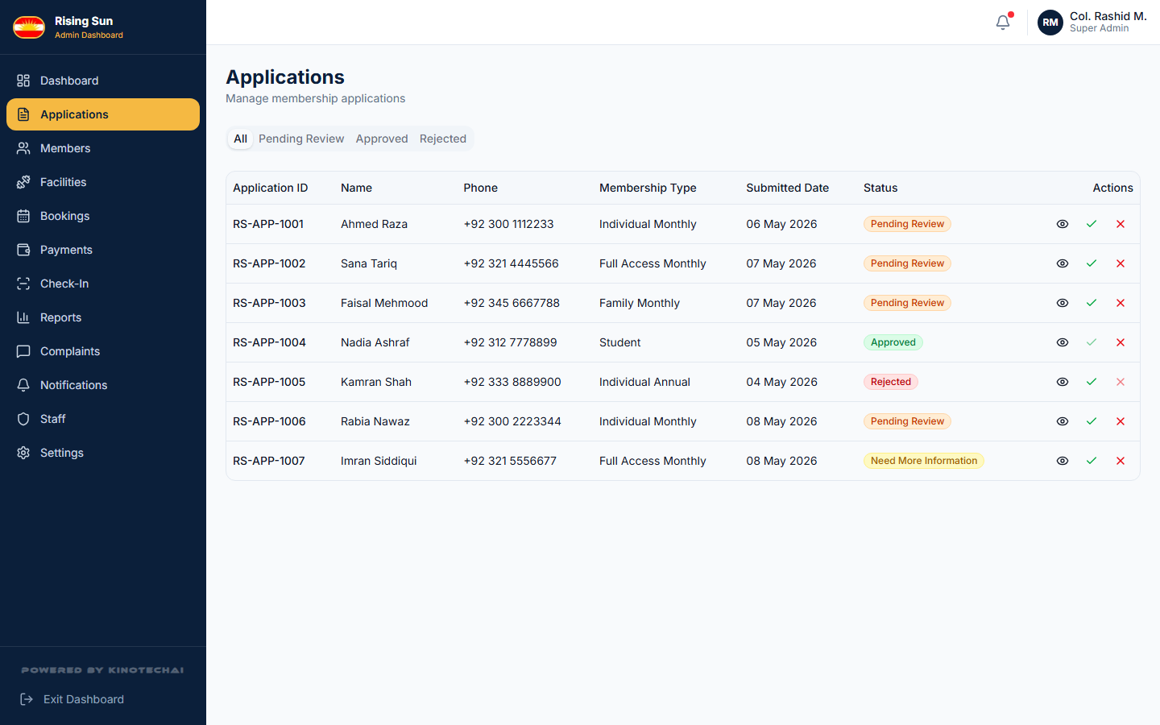
Admin — Applications Management

Slide 21
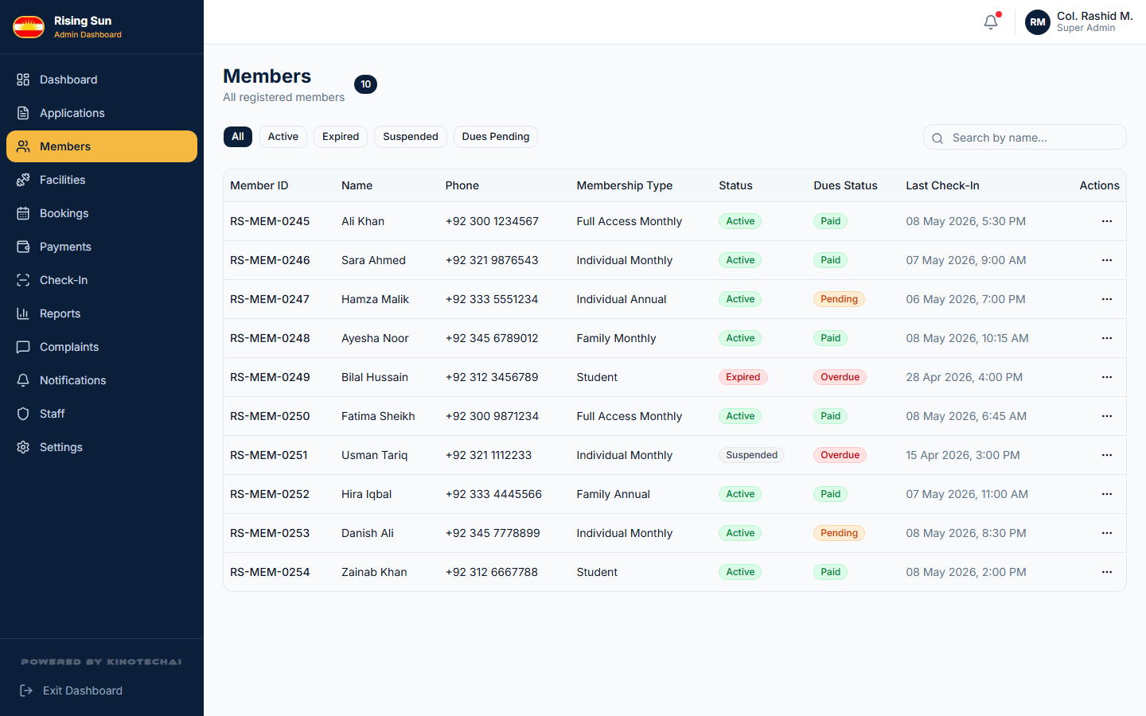
Admin — Members Management

Slide 22
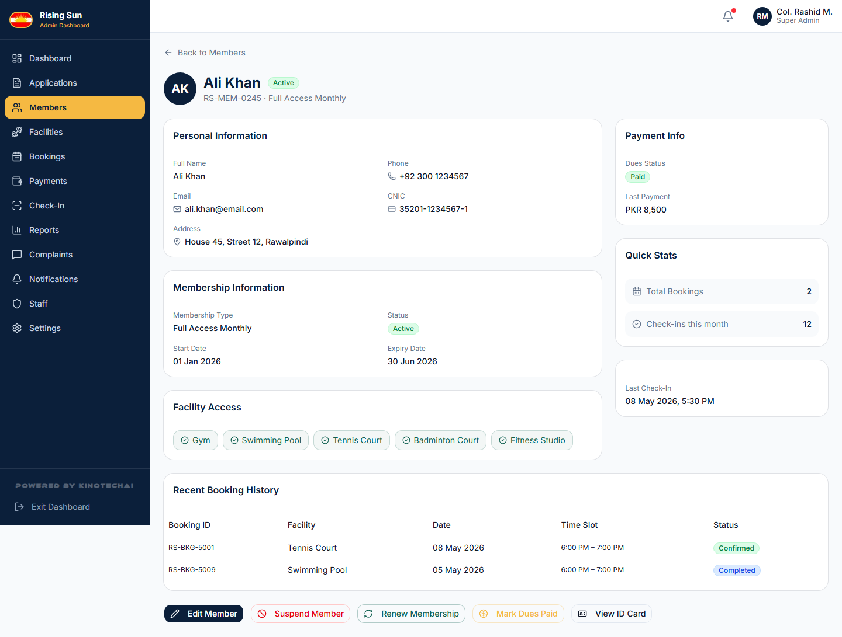
Admin — Member Detail

Slide 23
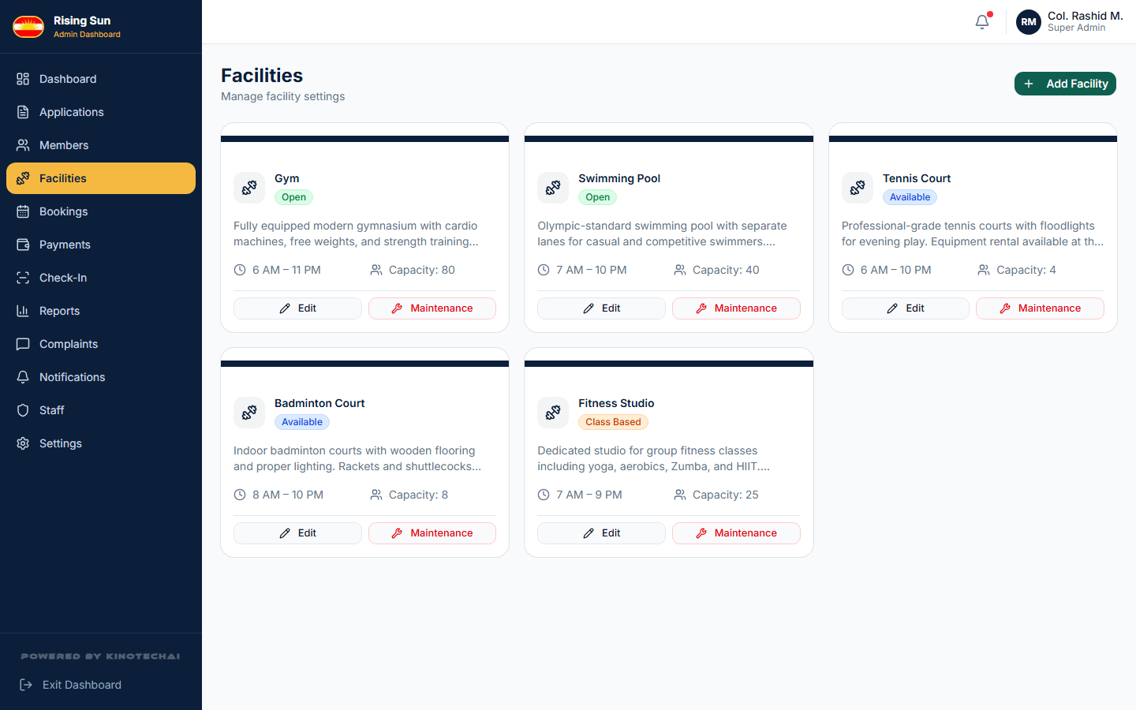
Admin — Facility Management

Slide 24
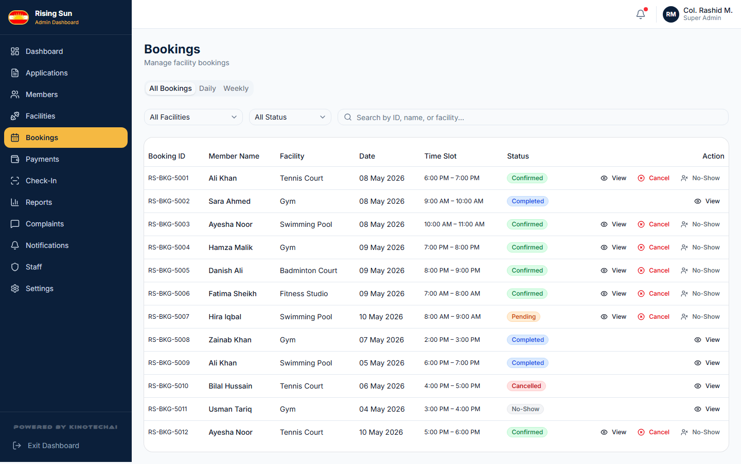
Admin — Booking Management

Slide 25
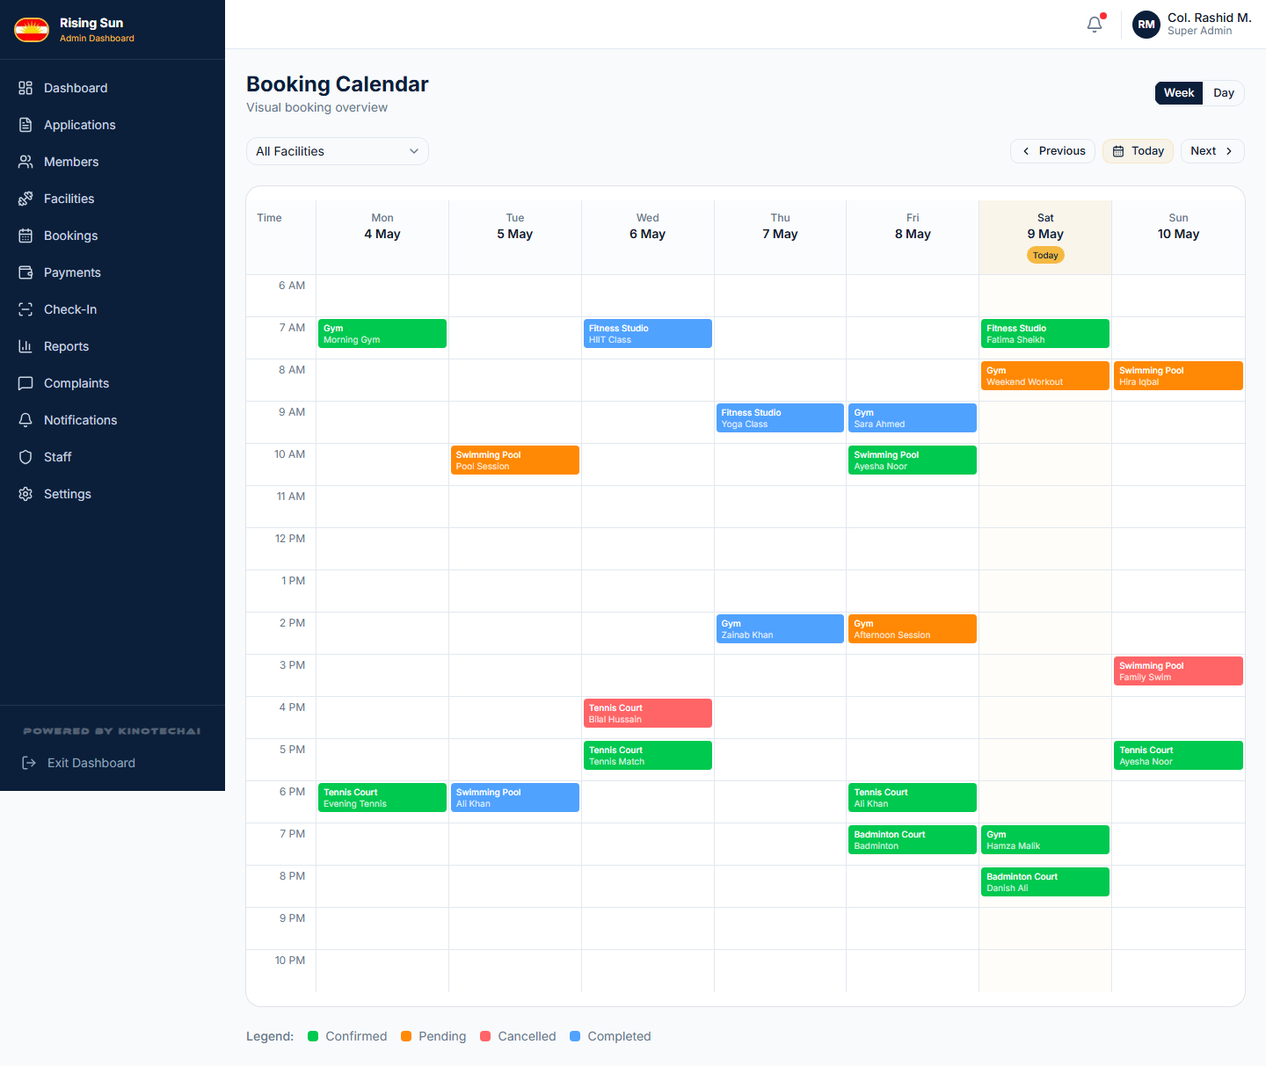
Admin — Booking Calendar

Slide 26
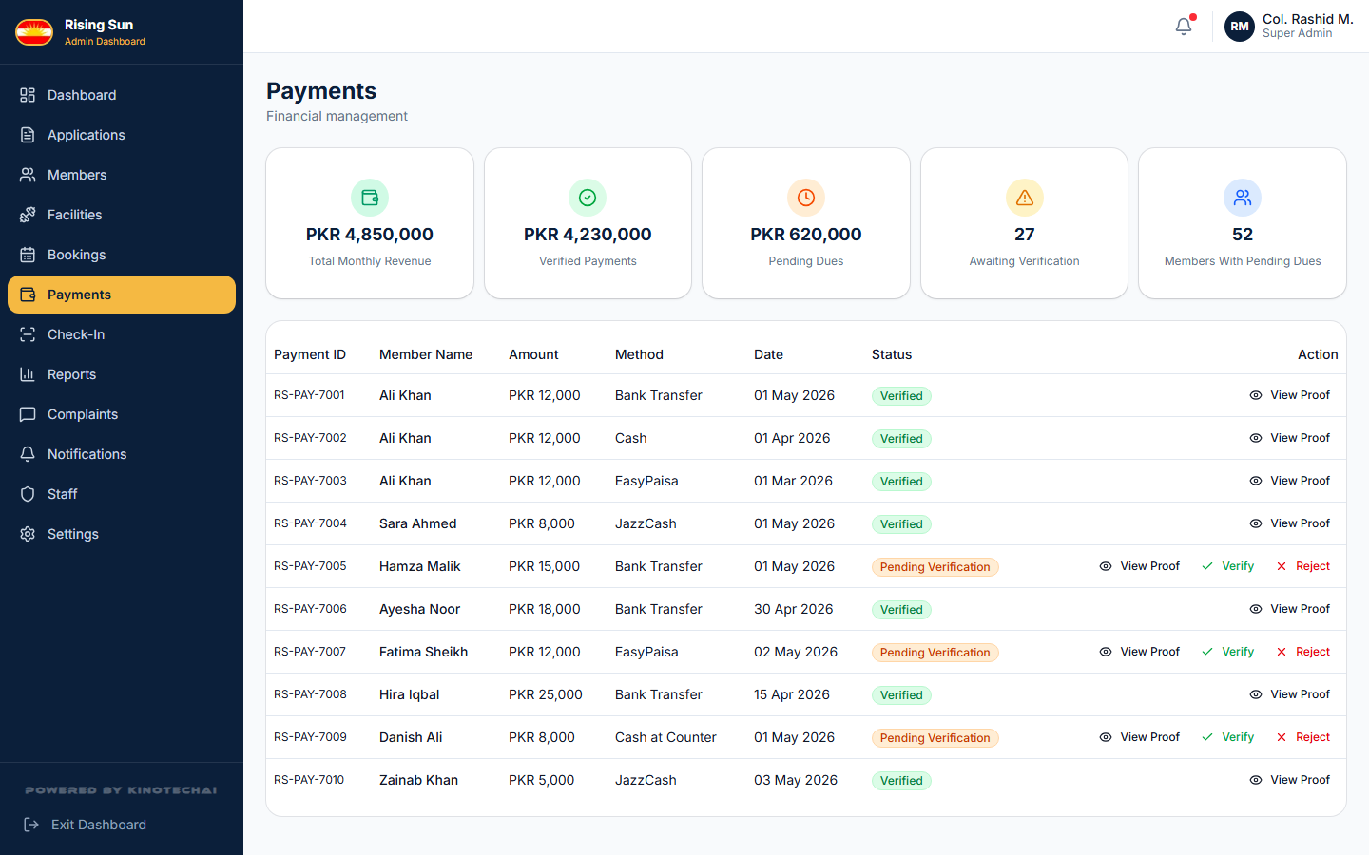
Admin — Payment Management

Slide 27
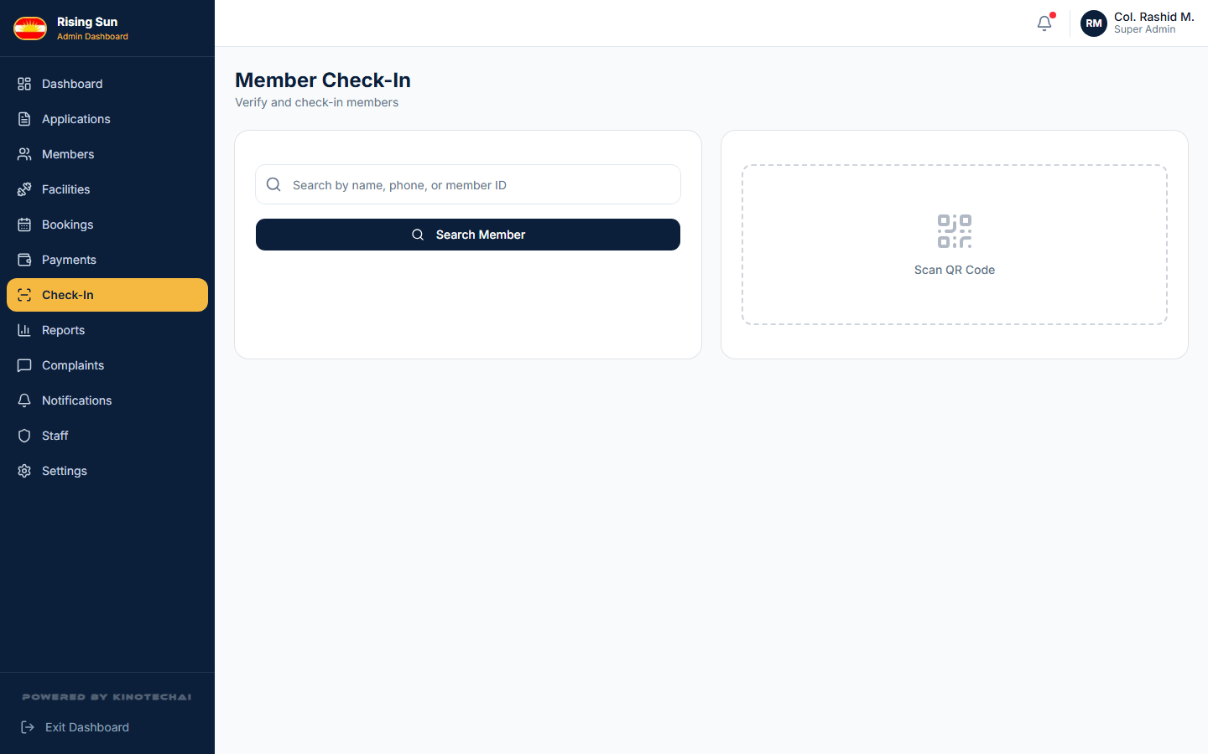
Admin — Member Check-In

Slide 28
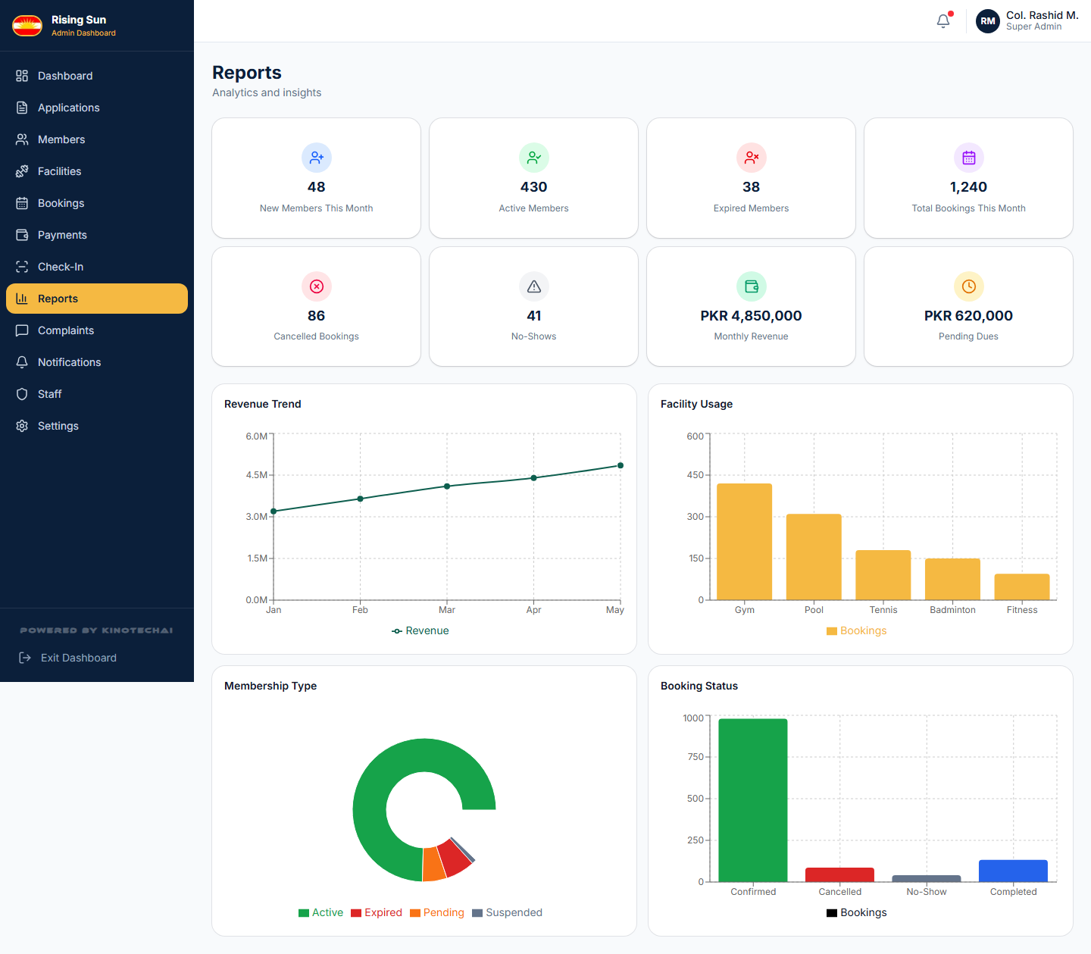
Admin — Reports

Slide 29
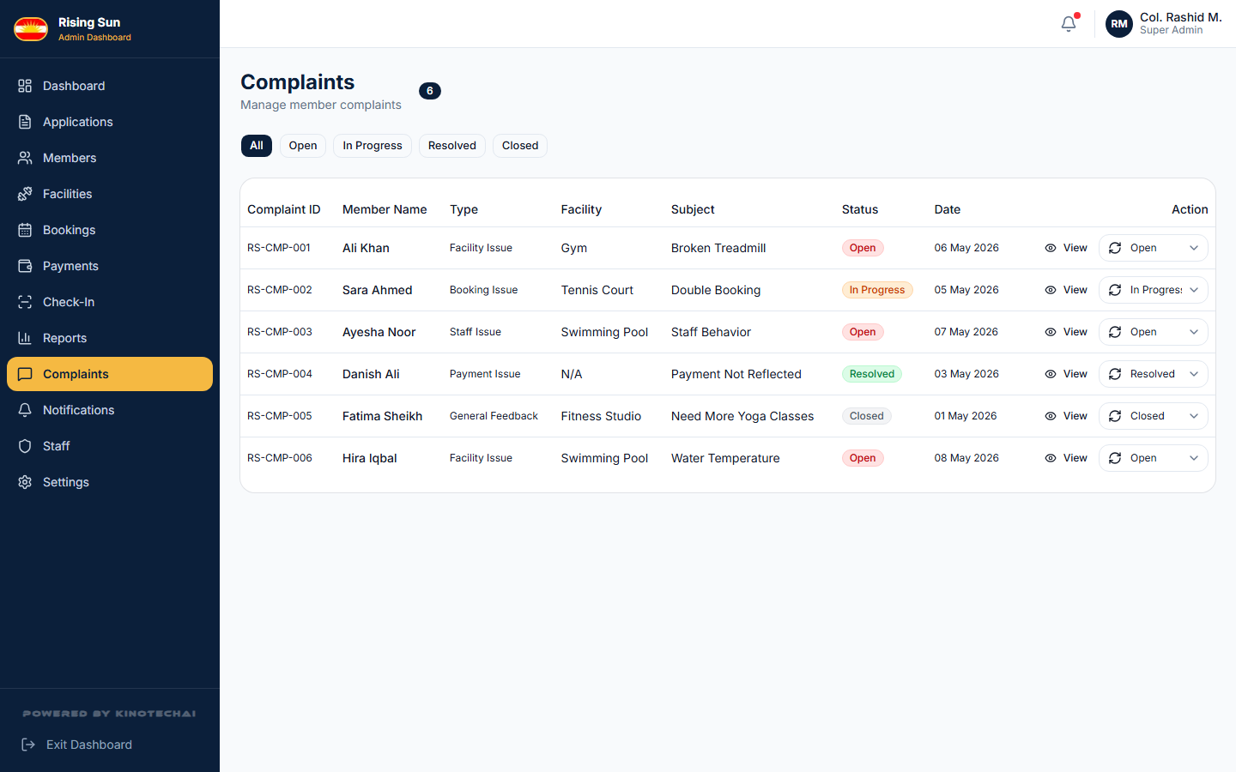
Admin — Complaints Management

Slide 30
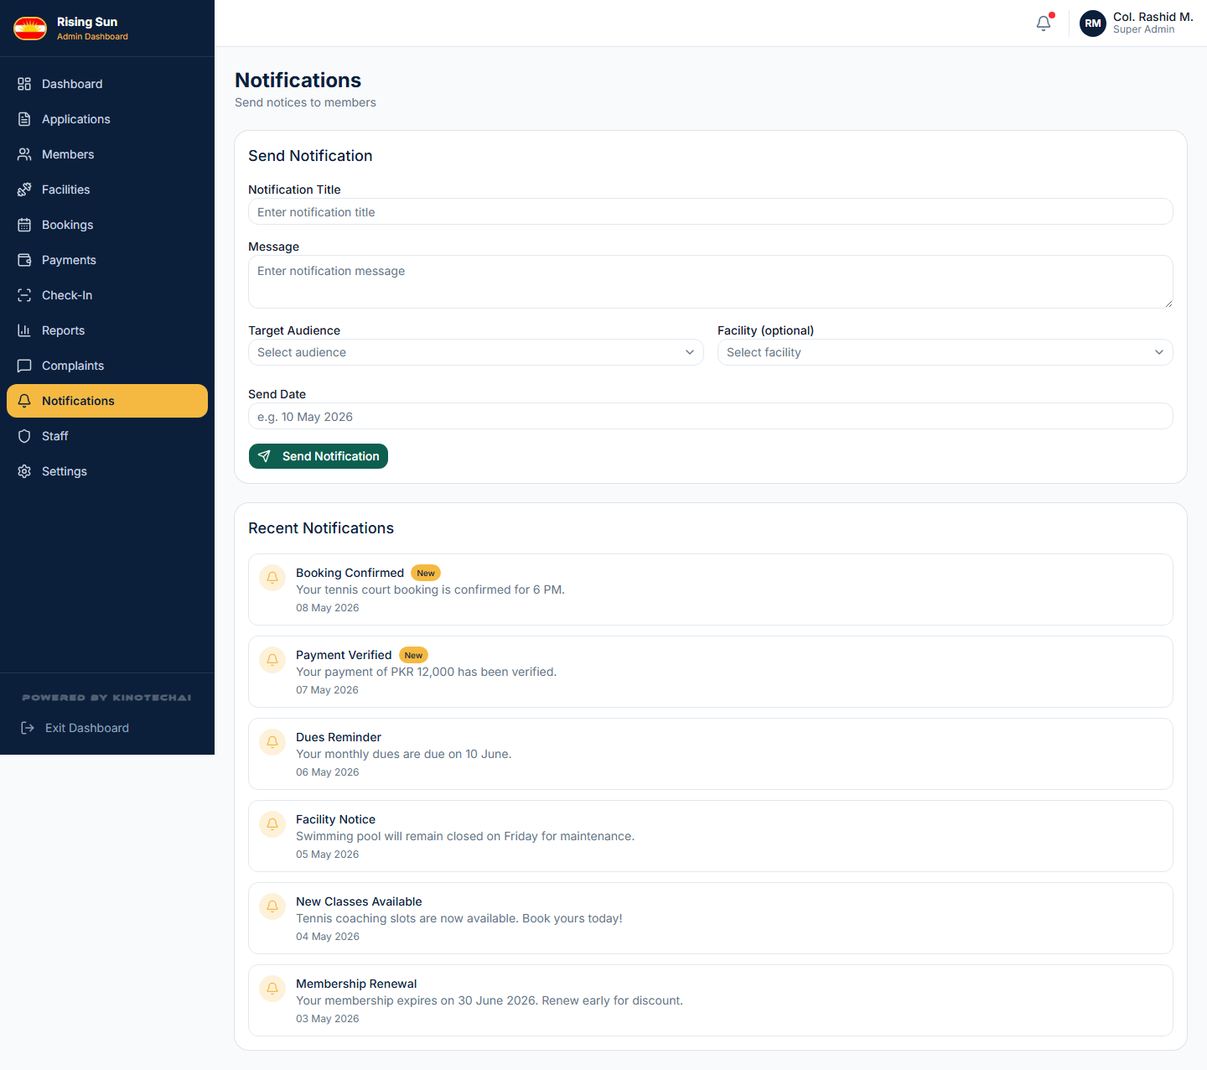
Admin — Notifications Management

Slide 31
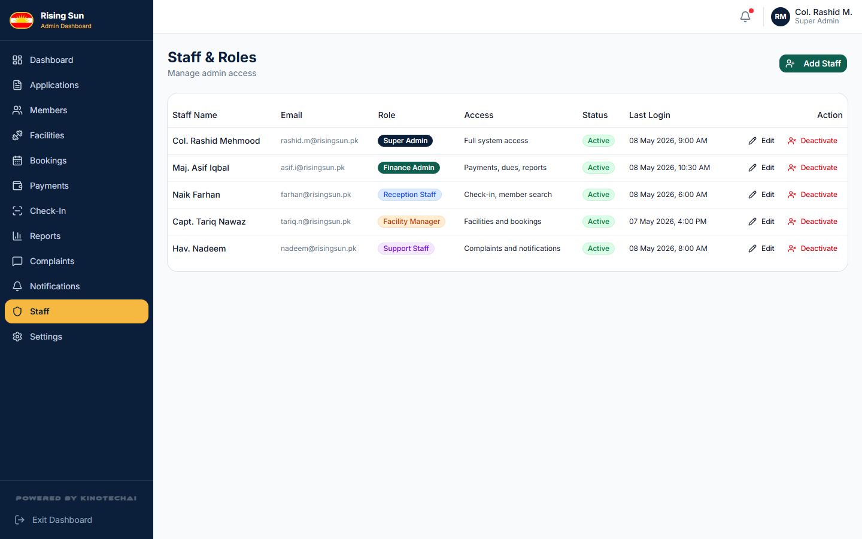
Admin — Staff & Roles

Slide 32
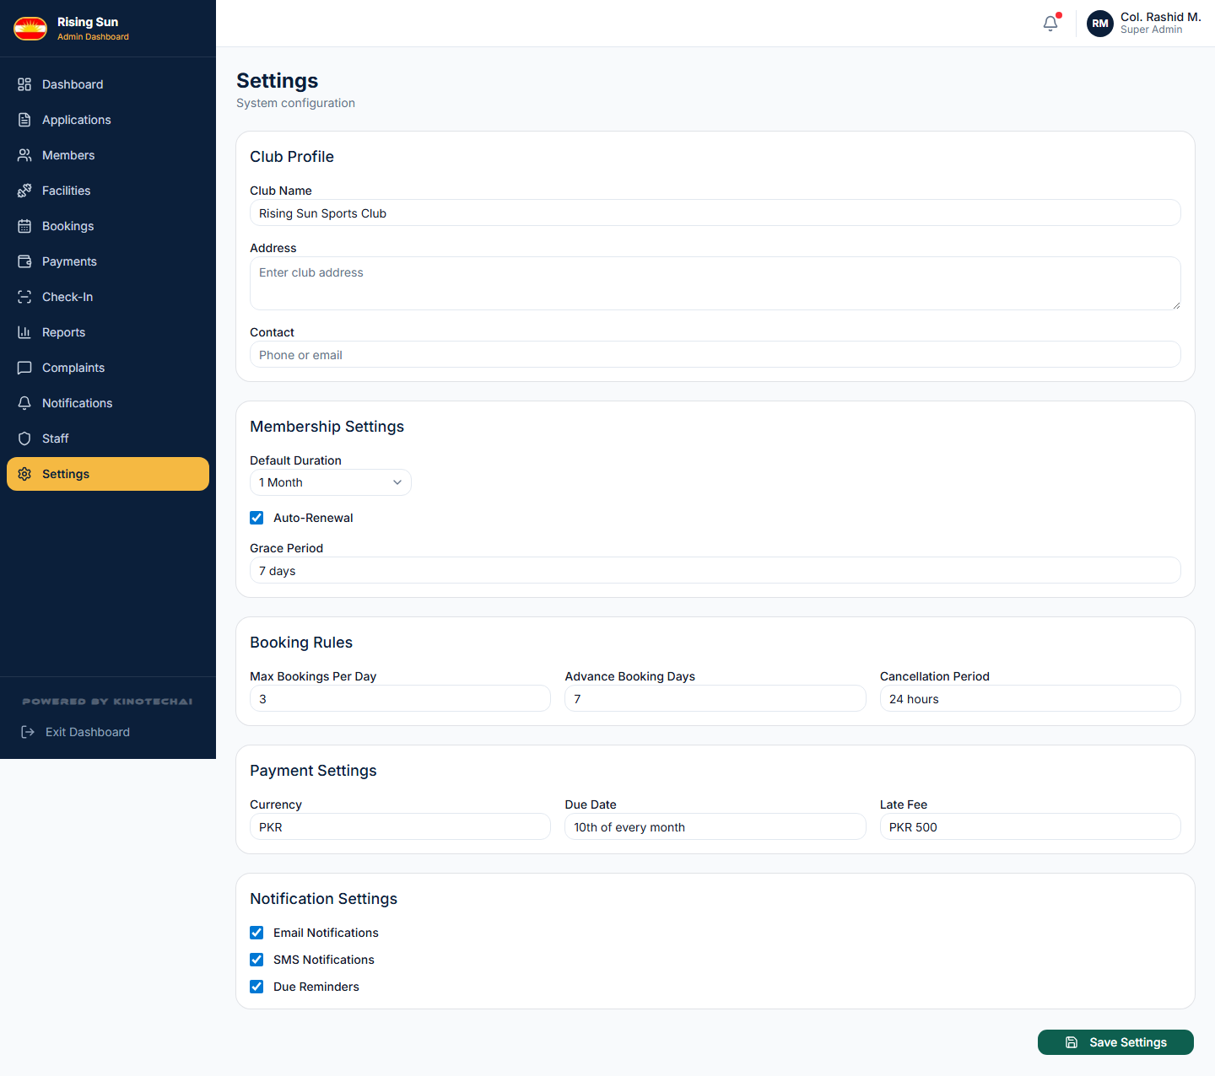
Admin — Settings

