Slide 1
Alzheimer's Disease Detection with Boosting
AdaBoost vs. Gradient Boosting on structured clinical data
Muhaimin Bin Habib · Ekram Khan · Md Sayeed Anwar
East Delta University, Chattogram, Bangladesh

Slide 2
Problem: finding Alzheimer's earlier, cheaply
2,149
35
35.4%
records with a diagnosis label
demographic, lifestyle, clinical and cognitive features
of records are Alzheimer cases (760)
Scans and specialist work-ups are costly and not widely available.
Tabular records could support low-cost screening.
Question: which boosting model classifies better, and what errors does it make?

Slide 3
Method: two models, one train/test split
1 Data
2 Preprocess
3 Split + train
4 Evaluate
Kaggle Alzheimer's Disease Dataset (2,149 × 35); publisher says it is synthetic
Drop non-informative columns; StandardScaler / Min-Max scaling
80:20 split (430 test records); AdaBoost and Gradient Boosting trained separately
Accuracy, precision, recall, F1 and confusion matrices on the test set
Added in the paper: specificity, MCC, majority-class baseline (64.4%) and 95% confidence intervals.

Slide 4
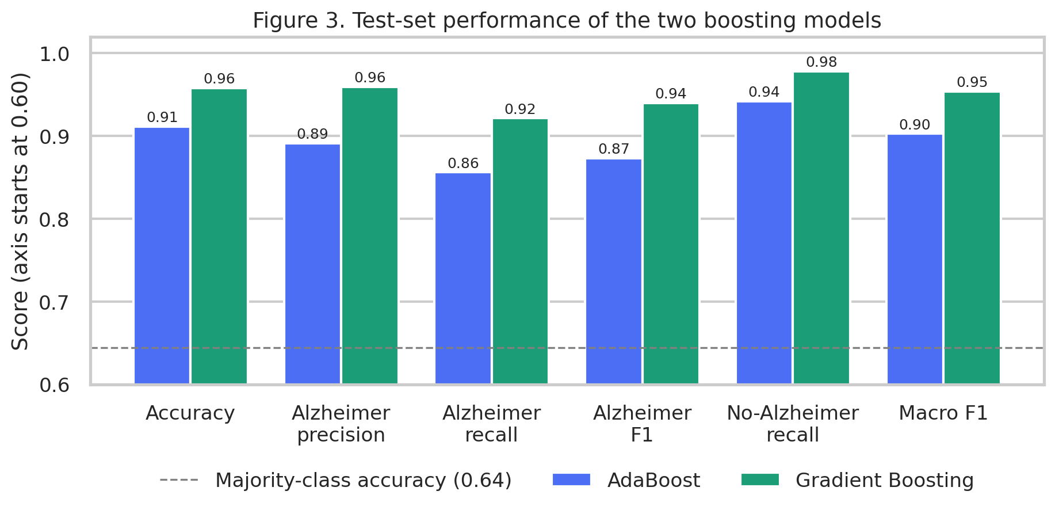
Results 1: Gradient Boosting scores higher
Gradient Boosting vs. AdaBoost
Accuracy: 95.8% vs. 91.2%
Alzheimer recall: 92.2% vs. 85.6%
Majority-class baseline: 64.4%
95% accuracy intervals just touch: AdaBoost 0.881–0.935, Gradient Boosting 0.935–0.973.

Slide 5
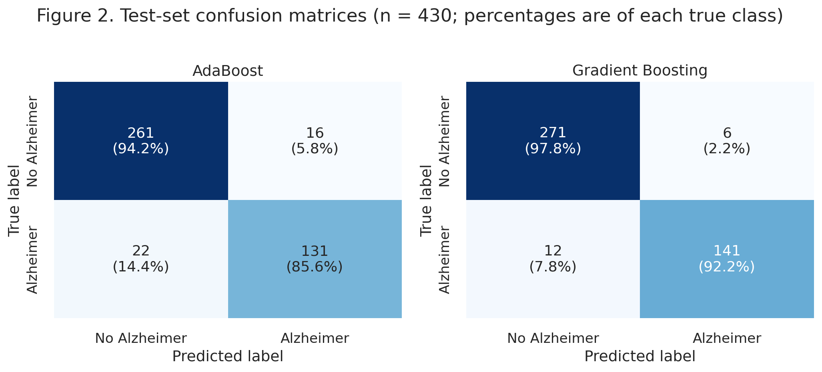
Results 2: fewer errors, fewer missed cases
 | Ada | GB
False positives | 16 | 6
Missed cases | 22 | 12
Total errors | 38 | 18
Gradient Boosting missed 7.8% of Alzheimer cases; AdaBoost missed 14.4%.
Errors fell by 53%, but about 1 in 13 Alzheimer cases is still missed by the better model.

Slide 6
Read with care: what these results are not
Synthetic data
The dataset's publisher says it is synthetically generated, so clinical accuracy is unknown.
One split, no tuning
A single 80:20 hold-out; no repeated runs or reported hyperparameter tuning.
Limited analysis
No ROC-AUC, threshold study or feature importance, so no claim about which features matter.

Slide 7
Takeaway
1
Gradient Boosting beat AdaBoost.
95.8% vs. 91.2% accuracy, and 18 errors instead of 38 on 430 test records.
2
Missed cases are the weak point.
Even the better model missed 12 of 153 Alzheimer cases; threshold tuning is the next step.
3
A method comparison, not a diagnosis tool.
Next: cross-validation, ROC analysis, feature importance, and validation on real clinical data.

