Slide 1
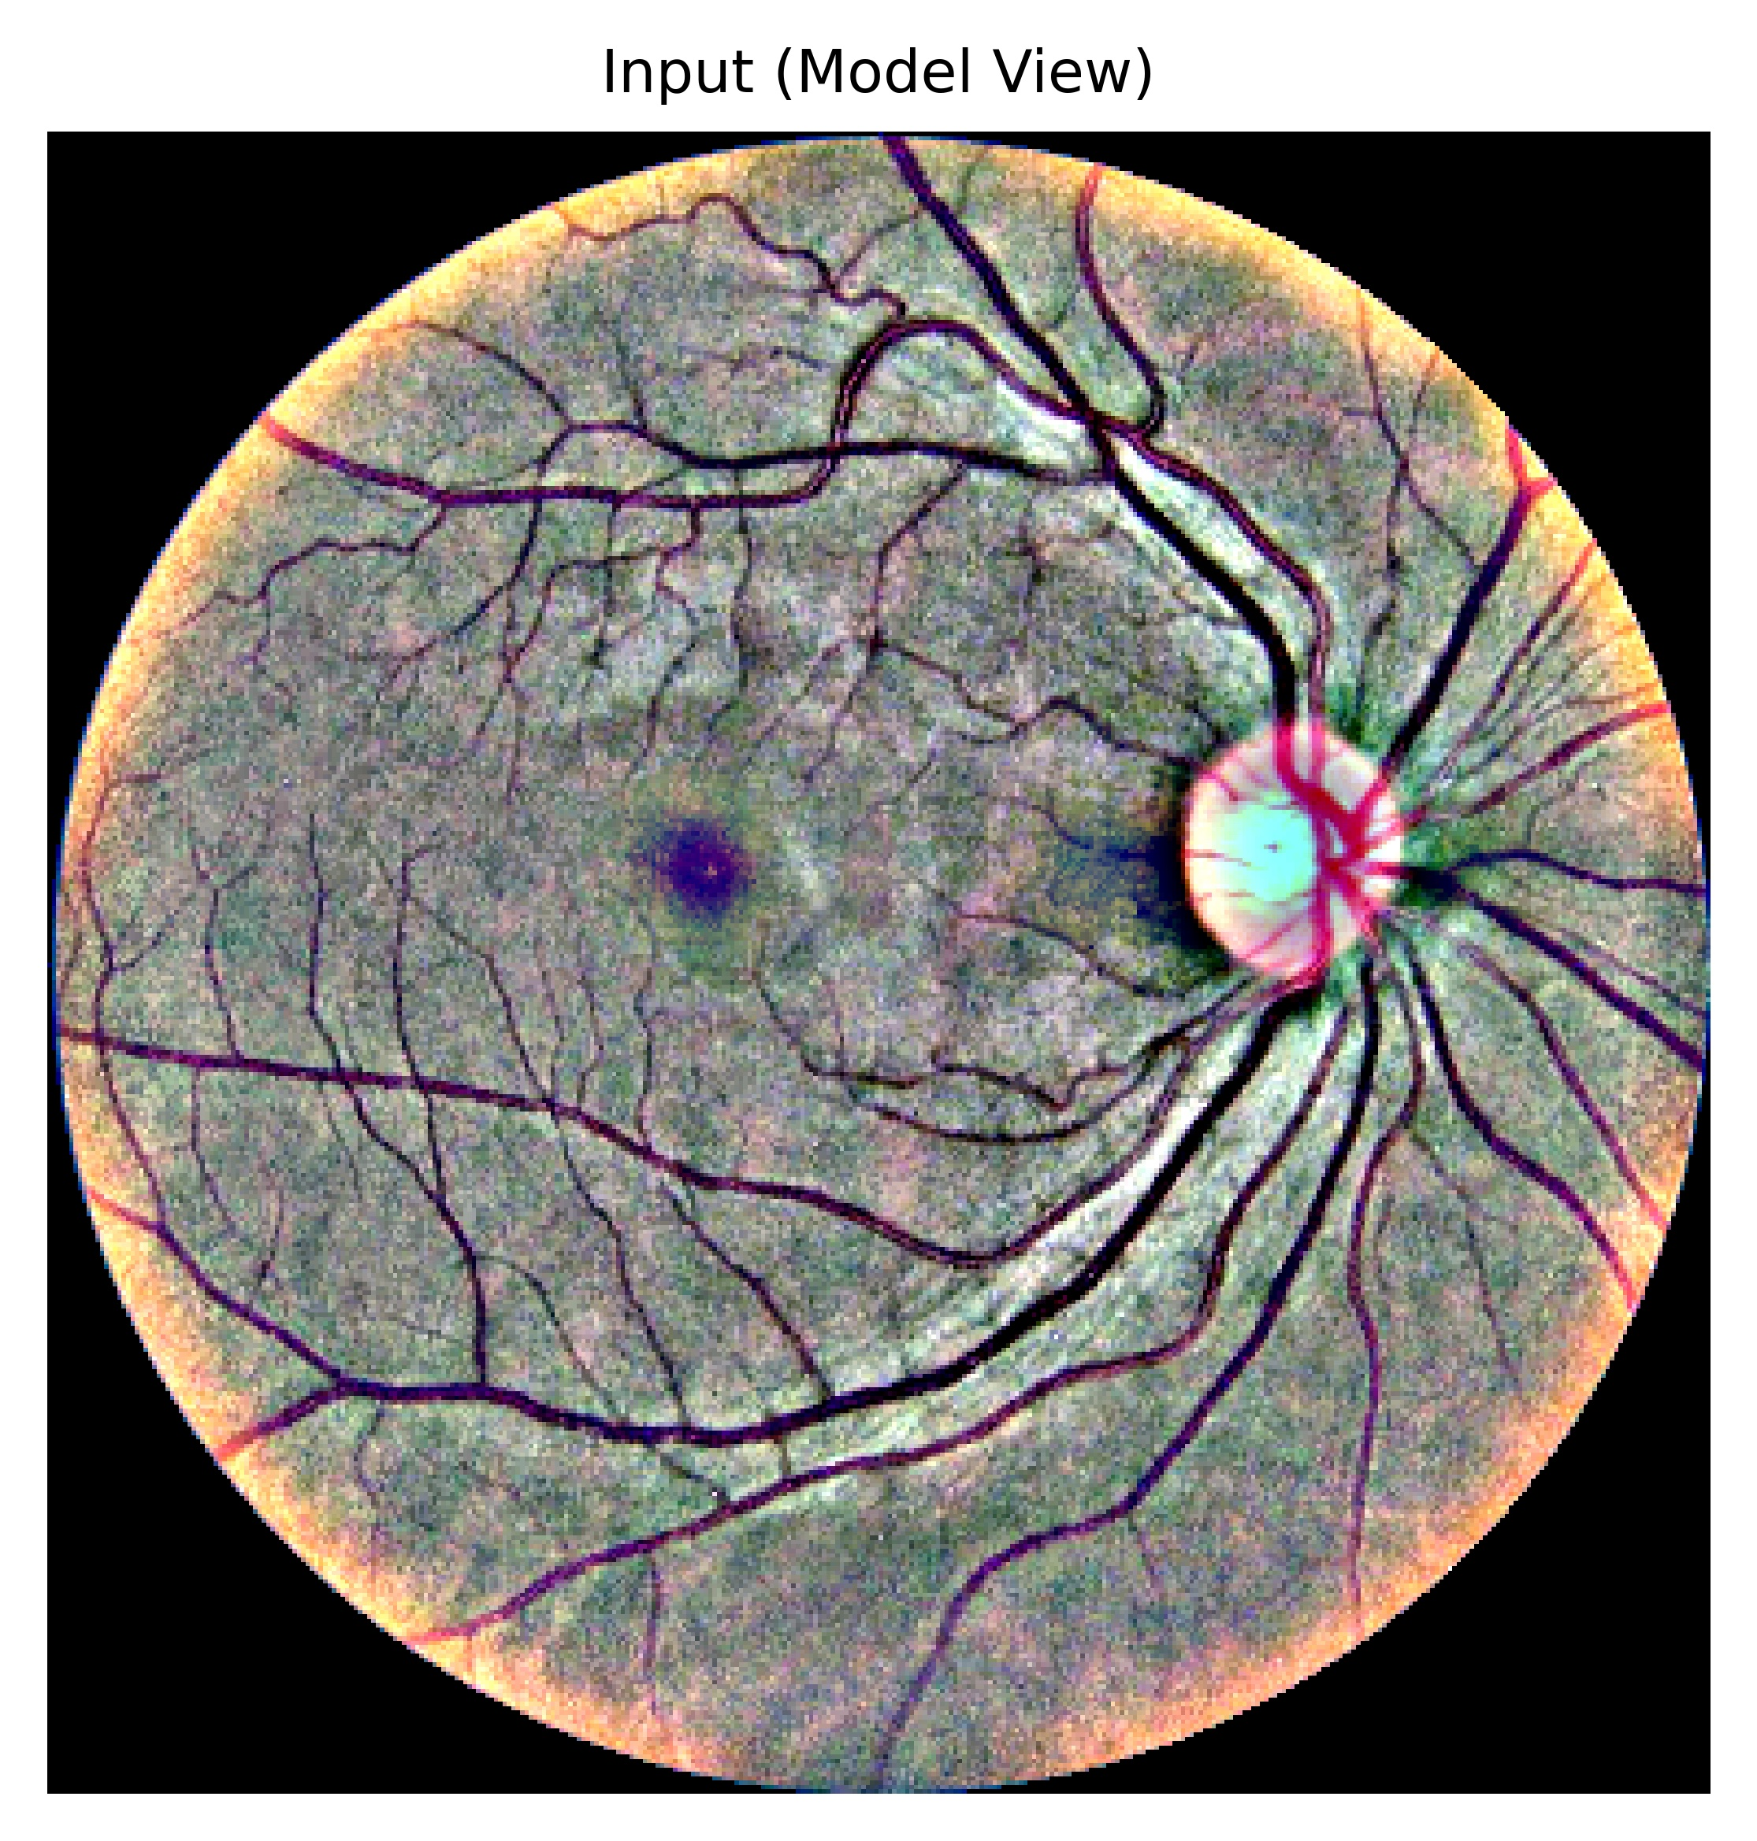
Medical Imaging, Explainable AI for Diabetic Retinopathy
Modeling to assess quality
Presented by
Ala Abu Hilal (700049213)
Muhammad Umair Khan (700049387)
Saeed Thabit (700049326)
Yingfeng Wang (700049354)
Supervised by Prof. Leila Ismail
ITPG708 · Foundations of Computational Science & Informatics

Slide 2
Outline
01
Introduction & Motivation
06
Explainability Methods
02
Problem Statement & Objectives
07
Evaluation Metrics
03
System Overview & Methodology
08
Results & Analysis
04
Dataset & Preprocessing
09
Key Findings & Limitations
05
Model Architecture
10
Conclusion & Future Work

Slide 3
Introduction & Motivation
Leading Cause of Blindness
Early Detection is Critical
Diabetic Retinopathy is a leading cause of preventable blindness in working-age adults worldwide — driven by the global diabetes epidemic.
Early detection is critical for effective treatment, Making automated detection vital.
Deep Learning Achieves High Accuracy
The Black-Box Problem
Recent deep learning approaches have achieved high performance in diabetic retinopathy assessment, supporting their potential for clinical decision support.
State-of-the-art DL models expose only a predicted grade and confidence score — no spatial or feature-level justification for the decision.
Clinician Trust Gap
Our Goal
Without interpretable models or explanations for black-box models, clinicians cannot verify model reasoning, limiting real-world clinical adoption.
Build a DR grading pipeline with two complementary explanation methods (Grad-CAM & SHAP) and quantitatively audit explanation quality.
Notes:
Recent deep learning approaches have achieved high performance in diabetic retinopathy assessment, supporting their potential for clinical decision support (Gulshan et al., 2016).

Slide 4
Problem Statement & Objectives
⚠ The Problem
✓ Our Objectives
DL models can detect DR accurately but behave as black boxes
5-Class DR Severity Classification
Fine-tune EfficientNet-B4 on APTOS 2019 using focal loss to predict No DR → Proliferative DR
Lack of interpretability reduces clinical trust and adoption
Dual XAI Explanations
Attach Grad-CAM (spatial heatmap) and SHAP DeepExplainer (pixel-level signed attribution) to every prediction
Standard Grad-CAM can highlight irrelevant regions (e.g., image borders)
Artifact
Generate interpretable explanations (Grad-CAM & SHAP) and ensure explanations focus on relevant retinal regions.
Quantitative XAI Audit
Evaluate both explanation methods using quantitative faithfulness metrics.

Slide 5
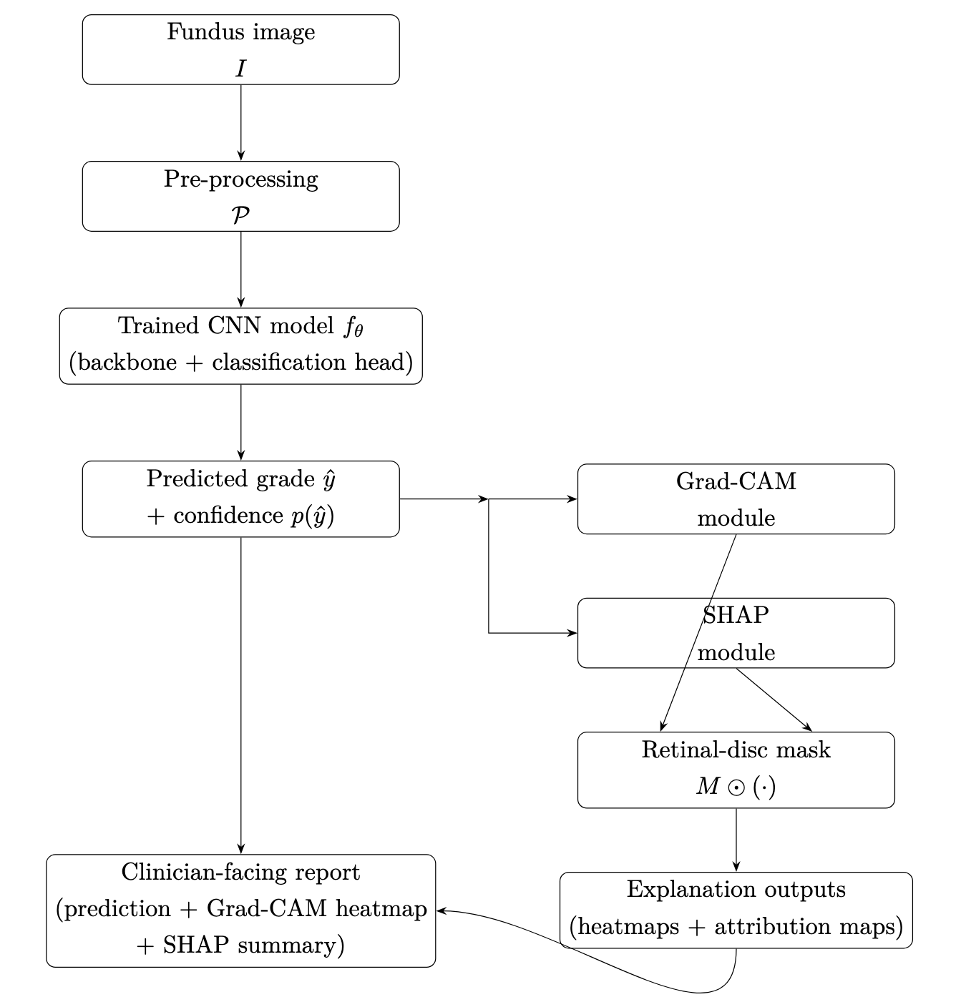
System Overview & Methodology
End-to-end pipeline: every fundus image produces a grade, a Grad-CAM heatmap, and a SHAP attribution map
Input: Fundus retinal image.
Preprocessing: Resize, contrast enhancement (CLAHE), circular crop.
Model: Fine-tuned EfficientNet-B4 for 5-class DR grading.
Training: Focal loss to handle class imbalance.
Explainability Modules:
Grad-CAM: Highlights important regions (spatial focus)
SHAP: Computes pixel-level contributions
Output: Predicted Grade + Confidence + Grad-CAM Heatmap + SHAP Attribution Map

Slide 6
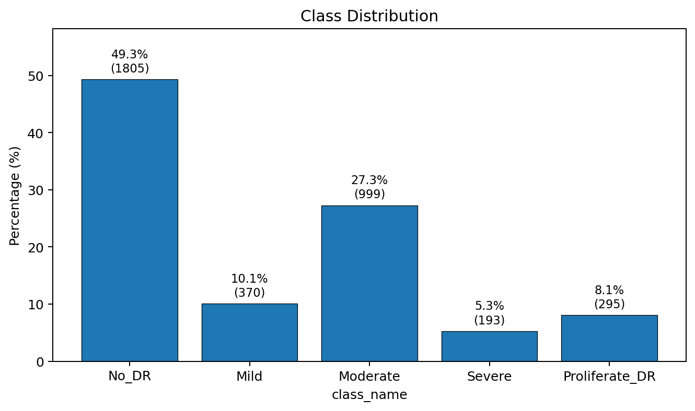
Dataset: APTOS 2019
Dataset Overview
⚠️ Highly imbalanced (No DR ≈ 49%, Severe ≈ 5%)
3,662
Total fundus images
5
DR severity classes (ICDR 0–4)
2,800
Training images (76.5%)
312
Validation images (8.5%)
550
Test images, held-out (15.0%)
Seed
1988 — fixed for reproducibility

Slide 7
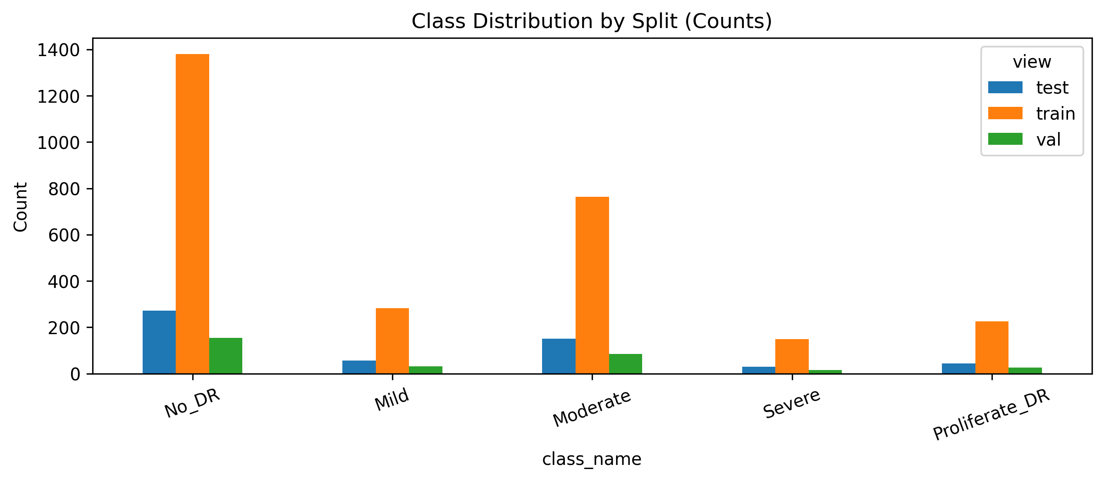
Dataset: Class Imbalance & Mitigation
Class Distribution
No DR
49.3%
Moderate
27.3%
Mild
10.1%
Prolif. DR
8.1%
Severe
5.3%
Mitigation Strategies
Focal Loss (γ=2.0) — Down-weights easy majority examples; per-class inverse-frequency weights boost Severe and Prolif. DR
Stratified Splits — Train/Val/Test share identical class ratios (seed 1988)
Balanced XAI Audit — N = 120 audit set — target 24 per true class; actual per-true-class: 26 / 31 / 25 / 21 / 17 (rare classes back-filled due to high-confidence filter).

Slide 8
Preprocessing Pipeline
Raw
Fundus
Resize
CLAHE
Ben-Graham
Subtraction
Circle
Crop
ImageNet
Norm
Any size
Any lighting
380 × 380 px
Standard input
LAB L-channel
Clip 2.0 / Tile 8×8
Local contrast boost
σ=10, weight=4
Emphasises vessels
& lesions
Ratio = 1.0
Removes aperture
artefacts
Why Each Step Matters
Fundus images vary in brightness across devices. CLAHE equalises local contrast in the LAB colour space, making subtle microaneurysms and haemorrhages visible.
CLAHE
Subtracts a Gaussian-blurred version of the image, removing slow illumination gradients and making retinal vessels the dominant signal. Grad-CAM and SHAP both operate on this enhanced image.
Ben-Graham
Masks the dark corners from the camera opening. Absence of this crop is the root cause of the Grad-CAM corner-attribution artifact — the model never sees the corners, but without masking the upsampled heatmap spreads into them.
Circle Crop

Slide 9
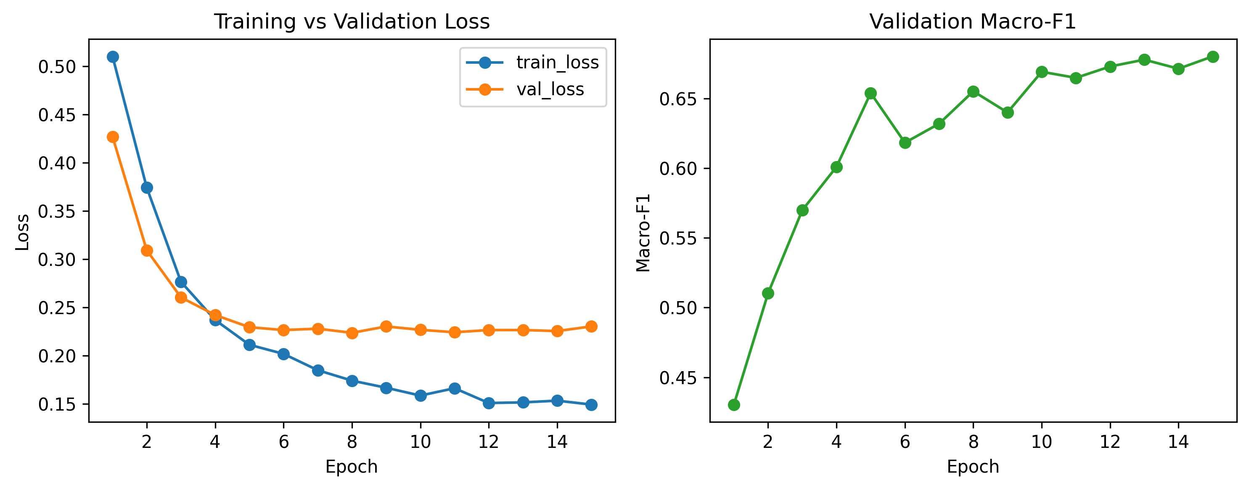
Model Architecture: EfficientNet-B4
Backbone
Focal Loss (γ=2.0)
EfficientNet-B4 pretrained on ImageNet. Input: 380×380 preprocessed fundus image.
L_focal = -α_t(1-p_t)^γ log(p_t) with per-class inverse-frequency weights. Combats class imbalance.
Feature Maps
Deep conv layers → F ∈ ℝ^{C×H'×W'}. Last-layer maps used by Grad-CAM.
Calibration
Temperature scaling: T* = 0.7435 fitted on validation set. ECE: 0.079 → 0.044.
Classification Head
Global Average Pooling → FC(5) → softmax. Predicted grade: ŷ = argmax softmax(z).

Slide 10
Explainability Methods: Grad-CAM vs SHAP
Two complementary methods: Grad-CAM answers WHERE, SHAP answers WHY
Grad-CAM
SHAP DeepExplainer
"WHERE did the model look?"
"WHY did each pixel matter?"
Mechanism: Grad-CAM uses internal model architecture (backpropagating gradients to the last convolutional layer) to see where the model focused. Strengths: · Fast — single forward + backward pass · Region-level spatial localization · Class-discriminative (targets predicted class) Limitation: · Low-res 12×12 grid must be upsampled — bilinear interpolation leaks attribution into dark corners unless the retinal-disc mask is applied
Mechanism: Game theory Shapley values at pixel level. Scoring system that measures how much each pixel helped or harmed the final prediction by testing the model with and without that pixel’s information.
Strengths: · Full pixel-level resolution · Signed attribution: pushes toward / away from class · Theoretically principled (Shapley axioms) Limitation: · Computationally heavier; background choice affects attributions

Slide 11
Key Contribution: Attribution-Mask Correction
⚠ Problem: The problem: Grad-CAM’s border ratio was inflated because bilinear upscaling spread attribution into the dark corners outside the retinal disc.
Root Cause
Effect on Metrics
Grad-CAM starts from a small 12×12 map. When we enlarge it (Bilinear upsampling to 380×380), some heat leaks into the black corners, even though those corners are not retina
Before correction, SHAP looked better on localization (0.234 vs 0.290) — but that was due to the corner artefact, not because SHAP was truly better
The Fix: Retinal-Disc Mask
Result After Correction
Apply the same retinal-disc mask to both Grad-CAM and SHAP before computing any XAI metric. This removes corner artefacts fairly for both methods. Mask (radius = 0.50 × min(H,W)) to both maps before any metric: Ẽ(Heatmap) = M ⊙ E_cam and φ̃ (AttributionMap) = M ⊙ φ_shap.
Numerically unchanged for SHAP (corners = constant in all SHAP inputs).
After correction, Grad-CAM’s border ratio improves to 0.206, lower than SHAP’s 0.234, so Grad-CAM becomes better on localization.

Slide 12
Evaluation Metrics
A Classification & Calibration
B XAI Explanation Quality
Accuracy
Border Ratio ↓
Overall fraction of correctly classified images on the 550-image test set
BR = total attribution inside outer 10% border
Fraction of attribution mass in the outer 10% image border. Lower is better. Pass threshold: BR ≤ 0.25.
Macro F1
Unweighted mean of per-class F1 scores — treats all 5 DR grades equally
Retina Ratio ↑
RR = total attribution inside retinal disc
Fraction of attribution mass inside the retinal disc. Higher is better.
QWK
Quadratic Weighted Kappa — penalises distant ordinal errors more than near ones; key metric for DR grading
Faithfulness Δ_k ↑
Δk = Confidence(original) − Avg Confidence(masked top-k%)
ECE
Drop in predicted-class confidence when the top-k% most important pixels are masked. Larger drop = highlighted pixels really matter. Example: Δ 20 ​ asks, What happens when I remove the top 20%?
Expected Calibration Error — measures how well confidence probabilities match true accuracy; reduced via temperature scaling
AOPC ↑
AOPC = Average [Confidence(original) − Confidence(masked at step ℓ)]
Average confidence drop as the top-attributed image regions or pixels are masked step by step. What happens overall as we progressively mask the most important regions or pixels? For Grad-CAM, these are regions from the heatmap; for SHAP, these are pixel-level attributions.

Slide 13
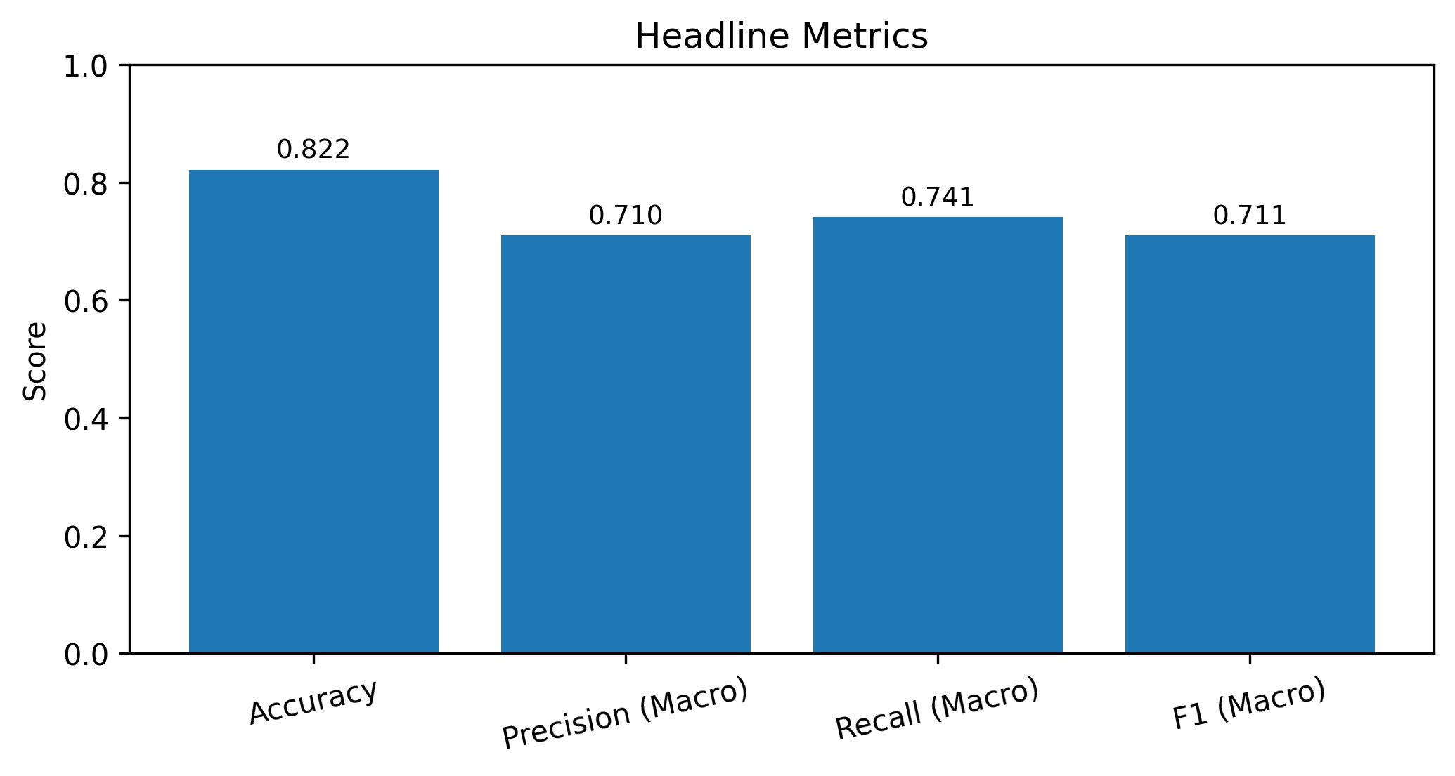
Results & Analysis: Classification Performance
82.2%
0.896
0.711
0.044
Accuracy
Quadratic Weighted Kappa
Macro F1-Score
Expected Calibration Error
Per-Class Performance
Class
Support
Precision
Recall
F1
No DR (0)
271
0.981
0.970
0.976
Mild (1)
56
0.513
0.696
0.591
Moderate (2)
150
0.805
0.687
0.741
Severe (3)
29
0.511
0.828
0.632
Prolif. (4)
44
0.742
0.523
0.613

Slide 14
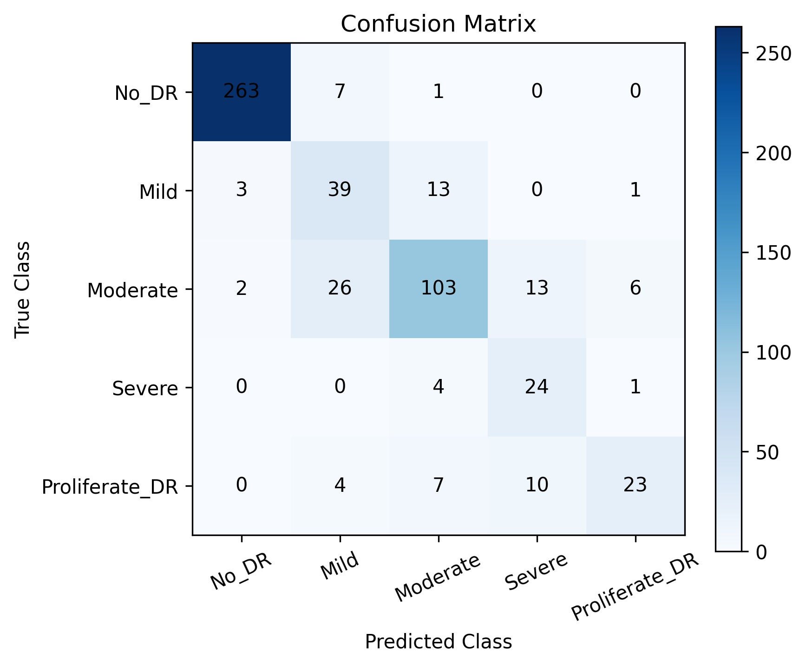
Results & Analysis: Confusion Matrix
Confusion Matrix (550 test images)
Key Observations
No DR (Grade 0)
263/271 correct (97%). The dominant class is also the most accurately classified — healthy retina is distinctive.
Mild (Grade 1)
Only 39/56 correct (70%). Most errors go to Moderate — Mild lesions are subtle and visually similar to adjacent grades.
Moderate (Grade 2)
103/150 correct (69%). Split between Mild (26 misclassified) and Severe (13 misclassified) — ordinal near-miss pattern.
Severe (Grade 3)
24/29 correct (83% recall), but precision only 51% — model over-predicts Severe when uncertain between adjacent grades.

Slide 15
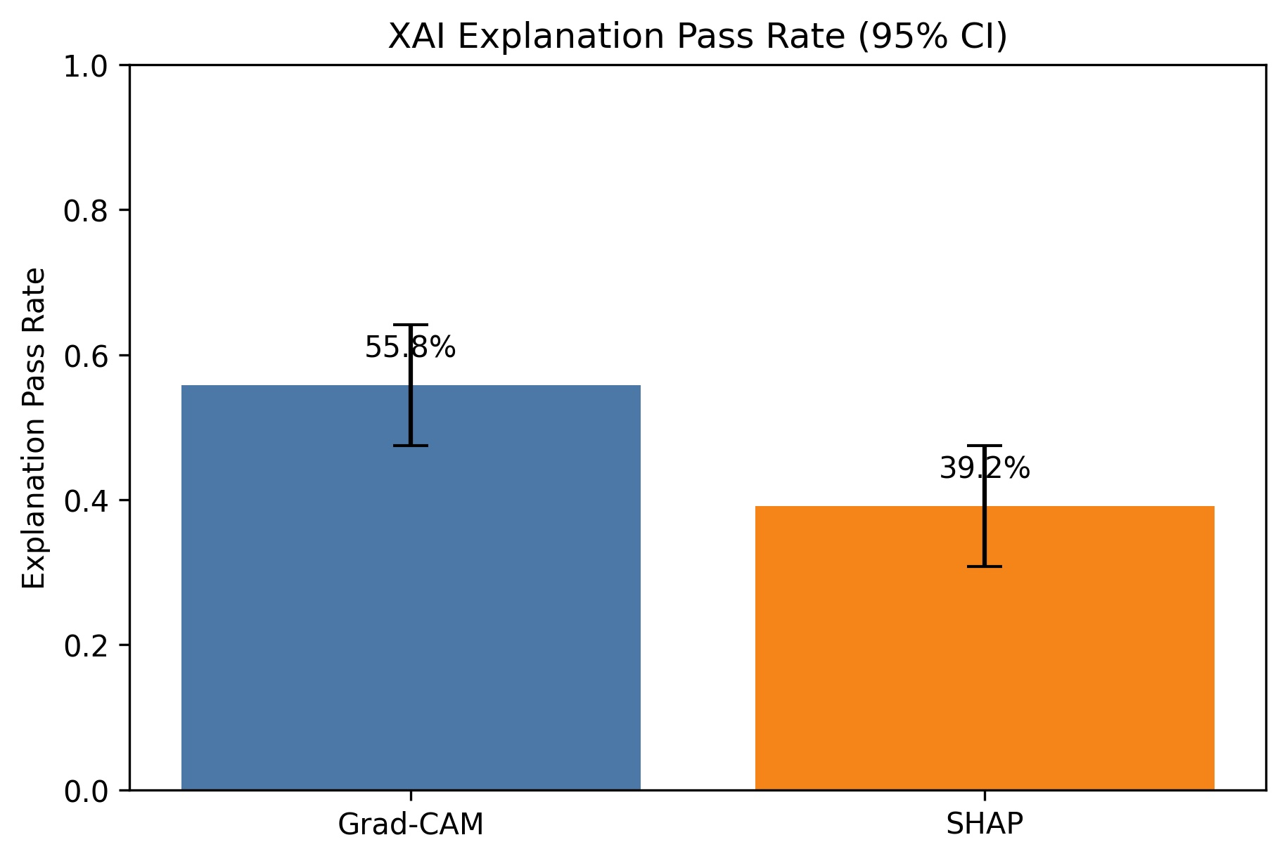
Results & Analysis: XAI Pass Rate
Operational pass rule: Border Ratio ≤ 0.25 AND Δ_k20 > 0.10 (on masked attribution maps, N=120 balanced test targets)
Grad-CAM
55.8%
95% CI: [47.5%, 64.2%]
SHAP
39.2%
95% CI: [30.8%, 47.5%]
McNemar exact p = 0.012 → Statistically significant difference
These pass rates are based on defined thresholds. Continuous metrics remain the primary evaluation.

Slide 16
Results & Analysis: Continuous XAI Metric Comparison
Paired Wilcoxon signed-rank tests on N=120 masked attribution maps (24 per class). All 6 metrics: p < 10⁻³.
Metric
Grad-CAM (mean)
SHAP (mean)
Paired Δ
Wilcoxon p
d_z
Winner
Border Ratio ↓
0.206
0.234
−0.028
9.6×10⁻⁵
0.32
Grad-CAM
Retina Ratio ↑
0.816
0.791
+0.025
6.6×10⁻⁴
0.27
Grad-CAM
Δ_k10 ↑
0.195
0.089
+0.107
2.1×10⁻⁶
0.46
Grad-CAM
Δ_k20 ↑
0.328
0.187
+0.141
5.3×10⁻⁸
0.54
Grad-CAM
Δ_k30 ↑
0.339
0.215
+0.124
5.6×10⁻⁹
0.58
Grad-CAM
AOPC ↑
0.287
0.163
+0.124
3.6×10⁻⁹
0.58
Grad-CAM
Mask Ablation:
Pre-mask → Grad-CAM BR = 0.290 vs SHAP 0.234 → SHAP wins (d_z=0.45) | Post-mask → Grad-CAM BR = 0.206 vs SHAP 0.234 → Grad-CAM wins (d_z=0.32)

Slide 17
Key Findings
Grad-CAM Outperforms SHAP Aggregate
01
After artifact correction, Grad-CAM outperforms SHAP on all 6 continuous XAI metrics (Wilcoxon p < 10⁻³). Border ratio 0.206 vs 0.234; AOPC 0.287 vs 0.163; Δ_k20 0.328 vs 0.187.
Artifact Correction is Essential
02
Without the retinal-disc mask, SHAP appears to win localization (d_z=0.45 SHAP's favour). After the symmetric mask, Grad-CAM wins (d_z=0.32). The correction has no effect on SHAP numerically.
Statistically Significant Differences
03
All metric comparisons reached p < 0.001 (Wilcoxon). McNemar exact test on pass rates: p = 0.012. Cohen's d_z ranges from 0.27 (retina ratio) to 0.58 (AOPC / Δ_k30).
Methods Are Complementary by Class
04
SHAP outperforms on No DR (+23.1 pp) and Severe (+23.8 pp); Grad-CAM dominates Mild (+54.8 pp), Moderate (+28 pp), Proliferative DR (+41.2 pp). Both methods may complement each other.
Severe Class Remains Challenging
05
Grad-CAM mean Δ_k20 on Severe = −0.10 (negative faithfulness). In the Severe cases, the highlighted areas weren’t really what mattered to the model. When we removed those ‘important’ regions, the model actually became more confident in its Severe diagnosis—so those highlighted spots weren’t really helping, and Grad-CAM was pointing us to the wrong places.

Slide 18
Limitations
📊 Single Dataset
🔬 No Lesion-Level Ground Truth
APTOS 2019 only — no cross-dataset validation to EyePACS or Messidor. Results may not generalise to images from different devices or populations.
APTOS 2019 provides image-level DR grades only. XAI explanations cannot be validated against pixel-level problem areas since we don’t have local annotations pinpointing exactly where the issues exist in the images.
⚖️ Class Imbalance Persists
🧠 Grad-CAM Fails on Severe DR
Despite focal loss and balanced XAI audit, minority classes (Severe: 29, Mild: 56 test images) have weaker per-class performance and less reliable explanations.
Mean Δ_k20 for Grad-CAM on Severe = −0.10 (negative faithfulness). Diffuse haemorrhages and lesions resist compact focal attribution — SHAP is better here.
🎲 Single-Seed Experiment
📐 Mask Radius Choice
All results use seed 1988. Variance across seeds is not reported; results may shift with different random initialisations.
Mask radius = 0.50 × min(H,W) matches the preprocessing crop. Sensitivity to other radii (e.g., 0.45 or 0.55) is not explored.

Slide 19
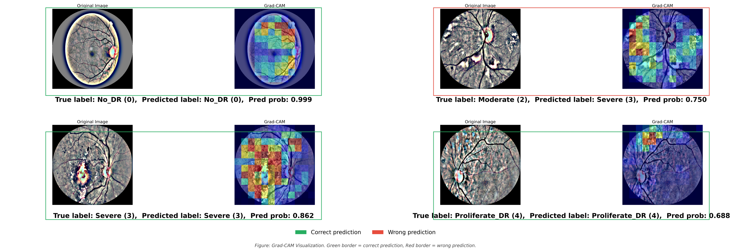
Grad-CAM Visualizations: Four Test Cases
Green border = correct prediction · Red border = wrong prediction · Warm colours = high attention regions

Slide 20
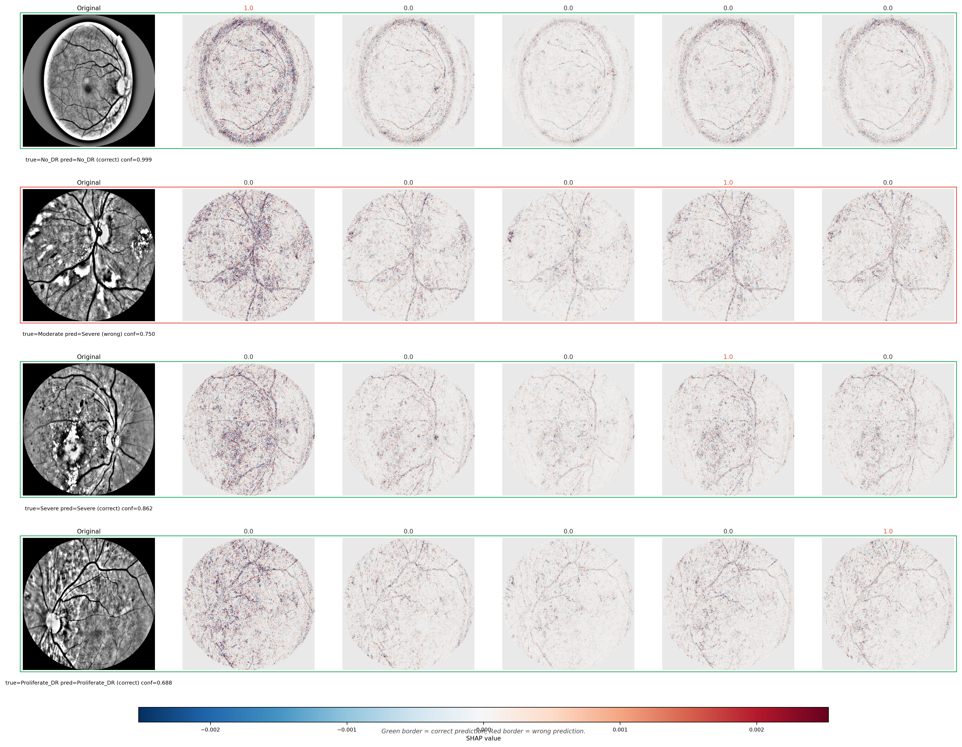
SHAP Visualizations: Per-Class Attribution Maps
Red pixels push prediction toward a class · Blue pixels push prediction away · Highlighted column = predicted class
SHAP maps cover all 5 class columns simultaneously — showing not only why the model predicted a class but also what makes the image NOT belong to other grades. Positive attribution for the predicted class concentrates on retinal tissue.

Slide 21
Conclusions & Future Work
82.2% accuracy, QWK=0.896
EfficientNet-B4 with focal loss predicted diabetic retinopathy reasonably accurately.
Thank You
Artifact correction
Grad-CAM was sometimes highlighting the black edges of the image instead of the retina. We fixed that by applying a retinal mask before scoring the explanations.
Questions & Discussion
Grad-CAM was better, but both methods were useful
On average, Grad-CAM has stronger explanation scores, but SHAP was better in some cases, especially for No DR and Severe images. So the two methods can complement each other.
Future: multi-seed, multi-dataset, lesion GT
We only tested one dataset and one random seed, and we do not have detailed lesion annotations. In future work, we should test on more datasets, repeat with multiple seeds, and use data with pixel-level labels.

