Slide 1
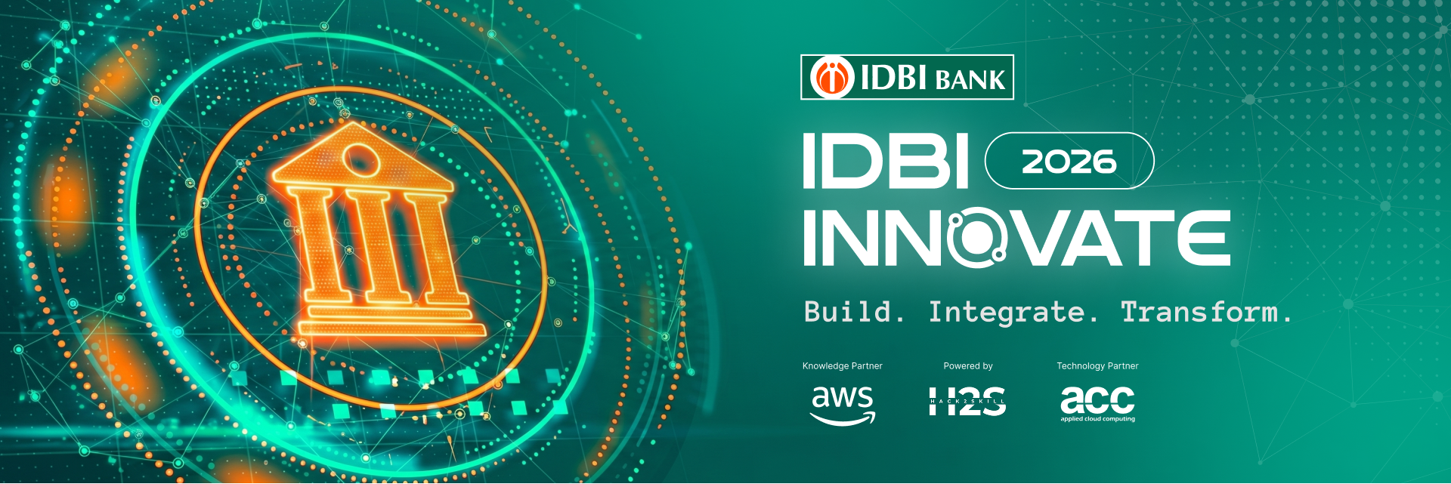

Team Details
Team name: VibeArc
Team leader: Saeed Khan
Members: Roshan Kasmani · Saeed Khan · Zubiya Quadri
Problem Statement: Agentic Compliance — turning SEBI regulatory circulars into tracked, auditable operational action for IDBI Bank.
RegLens-AI
Agentic SEBI compliance,
automated end-to-end.

Slide 2
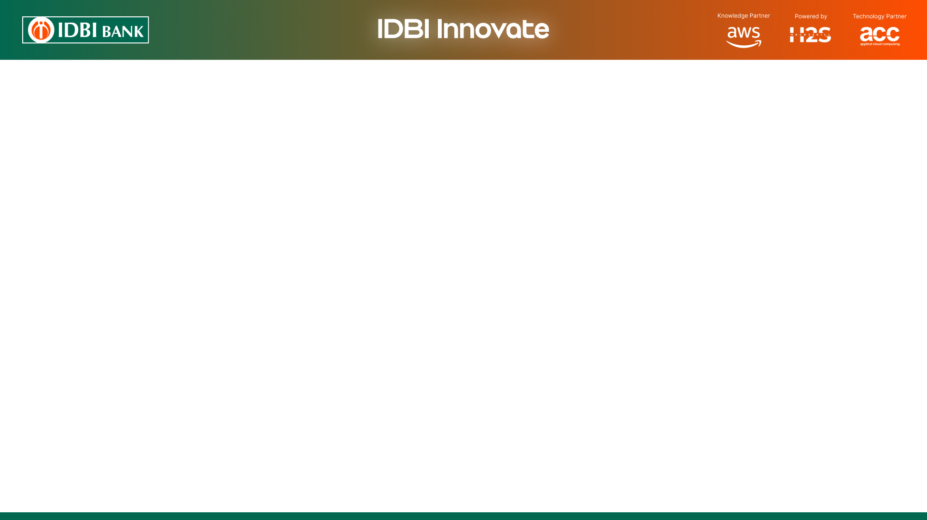




Brief about the idea
IDBI Bank operates under a continuously evolving SEBI regulatory framework — as a Depository Participant, Banker to Issue and through its capital-market functions. Today, interpreting each circular and converting it into tracked, provable action is manual, slow and penalty-prone.
Read & Understand
Track & Comply
Detect & Prove
AI ingests every SEBI circular and extracts machine-actionable obligations — with a verbatim citation back to the exact clause.
Each obligation auto-generates a live compliance checklist across the right department, with evidence capture and status.
Gaps are flagged by severity before they become findings; every action is written to an immutable audit trail.
The shift: from manual legal interpretation of regulatory text → automated, citation-grounded operational compliance.

Slide 3



Opportunities
How different is it from any of the other existing ideas?
How will it be able to solve the problem?
USP of the proposed solution
How different is it?
Existing GRC / compliance tools are document stores and manual checklists — a human still reads each circular and types in the rules. RegLens-AI automates the interpretation itself: an agent reads the regulation and produces structured, machine-actionable obligations.
How it solves the problem
It closes the gap between a SEBI circular being issued and IDBI acting on it — auto fan-out of obligations to the right function, live tracking, and gap detection that surfaces risk before it becomes a regulatory finding or penalty.
USP of the solution
Every obligation is grounded in a verbatim citation (page + section) — fully auditable, zero hallucination. Combined with automatic cross-function fan-out and an immutable audit trail. And it is already built and running end-to-end.

Slide 4







List of features offered by the solution
AI Circular Ingestion
Agentic Extraction
Automatic Fan-out
Evidence Management
Docling + OCR parse any SEBI PDF into structured, page-tagged text.
LangGraph + Gemini extract obligations, citation-validated against the source.
One publish creates checklist items across every applicable function/entity.
Presigned uploads, auto status-flip to compliant, fully attributed.
Gap Detection
Immutable Audit Trail
Compliance Dashboard
Multi-entity Isolation
Missing evidence, past deadlines & stale proof flagged by severity.
Every action logged once, never edited — a complete supervisory record.
Live status, open gaps by severity, upcoming deadlines & analytics.
Each department/entity sees only its own data — secure by construction.
Plus: background job orchestration (Trigger.dev) with retries · scheduled auto gap-detection · one-click failed-run retry

Slide 5



Process flow diagram or Use-case diagram
01
02
03
04
05
06
07
›
›
›
›
›
›
Ingest
Parse
Embed
Extract
Review
Fan-out
Track
SEBI circular PDF uploaded to secure storage
Docling + OCR extract structure & page-tagged text
Chunks indexed into pgvector for grounded retrieval
LangGraph + Gemini propose citation-backed obligations
Compliance officer verifies & publishes
Checklists auto-created across applicable functions
Evidence, gap detection & immutable audit trail
Publish once — the whole compliance ecosystem updates. Event-driven obligations (e.g. a SCORES complaint) spawn their checklist item the moment the event is logged, with the deadline clock computed automatically.

Slide 6
Wireframes/Mock diagrams of the proposed solution (optional)
Compliance Dashboard
Obligation Detail — citation-grounded
IA-GRIEVANCE-RESOLVE-01
Checklist
Compliant
Open Gaps
128
96
9
“...resolve grievances via SCORES within 21 days...”
Status donut · gaps by severity
upcoming deadlines list
Verbatim citation · p.14 · §4.2 [ Publish ]
Checklist Item — evidence & audit
Gap Triage — by severity
PENDING
COMPLIANT
GAP
CRITICAL
HIGH
MEDIUM
LOW
↑ Evidence upload → auto-flip to Compliant
✓ Audit trail: publish · status change · upload
Missing evidence · past deadline · stale proof
Resolve with a note → logged to audit trail

Slide 7




Architecture diagram of the proposed solution
FRONTEND
API + AGENTS
DATA + STORAGE
›
›
• TanStack Start · React 19
• Hono · tRPC (type-safe)
• PostgreSQL · pgvector
• TanStack Router / Query
• LangGraph · Gemini 2.5 Flash
• Prisma ORM
• tRPC client · shadcn/ui
• Gemini Embedding 001
• Cloudflare R2 objects
Python Docling Sidecar
Structure-aware PDF parsing + PaddleOCR fallback, isolated & independently deployable.
Trigger.dev Background Jobs
Retryable ingestion & fan-out tasks, scheduled gap detection, run observability.
Auth & multi-tenant isolation via Clerk · every query scoped to the entity's own organization

Slide 8

Technologies to be used in the solution
Frontend
TanStack Start
React 19
TanStack Router
TanStack Query
tRPC
Backend / API
Hono
tRPC
Node / Bun
Zod
Clerk Auth
AI / ML
LangGraph
Gemini 2.5 Flash
Gemini Embedding 001
Docling
PaddleOCR
Data / Infra
PostgreSQL
pgvector
Prisma
Cloudflare R2
Trigger.dev

Slide 9


Estimated implementation cost (optional)
Cloud-native and usage-based — no heavy licensing. Indicative monthly cost for an IDBI pilot deployment:
Component
Notes
Cost band
LLM & Embeddings (Gemini)
Usage-based per circular processed
Low
Managed Postgres + pgvector
Serverless / managed tier
Low
Object storage (Cloudflare R2)
Documents & evidence, egress-free
Very low
Background jobs (Trigger.dev)
Free tier covers pilot volumes
Free
Auth (Clerk)
Free tier for pilot org
Free
Compute (API + sidecar)
Small container instances
Low
Cost scales with usage, not seats — a pilot runs at a fraction of the cost of a single SEBI penalty avoided.

Slide 10
Snapshots of the prototype
RegLens-AI · Dashboard
Obligation · citation-grounded
Checklist items
Compliant
Open gaps
Published
IA-GRIEVANCE-RESOLVE-01 PUBLISHED
128
96
9
24
VERBATIM CITATION
“...resolve investor grievances via SCORES within 21 days of receipt...”
Checklist status breakdown
gaps by severity · upcoming deadlines
Master Circular for IA · p.14 · §4.2
Checklist item · evidence + audit
Gap triage
Risk Profiling — Client A
COMPLIANT
Past Deadline
CRITICAL
• Evidence uploaded — 12 Jul
Missing Evidence
HIGH
• Status → Compliant
• Audit: publish · upload · status
Stale Evidence
MEDIUM
Resolve with a note → written to audit trail

Slide 11
Prototype Performance report/Benchmarking
Minutes
6
0
100%
circular → tracked obligations
obligations auto-extracted
hallucinated obligations
auditable
(vs. days of manual review)
from one real SEBI circular
citation-validation rejects them
every obligation cites its source
MANUAL COMPLIANCE TODAY vs. REGLENS-AI
Task
Manual today
RegLens-AI
Interpret a new circular
Days of manual legal review
Automated in minutes, citation-backed
Map to operational action
Spreadsheets, uneven across teams
Auto fan-out to every applicable function
Detect compliance gaps
Reactive — found during audits
Proactive — flagged by severity, pre-finding
Prove compliance
Manual trail reconstruction
Immutable audit log, always ready

Slide 12





Additional Details/Future Development (if any)
Multi-category expansion
Predictive deadline alerts
Extend beyond one function to every SEBI intermediary type — stockbrokers, DPs, RTAs, AMCs — same engine, new data.
Deadline-aware notifications that warn before an obligation lapses into a gap or a finding.
IDBI system integration
Regulatory change diffing
Connect to IDBI's internal compliance, document and workflow systems for straight-through processing.
Detect when a new circular supersedes or amends an existing obligation and re-propagate automatically.
Supervisory analytics view
Scale-out fan-out
Aggregate, board-ready compliance posture across all functions and entities.
Batch background processing so a large publish fans out across thousands of items in parallel.

Slide 13



Provide links to your:
GitHub Public Repository
Demo Video Link (3 Minutes)
Final Product Link
GitHub Public Repository
github.com/SaeedKhan36/reglens-ai
Demo Video (3 minutes)
[ paste your demo video link ]
Final Product Link
[ paste your deployed app link ]

Slide 14


THE BOTTOM LINE FOR IDBI BANK
Turn every SEBI circular into tracked, auditable action —
before the penalty, not after.
Built & running end-to-end
Citation-grounded & auditable
Scales to every SEBI function

Slide 15
