Slide 1
Role of ryanodine receptors in mediating metaplasticity in hippocampus

Slide 2

Neuroplasticity

Slide 3
The Synapse

Slide 4
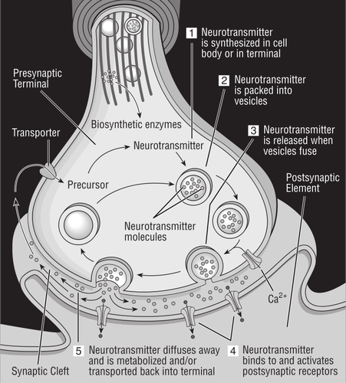
Microscopic junction between neurons
Changes in synaptic strength - neuroplasticity
Biological basis of memory formation

Slide 5
Calcium Signalling and Neuroplasticity

Slide 6
Brief account of second messenger - Calcium
An increase in intracellular calcium is believed to be a precursor event to short- and long term modifications to synaptic strength
Studies about role of calcium broadly suggest that
It triggers an increase in glutamate receptors
Autophosphorylation of kinase - which stores information for a long time
Change in effectiveness of synapse
(E. Kandel; E. Gamble and C. Koch, 1987)

Slide 7
Ryanodine receptor model

Slide 8
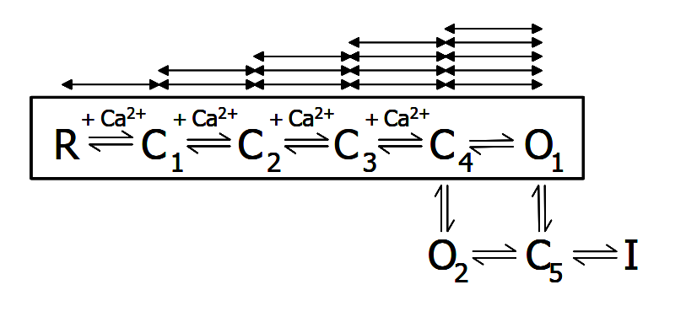
Dura et al. 2002
Reaction-diffusion CICR model
States C₁ - C₅ are closed states
O₁ and O₂ are open states
I is long-lived closed state (Inactive State)
Transitions in the box are Ca²⁺ dependent

Slide 9
Simulation Results

Slide 10
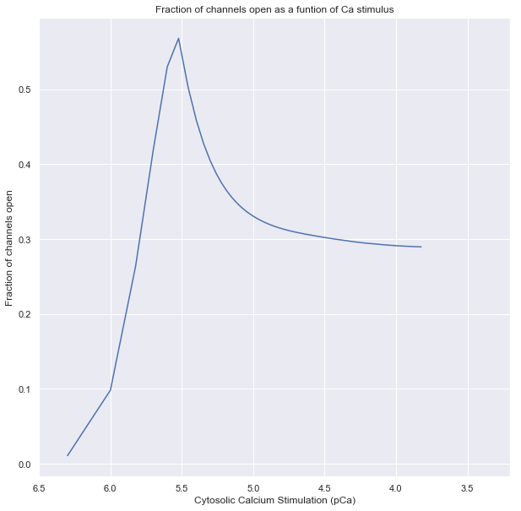
Slow inactivation
Deviation from canonical bell shaped curve
Peak occurs at ~1μM range

Slide 11
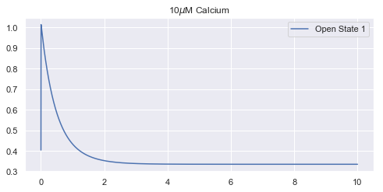
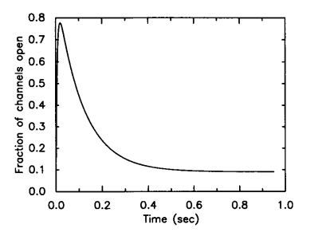
Adaptation to a constant Calcium Stimulus
Simulation Result
Y. Tang et al. 1994 Experimental Data

Slide 12
Integrating ryanodine receptor into spine model

Slide 13
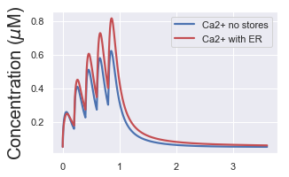
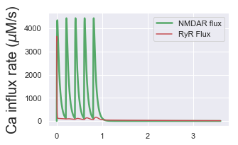
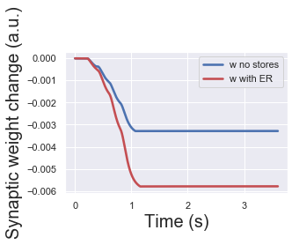
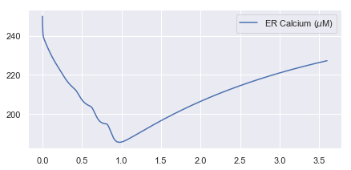
5 inputs at 5Hz for 30 ryanodine receptors

Slide 14
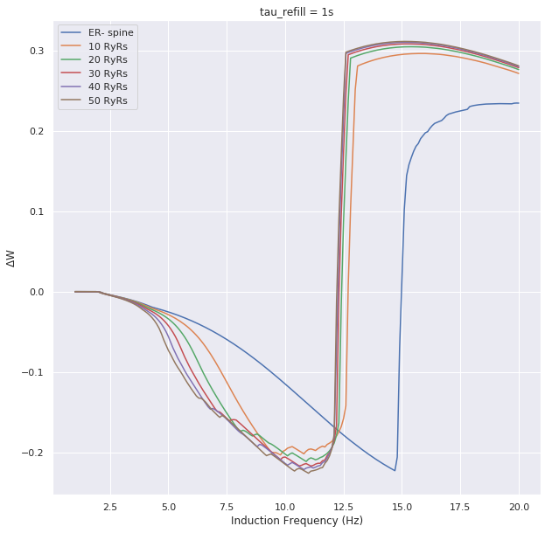
50 input APs
Frequency varied from 0.1Hz to 20Hz
Plotted against change in synaptic strength
Highlights:
The LTD induction point (~2Hz) is the same even in presence of RyRs
The breakaway point (~3Hz) is same for all cases
Early LTP induction (needs further support)
Rate Dependent Plasticity Protocol

Slide 15
Preliminary Conclusions

Slide 16
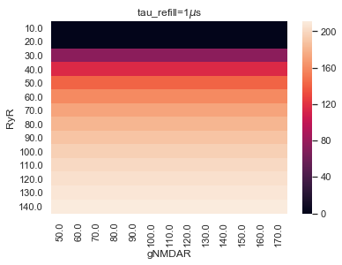
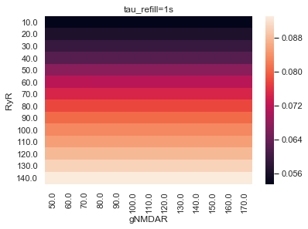
Store Refilling Time: 1s
Evidence suggests that maximum calcium transients evoked are of the order of 1000 nM. An instantaneous refilling thus seems physiologically inconsistent

Slide 17
Adaptive Thresholds in Shouval Model for LTD and LTP induction
Magali Reyes and Patric K. Stanton reported role of RyRs in presynaptic and IP3 receptors in postsynaptic terminal to bring about metaplasticity together
Support exists for lowering in LTD induction frequency with an increase in synaptic strength depending on
Retrograde Messengers like NO
Increase in spine volume causing resting calcium concentration to drop

