Slide 1


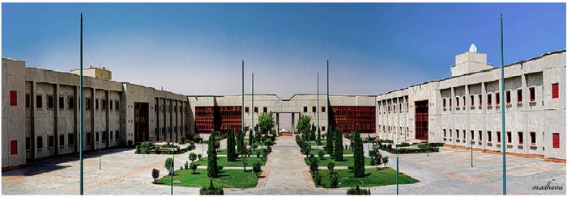

26th Annual IASBS Meeting on Condensed Matter Physics
July 7-9, 2021 (16-18 Tir 1400)
Organized by:
Department of Physics
(Condensed Matter, Soft Biological Physics, and Complex Systems Groups)
The Meeting:
The aim of this meeting is to bring together experimental and theoretical scientists in the field of condensed matter, soft matter & biological physics, and complex systems to present their most recent research and to create an atmosphere for fruitful discussion. The poster session is provides an excellent opportunity for young researchers and students to gain invaluable experience through personalized on the spot Q&A.
Scientific Committee:
Davood Abbaszadeh (IASBS)
Saeed Abedinpour (IASBS)
Zahra Faraei (IASBS)
Farshid Mahammadrafei (IASBS)
Alireza Valizadeh (IASBS), Chair
Mina Zarei (IASBS)
Deadline for registration and paper submission
May 20, 2021 (30 Ordibehesht 1400)
To register and for more information visit:
https://iasbs.ac.ir/~condmat-meeting/m26
Address:
Institute for advanced studies in basic sciences (IASBS), PO Box 45195-1159, Zanjan, Iran,
Tel: (+98)24 3315 2212, Fax: (+98) 3315 2104

