Slide 1


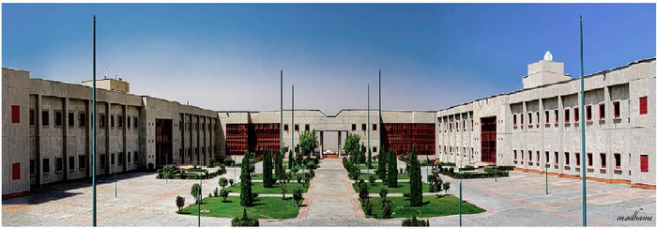

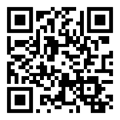
26th Annual IASBS Meeting on Condensed Matter Physics
July 7-9, 2021 (16-18 Tir 1400)
Organized by:
Department of Physics
(Condensed Matter, Soft Matter & Biological Physics, and Complex Systems Groups)
The Meeting:
The 26th annual IASBS meeting on condensed matter physics will be held online this year. The aim of this meeting is to bring together experimental and theoretical scientists in the fields of condensed matter, soft matter & biological physics, and complex systems to present their most recent research and to create an atmosphere for fruitful discussion. The poster session provides an excellent opportunity for young researchers and students to gain invaluable experience through online discussion.
Scientific Committee:
Davood Abbaszadeh (IASBS)
Saeed Abedinpour (IASBS)
Zahra Faraei (IASBS)
Farshid Mahammadrafei (IASBS)
Alireza Valizadeh (IASBS), Chair
Mina Zarei (IASBS)
Deadline for registration and abstract submission
May 21, 2021 (31 Ordibehesht 1400)
For more information visit:
https://iasbs.ac.ir/~condmat-meeting/m26
For registration and
abstract submission visit:
http://www.psi.ir/f/meeting.cm26
Address: Institute for advanced studies in basic sciences (IASBS), PO Box 45195-1159, Zanjan, Iran,
Tel: (+98)24 3315 2212, Fax: (+98) 3315 2104

Slide 2
26th Annual IASBS Meeting on Condensed Matter Physics
July 7-9, 2021 (16-18 Tir 1400)
The 26th annual IASBS meeting on condensed matter physics will be held online this year. The aim of this meeting is to bring together experimental and theoretical scientists in the fields of condensed matter, soft matter & biological physics, and complex systems to present their most recent research and to create an atmosphere for fruitful discussion. The poster session provides an excellent opportunity for young researchers and students to gain invaluable experience through online discussion.
Deadline for registration and abstract submission
May 21, 2021 (31 Ordibehesht 1400)
For more information visit:
https://iasbs.ac.ir/~condmat-meeting/m26
Registration and Abstract Submission
For registration and abstract submission visit:
http://www.psi.ir/f/meetingcm26
Scientific Committee:
Davood Abbaszadeh (IASBS)
Saeed Abedinpour (IASBS)
Zahra Faraei (IASBS)
Farshid Mahammad-Rafiee (IASBS)
Alireza Valizadeh (IASBS), Chair
Mina Zarei (IASBS)
Address: Institute for advanced studies in basic sciences (IASBS), PO Box 45195-1159, Zanjan, Iran,
Tel: (+98)24 3315 2204, Fax: (+98) 3315 2104

Slide 3
26th Annual IASBS Meeting on Condensed Matter Physics
July 7-9, 2021 (16-18 Tir 1400)
The 26th annual IASBS meeting on condensed matter physics will be held online this year. The aim of this meeting is to bring together experimental and theoretical scientists in the fields of condensed matter, soft matter & biological physics, and complex systems to present their most recent research and to create an atmosphere for fruitful discussion. The poster session provides an excellent opportunity for young researchers and students to gain invaluable experience through online discussion.
Deadline for registration and abstract submission
May 21, 2021 (31 Ordibehesht 1400)
June 4, 2021(14 Khordad 1400)
For more information visit:
https://iasbs.ac.ir/~condmat-meeting/m26
Registration and Abstract Submission
For registration and abstract submission visit:
http://www.psi.ir/f/meetingcm26
Scientific Committee:
Davood Abbaszadeh (IASBS)
Saeed Abedinpour (IASBS)
Zahra Faraei (IASBS)
Farshid Mahammad-Rafiee (IASBS)
Alireza Valizadeh (IASBS), Chair
Mina Zarei (IASBS)
Address: Institute for advanced studies in basic sciences (IASBS), PO Box 45195-1159, Zanjan, Iran,
Tel: (+98)24 3315 2204, Fax: (+98) 3315 2104

