Slide 1
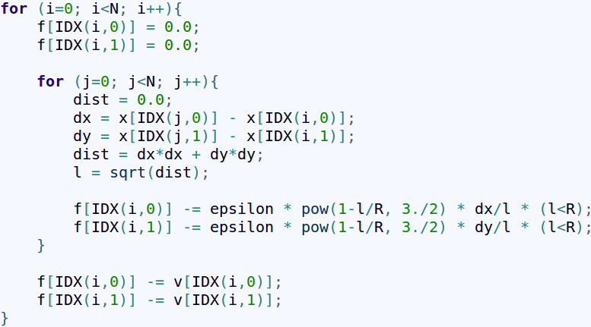
Basic N-body code
All-all interactions
Hertzian elastic sphere potential
2D with one dimensional arrays

Slide 2
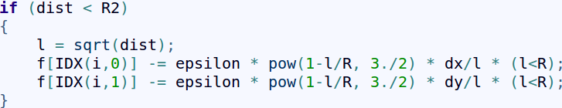
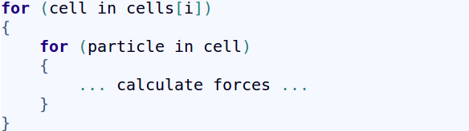
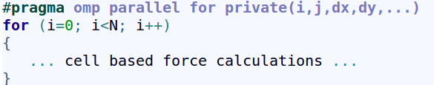
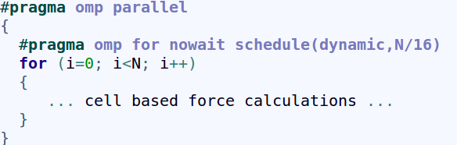
Test radius – only do calculations if necessary
4.2x
Half list – use Newton's third law
8.1x
Cell based neighbors – large rewrite
110x
Change from column to row major
114x
OpenMP parallelism
172x
Non-blocking OpenMP parallelism
844x
Translate to CUDA for GPUs
27000x

Slide 3
Core i7 desktop
-O0
-Ofast
Test radius – only do calculations if necessary
4.2x
7.6x
Half list – use Newton's third law
8.1x
13.6x
Cell based neighbors – large rewrite
110x
113x
Change from column to row major
114x
116x
OpenMP parallelism
172x
98x
Non-blocking OpenMP parallelism
844x
623x
Translate to CUDA for GPUs
27,000x
20,000x

