Slide 1
Phase-Dependent Suppression of Neuronal Oscillations
Saeed Taghavi¹, Alireza Valizadeh¹
¹ Institute for Advanced Studies in Basic Sciences (IASBS)
Conference on Neuroscience and the Physics of Neuronal Systems
Sharif University of Technology
20 February 2020

Slide 2
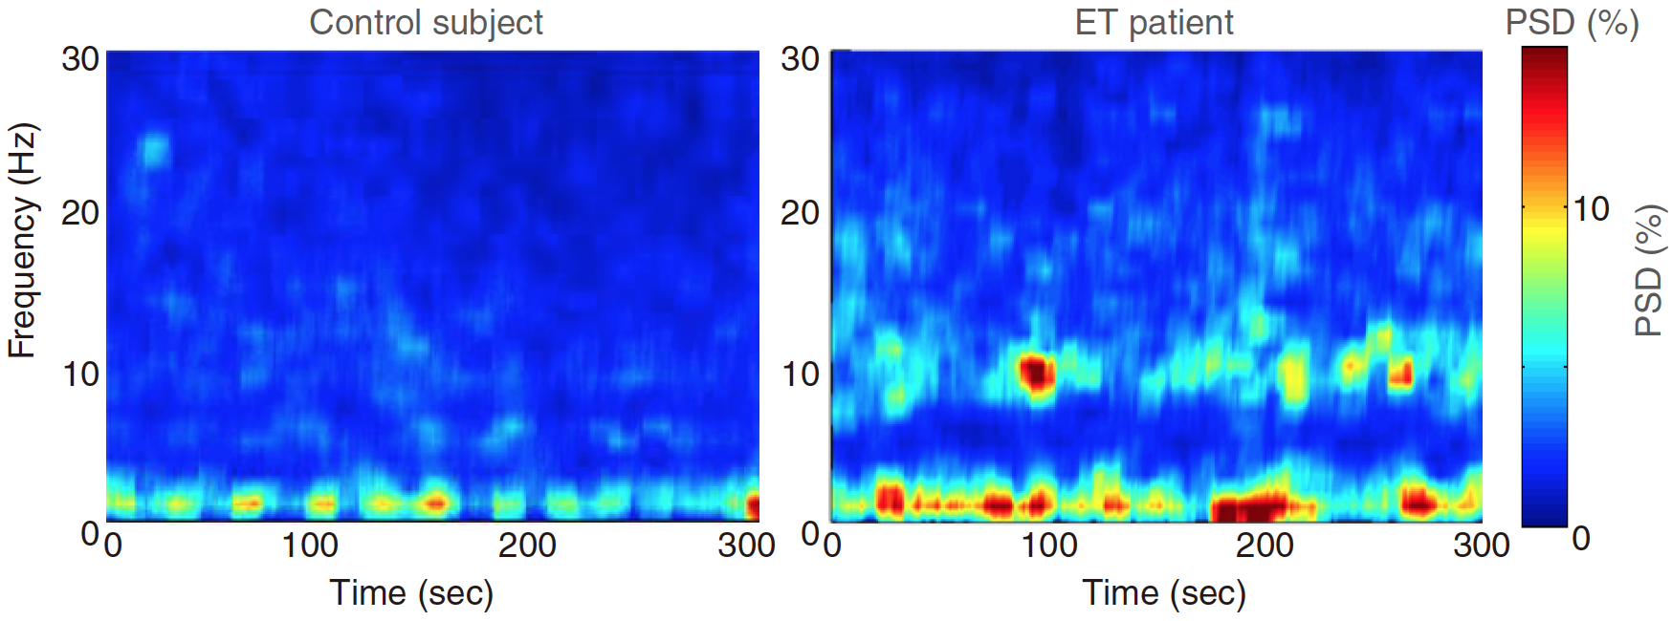
What is the problem?
Neural synchrony in brain disorders
Certain brain disorders are associated with abnormaly neural synchronization.
[1] Luft, Frauke, et al. Sensors 19.19 (2019): 4301. [2] Uhlhaas, Peter J., and Wolf Singer. Neuron 52.1 (2006): 155-168.

Slide 3
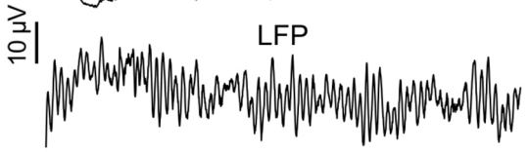
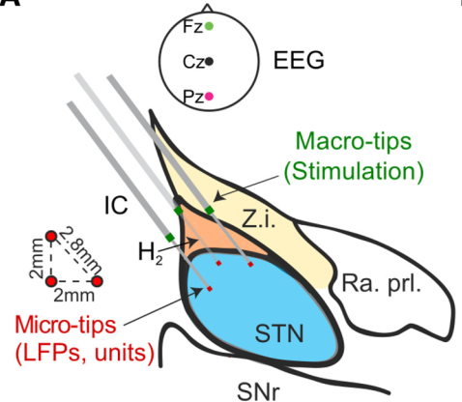
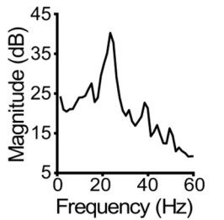
What is the problem?
Neural synchrony in brain disorders
A prominent example is the amplified persistent beta-frequency oscillations recorded from the cortex and subthalamic nucleus of Parkinsonian brains.
[1] Holt, Abbey B., et al. Journal of Neuroscience 39.6 (2019): 1119-1134.

Slide 4
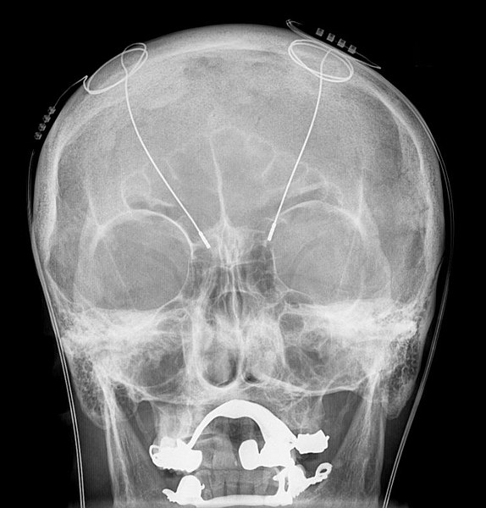
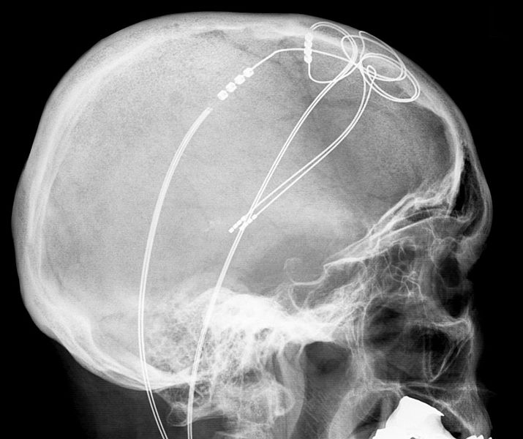
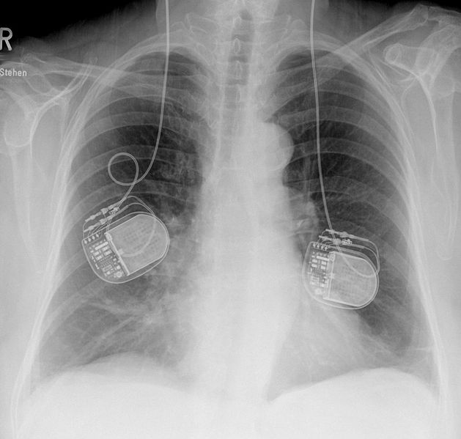
Deep Brain Stimulation (DBS)
DBS is known to be an effective treatment
Deep brain stimulation is a surgical therapy involving electrical stimulation of the brain via chronically implanted electrodes.
Once implanted, there are a number of stimulation parameters which must be set by the clinician in order to suppress the pathological symptoms, while not inducing any unwanted side effects.
Computational models can be used to estimate the optimal parameter settings for DBS to aid this process.
[1] Dronkers, N. F., and J. V. Baldo. Encyclopedia of neuroscience. Ed. Larry R. Squire. Elsevier, 2009.

Slide 5
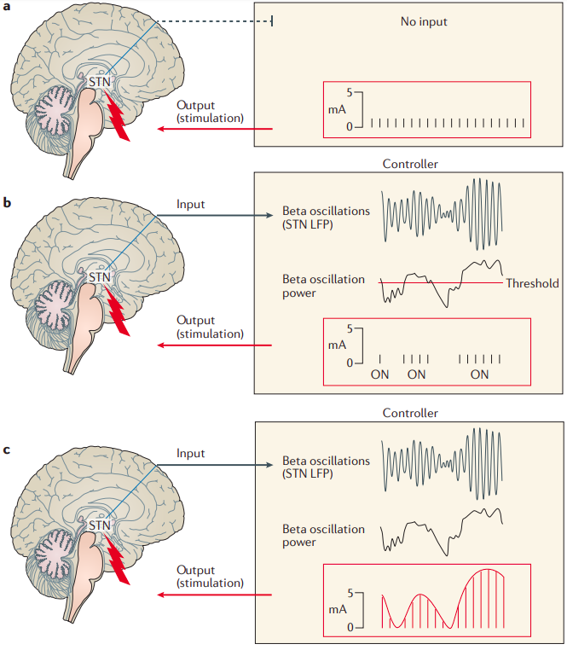
Deep Brain Stimulation designs
open-loop DBS: Fixed stimulation setting
High-frequency DBS ( f >100Hz )
Low-frequency DBS ( f ≤100Hz )
closed-loop responsive (on-demand) DBS: the power of the input signal (one variable) gates the controller’s output. Fixed-amplitude stimulation according to the power of beta oscillations reaches a given threshold in an all-or-nothing fashion.
In closed-loop adaptive DBS, several input variables gate several output variables, enabling changes in input to lead to changes in output
[1] Bouthour, Walid, et al. Nature Reviews Neurology 15.6 (2019): 343-352.

Slide 6
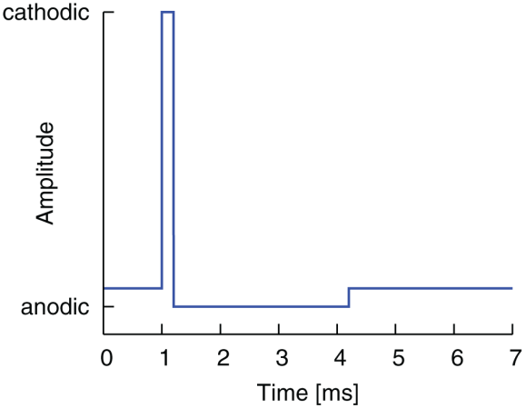
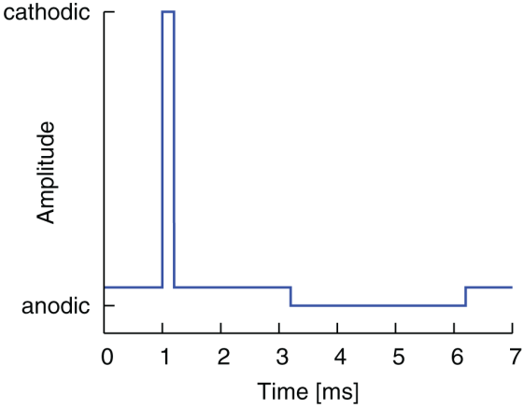
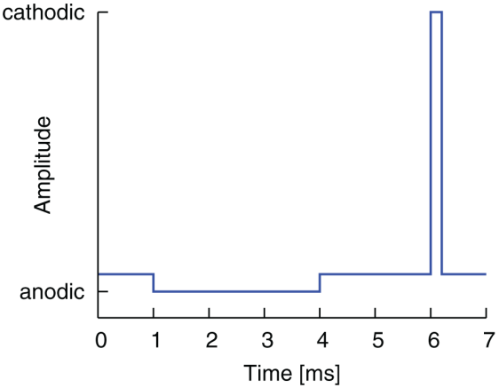
Modified pulse shapes for effective neural stimulation
delay between the anodic and cathodic pulse parts
Different modified pulse shapes could have the potential:
- to reduce side effects;
- to avoid tissue or electrode damage;
- and to increase battery lifetimes.
[1] Hofmann, Lorenz, et al. Frontiers in neuroengineering 4 (2011): 9.

Slide 7
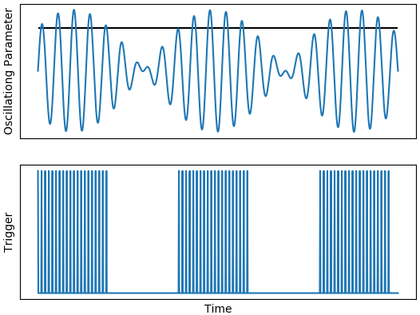
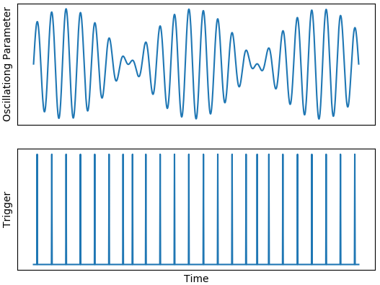
Deep Brain Stimulation designs
‘closed-loop’ approach involves delivering stimulation according to the ongoing brain activity.
It could improve efficiency and reduce side effects.

Slide 8

Success of closed-loop DBS
The success of closed-loop DBS depends on the design of a stimulation strategy that minimizes oscillations in neural activity associated with symptoms.
An important step to this end is to construct a mathematical model, which can describe how the brain oscillations should change when stimulation is applied at a particular state of the system.

Slide 9
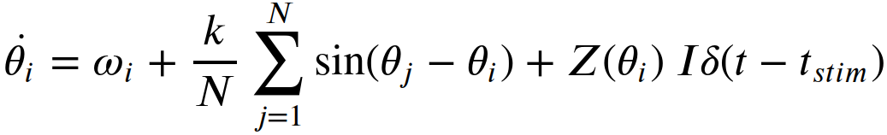
Model and Method
A network of coupled oscillators to model the neuronal populations that generate pathological oscillations.
[1] Ko, Tae-Wook, and G. Bard Ermentrout. Physical Review E 79.1 (2009): 016211.

Slide 10
Model and Method
A network of coupled oscillators to model the neuronal populations that generate pathological oscillations.
coupling constant
equals 1 if stimulation is applied at time t and 0 otherwise
natural frequency of oscillator i
PRC of the oscillator i
Angular frequency of the oscillator i
Phase of the oscillator i
intensity of stimulation
Total number of the oscillators

Slide 11
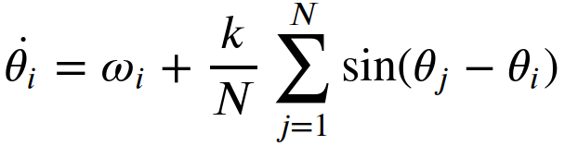
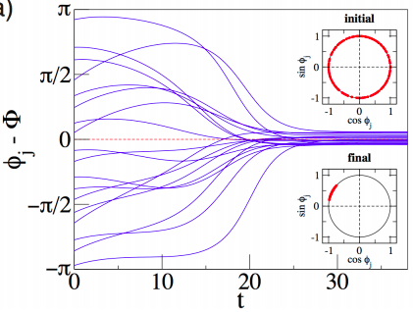
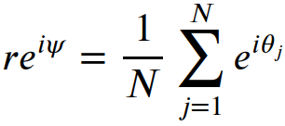



Model and Method
N= 100 (only 18 are shown)
𝜔 is random normal ( 𝜇=1.0, 𝜎=0.1)
Numerical integration was performed using Euler method with a time step of dt ≈ 0.01.
if 𝜓=0 then

Slide 12
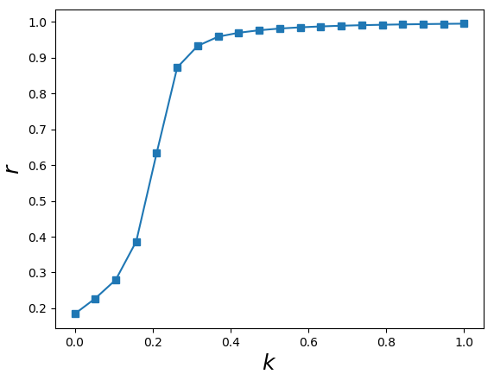
Model and Method
N= 1000
𝜔:
random normal ( 𝜇=1.0, 𝜎=0.1)
𝜃₀ :
random uniform ∈ (0,2𝜋)
Each point:
average of four systems with
different initial conditions.
Numerical integration:
Euler method, dt ≈ 0.01.

Slide 13
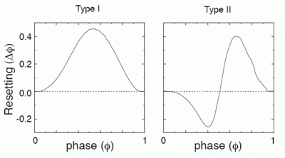
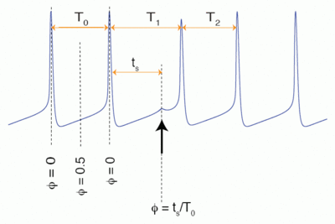

Phase response curve (PRC)
The phase response curve is measured by delivering a precisely timed perturbation to anoscillation and measuring the effect on the cycle period.
`
in Type I, the phase is only advanced by a small depolarization produced by excitatory postsynaptic potentials, whereas
in Type II either an advance or delay could be produced depending upon the timing of the perturbation.
[1] Canavier, Carmen C. "Phase response curve." Scholarpedia 1.12 (2006): 1332.

Slide 14
Model and Method
N= 1000
𝜔 is random normal ( 𝜇=1.0, 𝜎=0.1)
𝜃₀ is random uniform ∈ (0,2𝜋)
k ≈ 0.4
I ≈ 5
Numerical integration: Euler method (dt ≈ 0.01)

Slide 15
Results

Slide 16
Results

Slide 17
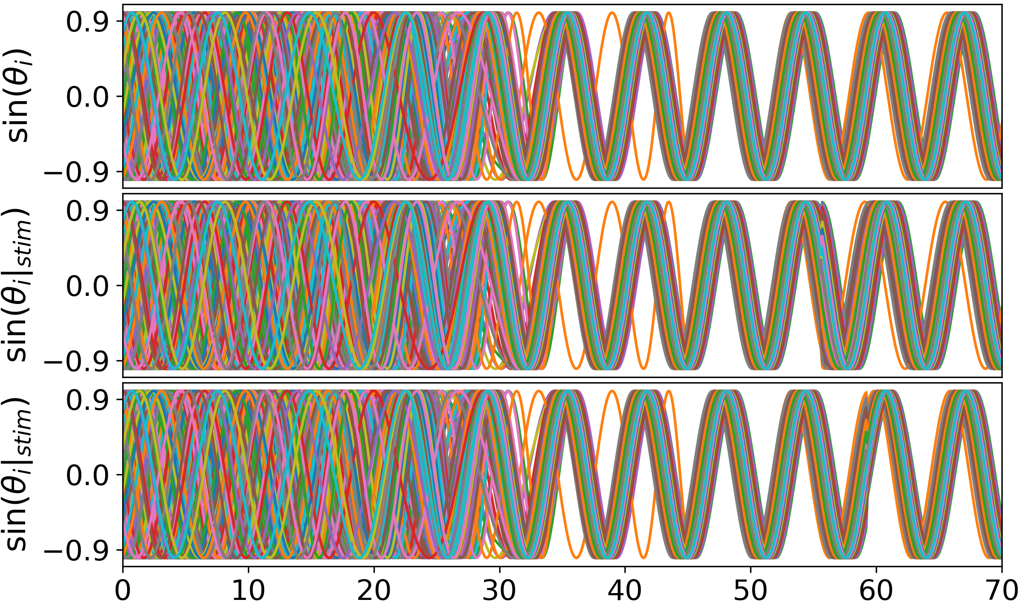
Results
time

Slide 18
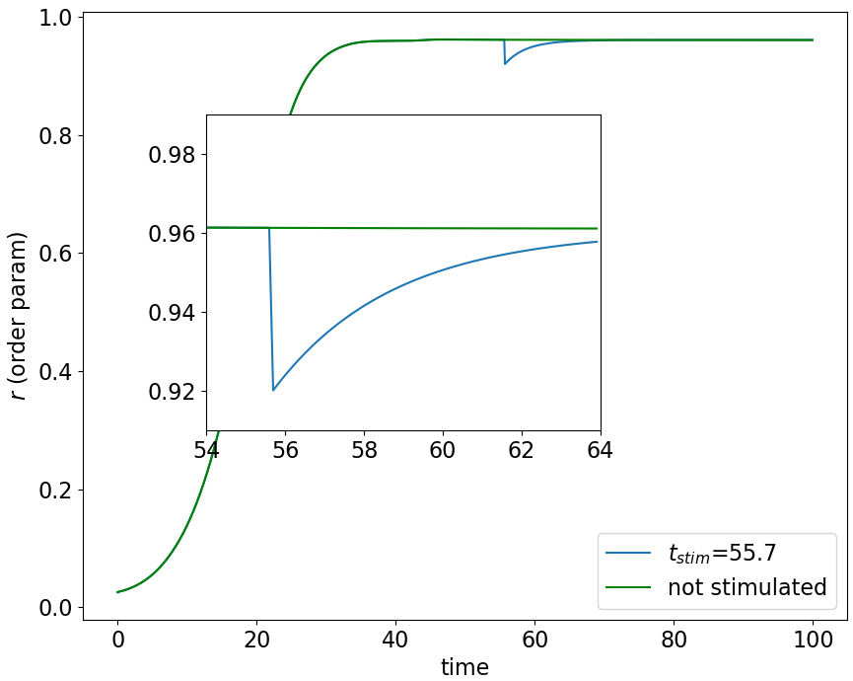
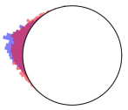
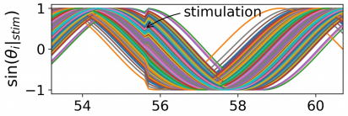
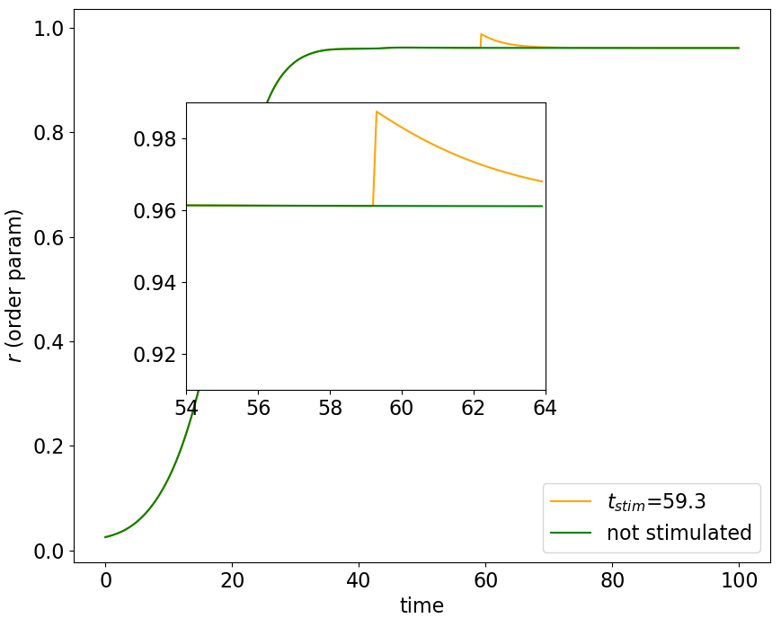
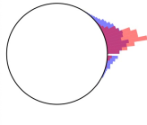
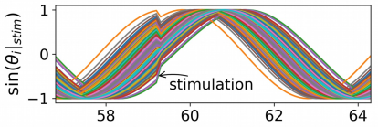
Results

Slide 19
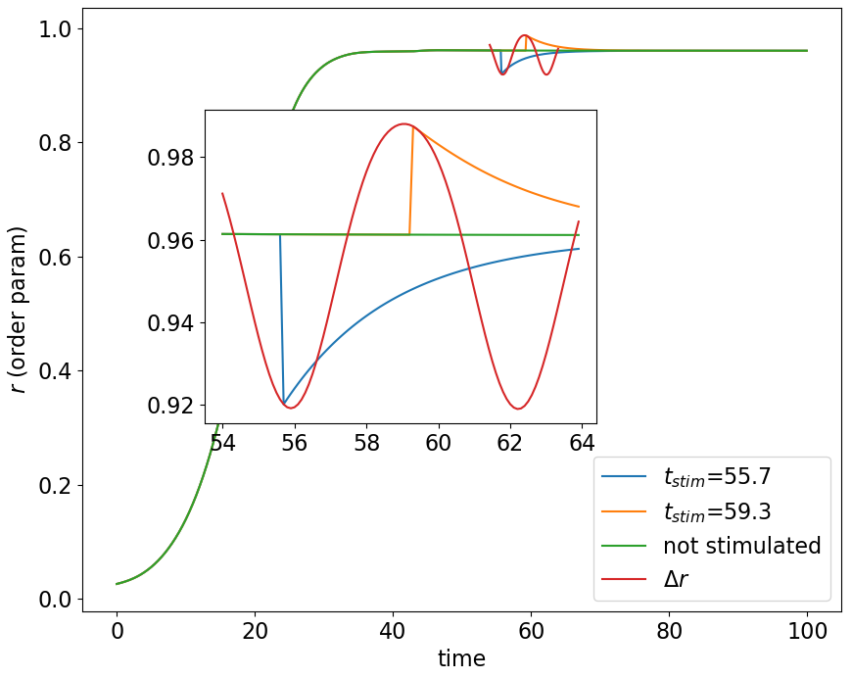
Results

Slide 20
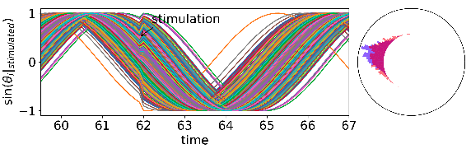
Results

Slide 21
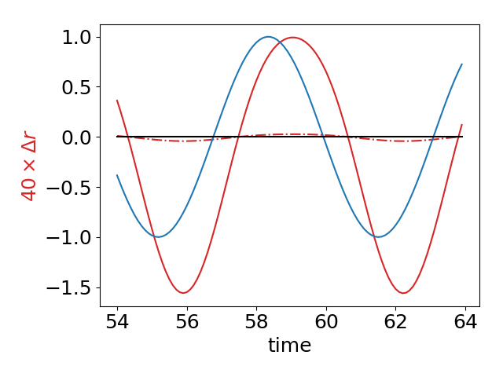

Results

Slide 22
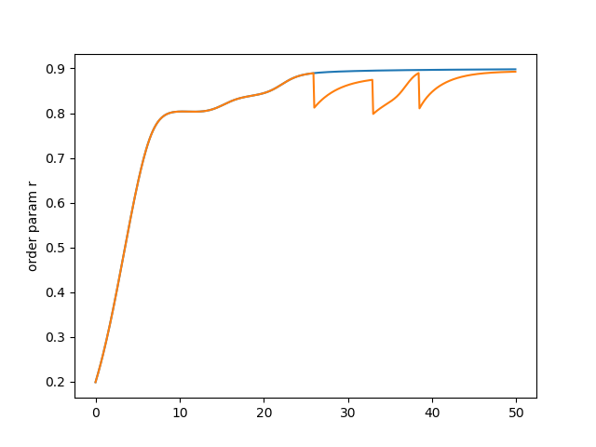
Results
Applying multiple stimulations

Slide 23
Conclusion
we have shown that the amplitude of collective oscillations could be modulated depending on the specific phase at which the stimulation is applied.
we could predict the good time for applying stimulation to get the maximum reduction in the oscillation amplitude based on the phase response curve (PRC) of oscillators.

Slide 24
Future Works
time-delays are essential because neuronal networks have finite signal transmission speed. In the next step we are going to include the effects of interaction time delay to our model.
In computational models used for developing and optimizing stimulation techniques, one should take into account spike timing-dependent plasticity (STDP), a fundamental property of neuronal tissue, according to which synaptic weights depend on the neuronal firing pattern. Neural networks may learn pathologically strong synaptic interactions. The novel desynchronizing stimulation protocols are designed to invert this pathological process.

