Slide 1
Sales Forecasting
Author Name :
Saeed Afrough
Nov 2023

Slide 2
Agenda
Introduction
Hypothesis
Objectives
Model Building
Data Overview
Model Evaluation
Data Exploration
Conclusion

Slide 3
Introduction :
Welcome to the Sales Forecasting dataset documentation! Within these pages, we'll explore the features of this dataset, providing insightful analysis and answers to various business-related questions. This information aims to assist in making informed decisions based on the data
Dataset source :
The data for this project has been sourced from the Kaggle

Slide 4
Objectives :
Exploratory Data Analysis (EDA)
Preprocessing
Model Building
Interpretation and Insights
Decision Making

Slide 5
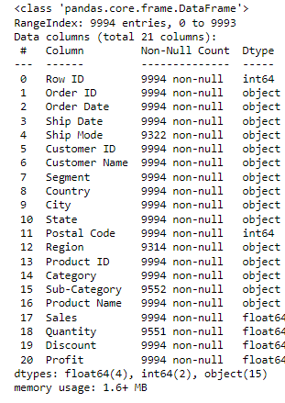
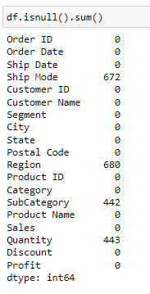
Data Description
9994
Rows
21
Features
4
Features with missing value

Slide 6
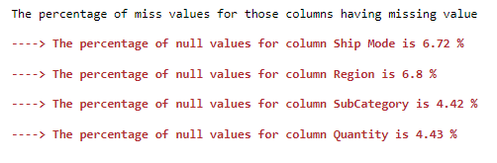
Exploratory Data Analysis
Converting Order Date and Ship Date to date format
Converting Postal code to Object
Dropping Irrelevant Features : Row ID‘ and 'Country'
Handling Missing Values
I imputed Ship Mode with the same order’s ship mode using Order_ID
I imputed Region by using State(Same states have same Region)
For Sub-Category
All the same Product ID's have same sub-category I extrac new feature from Product id , the second part of it and make a dictionary between it and sub category and use it to impute miss values
For imputing Quantity feature i used KNNImputer

Slide 7

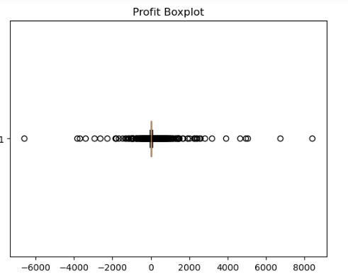
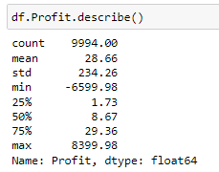
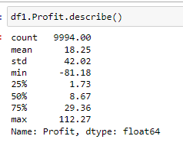
Handling Outliers
Data set has Only 1168 Extreme outliers in Profit feature
I Put extreme outliers into the range of q3 + 3 * iqr and q1 - 3 * iqr
With Outlier
Without Outlier

Slide 8
Feature Engineering and Extracting
List of features extracted from Dataset :
Order_year, Order_month , Order_DayInMonth , Order_Dayname from Order Date
Ship_year, Ship _month , Ship _DayInMonth , Ship _Dayname from Ship Date
ship_duraition from Ship Date - Order Date
Binary Feature HasDiscount=1 for those orders have discount and =0 for those orders do not have discount

Slide 9

Hypothesis tests
The Shapiro test assesses normality distribution across all groups, while the Levene test is utilized to check homoscedasticity
There is a significant difference in the Median sales among different regions
There is no significant difference in the Median sales among different segments
There is a significant difference in the Median sales among different Categories
There is no significant difference in the Median sales among different duration ship
There is no significant difference in the Median sales among different ship modes
There is no significant difference in the Median ship duration among different ship modes

Slide 10
Uni-variate Analysis

Slide 11
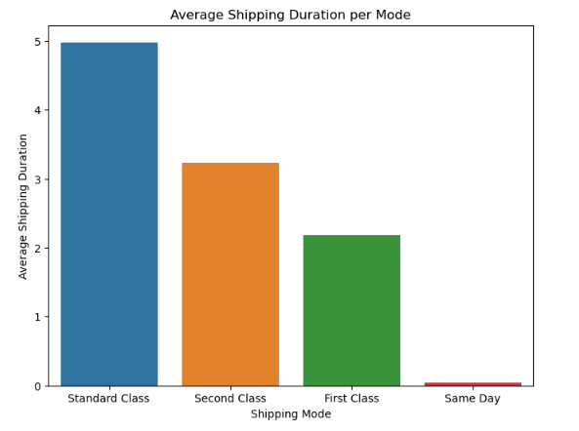
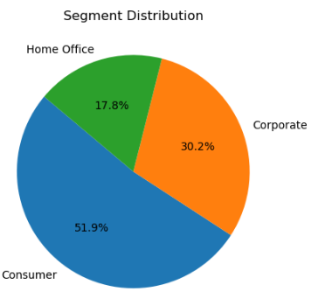
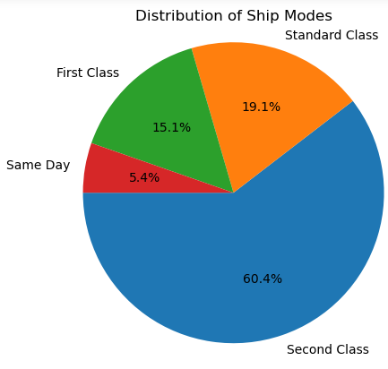
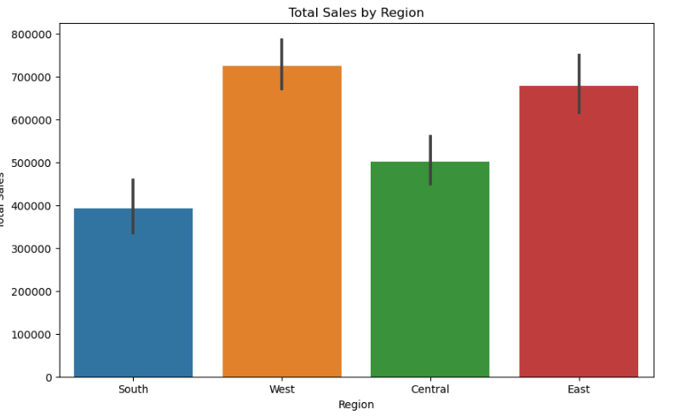
Standard Class is the most commonly used, followed by Second Class, First Class, and Same Day, in decreasing order of prevalence
It indicates the relative presence of each segment, illustrating that Consumer holds the largest portion
Among the top 10 cities, New York City demonstrates the highest number of sales, while Springfield has the lowest count.
In terms of states, California represents the highest percentage of sales, followed by New York and then Texas.
The West region exhibits the highest share of sales, followed by the East, Central, and finally, the South.
The largest share of sales is attributed to Office Supplies, followed by Furniture, and then Technology.

Slide 12
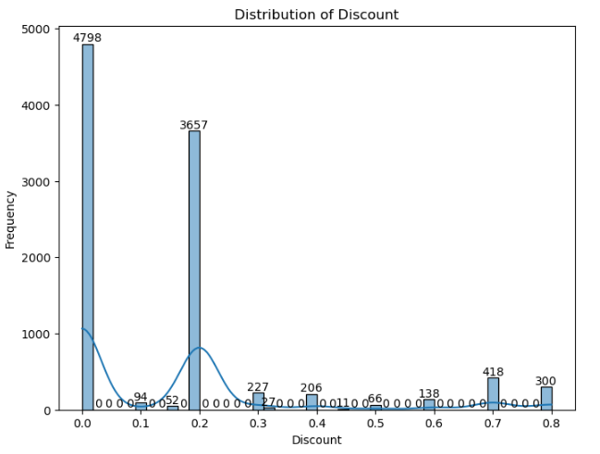
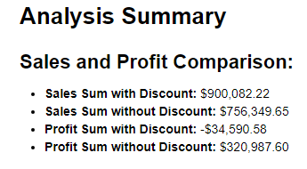
Most of the orders do not include a discount (4978 times). This can be investigated by examining the sales status to determine its impact on sales or profit
This data suggests that the total sales amount is higher when a discount is applied. However, the total profit is surprisingly negative when a discount is involved. On the other hand, the profit is notably higher when orders are placed without any discount.

Slide 13
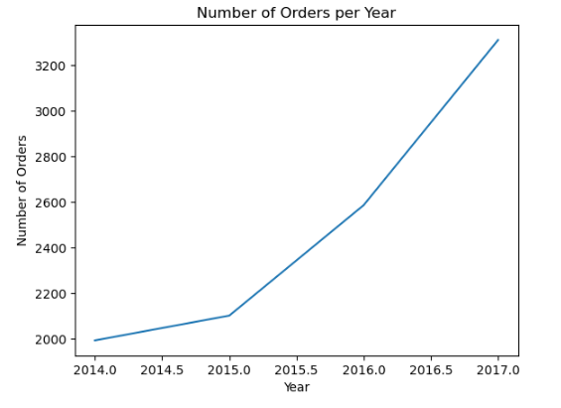
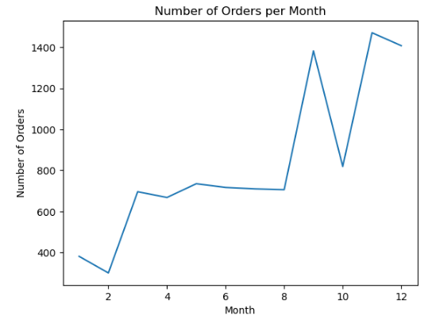
Annual Order Variations: Peaks and Valleys Across Seasons
The numbers suggest a positive growth trajectory, reflecting an increase in sales revenue from year to year.
Order numbers fluctuate seasonally: higher in Nov-Dec due to holidays like Black Friday, lower in Jan-Feb post-holiday; mid-year months show more stable patterns.

Slide 14
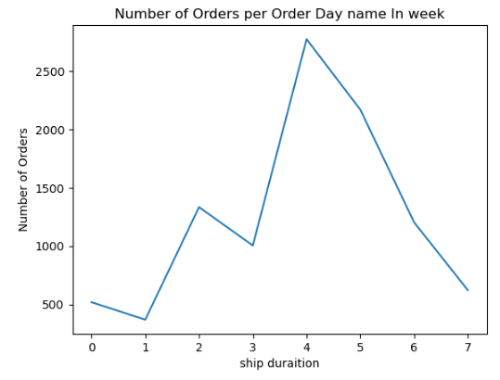
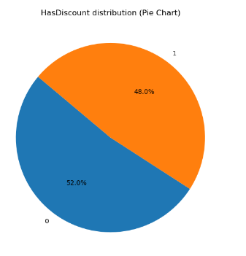
4 days shipping duration has the highest count of orders, with 2774 occurrences.
5196 orders have a discount (HasDiscount = 1).
4798 orders do not have a discount (HasDiscount = 0).

Slide 15
Bi-variate Analysis

Slide 16
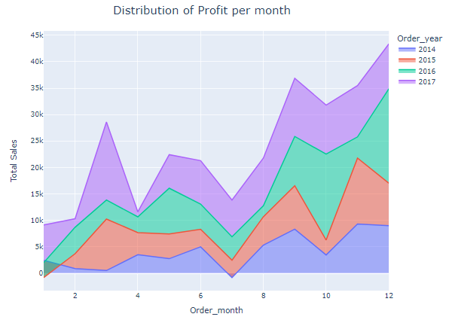
The Second Class shipping mode shows a higher average order value compared to other shipping modes.
The Corporate segment exhibits the highest average order value among all customer segments
The Copier category demonstrates a higher average sales value across its sub-category products.
Impact of Ship Mode on Delivery Days
the average delivery days of the first class is 2 days
the average delivery days of the second class is 3 days
the average delivery days of the standard class is 5 days
most of the sales are below 50 USD, and the biggest client are the 'Home Office', then 'Corporate' and finally 'consumer'
November and December exhibit higher sales rate , possibly due to holiday seasons and events like Black Friday, Christmas, and New Year's

Slide 17
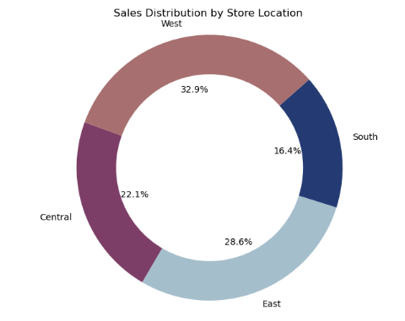
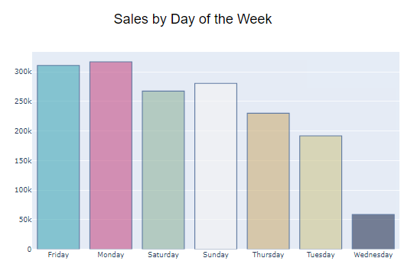
technology category has the highest sales number office supplies category is the lowest sales
Phones achieve the highest sales in sub-categories while fasteners are the lowest
west region the highst sales and highest profit across other Regions
California in Region West has maximum sales = 346205.24
Monday and Friday come in the first Place
SAFCO Arco Folding Chair is the highest product in sales

Slide 18
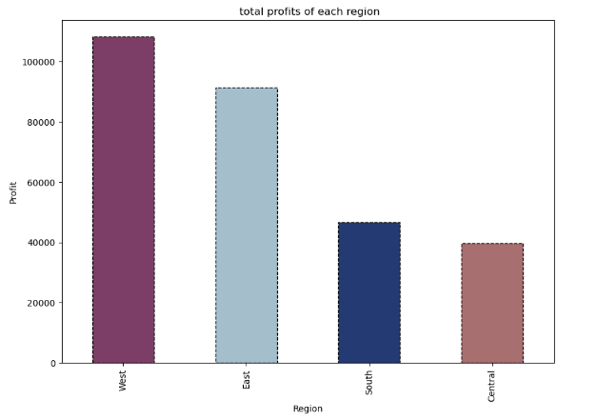

Slide 19
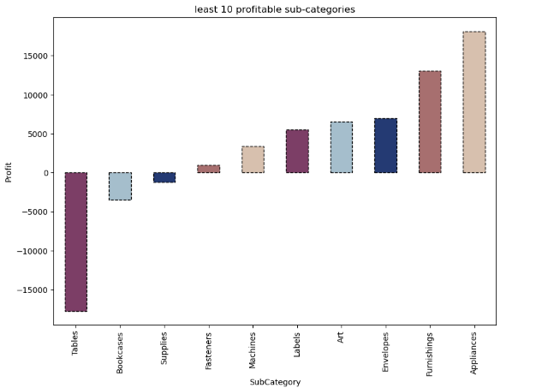

Slide 20
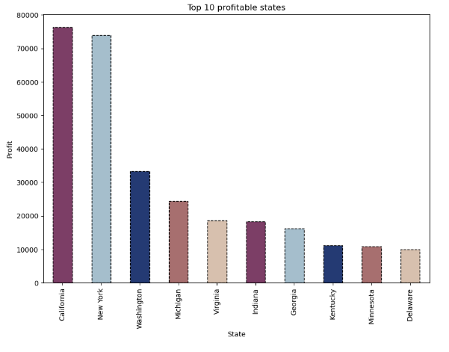

Slide 21
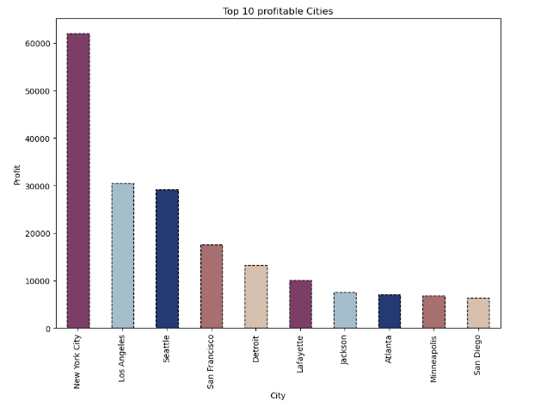

Slide 22
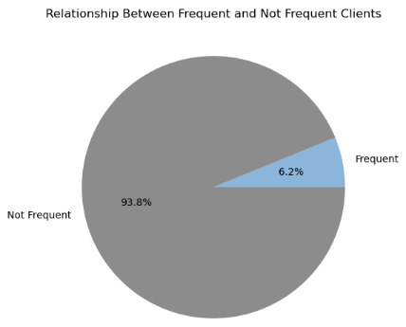
Customer Analysis
After conducting customer analysis, it was identified that there are 49 frequent customers with more than 10 orders, while there are 744 customers with less than 10 orders. As a strategy, I plan to offer the frequent clients a new feature called "offer.
Cramer test and correlation
After conducting the Cramer test, I removed highly correlated categorical variables such as Order ID, Postal Code, State, Customer ID, Customer Name, Product Name, SubCategory, and City.

Slide 23
Modeling

Slide 24
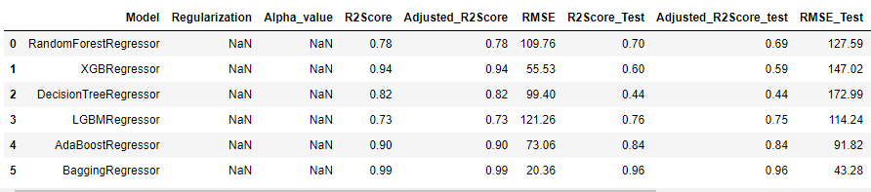
Data Encoding
Label encoding and dummy encoding are utilized to transform categorical data into numerical format
Split Data
The dataset is divided into training and testing subsets (Ratio70/30)
Scale Data
I utilized the StandardScaler to normalize or scale the data
Modeling
I applied six regression models to the dataset for analysis and prediction purposes.

Slide 25
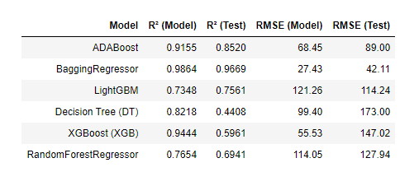
Model Comparison
ADABoost demonstrates good performance in both R² and RMSE, though its RMSE is slightly higher on the test set.
BaggingRegressor shows strong performance in R² scores and relatively low RMSE on both training and test sets.
LightGBM) Light Gradient Boosting Machine) presents lower R² scores but are similar in RMSE on the test set, though RMSE is slightly higher for the training set.
Both Decision Tree and XGBoost models demonstrate a substantial decline in R² on test data, indicating overfitting and poor performance on new, unseen data.
The Random Forest model shows good training fit (R²=0.76), slightly less accurate on unseen data (R²=0.69), with RMSE of 114.05 for the model and 127.94

Slide 26
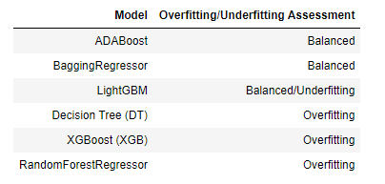
Overfitting/Underfitting Assessment¶
Balanced Models (No significant overfitting or underfitting): ADABoost and BaggingRegressor show relatively consistent performance between training and test datasets, suggesting a good balance between bias and variance. LightGBM indicates potential underfitting due to relatively lower R² scores compared to other models. Overfitting: Decision Tree (DT), XGBoost (XGB), and RandomForestRegressor demonstrate overfitting with a noticeable drop in R² and higher RMSE values on the test set compared to the training set.

Slide 27
Best Model
BaggingRegressor: Achieves a high R² on both training (0.9864) and test sets (0.9669). Shows a relatively low RMSE on both training (27.43) and test sets (42.11)

Slide 28
Thank You!

