Slide 1
Olist Ecommerce Analysis

Slide 2
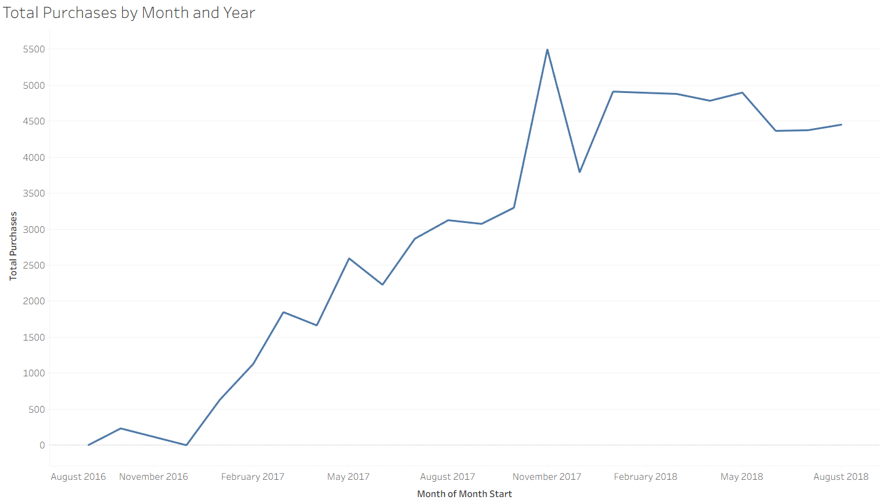
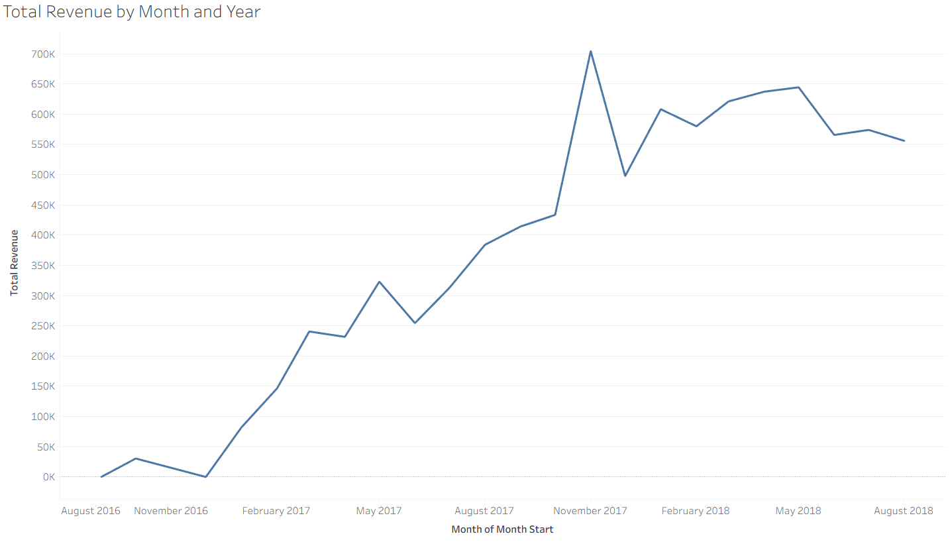
Sales and Revenue
Overall increase in sales indicating growth and popularity of the site
Brazil was emerging from economic trouble in 2017, leading to increase in online purchases as country recovers
Increasing mobile phone usage and lower inflation
Large spike in November due to Black Friday & Cyber Monday

Slide 3
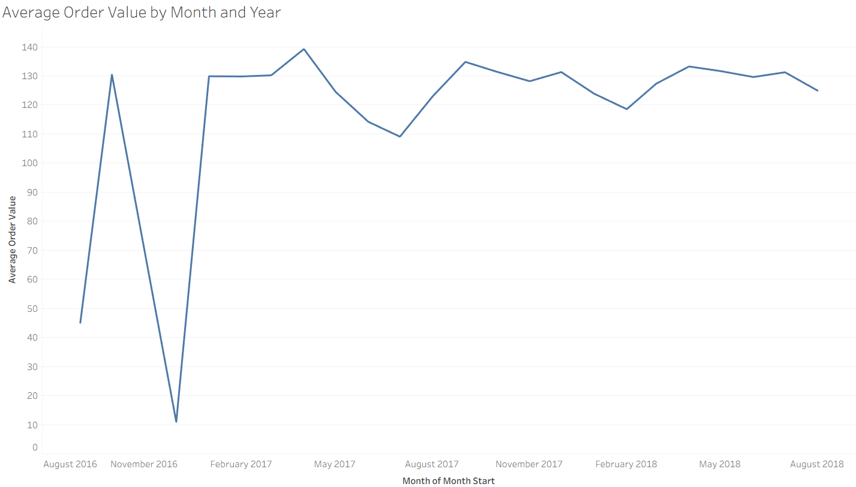
Average Order Value
Major drop in AOV from May – July 2017, and January – March 2018
Many lower value items bought in May and June 2017. Household goods, home decorations.
More sports equipment bought in the proceeding months
The 2018 drop may be due to large spending over the sales and holiday period, where people are trying to spend less money
Major increase in higher value items after February 2018 - Religious presents (+200 Reals) and beauty and healthcare (+130 Reals).

Slide 4
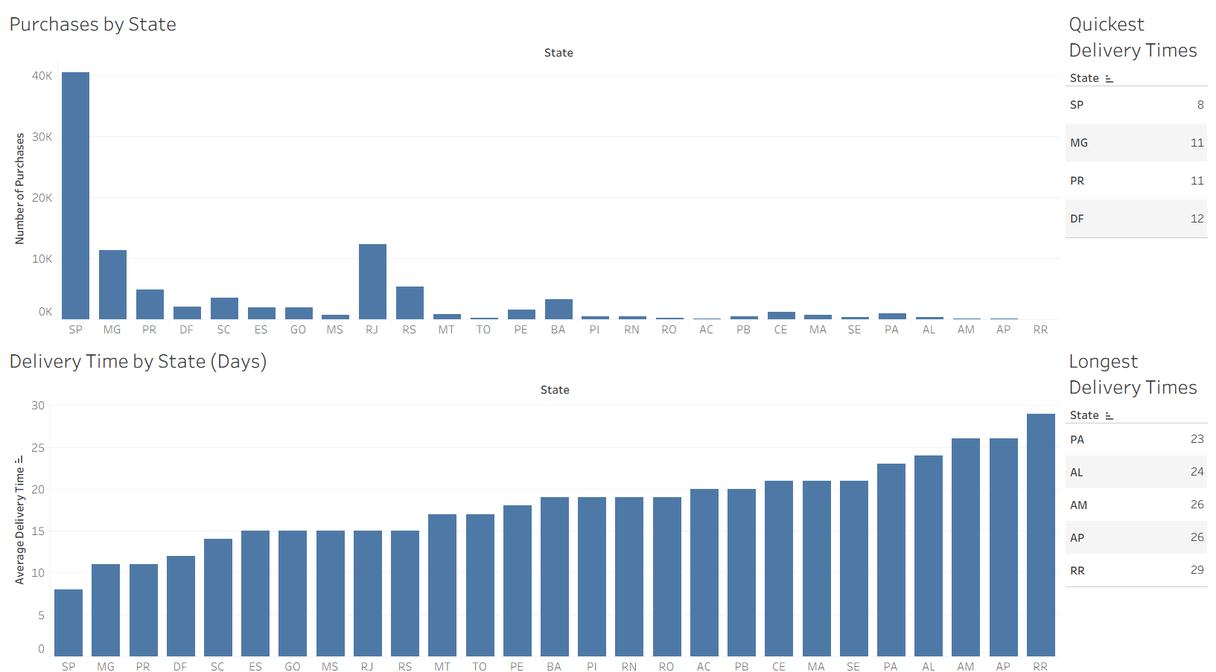
Delivery
Highest population areas also have the highest purchases
Average delivery time is 12 days
States with high delivery time are all within the Amazon Rainforest or far away from the big cities
Key focus states: RJ, RS, BA. High population and sales but long delivery time
Positioning warehouses between Rio de Janeiro and Bahia, and near Rio Grande Do Sul will improve delivery times and improve reputation in these key areas

Slide 5
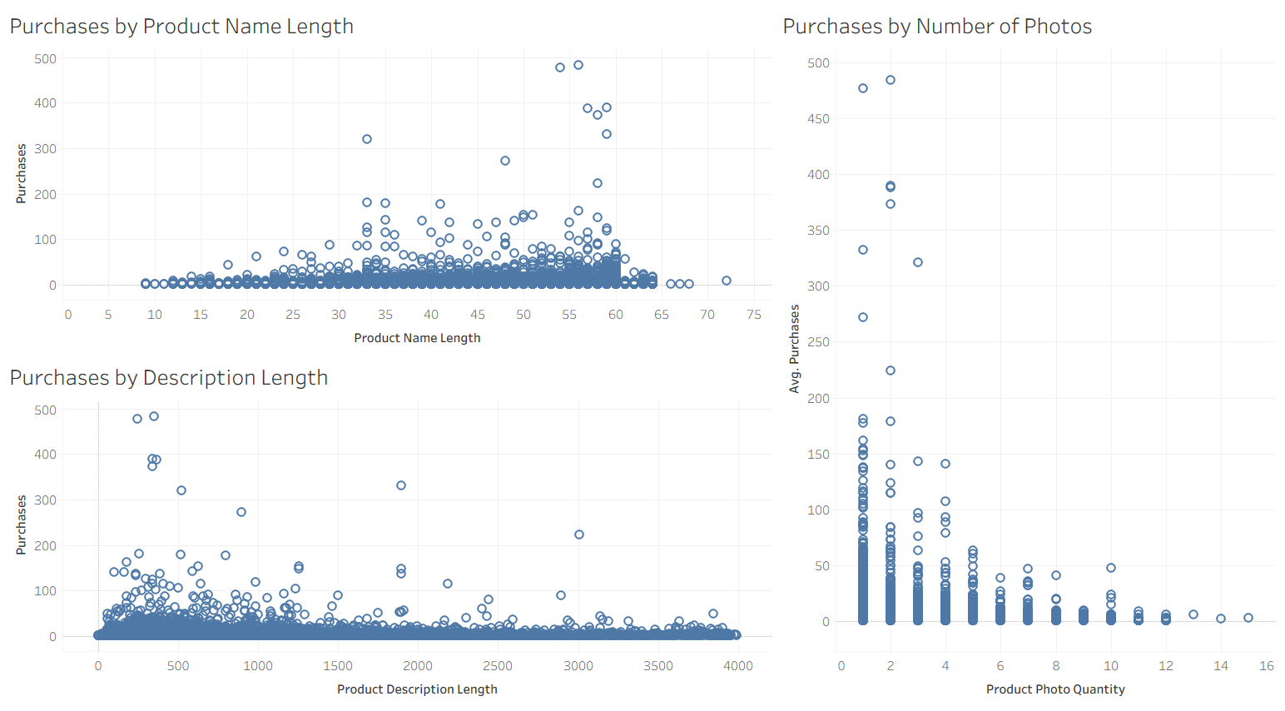
Product Posting Details
No clear correlation, but product name should be at least 25 characters, and description, no more than 2000
Slightly higher purchases on 2 photos

Slide 6
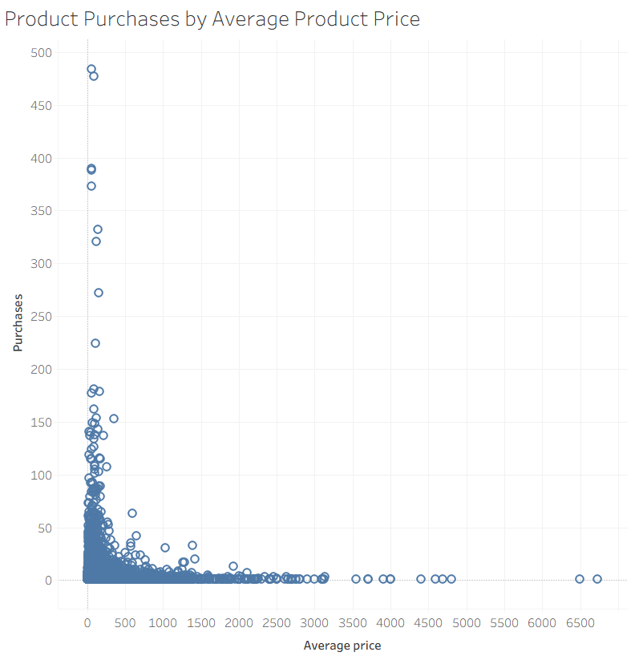
Pricing
People are drawn to the cheaper products
No product over 600 Real has more than 50 purchases
More expensive purchases may be one-off big expenses. Cheaper products may be those that need to be replaced
Adding better, or more discounts to products may encourage more purchases, especially around holiday season

Slide 7
Actions
Actions | Expected Result
Aim to offer discounts around key holidays and sale periods like Black Friday and Christmas | Capitalizing on the higher purchase intent at these times to drive even more sales
Ensure mobile-friendly user experience | Mobile users make up the majority of online shoppers worldwide. Paired with the increasing use in Brazil, UI on mobile needs to be very strong.
Place warehouses near the 3 key states with high delivery time. RJ, BA and RS. RJ and BA are close together so 1 warehouse can be between them | Reducing delivery time will improve customer satisfaction and will improve the company’s reputation, leading to more purchases over time.
Communicate with customers by email with recommended products based on purchase history, and abandoned carts | This will bring in more purchases from those who forgot to purchase items in their basket, and target existing customers

