Slide 1

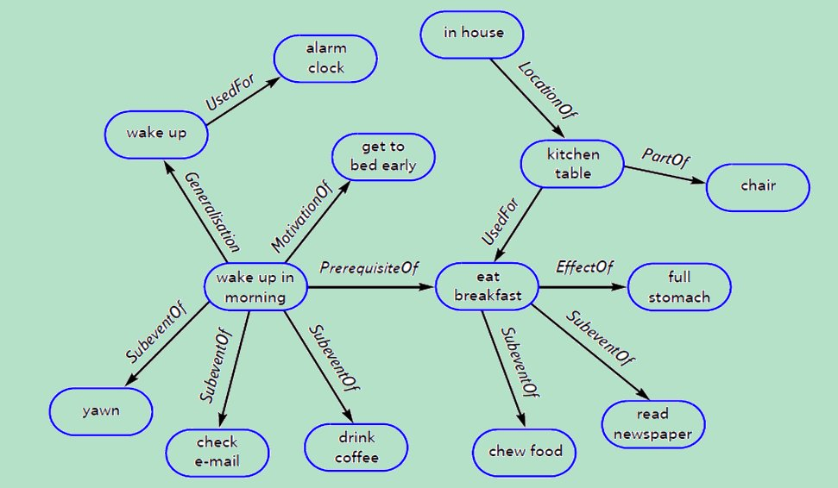
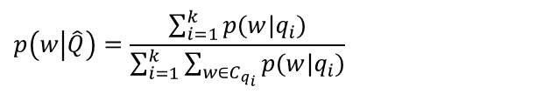
Comparison of Effectiveness of Term Association and Knowledge Graphs for Query Expansion
Textual Data Analytics (TEANA) lab
Saeid Balaneshinkordan
saeid@wayne.edu
Alexander Kotov
kotov@wayne.edu
Problem
Difficult queries: queries for which most (top) results are irrelevant (AP < 0.1). Some of the main causes:
Vocabulary mismatch: searchers and authors of relevant documents use different terms to refer to the same concepts
Partially specified and poorly formulated information needs
Challenges:
Query results can be improved through query expansion using explicit or pseudo-relevance feedback. However, RF is ineffective for difficult queries due to the absence of positive relevance signals in the initial retrieval results
external resources (e.g. term graphs) can be utilized
Research question: how do statistical association term graphs compare with term graphs derived from knowledge bases in terms of retrieval effectiveness for normal and difficult queries?
ConceptNet, DBpedia and Freebase: ConceptNet 5 is the largest common sense knowledge base, which features diverse relational ontology of 20 relationship types. DBpedia is a structured version of Wikipedia in RDF format. Freebase, similar to DBpedia, provides descriptions of entities as RDF triplets, with a more comprehensive list of concepts in comparison to DBpedia.
Term association graphs
Nodes are distinct words or phrases in the collection
Weighted edges represent strength of semantic relatedness between words and phrases
Can be constructed manually or automatically from the document collection using information-theoretic measures of term association, such Mutual Information (MI) or Hyperspace Analog to Language (HAL)
Using term graphs for query LM expansion
Query expansion LM is constructed from the neighbors of query terms in the term graph:
Results
AQUAINT, ROBUST and GOV TREC collections are used in experiments
KL-DIR: KL-divergence retrieval with Dirichlet prior smoothing
TM: document LM expansion using translation model on MI term graph (Karimzadehgan and Zhai, SIGIR’10)13
HAL: edge weights in term graph are calculated using Hyperspace Analog to Language
MI: edge weights in term graph are calculated using Mutual Information
NEIGH: all neighbors of query terms are used in query expansion LM (Bai et al., CIKM’05)
DB: term graph structure is derived from DBpedia 3.9
FB: term graph structure is derived from the last version of Freebase
CNET: term graph structure is derived from ConceptNet 5
Method | MAP | P@20 | GMAP
KL-DIR | 0.1943 | 0.3940 | 0.1305
TM | 0.2033 | 0.3980 | 0.1339
NEIGH-MI | 0.2031 | 0.3970 | 0.1326
NEIGH-HAL | 0.1989 | 0.3900 | 0.1319
DB-MI | 0.2073 | 0.4160 | 0.1468
DB-HAL | 0.2059 | 0.4080 | 0.1411
FB-MI | 0.2055 | 0.3990 | 0.1336
FB-HAL | 0.2056 | 0.3960 | 0.1384
CNET | 0.2051 | 0.3900 | 0.1388
CNET-MI | 0.2042 | 0.3920 | 0.1371
CNET-HAL | 0.2058 | 0.3920 | 0.1388
Method | MAP | P@20 | GMAP
KL-DIR | 0.2413 | 0.3460 | 0.1349
TM | 0.2426 | 0.3488 | 0.1360
NEIGH-MI | 0.2432 | 0.3460 | 0.1360
NEIGH-HAL | 0.2431 | 0.3454 | 0.1333
DB-MI | 0.2482 | 0.3524 | 0.1397
DB-HAL | 0.2426 | 0.3444 | 0.1349
FB-MI | 0.2452 | 0.3526 | 0.1232
FB-HAL | 0.2476 | 0.3540 | 0.1261
CNET | 0.2452 | 0.3472 | 0.1407
CNET-MI | 0.2495 | 0.3530 | 0.1459
CNET-HAL | 0.2503 | 0.3528 | 0.1463
Method | MAP | P@20 | GMAP
KL-DIR | 0.2333 | 0.0464 | 0.0539
TM | 0.2399 | 0.0476 | 0.0551
NEIGH-MI | 0.2415 | 0.0489 | 0.0518
NEIGH-HAL | 0.2419 | 0.0456 | 0.0476
DB-MI | 0.2346 | 0.0467 | 0.0019
DB-HAL | 0.2404 | 0.0467 | 0.0019
FB-MI | 0.2420 | 0.0484 | 0.0573
FB-HAL | 0.2404 | 0.0476 | 0.0565
CNET | 0.2407 | 0.0489 | 0.0584
CNET-MI | 0.2416 | 0.0504 | 0.0587
CNET-HAL | 0.2428 | 0.0516 | 0.0586
Performance on AQUAINT for all queries
Performance on ROBUST for all queries
Performance on GOV for all queries
Method | MAP | P@20 | GMAP
KL-DIR | 0.0474 | 0.1250 | 0.0386
TM | 0.0478 | 0.1250 | 0.0386
NEIGH-MI | 0.0476 | 0.1375 | 0.0393
NEIGH-HAL | 0.0474 | 0.1500 | 0.0378
DB-MI | 0.0528 | 0.1906 | 0.0452
DB-HAL | 0.0544 | 0.1538 | 0.0455
FB-MI | 0.0534 | 0.1333 | 0.0437
FB-HAL | 0.0564 | 0.1444 | 0.0471
CNET | 0.0504 | 0.1219 | 0.0440
CNET-MI | 0.0496 | 0.1156 | 0.0422
CNET-HAL | 0.0502 | 0.1219 | 0.0436
Method | MAP | P@20 | GMAP
KL-DIR | 0.0410 | 0.1290 | 0.0261
TM | 0.0458 | 0.1290 | 0.0267
NEIGH-MI | 0.0429 | 0.1323 | 0.0273
NEIGH-HAL | 0.0419 | 0.1260 | 0.0265
DB-MI | 0.0503 | 0.1449 | 0.0301
DB-HAL | 0.0474 | 0.1437 | 0.0273
FB-MI | 0.0381 | 0.1222 | 0.0200
FB-HAL | 0.0393 | 0.1272 | 0.0211
CNET | 0.0559 | 0.1487 | 0.0334
CNET-MI | 0.0560 | 0.1487 | 0.0326
CNET-HAL | 0.0558 | 0.1475 | 0.0323
Method | MAP | P@20 | GMAP
KL-DIR | 0.0311 | 0.0281 | 0.0140
TM | 0.0343 | 0.0304 | 0.0146
NEIGH-MI | 0.0333 | 0.0307 | 0.0130
NEIGH-HAL | 0.0425 | 0.0293 | 0.0122
DB-MI | 0.0312 | 0.0285 | 0.0136
DB-HAL | 0.0306 | 0.0274 | 0.0134
FB-MI | 0.0350 | 0.0319 | 0.0154
FB-HAL | 0.0339 | 0.0293 | 0.0152
CNET | 0.0407 | 0.0333 | 0.0172
CNET-MI | 0.0427 | 0.0367 | 0.0176
CNET-HAL | 0.0453 | 0.0385 | 0.0181
Performance on AQUAINT for difficult queries
Performance on ROBUST for difficult queries
Performance on GOV for difficult queries
Conclusions
Query expansion using different types of term graphs behaves differently depending on the collection: using knowledge graphs is more effective than using collection terms association graphs for newswire datasets on both regular and difficult queries. However, on Web collections, term association graphs have better (for all queries) or comparable performance (for difficult queries) with statistical term association graphs.
ConceptNet-based term graphs outperformed DBpedia and Freebase -based ones on 2 out of 3 experimental collections, which indicates the importance of using commonsense knowledge repositories in addition to the ones derived from encyclopedia

