Slide 1
SafeStreets
Tiberio Galbiati – Saeid Rezaei

Slide 2
For the RASD part:
Goals of the system
Boundaries, for example describe some world and machine phenomena to highlight such boundaries
Meaningful use cases
The most important three to five requirements
The most important assumptions
What you aim to analyse and prove through the Alloy model

Slide 3
Goals of the system
[G1] Allow users to notify authorities about traffic violations
[G2] Allow users to send pictures with metadata of violations
[G3] Allow users to mine information recorded
[G4] Have at least two different priviledge for mining data
[G5] Generate traffic tickets
[G6] Generate statistics about issued tickets
[G7] Be sure every information uploaded is never altered

Slide 4
Domain Assumptions
[D1] Device has a working internet connection.
[D2] Device has a camera accessible via software.
[D3] The device should acquire position with an accuracy of enough meters in order to univocally determine the road (e.g. 5 meters)
[D4] We have access to an ALPR service which is able to read every license plate in a picture and return each of them as a string
[D5] ALPR service has an accuracy of more than 95%
[D6] The device should take pictures with enough resolution to be able to read them with the ALPR service
Notes:
Key decision not letting user to manually write the plate to have only consistent data

Slide 5
Domain Assumptions
[D7] Every vehicle that can be reported should have a license plate visible
[D8] The number and kind of violations should be finite
[D9] Every authority account is verified and it’s not possible to be created using the front end.
[D10] Each vehicle has one and only one main owner, and we can extract his/her information like name, address and … from vehicle registration database
[D11] The only way to upload pictures of violation is through the application
[D12] Each license plate is unique, there are no vehicles with the same plate
Notes:
Key decision not letting user to manually write the plate to have only consistent data

Slide 6
Requirements
The user must be able to select the vehicle to report in case there are other vehicles in picture
@tiberio

Slide 7
Usecases
Reporting
Mining
Tickets
@tiberio

Slide 8
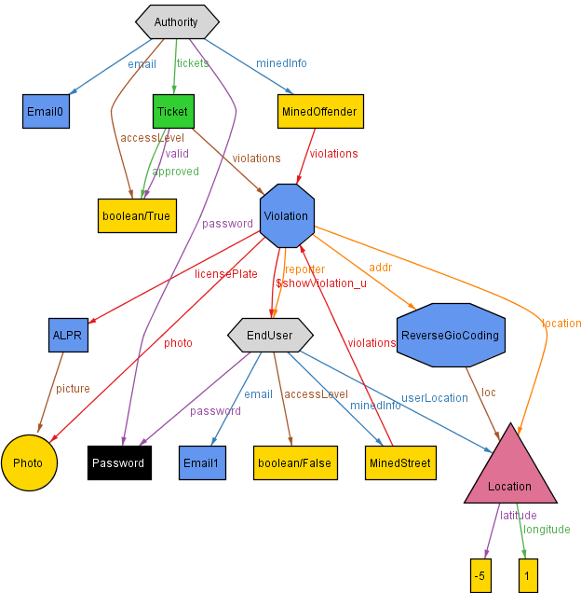
Alloy (1)

Slide 9
Alloy (2)
abstract sig User { name: one Name, surname: one Surname, email: one Email, password: one Password, accessLevel: one Bool, minedInfo: some MiningModule, }
sig Violation { location: one Location, addr: some GPSconvertor, reporter: one Costumer, photo: one Photo, licensePlate: one ALPR, date: one Date }
Signatures
sig Costumer extends User { costumerLocation: one Location, accessLevel = False
}
abstract sig MiningModule { violations: some Violation,
}
sig AverageViolations extends MiningModule {}
sig OffenderFinder extends MiningModule {}
sig ThirdParty extends User { tickets: some Ticket, #tickets >= 0 accessLevel = True }

Slide 10
Alloy (3)
// Every Costumer Has Espesific Location
Fact { no disjoint c1, c2 : Costumer | c1.costumerLocation = c2.costumerLocation }
Also for Email, Violation, photo
// Each Ticket Issued by One Third Party
Fact { all t: Ticket | one tp: ThirdParty | tp.tickets = t }
// Every User Just Can Use No.1 Service Of Mining Module, AverageViolations
Fact {
all c: Costumer |
c.minedInfo = AverageViolations
}
// Each Date Belongs to one Violation
Fact {
all d: Date, viol: Violation |
viol.date = d
}
// if a ticket exist, it belongs to one violation
Fact {
one t: Ticket , v:Violation |
t.violations = v
}
// Each Date Belongs to one Violation
Fact { all d: Date, viol: Violation | viol.date = d
}
Facts

Slide 11
For the DD part:
The components of your system
Their interfaces
Meaningful interactions
The architectural styles/patterns and important design decisions
The strategy you plan to use to carry the implementation, integration and testing of your system and how this is strategy mapped on your components

Slide 12
architecture
@tiberio

Slide 13
components
@tiberio

Slide 14
Implementation and testing
@saeid

