Slide 1
SafeStreets
Tiberio Galbiati – Saeid Rezaei

Slide 2
Requirement Analysis
and Specification Document
(RASD)

Slide 3
Goals & use-cases of the system
Reporting
Picture
Location
Kind of violation
Mining information
Heatmap
Statistics
Tickets
Automatic generation
Approval by policemen

Slide 4
Requirements
Requirements
Form: User must be able to choose the kind of violation from a list
Date, time and position should be automatically added to the violation reported
Brush tool: The user must be able to select the vehicle to report in case there are other vehicles in picture
Heatmap: an interactive map with a colored overlay to show how many violations happened in each street
Application must be able to read every violation stored and automatically generate a ticket

Slide 5
Assumptions
Device
HD camera
GPS location with at least 5m accuracy
Plate Recognition
Accuracy > 95%
No manual insertion
Authority integration
Verified accounts
Access to vehicle registration databases
Notes:
Key decision not letting user to manually write the plate to have only consistent data

Slide 6
Alloy

Slide 7
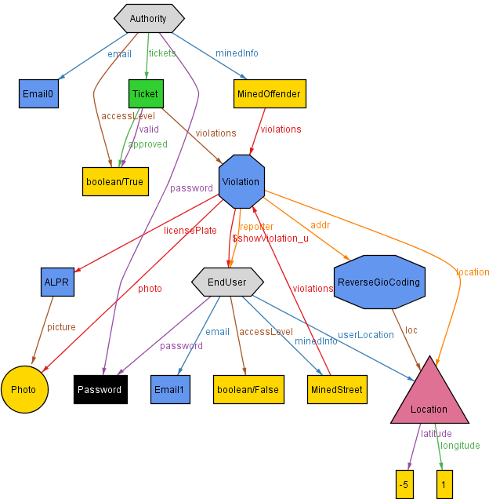

Slide 8
Assumptions
abstract sig User { name: one Name, surname: one Surname, email: one Email, password: one Password, accessLevel: one Bool, minedInfo: some MiningModule, }
sig Violation { location: one Location, addr: some GPSconvertor, reporter: one Costumer, photo: one Photo, licensePlate: one ALPR, date: one Date }
Signatures
sig Costumer extends User { costumerLocation: one Location, accessLevel = False
}
abstract sig MiningModule { violations: some Violation,
}
sig AverageViolations extends MiningModule {}
sig OffenderFinder extends MiningModule {}
sig ThirdParty extends User { tickets: some Ticket, #tickets >= 0 accessLevel = True }

Slide 9
Assumptions
// Every User Just Can Use No.1 Service Of Mining Module, AverageViolations
Fact {
all c: Costumer |
c.minedInfo = AverageViolations
}
// Each Date Belongs to one Violation
Fact {
all d: Date, viol: Violation |
viol.date = d
}
// if a ticket exist, it belongs to one violation
Fact {
one t: Ticket , v:Violation |
t.violations = v
}
// Each Date Belongs to one Violation
Fact { all d: Date, viol: Violation | viol.date = d
}
Facts
// Every Costumer Has Espesific Location
Fact { no disjoint c1, c2 : Costumer | c1.costumerLocation = c2.costumerLocation }
Also for Email, Violation, photo
// Each Ticket Issued by One Third Party
Fact { all t: Ticket | one tp: ThirdParty | tp.tickets = t }

Slide 10
Design Document
(DD)

Slide 11
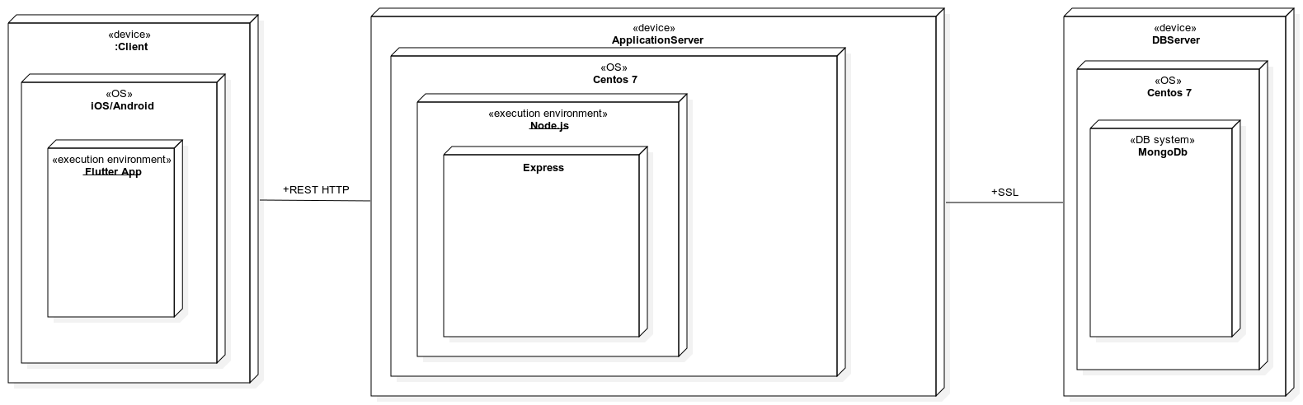




Deployment architecture
Deployment
--API--
--SSL--

Slide 12
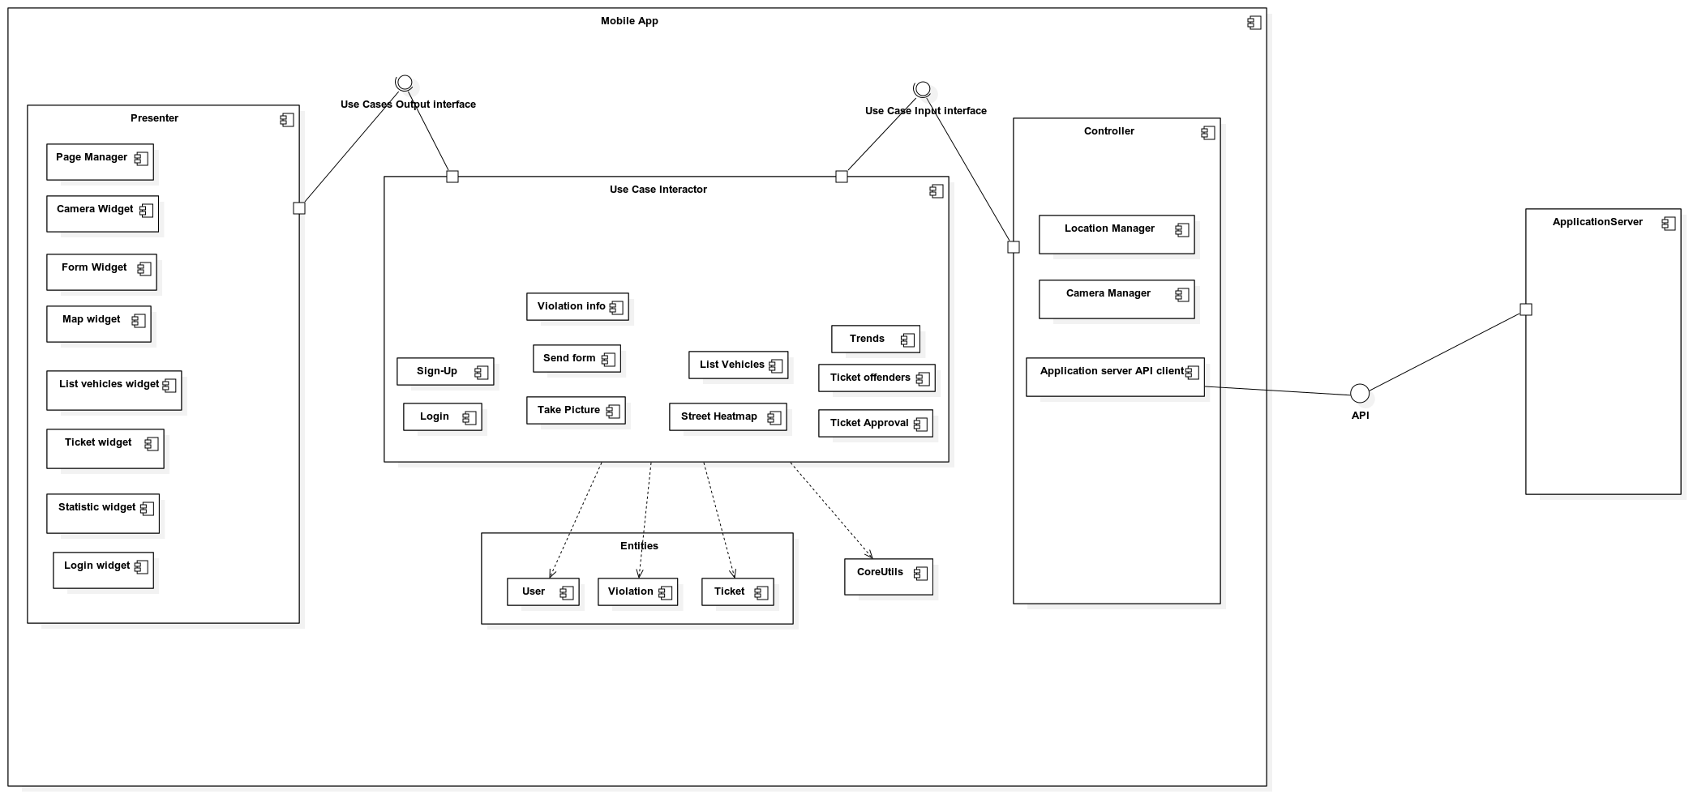
Components & clean architecture
Mobile App components

Slide 13
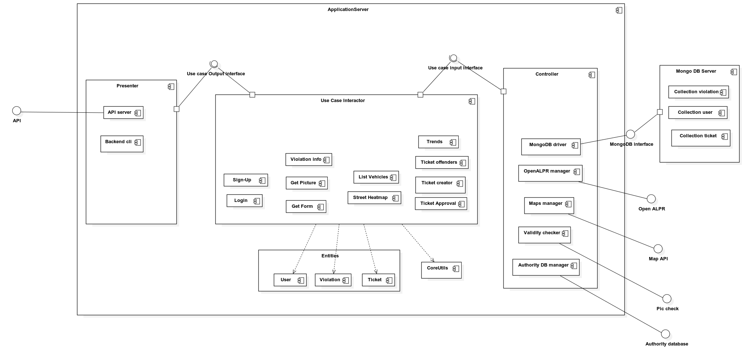
Components & clean architecture
Server Components

Slide 14
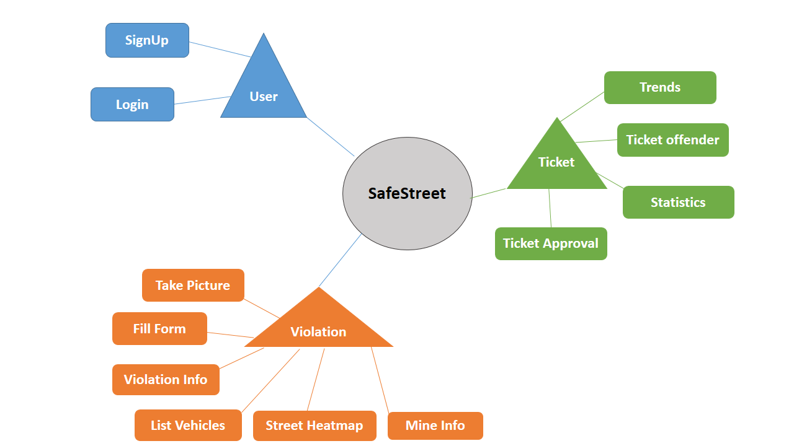
Implementation and testing
Implementation & Testing

