Slide 1
Quantum Electrodynamic Effects in Multi-TeV Scale e-e+ Collisions
PHYS 498
Ryan Saelens | Dr. Piot
Apr. 25, 2024

Slide 2
Main Objectives
What is a linear e-e+ collider?
Advanced LInear Collider (ALIC): linear e-e+ collider with a 10TeV COM energy
Measuring Performance: Luminosity
Potential collision challenges
i.e., Quantum Electrodynamic Effects, also known as Beam-Beam Effects
Our current progress
i.e., simulated performances using particle-in-cell framework WarpX

Slide 3
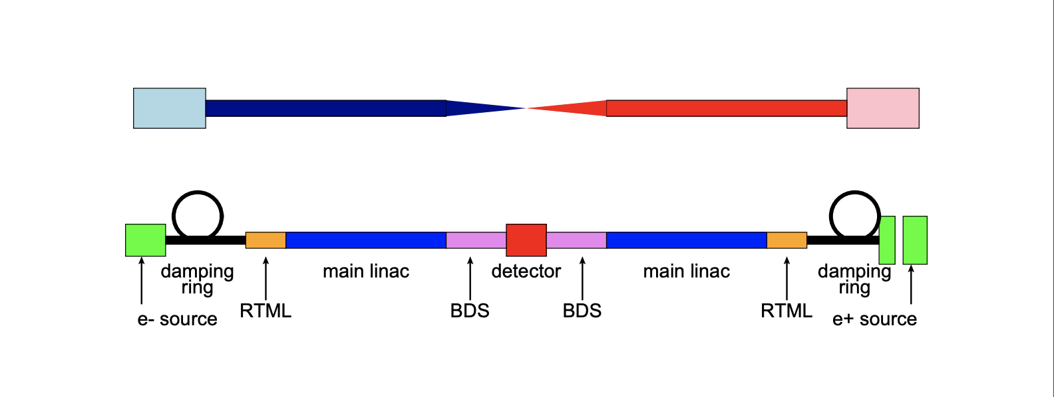
What is a linear e-e+ collider?
Linear collider that accelerates and collides beams of electrons (e-) and positrons (e+)
e-e+ collision results in far less noise than hadron collision
Easier to search for rare (new) particles
Higgs Boson
Dark Matter Particle
D. Schulte. Beam-Beam Effects in Linear Colliders. (2017)

Slide 4
The Advanced LInear Collider (ALIC)
Proposed e-e+ collider with a 10TeV COM energy
What can be expected?
Known particles can be measured with greater precision
Forces us to explore the behavior of particles at such high energies
Can better study particle interactions at extremely short distances
Can lead to the discovery of new leptons
ALEGRO Collaboration. Towards an Advanced Linear International Collider. (2019)

Slide 5
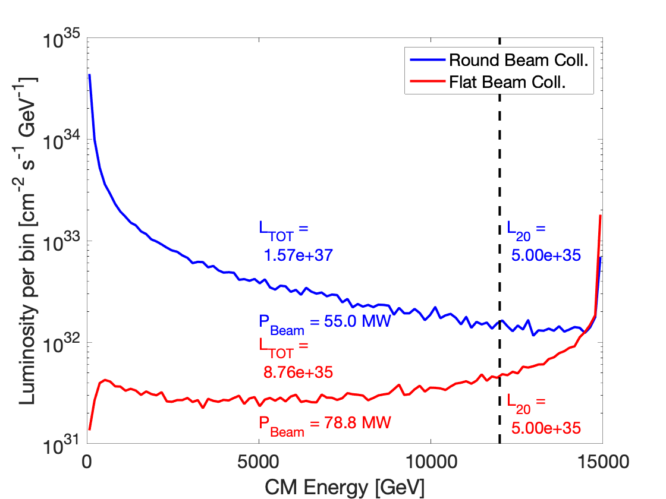
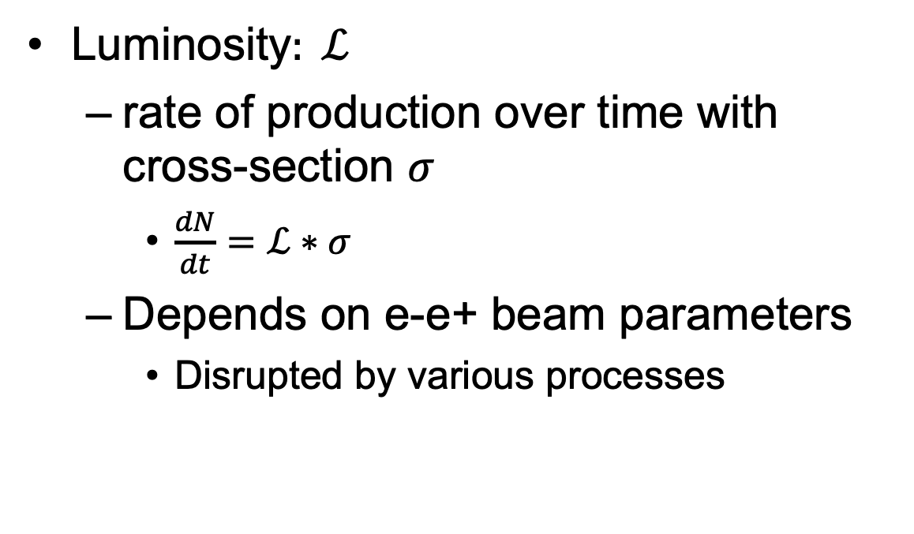
Measuring Performance
Luminosity$: ℒ$
rate of production over time with cross-section $σ$
$\frac{dN}{dt}=ℒ∗σ$
Depends on e-e+ beam parameters
Disrupted by various processes
R. Lehe, J.L. Vay. Plans for WarpX. (2024)

Slide 6
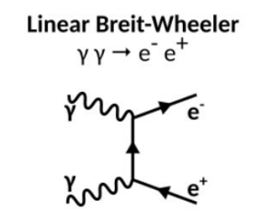
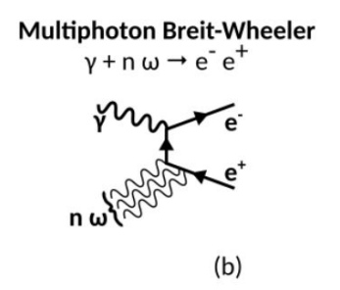
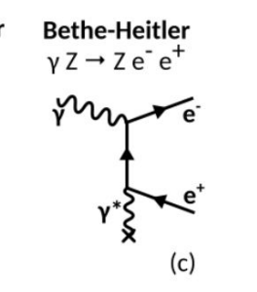
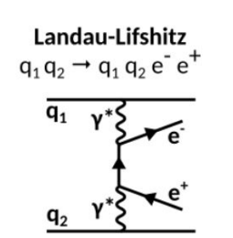
Beam-Beam Effects
Synchrotron Radiation
i.e., Beamstrahlung – though not a QED effect, still needs to be considered
QED Effects
Linear Breit-Wheeler
Multiphoton (Non-Linear) Breit-Wheeler
Bethe-Heitler
Landau-Lifshitz
A. Formenti. First results of beam-beam simulations with WarpX. (2024)

Slide 7
Simulating Performance
Simulating QED Effects of e-e+ collisions using WarpX:
Without QED Effects
With QED Effects
Cho-Kuen Ng, SLAC. Flat Beam (2D Electrostatic Simulations in WarpX. (2024)

Slide 8
Simulating Performance Cont’d
Simulating QED Effects of e-e+ collisions using WarpX:
Photon Spread
e-e+ Pair-Production
Cho-Kuen Ng, SLAC. Flat Beam (2D Electrostatic Simulations in WarpX. (2024)

Slide 9
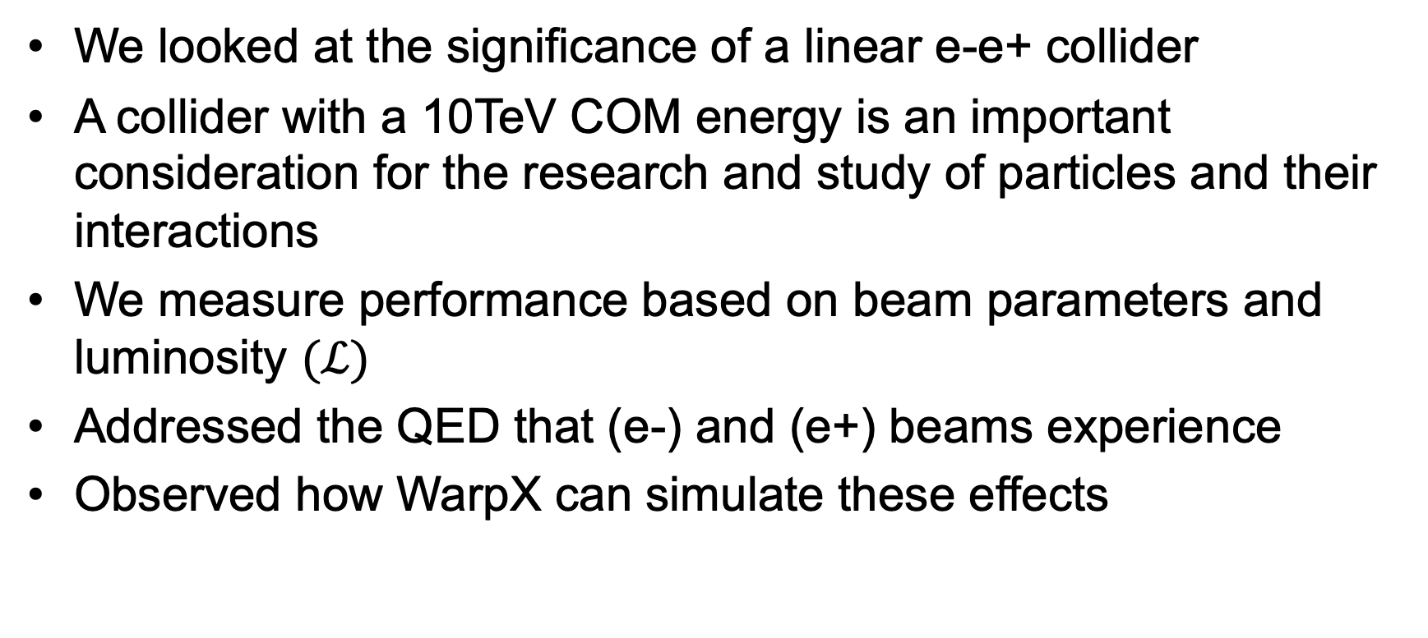
Conclusion
We looked at the significance of a linear e-e+ collider
A collider with a 10TeV COM energy is an important consideration for the research and study of particles and their interactions
We measure performance based on beam parameters and luminosity $(ℒ)$
Addressed the QED that (e-) and (e+) beams experience
Observed how WarpX can simulate these effects

Slide 10
Thank you to the following:
Dr. Piot | Dr. Chmaissem | Phys 498 Peers

