Slide 1
QED Effects in Multi-TeV Scale e+e- Collisions
Ryan Saelens | Dr. Philippe Piot
Apr. 19, 24

Slide 2
Main Objectives
What is an e-e+ (lepton) collider?
ALIC – an e-e+ collider with a COM energy of 10TeV
Measuring Performance
Potential collision challenges
i.e., beam-beam effects or QED effects
Our current progress
i.e., simulating performance using WarpX

Slide 3
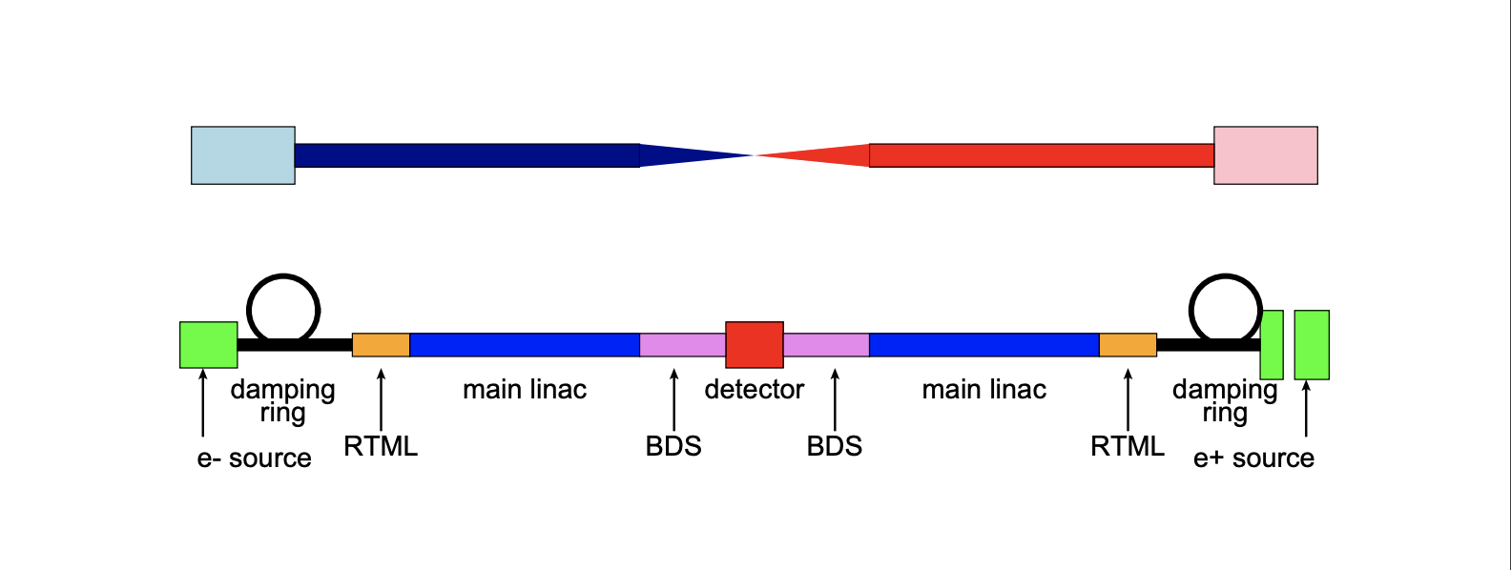
What is an e+e- collider?
Machine that accelerates and collides beams of leptons – i.e. electrons and positrons
Collision results in far less noise than hadron collision
Easier to search for rare (new) particles
Higgs Boson
Dark Matter Particle

Slide 4
ALIC--> photo of ALIC!!!!!
The Advanced Linear International Collider
Proposed e+e- collider with a 10TeV COM energy
What can be expected?
Known particles an be measured with greater precision
Forces us to explore the behavior (interactions) of particles at such high energies
Certain theories predict the existence of new particles and interactions

Slide 5
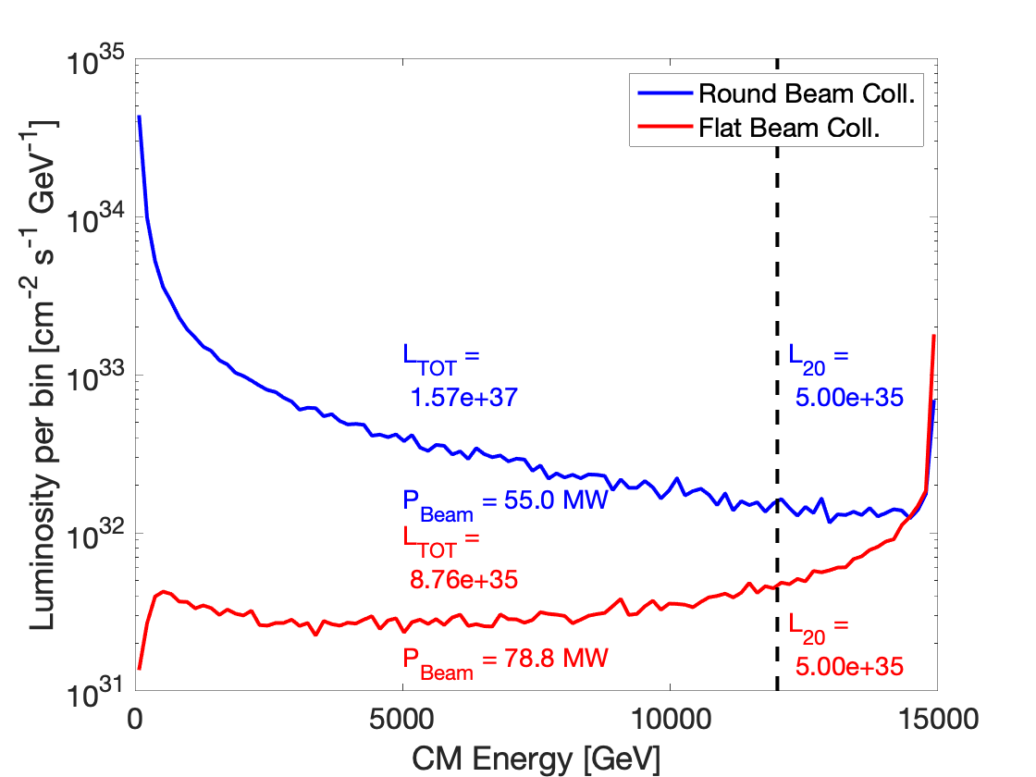
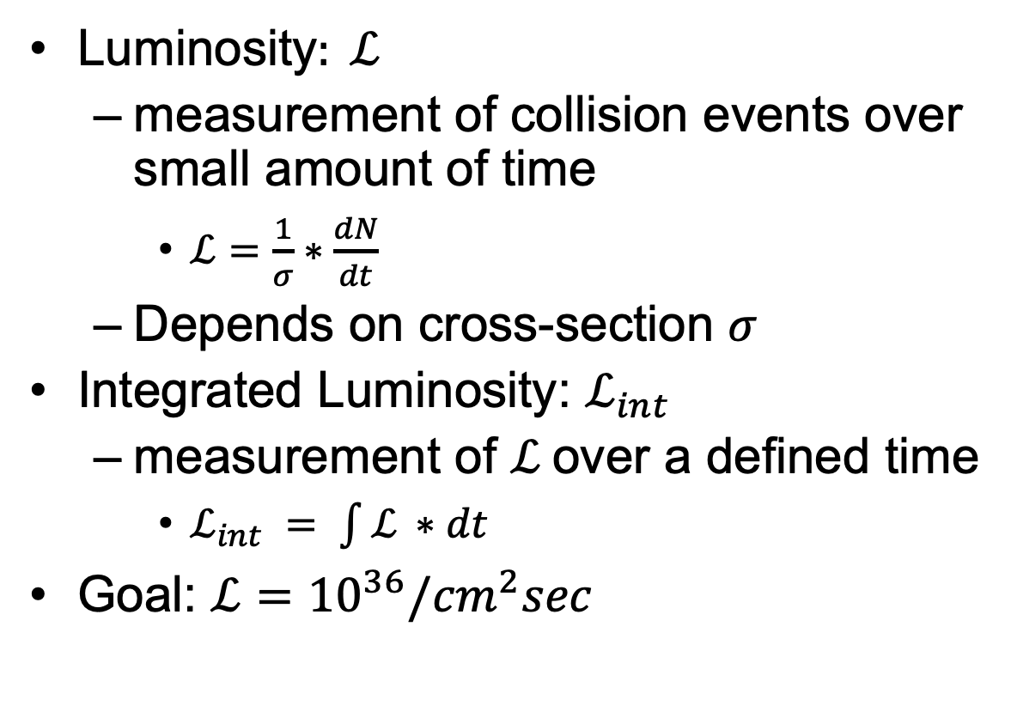
Measuring Performance
Luminosity$: ℒ$
measurement of collision events over small amount of time
$ℒ=\frac{1}{σ}∗\frac{dN}{dt}$
Depends on cross-section $σ$
Integrated Luminosity: $ℒ_{int}$
measurement of $ℒ$over a defined time
$ℒ_{int} = \int{ℒ ∗dt}$
Goal: $ℒ={10}^{36}/{cm}^{2}sec$

Slide 6
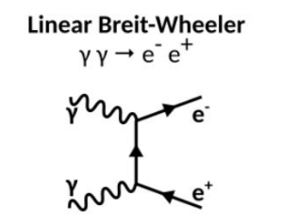
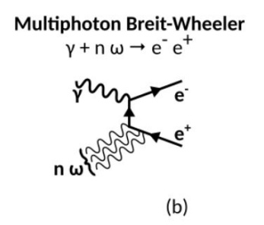
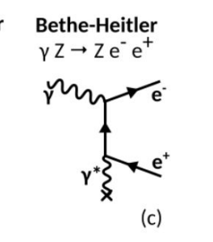
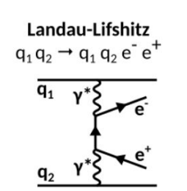
Beam-Beam Effects
Synchrotron Radiation
i.e., Beamstrahlung – though not a QED effect, still needs to be considered
QED Effects
Linear Breit-Wheeler
Multiphoton (Non-Linear) Breit-Wheeler
Bethe-Heitler
Landau-Lifshitz

Slide 7
Simulating Performance
Simulating QED Effects of e+e- collisions using WarpX:
Without QED Effects
With QED Effects

Slide 8
Simulating Performance Cont’d
Simulating QED Effects of e+e- collisions using WarpX:
Photon Spread
e-e+ Pair-Production

Slide 9
Conclusion
We looked at what an e-e+ collider is and its significance to the field of HEP
We addressed why a collider with a 10TeV COM energy could be important for the research and study of particle interactions, as well as the potential to discover new particles in this higher region of energy
We attempted to understand luminosity and how the performance of a machine can be determined by such a property
We addressed the QED effects that e- and e+ beams may experience as they accelerate and eventually collide
Lastly we observed how WarpX can simulate these effects

Slide 10
Thank you to the following:
Dr. Piot | Dr. Chmaissem | Phys 498 Peers

