Slide 1

GEOMETRY OF CRYSTALS
Space Lattices
Motifs
Crystal Systems
MATERIALS SCIENCE
&
ENGINEERING
Part of
A Learner’s Guide
AN INTRODUCTORY E-BOOK
Anandh Subramaniam & Kantesh Balani
Materials Science and Engineering (MSE)
Indian Institute of Technology, Kanpur- 208016
Email: anandh@iitk.ac.in, URL: home.iitk.ac.in/~anandh
Advanced Reading
http://home.iitk.ac.in/~anandh/E-book.htm
Elementary Crystallography
M.J. Buerger
John Wiley & Sons Inc., New York (1956)
The Structure of Materials
Samuel M. Allen, Edwin L. Thomas
John Wiley & Sons Inc., New York (1999)
Crystallography (2nd Edition)
Walter Borchardt-Ott
Springer, Berlin (1995)
Caution Note: In any chapter, amongst the first few pages (say 5 pages) there will be some ‘big picture’ overview information. This may lead to ‘overloading’ and readers who find this ‘uncomfortable’ may skip particular slides in the first reading and come back to them later.

Slide 2
What will you learn in this chapter?
This chapter is divided into three ‘sub-chapters’ (file structure)*
In this chapter we shall try to understand a CRYSTAL
We shall consider some ideal mathematical descriptions before taking up examples of real crystals (as we shall see these crystals contain atoms, ions or molecules)
The use of Miller indices for directions and planes in lattices and crystals
How to use X-Ray Diffraction for determination of crystal geometry.
* 3.1 Overview, Geometry of Crystals
3.2 Miller Indices
3.3 X-ray Diffraction
Caution Note: In any chapter, amongst the first few pages (say 5 pages) there will be some ‘big picture’ overview information. This may lead to ‘overloading’ and readers who find this ‘uncomfortable’ may skip particular slides in the first reading and come back to them later.

Slide 3
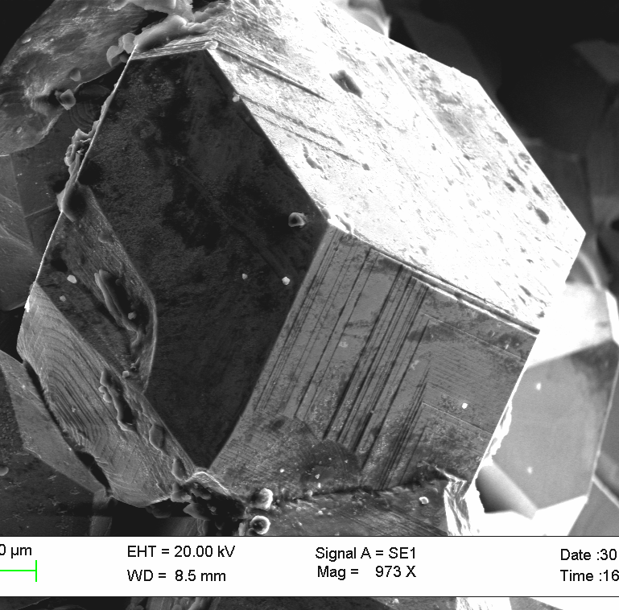

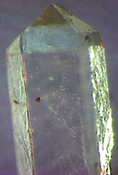

What will you learn in this ‘sub-chapter’?
In this sub-chapter we shall try to understand a CRYSTAL.
We shall consider some ideal mathematical descriptions before taking up examples of real crystals (as we shall see these crystals contain atoms, ions or molecules).
We will see that the language of crystallography is applicable to all kinds of crystals (those containing atomic entities, ‘physical properties’ or mathematical ones).
The real crystals we consider in this chapter are also ‘idealizations’ (i.e. The crystals found in practice have various kinds of defects in them and we shall take up topics related to defects in crystals in the chapter on crystal imperfections (Chapter-5)).
Note the facets
Crystals on the surface of an AlCoFeNi alloy
To see other kinds of crystals click here
Slide 4 (few slides)
Let us start by looking at crystallization from a melt
(of stearic acid)
Video: Dendritic growth of crystal from melt
KDP crystals grown from solution

Slide 4
Why study crystal structures?
When we look around much of what we see is non-crystalline (organic things like wood, paper, sand; concrete walls, etc. → some of the things may have some crystalline parts!).
But, many of the common ‘inorganic’ materials are ‘usually*’ crystalline:
◘ Metals: Cu, Zn, Fe, Cu-Zn alloys
◘ Semiconductors: Si, Ge, GaAs
◘ Ceramics: Alumina (Al₂O₃), Zirconia (Zr₂O₃), SiC, SrTiO₃.
Also, the usual form of crystalline materials (say a Cu wire or a piece of alumina) is polycrystalline and special care has to be taken to produce single crystals.
Polymeric materials are usually not ‘fully’ crystalline.
The crystal structure directly influences the properties of the material
(as we have seen in the Introduction chapter many additional factors come in).
Why study crystallography?
Gives a terse (concise) representation of a large assemblage of species
Gives the ‘first view’ towards understanding of the properties of the crystal
Click here to see how symmetry helps reduce the information content
Slide 6
Also see
Slide 9
* Many of the materials which are usually crystalline can also be obtained in an amorphous form

Slide 5
We shall consider two definitions of a crystal:
1) Crystal = Lattice + Motif [Lattice decorated with a motif]
2) Crystal = Space Group + Asymmetric unit (+Wyckoff positions)*.
The second definition is the more advanced one (the language of crystallographers) and we shall only briefly consider it in this introductory text.
The second definition becomes important as the classification of crystals (7 crystal systems) is made based on symmetry and the first definition does not bring out this aspect.
Note: Since we have this precise definition of a crystal, loose definitions should be avoided (Though often we may live with definitions like: a 3D translationally periodic arrangement of atoms in space is called a crystal).
Initially we shall start with ideal mathematical crystals and then slowly we shall relax various conditions to get into practical crystals.
Note: ‘+’ above does not imply simple addition! It implies a lattice decorated with a motif.
More technically it can be thought of as a convolution operation.
*Actually, the space group in combination with the Wyckoff positions will do the job (give us the whole crystal).
The language of crystallography is one succinctness

Slide 6
Ideal Crystals → Real Crystals → Microstructures → Material → Component
Ideal Crystal
Some of these aspects will be considered in detail later
Ideal Mathematical Crystal
Consider only the Geometrical Entity
or
only the Physical Property
Crystal*
Consider only the Orientational
or
Positional Order
Crystal**
Put in Crystalline defects
& Free Surface
& Thermal Vibration
‘Real Crystal’
Put in Multiple Crystals (Phases) giving rise to interfacial defects
~Microconstituents
Put multiple ~microconstituents
Add additional residual stress
Real materials are usually complex and we start with ideal descriptions
Microstructure
Material
Material or Hybrid
Component
*, ** Reduced definition of crystals
 That which is NOT associated with defects (crystalline or interfacial) → e.g. thermal residual stresses

Slide 7

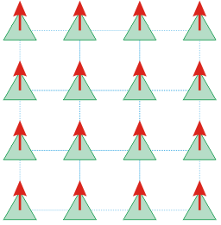

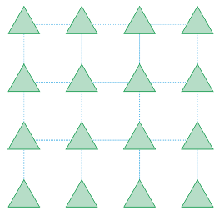
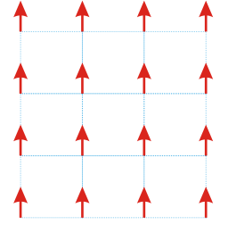
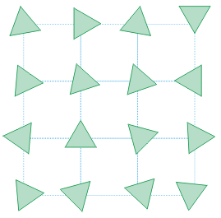
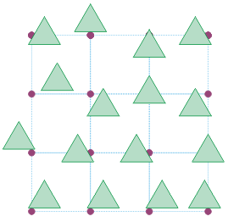
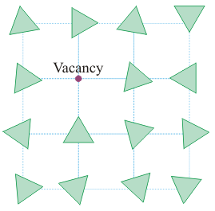
Ideal Crystals → Real Crystals → Microstructures → Material → Component
Geometrical entity
Ideal Crystal
Ideal Mathematical Crystal
Physical Property
Consider only the Geometrical Entity
or
only the Physical Property
Part of the infinite crystal
Crystal*
Part of the infinite crystal
Consider only the Orientational
or
Positional Order
A detailed look
Crystal**
Part of the infinite crystal
Put in Crystalline defects
& Free Surface
& Thermal Vibration
Vacancy shown as an example of a defect
‘Real Crystal’
*, ** Reduced definition of crystals

Slide 8
Ideal Crystals → Real Crystals → Microstructures → Material → Component
Ideal Mathematical Crystal
Ideal Crystal
(Considers both Geometrical Entity AND Physical Property/)
Some of these aspects will be considered in detail later
________ ____
Crystal*
(Here we consider either geometrical entity OR physical property)
Crystal**
(Consider either the Orientational OR the Positional Order)
‘Real Crystal’
(Presence of Crystalline defects & Free Surface & Thermal Vibration)
~Microconstituents
(Put in Multiple Crystals (Phases) giving rise to interfacial defects)
Microstructure
(Put in multiple ~microconstituents and add additional residual stress )
Material
(Put in many microstructures)
Component
(Put in material/s and/or material treatment i.e. temperature/pressure)
*, ** Reduced definition of crystals
 That which is NOT associated with defects (crystalline or interfacial)

Slide 9
Definition 1
Crystal = Lattice + Motif
We will first informally consider the concept of a lattice and motif and then take-up the formal definitions
Motif or Basis:
an entity (typically an atom or a group of atoms) associated with each lattice point
Lattice ➢ the underlying periodicity of the crystal
Motif ➢ Entity associated with each lattice point
Lattice ➢ how to repeat
Motif ➢ what to repeat
Lattice
Crystal
Translationally periodic arrangement of points
Translationally periodic arrangement of motifs

Slide 10

Crystal =
Lattice (Where to repeat)
+
Motif (What to repeat)
Definition 1
Crystal
∞
∞
a
=
Lattice
∞
∞
a
+
Motif
Note: all parts of the motif do not sit on the lattice point
e.g.
Slide 12
Motifs are associated with lattice points
→ they need NOT sit physically at the lattice point
Note: Later on we will also consider cases wherein these arrow marks are replaced with atomic entities

Slide 11



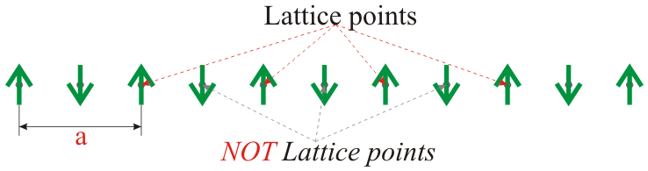
Funda Check
Let us construct the crystal considered before starting with an infinite array of points spaced a/2 apart
Fig.1
This array of points also forms a lattice.
Lattice parameter for this lattice is a/2.
Put arrow marks pointing up and down alternately on the points:
Fig.2
What we get is a crystal of lattice parameter ‘a’ and not ‘a/2’!
→ as this lattice parameter is a measure of the repeat distance!
And the motif is: ↑ + ↓
Fig.3
Note: the lattice in Fig.1 is not the lattice for the crystal in Fig.3
Note that only these alternate points have identical surroundings
Note that only these alternate points have identical surroundings
Note: we could have alternately chosen the centres of bottom arrows as lattice points!

Slide 12
Space Lattice
A lattice is also called a Space Lattice (or even Bravais Lattice in some contexts)
An array of points in space such that every point has identical surroundings.
Whichever point in the lattice you ‘sit’ (position yourself), space should look identical to you.
❑ This automatically implies two properties of lattices
➢ In Euclidean space lattices are infinite (infinite array)
➢ Lattices ‘have translational periodicity’
Note: this is the formal definition of a lattice
Translationally periodic arrangement of points in space is called a lattice*
We can have 1D, 2D or 3D arrays (lattices)
The motif associated with these lattices can themselves be 1D, 2D or 3D ‘entities’.
* this definition arises naturally from the first definition.
Note: points are drawn with finite size for clarity → in reality they are 0D (zero dimensional).

Slide 13
Definition 2
Crystal =
Space group (how to repeat)
+
Asymmetric unit (Motif’: what to repeat)
This is a advanced definition
‘Just for information’
Readers can skim through this slide
+Wyckoff positions
∞
∞
a
=
Glide reflection
operator
a
Symbol g may also be used
+
Positions entities with respect to symmetry operators
+Wyckoff label ‘a’
Usually asymmetric units are regions of space- which contain the entities (e.g. atoms)

Slide 14
Q & A
What properties/characteristics of the crystal arise from the definitions (considered earlier)?
Crystals are endowed with the following characteristics.
➢ Crystals are periodic.
➢ Crystals are infinite (in Euclidian space). (Practical crystals are finite!).
➢ Crystals have orientational and positional order.
➢ Many/most crystals have additional symmetries associated with them (we will see this soon).
Additionally:
➢ Crystals may be anisotropic with respect to many of the properties.
➢ Have well defined equilibrium shapes (at low temperatures), which reflect the internal symmetry present at the atomic level.

Slide 15
As mentioned before crystals are understood based on the language of symmetry
SYMMETRY
Symmetry is perhaps the most important principle of nature:
➢ though often you will have to dig deeper to find this statement
The analogous terms to symmetry are:
Symmetry ⇔ Conservation ⇔ Invariance
The kind of symmetry of relevance to crystallography is geometrical symmetry
The kind of symmetry we encountered in the definition of a lattice is TRANSLATIONAL SYMMETRY (t)
To know more about symmetry and its role in the definition of crystal structures click here (Very Important!!)

Slide 16
Now let us make some crystals
(to see more examples click here)

Slide 17

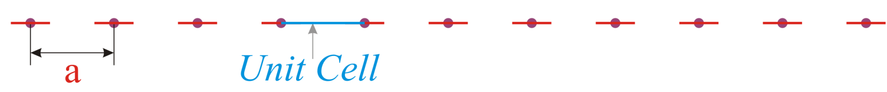
Making a 1D Crystal
Some of the concepts are best illustrated in lower dimensions → hence we shall construct some 1D and 2D crystals before jumping into 3D
A strict 1D crystal = 1D lattice + 1D motif
The only kind of 1D motif is a line segment
An unit cell is a representative unit of the structure (finite part of an infinite structure)
➢ which when translationally repeated gives the whole structure.
Lattice
∞
∞
+
Motif
=
Crystal
∞
∞

Slide 18
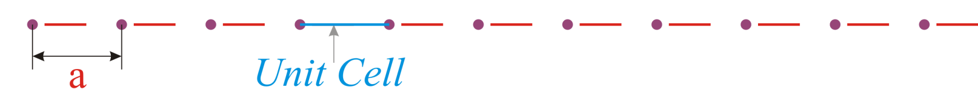

Other ways of making the same crystal
We had mentioned before that motifs need not ‘sit’ on the lattice point- they are merely associated with a lattice point.
Here is an example: (in this case each red line segment is positioned to the right of the lattice point by a fixed amount)
Note:
For illustration purposes we will often relax this strict requirement of a 1D motif
➢ We will put 2D motifs on 1D lattice to get many of the useful concepts across
(Actually we have already done this in the example considered before → with an up arrow (↑) and a down arrow (↓))
1D lattice +
2D Motif*
*looks like 3D due to the shading!
It has been shown in literature that 1D crystals cannot be stable!!

Slide 19
Making a 2D Crystal
Some aspects we have already seen in 1D → but 2D many more concepts can be clarified in 2D
2D crystal = 2D lattice + 2D motif
As before we can relax this requirement and put 1D or 3D motifs!
(to know more about motifs click here)
Continued

Slide 20


Lattice
∞
Motif
+

∞
∞
∞
Continued

Slide 21



Crystal
The 2D crystal (& lattice) is specified using 3 lattice parameters: ‘a’, ‘b’ and α.
∞














As before there are many ways of associating the motif with a lattice point (one of these is shown)
=














∞
∞














In many places the ‘infinity’ will be left out
(it is implied)














∞
For objects with circular symmetry in 2D and spherical symmetry in 3D there is no need to ‘worry about’ orientational order!
Note:
Each motif is identically oriented (orientationally ordered)
and
is associated exactly at the same position with each lattice point (positionally ordered)
We will have more to say on this in Chapter 4

Slide 22
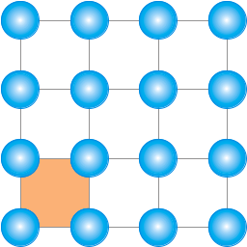
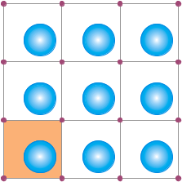
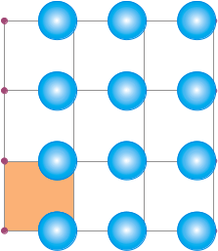
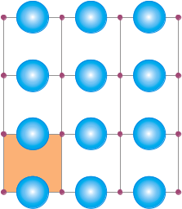
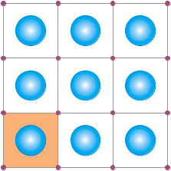
Funda Check
What is meant by the statement that motif is ‘associated’ with the lattice point?
Motif is associated with the lattice point and need not ‘sit’ on the lattice point. In any case the full motif cannot ‘sit’ on the lattice point (just one point, maybe the centroid of an object, can ‘sit’ on the lattice point).
Motif can be associated with a lattice point in many ways, as in the examples below*.
In some cases the motif may consist of many atoms, but in the natural choice of association with a lattice point, none of the atoms ‘sit’ at the lattice point: (i) in the Fullerene crystal with 60 carbon atoms per molecule (the motif) none of the carbon atoms are at the lattice point; (ii) in γ-brass there are 26 atoms in the motif (Cu₁₀Zn₁₆) (and 52 in the UC), but none of them are at the lattice point.
In all the cases the conventional unit cell is marked in orange. This UC has lattice points as vertices.
* As obvious, there are infinite number of ways of making this crystal!

Slide 23
Now let us make some more 2-D crystals
Click here

Slide 24
Making a 3D Crystal
3D crystal = 3D lattice + 3D motif.
There are 14 distinct lattices possible in 3D called the Bravais lattices.

Slide 25
Crystal system
Lattices can be constructed using translation alone.
The definition (& classification) of Crystals is based on symmetry and NOT on the geometry of the unit cell (as often one might feel after reading some books!).
Crystals based on a particular lattice can have symmetry:
➢ equal to that of the lattice or
➢ lower than that of the lattice.
Based on symmetry crystals are classified into seven types/categories/systems known as the SEVEN CRYSTAL SYSTEMS.
We can put all possible crystals into 7 boxes based on symmetry.
Alternate view
Advanced concept: readers can return to this point later!
Symmetry operators acting at a point can combine in 32 distinct ways to give the 32 point groups.
Lattices have 7 distinct point group symmetries which correspond to the SEVEN CRYSTAL SYSTEMS.

Slide 26
Funda Check
If the definition/classification of Crystals (e.g. cubic crystal) is based on symmetry and the existence of 7 crystal systems is also based on symmetry; then how come we have statements like: a = b = c, α = β = γ = 90° is a cubic crystal?
This is an important point and requires some clarification.
Though the definition of crystals (e.g. cubic crystals) are based on symmetry and NOT on the geometry of the unit cell; it is true that if we already have cubic crystal it is most preferred/logical to use parameters like
a = b = c, α = β = γ = 90°.
The next slide explains as to why a set of coordinate axis is more preferred for certain geometrical entities using the example of a circle.
Also see hyperlink below.
Relation between geometry and symmetry in atomic crystals

Slide 27
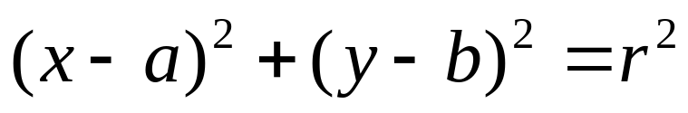

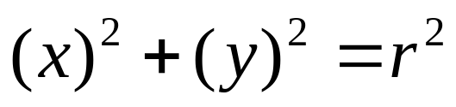
Concept of symmetry and choice of axes
(a,b)
The centre of symmetry
of the object does not
coincide with the origin
Polar coordinates (ρ, θ)
The circle is described equally well by the three equations; but, in the polar coordinate system (with centre of the circle coinciding with the origin), the equation takes the most elegant (simple) form
The type of coordinate
system chosen is not
according to the symmetry
of the object
Our choice of coordinate axis does not alter the symmetry of the object (or the lattice)!

Slide 28

What are the symmetries of the 7 crystal systems?
Minimum symmetry of the 7 crystals systems are listed in the table below.
As an example: cubic crystals have four 3-fold axes (at least), while a trigonal crystal has only one 3-fold axis (but can have other symmetries). Tetragonal crystals have one 4-fold axis at least (but cannot have three 4-fold axes).
The characteristic symmetry refers to the minimum symmetry that needs to be present.
We have stated that basis of definition of crystals is ‘symmetry’ and hence the classification of crystals is also based on symmetry.
The essence of the required symmetry is listed in the table
➢ more symmetries may be part of the point group in an actual crystal.
Note that the symmetry being considered is the point group symmetry. The translational components are ‘dropped’ while noting the symmetry. E.g. 6₃ screw axis is written as a ‘6’.
(only translational symmetry)
Note: translational symmetry is always present in crystals (i.e. even in triclinic crystal)

Slide 29
14 Bravais Lattices divided into 7 Crystal Systems
Refer to slides on Lattice for more on these
A Symmetry based concept
‘Translation’ based concept
 | Crystal System | Shape of UC | Bravais Lattices
 |  |  | P | I | F | C
1 | Cubic | Cube |  |  | 
2 | Tetragonal | Square Prism (general height) |  | 
3 | Orthorhombic | Rectangular Prism (general height) |  |  |  | 
4 | Hexagonal | 120° Rhombic Prism | 
5 | Trigonal | Parallelepiped (Equilateral, Equiangular) | 
6 | Monoclinic | Parallogramic Prism |  |  |  | 
7 | Triclinic | Parallelepiped (general) | 
P | Primitive
I | Body Centred
F | Face Centred
C | A/B/C- Centred
Why are some of the entries missing?
➢ Why is there no C-centred cubic lattice?
➢ Why is the F-centred tetragonal lattice missing?
➢ ….?

Slide 30
THE 7 CRYSTAL SYSTEMS
Some general notes on the frequency of occurrence of various crystal systems
In metals the high symmetry cubic & hexagonal systems are more common, while in organic systems the low symmetry ones are more common (as expected it is difficult to pack the complicated organic molecules into a high symmetry configuration).

Slide 31
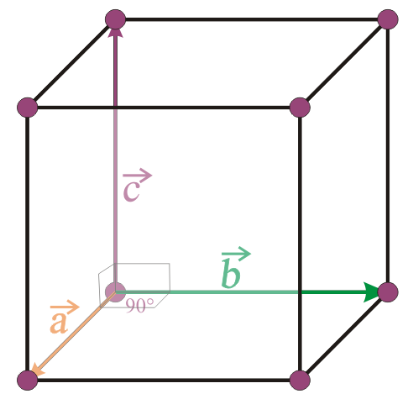
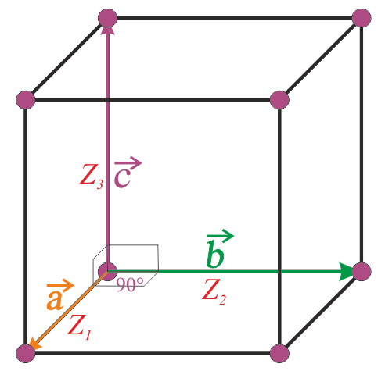
Name of crystal system
lattice parameters and relationship amongst them
(preferred Unit Cell)
Possible Bravais lattices
Orientation of property axes w.r.t to UC*
Diagram of preferred UC
Template followed for the 7 crystal systems
* When various properties are measured these are the axes along which the values are tabulated

Slide 32
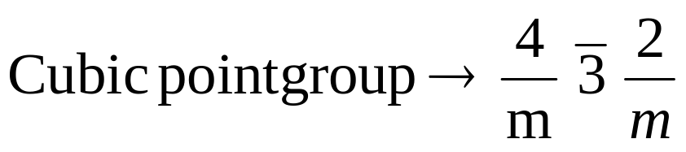
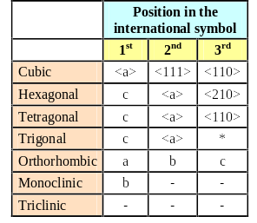
Note on understanding point groups
Click here to know more about symmetry and point groups
Typically the topic of point groups is advanced for a elementary course. However, if interested one can refer to the chapter on symmetry first.
In the symbol for the point group there is a maximum of 3 positions as in the example below.
Symmetry directions in the seven crystal systems
<a>
<111>
<110>
These correspond to well defined crystallographic directions as in the table. As usual these brackets < > refer to the family of directions.
* Few trigonal space groups have <210> as the 3rd symmetry direction (similar to hexagonal system).
E.g. P312.

Slide 33
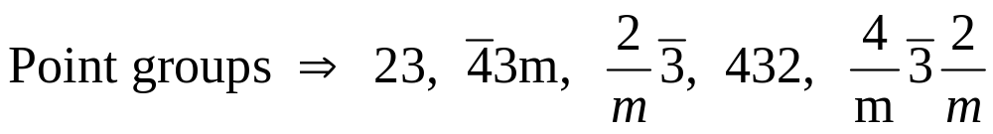
Cubic Crystals
a = b= c
α = β = γ = 90º
Orientation of property axes orthogonal set (Z₁, Z₂, Z₃)
Simple Cubic (P) - SC
Body Centred Cubic (I) – BCC
Face Centred Cubic (F) - FCC
SC, BCC, FCC are lattices
while HCP & DC are crystals!
Note the 3s are in the second position
Elements with Cubic structure → SC: F, O, Po
BCC: Cr, Fe, Nb, K, W, V
FCC: Al, Ar, Pb, Ni, Pd, Pt, Ge
Note: Ge has two atoms per lattice point (has DC crystal structure
Note: here SC, BCC & FCC are lattices

Slide 34
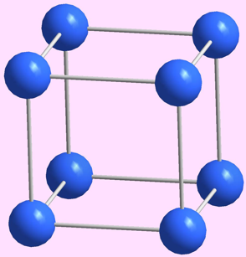
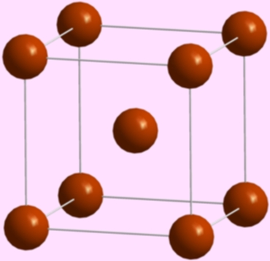
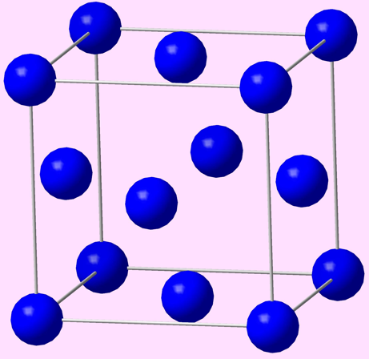
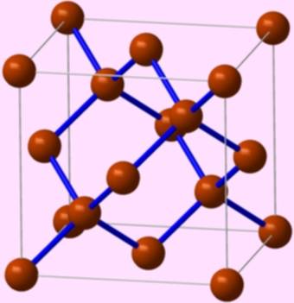
Examples of elements with Cubic Crystal Structure
Depending on the type of lattice and the motif the number of atoms per unit cell can vary.
Fe
Cu
Po
n = 1
SC
n = 2
BCC
n = 4
FCC/CCP
n = 8
DC
C (diamond)

Slide 35
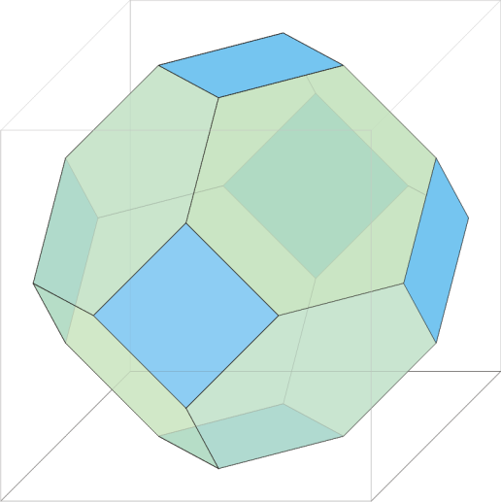
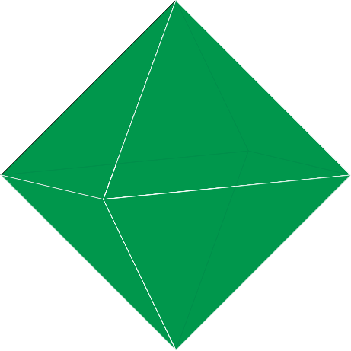
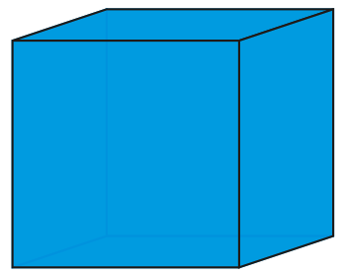
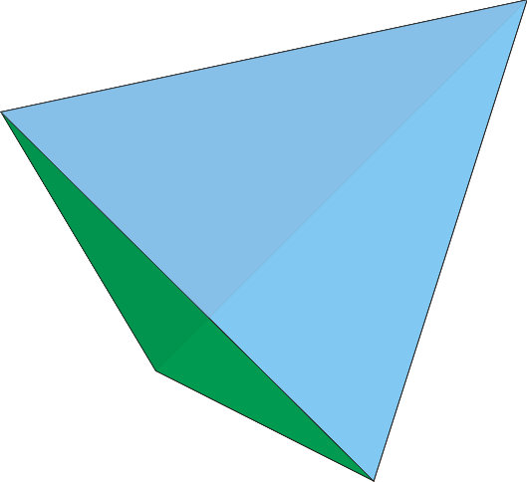
Crystal Shape
Examples of few crystal shapes (cubic crystal system)
In well grown (eumorphic) and ‘equilibrated’ crystals the inherent point group symmetry (not that translations involved in space group symmetry are not relevant at this length scale) is expressed in the external shape (form) of the crystals.
Hence, cubic crystals can have equilibrium shapes which include: cube, octahedron, truncated octahedron, tetrahedron (for 23 point group crystals), etc.
The shape of the crystal (Eumorphic- well formed) will ‘reflect’ the point group symmetry of the crystal
Tetrakaidecahedron
(Truncated Octahedron)
Cube
Octahedron
Tetrahedron

Slide 36
Note that cubic crystals can have the shape of a cube, an octahedron, a truncated octahedron etc.
(some of these polyhedra have the same rotational symmetry axes; noting that cube and octahedron are regular solids (Platonic) while truncated octahedron with two kinds of faces is not a regular solid)
The external shape is a manifestation (‘reflection’) of the symmetry at the atomic level.
Point groups have been included for completeness and can be ignored by beginners.
Cubic crystals can be based on Simple Cubic (SC), Body Centred Cubic (BCC) and Face Centred Cubic Lattices (FCC)
➢ by putting motifs on these lattices.
After the crystal is constructed based on the SC, BCC or FCC lattice, it should have four 3-fold symmetry axes (along the body diagonals)
➢ which crystals built out of atomic entities will usually have
➢ if the crystal does not have this feature it will not be a cubic crystal (even though it is based on a cubic lattice).

Slide 37
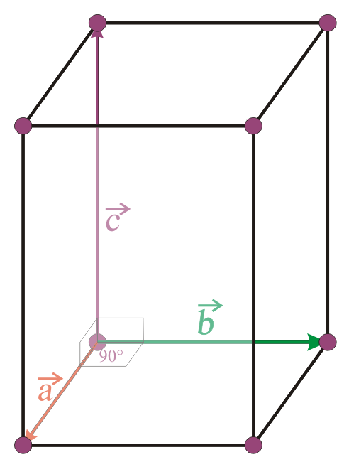
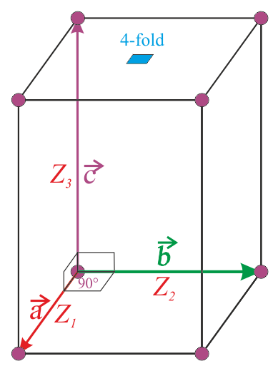
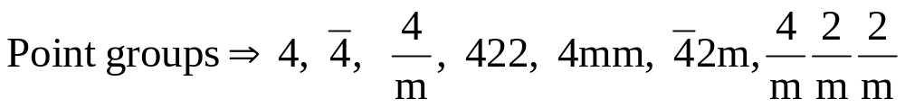
Tetragonal Crystals
a = b ≠ c
α = β = γ = 90º
Simple Tetragonal
Body Centred Tetragonal -BCT
Orientation of property axes orthogonal set (Z₁, Z₂, Z₃)
Elements with Tetragonal structure → In, Sn
Note the 4 in the first place

Slide 38
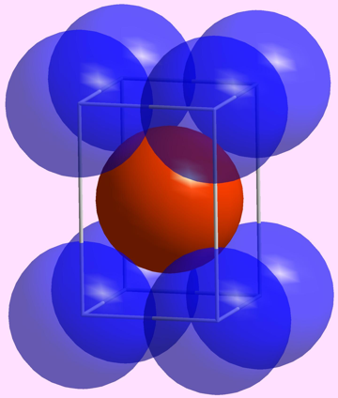
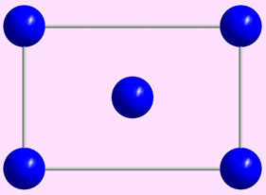
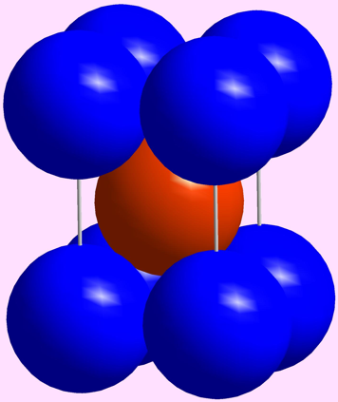
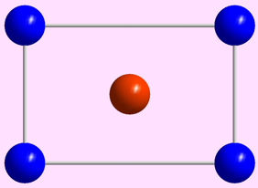
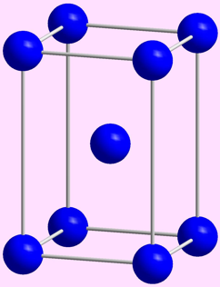
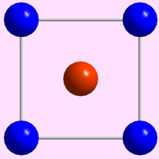
In
Example of an element with Body Centred Tetragonal Crystal Structure
[100] views
BCT
All atoms are In → coloured for better visibility
In
Lattice parameter(s) | a = 3.25 Å, c = 4.95 Å
Space Group | I4/mmm (139)
Strukturbericht notation | A6
Pearson symbol | tI2
Other examples with this structure | Pa
[001] view
 | Wyckoff position | Site Symmetry | x | y | z | Occupancy
In | 2a | 4/mmm | 0 | 0 | 0 | 1
Note: All atoms are identical (coloured differently for easy visualization)

Slide 39
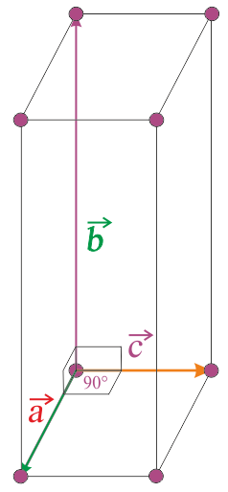
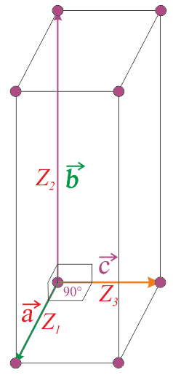

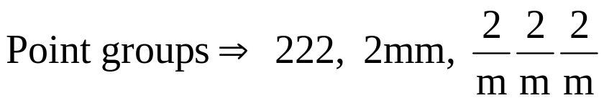
Orthorhombic Crystals
a ≠ b ≠ c
α = β = γ = 90º
Simple Orthorhombic
Body Centred Orthorhombic
Face Centred Orthorhombic
End Centred Orthorhombic
(note: the only lattice with all possibilities present)
Orientation of property axes orthogonal set (Z₁, Z₂, Z₃)
Usual convention
Elements with Orthorhombic structure → Br, Cl, Ga, I, S, U

Slide 40
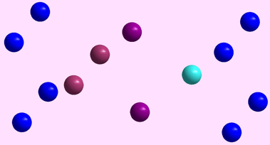
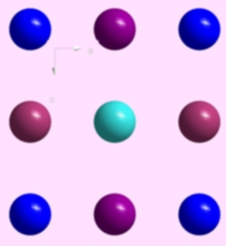
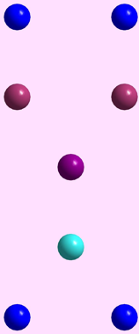
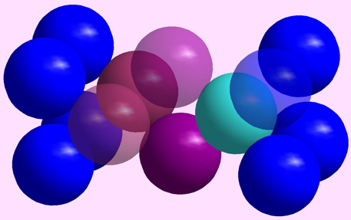
Ga
Example of an element with Orthorhombic Crystal Structure
[010] view
[001] view
Ga
Lattice parameter(s) | a = 2.9 Å, b = 8.13, c = 3.17 Å
Space Group | Cmcm (63)
Strukturbericht notation
Pearson symbol | oC4
 | Wyckoff position | Site Symmetry | x | y | z | Occupancy
Ga | 4c | m2m | 0 | 0.133 | 0.25 | 1
Note: All atoms are identical (coloured differently for easy visualization)

Slide 41
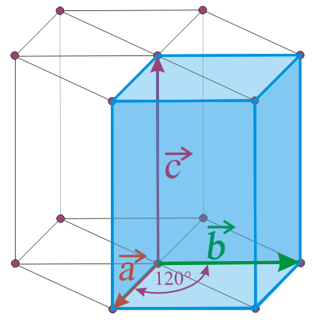
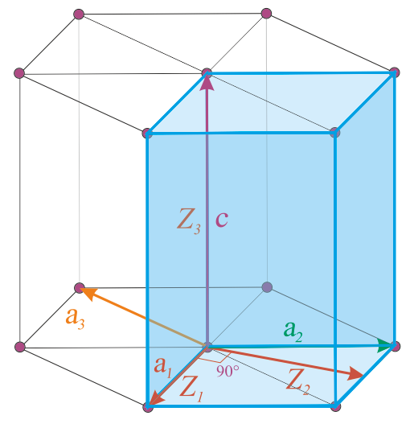
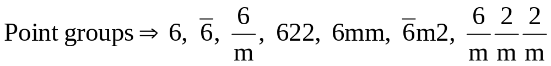
Hexagonal Crystals
a = b ≠ c
α = β = 90º γ = 120º
Simple Hexagonal
(note: there is only one type of hexagonal lattice)
Orientation of property axes orthogonal set (Z₁, Z₂, Z₃)
Note that the unit cell is not the hexagonal prism, but the blue shaded rhombic prism. This unit cell does not have the hexagonal symmetry and hence we often show a compound of 3 unit cells (as above), which has 6-fold symmetry.
Elements with Hexagonal structure → Be, Cd, Co, Ti, Zn
Click here to know more about
HCP crystals
* Note: note HCP is one type of a crystal having a hexagonal lattice (with two identical atom motif). We will discuss this soon.

Slide 42

Mg
Example of an element with Hexagonal Crystal Structure
This is a HCP structure
(it has only a 3-fold pure rotation axis along z-direction, along ‘z’ it has a 6₃ screw axis)
More about this in the chapter on Structure_of_Solids_Metallic
Note: All atoms are identical (coloured differently for easy visualization)

Slide 43




5. Trigonal/Rhombohedral Crystals
a = b = c
α = β = γ ≠ 90º
Rhombohedral (simple)
Some times an alternate hexagonal cell is used instead of the Trigonal Cell
Note the 3s are in the first position
Elements with Trigonal structure → As, B, Bi, Hg, Sb, Sm
Video: Cubic to Trigonal unit cell

Slide 44


α-Hg
Example of an element with Simple Trigonal Crystal Structure
[111] view
α-Hg
Lattice parameter(s) | a = 3.005 Å
Space Group | R-3m (166)
Strukturbericht notation | A10
Pearson symbol | hR1
Other examples with this structure | β-Po
 | Wyckoff position | Site Symmetry | x | y | z | Occupancy
Hg | 1a | -3m | 0 | 0 | 0 | 1

Slide 45



Monoclinic Crystals
a ≠ b ≠ c
α = γ = 90º ≠ β
Simple Monoclinic
End Centred (base centered)
Monoclinic (A/C)
The ‘b’ axis is along the 2 or 2bar or ⊥ m
Orientation of property axes orthogonal set (Z₁, Z₂, Z₃)
Elements with Monoclinic structure → P, Pu

Slide 46



7. Triclinic Crystals
a ≠ b ≠ c
α ≠ γ ≠ β
Simple Triclinic
Orientation of property axes orthogonal set (Z₁, Z₂, Z₃)

Slide 47
Note that cubic crystals can have the shape of a cube, an octahedron, a truncated octahedron etc. (all these polyhedra have the same symmetry; noting that cube and octahedron are regular solids (Platonic) while truncated octahedron with two kinds of faces is not a regular solid).
The external shape is a ‘reflection’ of the symmetry at the atomic level.
Point groups have been included for completeness and can be ignored by beginners.
Cubic crystals can be based on Simple Cubic (SC), Body Centred Cubic (BCC) and Face Centred Cubic Lattices (FCC)
➢ by putting motifs on these lattices.
After the crystal is constructed based on the SC, BCC or FCC lattice, it should have four 3-fold symmetry axes (along the body diagonals)
➢ which crystals built out of atomic entities will usually have
➢ if the crystal does not have this feature it will not be a cubic crystal (even though it is based on a cubic lattice) → more on this here.

Slide 48

Now let us consider some simple crystals

Slide 49




Simple Cubic (SC) Lattice
+
Sphere Motif
Graded Shading to give 3D effect
Unit cell of the SC lattice
Simple Cubic Crystal
=
If these spheres were ‘spherical atoms’ then the atoms would be touching each other
The kind of model shown is known as the ‘Ball and Stick Model’
Click here to know more about the kind of models used to represent crystal structures

Slide 50

A note on kind of models used for representation of Crystal Structures
Wire Frame model
Ball & Stick Model
Atoms are reduced to points and the focus is on the cell edges
Both atoms & cell edges are in view (but atoms do not touch each other)
Cubic void
Void Models
Space Filling Model
Where the void (actually the polyhedron formed by the vertices of the void) is in full view and everything else is hidden away
Atoms touch each other.
Unit cell edges may not be visible
Note: though these are called space filling models in reality they do not fill space
[as obvious from the space between the atoms (-the voids)]

Slide 51



Body Centred Cubic (BCC) Lattice
+
Sphere Motif
Atom at (½, ½, ½)
Body Centred Cubic Crystal
Atom at (0, 0, 0)
=
Unit cell of the BCC lattice
Space filling model
So when one usually talks about a BCC crystal what is meant is a BCC lattice decorated with a mono-atomic motif
Central atom is coloured differently for better visibility
Note: BCC is a lattice and not a crystal
Video: BCC crystal

Slide 52




All atoms are identical- coloured differently for better visibility
Face Centred Cubic (FCC) Lattice
+
Sphere Motif
Cubic Close Packed Crystal
(Sometimes casually called the FCC crystal)
Atom at (½, ½, 0)
Atom at (0, 0, 0)
=
Unit cell of the FCC lattice
Space filling model
So when one talks about a FCC crystal what is meant is a FCC lattice decorated with a mono-atomic motif
Note: FCC is a lattice and not a crystal
Video: FCC crystal

Slide 53




Face Centred Cubic (FCC) Lattice
+
Two Ion Motif
(0,0,0)
(½,0,0)
NaCl Crystal
=
Unit cell formula:
Cl⁻ Ion at (0, 0, 0)
Na⁺ Ion at (½, 0, 0)
Note: This is not a close packed crystal
Has a packing fraction of ~0.67 (using rigid sphere model)
Solved example: packing fraction of NaCl
Note that the two ion motif leads to crystal which is not close packed− unlike the mono-atomic (sphere) packing case
Video: NaCl crystal
Notes:
Can have one sentence about difference between FCC with monoatomic packing and diatomic packing → close packing

Slide 54


Face Centred Cubic (FCC) Lattice
+
Two Carbon atom Motif
(0,0,0) & (¼, ¼, ¼)
Diamond Cubic Crystal
=
Tetrahedral bonding of C
(sp³ hybridized)
It requires a little thinking to convince yourself that the two atom motif actually sits at all lattice points!
Note: This is not a close packed crystal
Video: Diamond crystal
There are no close packed directions in this crystal either!

Slide 55
Emphasis
For a well grown crystal (eumorphic crystal) the external shape ‘reflects’ the point group symmetry of the crystal
→ the confluence of the mathematical concept of point groups and practical crystals occurs here!
The unit cell shapes indicated are the conventional/preferred ones and alternate unit cells may be chosen based on need
It is to be noted that some crystals can be based on all possible lattices (Orthorhombic crystals can be based on P, I, F, C lattices); while others have a limited set (only P triclinic lattice) → more about this is considered in here

Slide 56


Next (two slides) we shall try to order the 7 crystal systems based on:
➢ Symmetry and
➢ the expenditure in terms of lattice parameters (terseness)
Then we shall put the 32 point groups into the 7 boxes (7 crystal systems)
Though this task is a little advanced for this elementary treatment
- it brings out the concept that a given crystal type like cubic crystal does not involve just one symmetry (point group)
- cubic crystals can have lower symmetry than the lattices they are built on (cubic lattices have symmetry
- we can have cubic crystals without a (pure) 4-fold axis! (e.g. Diamond Cubic crystal does not have a 4-fold it has a axis)
The concept of terseness is explained in a subsequent slide

Slide 57
Ordering the 7 Crystal Systems: Based on Symmetry (the order of the point group)
Progressive lowering of symmetry amongst the 7 crystal systems
Order of the point group of the lattice
Order
Cubic⁴⁸
Increasing symmetry
Cubic
Hexagonal²⁴
Hexagonal
Tetragonal¹⁶
Trigonal¹²
Tetragonal
Orthorhombic⁸
Trigonal
Orthorhombic
Monoclinic⁴
Monoclinic
Triclinic²
Triclinic
Arrow marks lead from supergroups to subgroups
Superscript to the crystal system is the order of the point group of the lattice
(as crystals based on the lattice can have a lower symmetry)

Slide 58
Ordering the 7 Crystal Systems: terseness
As we have noted before, when it comes to crystals symmetry is of paramount importance
However, we have also seen that a given crystal is ‘best’ described by a certain choice of axes (lattice parameters)
The next slides describes how the lattice parameters can be used to order the seven crystal systems
To do this a parameter called terseness (t) is defined as:
t = (p’ − c)
Where, p’ = (p − e)
e → number of ‘=’ amongst the lattice parameters (e.g. in cubic crystals: a = b = c; α = β = γ ⇒ e = 4)
c → number of constraints (numerical) on lattice parameters (e.g. in cubic crystals α, β, γ = 90° ⇒ c = 1)
Terseness (t) is a measure of ‘how much do we spend’ on lattice parameters!
The more we spend (larger ‘t’ number) → the lower down it is in the order
The less we spend (small ‘t’ number) → the ‘terser’ we are → higher up in the list
E.g. for Hexagonal: there are 6 parameters (p) and 2 “=“ amongst them (e)
p’ = (p − e) = (6 − 2) = 4
c the number of numerical constraints on values is 2 (α, β = 90°; γ = 120°)
t = (p’ − c) = (4 − 2) = 2

Slide 59
Calculations
Crystal System | p (in 3D) | e | p’ = p − e | c | (e + c) | t = p − (e + c) or t = p’ − c
Cubic | 6 | 4 | 2 | 1 | 5 | 1
Tetragonal | 6 | 3 | 3 | 1 | 4 | 2
Hexagonal | 6 | 2 | 4 | 2 | 4 | 2
Trigonal | 6 | 4 | 2 | 0 | 4 | 2
Orthorhombic¹ | 6 | 2 | 4 | 1 | 3 | 3
Orthorhombic² | 6 | 2 | 4 | 1 | 3 | 3
Monoclinic | 6 | 1 | 5 | 1 | 2 | 4
Triclinic | 6 | 0 | 6 | 0 | 0 | 6
(e + c) → is a measure of ‘how much help’ is available via constraints

Slide 60
Progressive relaxation of the constraints on the lattice parameters amongst the 7 crystal systems
E.g. for Cubic: there are 6 parameters (p) and 4 “=“ amongst them (e)
p’ = (p − e) = (6 − 4) = 2
c the number of numerical constraints on values is 1 (= 90°)
t = (p’ − c) = (2 − 1) = 1
Cubic (p’ = 2, c = 1, t = 1)
a = b = c
α = β = γ = 90º
Increasing number t
Tetragonal (p’ = 3, c = 1 , t = 2)
a = b ≠ c
α = β = γ = 90º
Hexagonal (p’ = 4, c = 2 , t = 2)
a = b ≠ c
α = β = 90º, γ = 120º
Trigonal (p’ = 2, c = 0 , t = 2)
a = b = c
α = β = γ ≠ 90º
Orthorhombic¹ (p’ = 4, c = 1 , t = 3)
a ≠ b ≠ c
α = β = γ = 90º
Orthorhombic² (p’ = 4, c = 1 , t = 3)
a = b ≠ c
α = β = 90º, γ ≠ 90º
Monoclinic (p’ = 5, c = 1 , t = 4)
a ≠ b ≠ c
α = γ = 90º, β ≠ 90º
p’ = number of independent parameters = p − e
(discounting the number of =)
c = number of constraints (positive ⇒ “= some number“)
t = terseness = (p’ − c)
(is a measure of the ‘expenditure’ on the parameters
Triclinic (p’ = 6, c = 0 , t = 6)
a ≠ b ≠ c
α ≠ γ ≠ β ≠ 90º
Orthorhombic¹ and Orthorhombic² refer to the two types of cells
Click here to know more about the two Orthorhombic settings

Slide 61

Minimum symmetry requirement for the 7 crystal systems
This slide is best understood after reading the slides on symmetry
The corresponding (for each system) lattices have the highest symmetry, which is marked in yellow shaded box. E.g. Cubic lattices have 4/m −3 2/m symmetry (though cubic crystals can have a lower symmetry).

Slide 62


Examples of crystals in the 32 point groups
Minimum symmetry for the point groups

Slide 63

Statistics for the 32 crystallographic point groups gathered from more than 280,000 chemical compounds (by G. Johnson)

Slide 64
Ideal versus Real crystals
Ideal crystals may have perfect positional and orientational order with respect to geometrical entities and physical properties.
In (defining) real crystals some of these strict requirements may be relaxed:
➢ the order considered may be only with respect to the geometrical entity
➢ the positional order may be in the average sense
➢ the orientational order may be in the average sense.
In addition real crystals:
➢ are finite
➢ may contain other defects (Chapter 5).

Slide 65
Revision of previous slide:
CRYSTALS
Orientational Order
Positional Order
Later on we shall discuss that motifs can be:
MOTIFS
Geometrical entities
Physical Property
In practice some of the strict conditions imposed might be relaxed and we might call something a crystal even if :
Orientational order is missing
There is only average orientational or positional order
Only the geometrical entity has been considered in the definition of the crystal and not the physical property.

Slide 66
Allotropy, Polymorphism, Isomorphism & Amorphous
The term “morphous” comes from: Late Latin -morphus –morphous or from Greek –morphos ➢ which refers to form or shape.
Allotropy → existence of an element in more than one crystal structure.
➢ E.g. Fe in CCP (high temperature, γ) and BCC (low temperature, α) forms.
Polymorphism → existence of a crystalline compound in more than one crystal structure.
➢ E.g. 3C-SiC (cubic) and 2H-SiC (Wurtzite, hexagonal)*.
Isomorphism → existence of different materials in same crystal structure.
➢ E.g. Ni and Cu in CCP (FCC).
Amorphous → having no crystal structure (~glass).
➢ E.g. Window pane silicate glass.
Poly-amorphism → existence of a more than one type of amorphous structure.
➢ E.g. in Y₂O₃ – Al₂O₃ amorphous solutions.
* This is according to the Ramsdell Notation.

Slide 67
SUMMARY
Crystal = Lattice + Motif
There are 14 Bravais lattices in 3D (which are based on translation)
Motif is any entity (or entities) which is positioned identically with respect to every lattice point
There are 32 different ways in which symmetries (rotation, roto-inversion, mirror, inversion) can combine at a point called the 32 point groups
These Bravais lattices have 7 different symmetries which correspond to the 7 crystal systems
Conventionally, 7 different unit cells are chosen for these 7 crystal systems
Real crystals are ‘defected’ in many ways so that some of the symmetries present in an ideal crystal are ‘disturbed’ (either locally or globally).

Slide 68
Funda Check
The definition of crystals are based on symmetry and not on the geometry of the unit cell.
Our choice of unit cell cannot alter the crystal system a crystal belongs to.
Crystals based on a particular lattice can have symmetry equal to or lower than that of the lattice.
When all symmetry (including translation) is lost the construct is called amorphous.
Often similar sounding’’ acronyms can be confusing.
➢ SC, BCC, FCC are lattices.
➢ DC, HCP are crystals.
In the space group symbol for crystals with a SC lattice the alphabet ‘P’ is used (e.g. Pm−3m for the B2 structure). (This should not be confused with ‘primitive’. The term primitive is used in conjunction with an unit cell, while the term simple is used to designate a type of lattice).
The alphabet ‘I’ is used for body centred lattices (e.g. Im−3m), ‘F’ for face centred lattices ((e.g. Fm−3m) and ‘C’ for end centred lattices (e.g. C2/c).

Slide 69



Funda Check
What is a cubic crystal? (or more formally, ‘define a cubic crystal’)
A cubic crystal is one having at least Four 3-fold axes of rotational symmetry (along the <111> directions).
The symmetry along <111> maybe higher: they can be roto-inversion axis: .
A cubic crystal may or may not have 4-fold axes of symmetry!
If you have a cubic crystal, then you may (i.e. may not also!) chose axes as (preferred):
a = b = c; α = β = γ = 90º (but then you are allowed to make other choices!)
A cubic crystal should be defined based on symmetry and not the geometry of the unit cell.
A cubic lattice (SC, BCC, FCC) will have point group symmetry (the highest possible symmetry for cubic systems).
This is also the symmetry of crystals like Po (based on SC lattice), Cr (based on BCC lattice, Cu (based on FCC lattice).
Cubic crystals can have lower symmetry as well (e.g. )
Note that in the point group symbol of cubic crystals the ‘3’ is placed in the second position.
An end centred (or C-centred) cubic lattice is not possible, as this will destroy the 3-fold axes.

Slide 70
Q & A
What is a crystal?
➢ Crystal = Lattice + Motif
➢ Crystal = Asymmetric Unit + Space Group (+ Wyckoff Positions)
➢ An array of entities in space, having at least translational symmetry
What constitutes a motif?
➢ A geometrical entity or a physical property or a combination of both can serve a motif
How is the classification of crystals made into the 7 crystal system?
➢ The classification is purely based on symmetry
➢ E.g. if a crystal has only one 4-fold axis then it would be classified as a tetragonal crystal
➢ This classification is not based on geometry of the unit cell (as commonly perceived)
➢ Ofcourse if one has a cubic crystal, then it will be referred to the cubic axis system
What are the 14 Bravais lattices?
➢ There are only 14 different ways in which points can be arranged in 3D space such that each point has identical surrounding
What is the relation between the 7 crystal systems and the 14 Bravais lattices?
➢ Based on symmetry the 14 Bravais lattices can be put into 7 boxes → the 7 crystal systems
➢ E.g. all lattices with two/four 3-fold axes are put into the box labeled ‘cubic’
What is the relation between the symmetry of a crystal and the symmetry with respect to its properties?
➢ The properties of a crystal can have a symmetry equal to that of the crystal or a symmetry higher than that of the crystal*
➢ E.g. cubic crystals (say with 4/m −3 2/m symmetry) have a spherical symmetry w.r.t. to refractive index.
* deriving the actual symmetry is an advanced topic and will not be considered for now

Slide 71

Solved
Example
This example pertains to the decoration of 1-dimensional lattice with a two dimensional object.
1
An infinite one dimensional array of points are spaced equally with spacing ‘a’
  Place an object having the shape of an arrow mark (e.g. ↑) at each point to create a crystal of lattice parameter ‘3a’
  Describe this crystal in terms of a Lattice and a Motif
  How is the symmetry altered on the formation of a crystal?

Slide 72




Solution
Method-1
As the shape only has been specified we can use arrow marks of different sizes
3a
Motif:
Note: there are an infinite set of possibilities here
Method-2
As the shape only has been specified we can use arrow marks of different colours
3a
Motif:
Note: there are an infinite set of possibilities here

Slide 73


Method-3
As the shape only has been specified we can use arrow marks in different orientations
3a
Motif:
Note: there are an infinite set of possibilities here
How is the symmetry altered on the formation of a crystal?
In the above cases the translational symmetry is lowered from ‘a’ to ‘3a’.
The array of points have a translational symmetry of ‘a’
→ on formation of the crystal only every third point is a lattice point &
the repeat distance of the crystal is ‘3a’.
Increase in the length of the translational symmetry vector can be conceived as a reduction in the symmetry

Slide 74





Solved
Example
  Does the array of points at the centres of the Carbon atoms in the graphene sheet as shown below form a lattice?
  Describe the crystal in terms of a lattice and a motif.
  What is the unit cell?
2
Part of the hexagonal array of C atoms which forms the Graphene structure
The answer is NO!
Not all carbon positions form a lattice
Crystal = Lattice + Motif
Grey atoms sit on the lattice positions
As atoms A & B do not have identical surrounding both cannot be lattice points
Motif = 1 grey + 1 green
(in positions as shown)
Primitive unit cell

Slide 75

Funda Check
List all the crystal systems, their preferred unit cells, along with the points groups belonging to these crystal systems

Slide 76


Q & A
What are the various symbols used in crystallography?
Typically the symbols used are:
(i) Strukturbericht notation (which is based on listing),
(ii) Pearson symbol,
(iii) Point/space group symbol/number.
Sometimes structure type is also used to designate a crystal.
Let us take the example of β-Mn below.
Space group
β-Mn
Lattice parameter(s) | a = 6.3145 Å
Space Group | P4₁32 (213) | ‘P’ is for primitive
Point Group | 432 | Drop the translational components to get point group
Strukturbericht notation | A13 | A-pure elements, B- AB type, C- AB₂ type, etc.* 13 is the number in the list.
Pearson symbol | cP20 | ‘c’ is for cubic, P for primitive, 20 atoms in UC
Space group number
Pearson symbol: c ≡ cubic, P ≡ simple lattice (not to be confused with primitive unit cell), 20 atoms in unit cell (here they are all Mn, but could be different in other structures).
βMn
Note: In reality the crystal does not have a ‘true’ 4-fold
* More details in the next page

Slide 77
Strukturbericht notation
Strukturbericht Designation | Crystal Type
A | Elements
B | AB Compounds
C | AB₂ or A₂B Compounds
D | A_{m}B_{n} compounds
E,F,G,H…K | More complex compounds e.g. ternary
L | Alloys (metallic + intermetallic)
O | Organic Compounds
S | Silicates
* The number following the letter gives the sequential order of the discovery of the particular structure type. Examples, A2 structure refers to BCC and B2 refers to an ordered AB compound with B atoms on cell vertices and A atoms on the B.C. Site.
In some cases, there is more than one derivative of an elemental structure within crystal type (denoted by subscript). Example, two derivative of FCC (A1) structure are the L1₀ and L1_{2.}

Slide 78




Solved
Example
For the crystal below (Fig.1): (i) mark the lattice points, (ii) show the motif, (iii) overlay the symmetry operators, (iv) mark a primitive & conventional unit cell, (v) write the space group and point group.
(ii)
(i)
Motif
(v) Space group: p4mm
Point group: 4mm
Fig.1
(iii)
(iv)

Slide 79





Solved
Example
For the crystal below (Fig.1): (i) mark the lattice points, (ii) show the motif, (iii) overlay the symmetry operators, (iv) mark a primitive & conventional unit cell, (v) write the space group and point group.
(ii)
Motif
(v) Space group: c2mm
Point group: 2mm
Fig.1
Two different ways of associating the motif with the lattice
(i)
(iii)
(iv)

Slide 80








Funda Check
How do we chose a motif to be associated with a lattice point?
As we have noted, there is no unique choice. Two choices of the motif for the square crystal (patch of the crystal shown in Fig.1) are as below are shown in Fig.2 and Fig.3.
The underlying
square lattice
Fig.1: patch of a
square crystal
Fig.2
Fig.3
For the crystal below, the motif consists of 4 yellow and 4 purple circles. There are many ways of choosing the motif (i.e. the configuration of 4Y and 4P circles) to be associated with a given lattice point (as shown).
Lattice point to which the motif is associated
Note that the “net content of the motif is the same”, irrespective of how you “reconfigure”!

Slide 81

Funda Check
Can 1D crystals be two-dimensional (2D) or 3D?
Can 2D crystals be 3D?
The dimension of the crystallinity (sometimes!) has to be decoupled with the dimension of the periodicity.
Based on the dimension of periodicity, we classify crystals as 1D, 2D or 3D. Correspondingly, the underlying lattices are 1D, 2D or 3D.
A 1D or 2D lattice may be decorated with a 3D motif, thus making the body/material 3D.
As an extreme example an amorphous 2D/3D layer may be repeated in 1D to get a 1D crystal. In the 2D plane the ‘atomic’ structure is amorphous; however, the ‘crystal’ has 1D periodicity.
Amorphous layer
Direction of periodicity

