Slide 1


MILLER INDICES
Miller (& Miller-Bravais) Indices for
Planes & Directions
Lattices & Crystals
MATERIALS SCIENCE
&
ENGINEERING
Part of
A Learner’s Guide
AN INTRODUCTORY E-BOOK
Anandh Subramaniam & Kantesh Balani
Materials Science and Engineering (MSE)
Indian Institute of Technology, Kanpur- 208016
Email: anandh@iitk.ac.in, URL: home.iitk.ac.in/~anandh
http://home.iitk.ac.in/~anandh/E-book.htm
Note: in this book we have used ‘−’ (minus) instead of a bar ̅ (i.e. [−1 0 0] instead of )
(this is technically wrong, but has been used for ease of typing)
From the law of rational indices developed by French Physicist and mineralogist
Abbé René Just Haüy
and popularized by
William Hallowes Miller

Slide 2
Miller indices are used to specify directions and planes.
These directions and planes could be in lattices or in crystals.
(It should be mentioned at the outset that special care should be given to see if the indices are in a lattice or a crystal).
The number of indices will match with the dimension of the lattice or the crystal: in 1D there will be 1 index, in 2D there will be two indices, in 3D there will be 3 indices, etc.
Sometimes, like in the case of Miller-Bravais indices for hexagonal lattices and crystals, additional indices are used to highlight the symmetry of the structure. In the case of the Miller-Bravais indices for hexagonal structures, a third redundant index is added (h k i l)→ 4 indices are used in 3D space. The use of such redundant indices bring out the equivalence of the members of a ‘family’.
Some aspects of Miller indices, especially those for planes, are not intuitively understood and hence some time has to be spent to familiarize oneself with the notation.
Note: both directions and planes are imaginary constructs
Miller Indices
Miller Indices
Directions
Planes
Lattices
Crystals

Slide 3
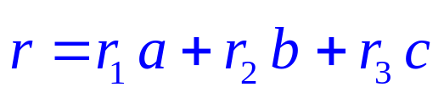
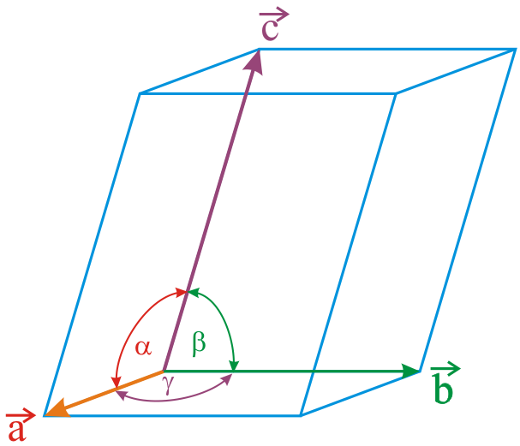
Miller indices for DIRECTIONS
❐ A vector r passing from the origin to a lattice point can be written as:
r = r₁ a + r₂ b + r₃ c
❐ Where, a, b, c → basic vectors (or generator vectors).
Basis vectors are unit lattice translation vectors, which define the coordinate axis
(as in the figure below).
Note that their lengths are usually one lattice translation and not 1 lengthscale unit! (this is unlike for the basis vectors of a coordinate axis). To give an example, if a rectangle crystal has lattice parameters a = 1 cm and b = 2.5 cm, then |a| = 1 cm and |b| = 2.5 cm (it is not 1 cm along the axes and the scale of the unit along the two directions are different).
In some cases, based on convenience, we may chose the basis vector as ‘multiple lattice translations’ (i.e. instead of one lattice translation we may chose 2 or 3).
We may also chose alternate basis vectors for the same structure (which corresponds to different unit cells).

Slide 4
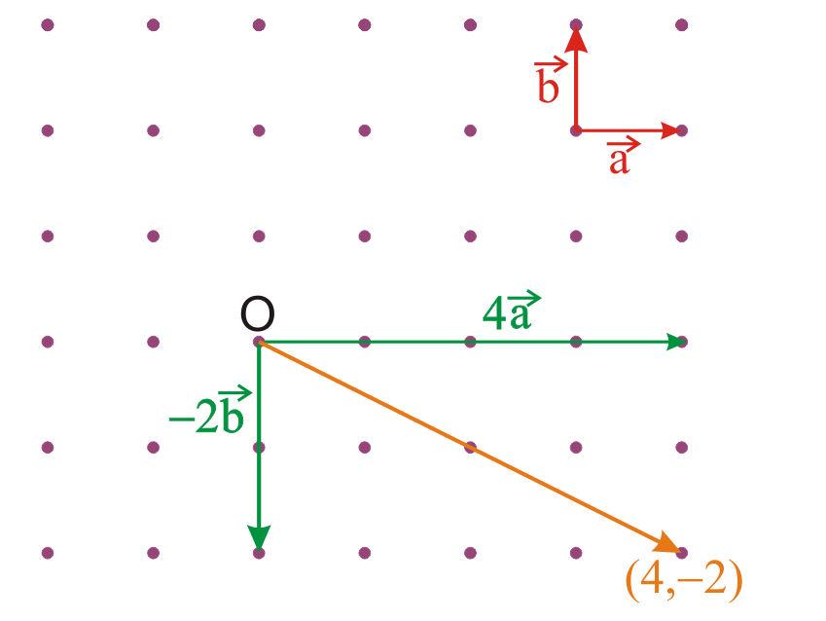
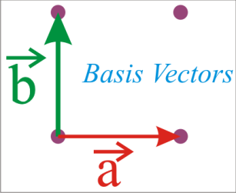
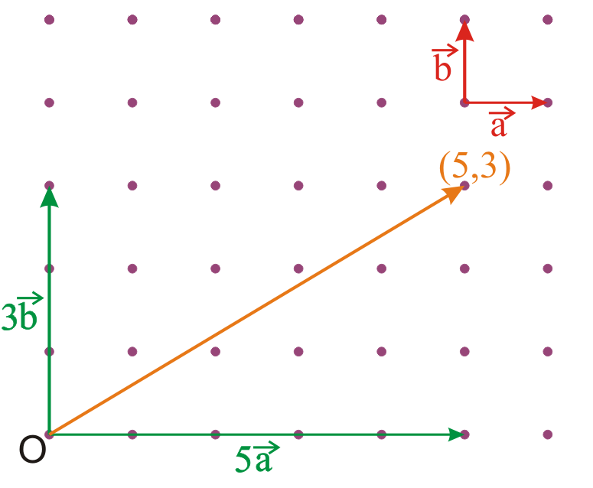


Miller Indices for directions in 2D
Another 2D example
Normally, we ‘take out’ the common factor
Miller indices → [53]
And then omit it!
We will see an example soon
STEPS in the determination of Miller indices for directions
Position the vector, such that start (S: (x₁, y₁)) and end points (E: (x₂, y₂)) are lattice points and note the value of the coordinates. Subtract to obtain: ((x₂−x₁), (y₂−y₁)).
Write these number in square brackets, without the ‘comma’: [* *].
‘Remove’ the common factors. (Note: keep the common factor, preferably outside the bracket, if the length has to be preserved in further computations).

Slide 5


Set of directions represented by the Miller index
This Miller index represents a set (an infinite set) of all such parallel vectors (and not just one vector)
(Note: ‘usually’ (actually always for now!))
originating at a lattice point and ending at a lattice point

Slide 6
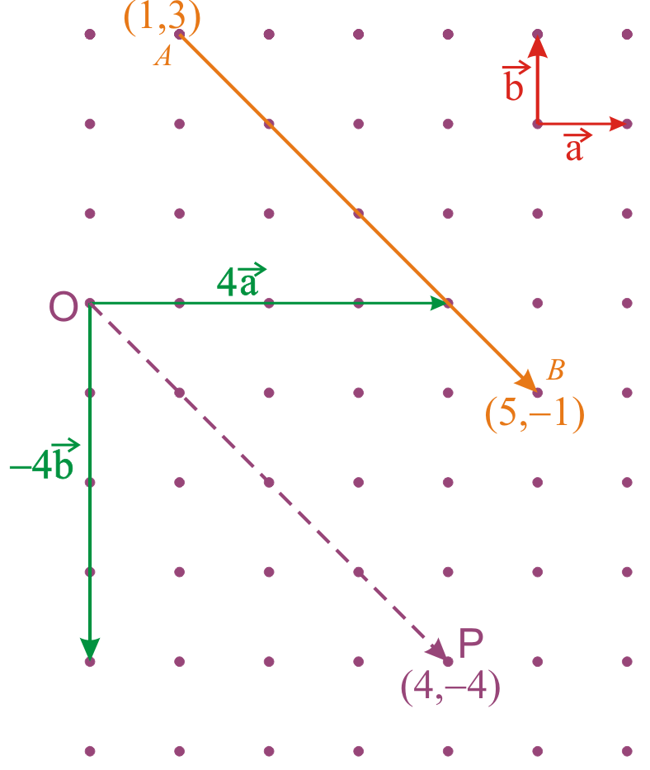





How to find the Miller Indices for an arbitrary direction? → Procedure
Consider the example below.
Subtract the coordinates of the end point from the starting point of the vector denoting the direction → If the starting point is A(1,3) and the final point is B(5,−1) → the difference (B−A) would be (4, −4).
Enclose in square brackets, remove comma and write negative numbers with a bar →
Factor out the common factor →
If we are worried about the direction and magnitude then we write →
If we consider only the direction then we write →
Needless to say the first vector is 4 times in length
The magnitude of the vector
is

Slide 7

Further points
General Miller indices for a direction in 3D is written as [u v w].
The length of the vector represented by the Miller indices is:
Important directions in 3D represented by Miller Indices (cubic lattice)
Z
Three important set of directions related to the cube are:
(i) cell edge ([001] type),
(ii) face diagonal ([011] type),
(iii) body diagonal ([111] type).
[011]
[001]
Memorize these
[101]
Body diagonal
[010]
Y
[111]
[100]
Face diagonal
[1‾10]
X
[110]
Procedure as before→
(Coordinates of the final point − coordinates of the initial point).
Reduce to smallest integer values.

Slide 8
The concept of a family of directions
A set of directions related by symmetry operations of the lattice or the crystal is called a family of directions. A family is a symmetry related set.
A family of directions is represented (Miller Index notation) as: <u v w>. Note the brackets.
Hence one has to ask two questions before deciding on the list of the members of a family:
1➢ Is one considering the lattice or the crystal?
2➢ What is the crystal system one is talking about. (What is its point group symmetry?)
Miller indices for a direction in a lattice versus a crystal
We have seen in the chapter on geometry of crystals that crystal can have symmetry equal to or lower than that of the lattice.
If the symmetry of the crystal is lower than that of the lattice then two members belonging to the same family in a lattice need not belong to the same family in a crystal → this is because crystals can have lower symmetry than a lattice
(examples which will taken up soon will explain this point).
Let us consider some examples to understand the concept of family of directions.
You may want to revise chapter on Symmetry and ‘Making_Crystals’.

Slide 9
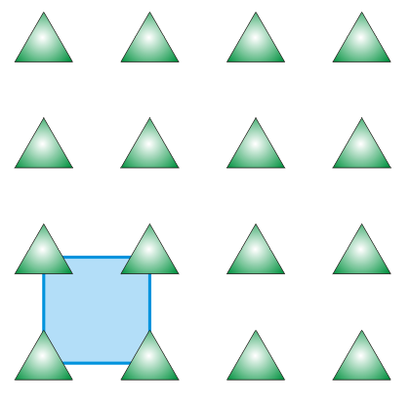
Let us start with a question.
Q & A
For the crystal in the figure below, what are the member(s) of the family of directions <01>?
The family <01> has only one member → [01] !!!
This crystal has m symmetry and belongs to the rectangle 2D crystal system. (Not a square crystal, though the unit cell is a square).
The mirrors are vertical and pass through lattice points and between them.
Click here to know more
[01]
!!!

Slide 10


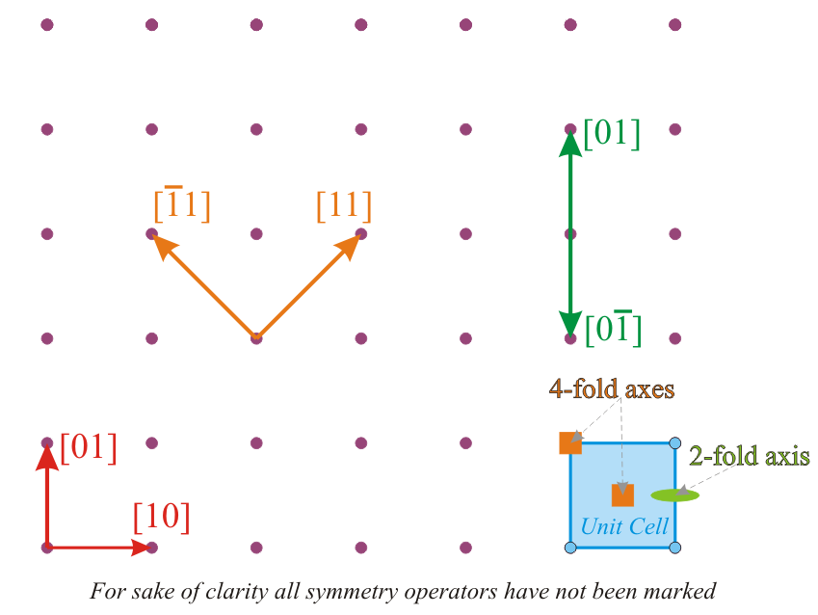


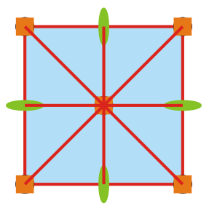
Family of directions
Examples
Let us consider a square lattice:
[10] and [01] belong to the same family → related by a 4-fold rotation
[11] and belong to the same family → related by a 4-fold rotation
➢ [01] and belong to the same family → related by a 2-fold rotation
(or double action of 4-fold)
Writing down all the members of the family
Essentially the 1st and 2nd index can be interchanged and be made negative (due to high symmetry)
4mm

Slide 11
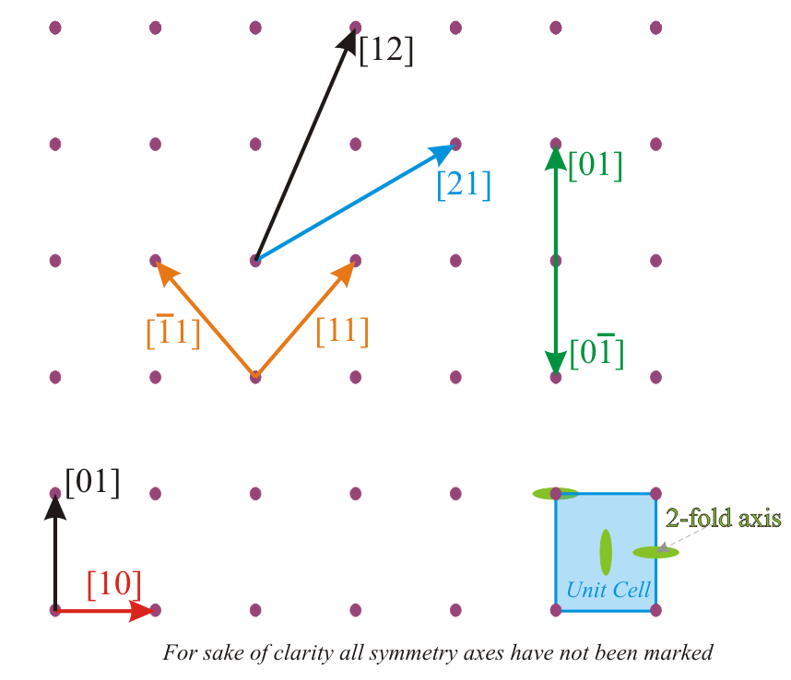



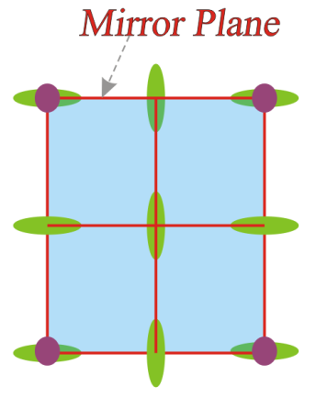
Let us consider a Rectangle lattice:
[10] and [01] do NOT belong to the same family
[11] and belong to the same family → related by a mirror
[01] and belong to the same family → related by a 2-fold rotation
➢ [21] and [12] do NOT belong to the same family
Writing down all the members of the family
Same family (related by horizontal mirror)
The 1st and 2nd index can NOT be interchanged, but can be made negative
Same family (related by vertical mirror)
Different directions as no 4-fold
2mm

Slide 12

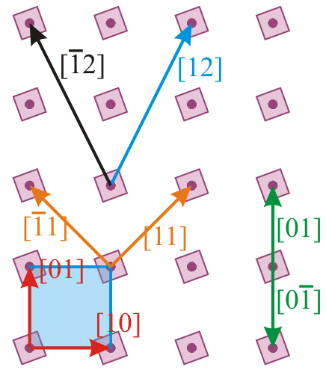





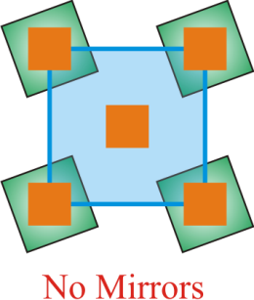
Let us consider a square lattice decorated with a rotated square to give a SQUARE CRYSTAL (as 4-fold still present):
[10] and [01] belong to the same family → related by a 4-fold
[11] and belong to the same family → related by a 4-fold
[01] and belong to the same family → related by a 4-fold (twice)
➢ [12] and do NOT belong to the same family
!
Writing down all the members of the family
4

Slide 13

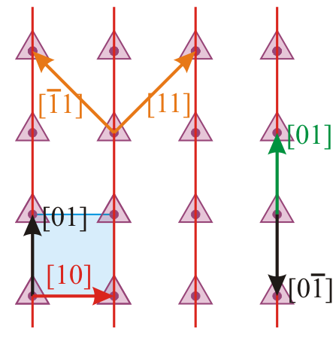





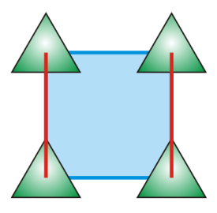

Let us consider a square lattice decorated with a triangle to give a RECTANGLE CRYSTAL:
[10] and [01] do NOT belong to the same family
→ 4-fold rotation destroyed in the crystal
[11] and belong to the same family → related by mirror
[11] and do NOT belong to the same family
➢ [01] and do NOT belong to the same family
Thought provoking example
m_{½}
m₀
Writing down all the members of the family
m

Slide 14
Important Note
Hence, all directions related by symmetry (only) form a family

Slide 15

Family of directions
Index | Members in family for cubic lattices (True for cubic crystals in holohedral class, but not true for all cubic crystals) | Number
<100> |  | 3 × 2 = 6
<110> |  | 6 × 2 = 12
<111> |  | 4 × 2 = 8
the ‘negatives’ (opposite direction)
Symbol | Alternate symbol
[ ] |  | → | Particular direction
< > | [[ ]] | → | Family of directions

Slide 16
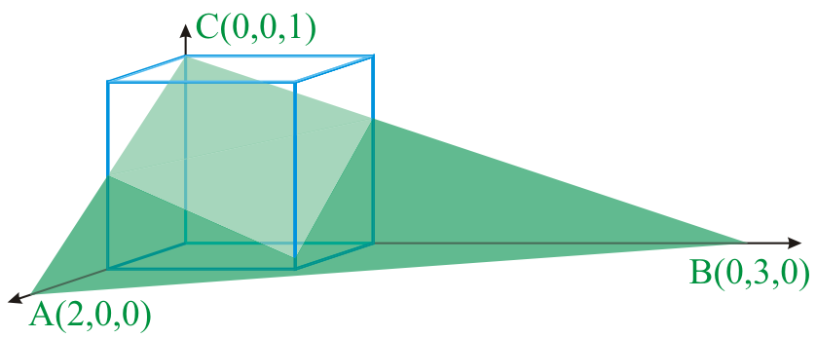
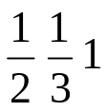
Miller Indices for PLANES
Miller indices for planes is not as intuitive as that for directions and special care must be taken in understanding them
Illustrated here for the cubic lattice
Find intercepts along axes → 2 3 1
Take reciprocal → 1/2 1/3 1*
Convert to smallest integers in the same ratio → 3 2 6
Enclose in parenthesis → (326) Note the type of brackets
Note: (326) does NOT represent one plane but an infinite set of parallel planes passing through lattice points.
Set of planes should not be confused with a family of planes- which we shall consider next.
* As we shall see later− reciprocals are taken to avoid infinities in the ‘defining indices’ of planes

Slide 17
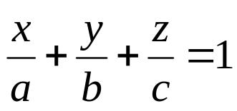

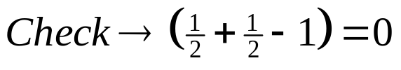
Funda Check
Why do need Miller indices (say for planes)?
Can’t we just use intercepts to designate planes?
Thus we see that Miller indices does the following:
Avoids infinities in the indices (intercepts of (1, ∞, ∞) becomes (100) index).
Avoids dimensioned numbers
➢ Instead we have multiples of lattice parameters along the a, b, c directions (this implies that 1a could be 10.2Å, while 2b could be 8.2Å).
How to know if a given atom/lattice point is ‘sitting’ on a plane?
Use the intercept form of the equation of a plane. If (a,0,0), (0,b,0) & (0,0,c) are the intercepts along x, y & z, then the equation is as below.
Substitute the coordinates of the atom to check if equation is satisfied [done for the (½, ½, ½) atom of BCC as below ( for the (112) plane).
This (½, ½, ½) atom sits on the on (110) plane
This implies that the atom at (½,½,½) does not sit on this plane.
Note: as done previously, we will continue to call planes in lower dimensions (like 2D) as planes− though they are actually lines in 2D.

Slide 18
The concept of a family of planes
A set of planes related by symmetry operations of the lattice or the crystal is called a family of planes (the translation symmetry operator is excluded→ the translational symmetry is included in the definition of a plane itself*).
All the points which one should keep in mind while dealing with directions to get the members of a family, should also be kept in mind when dealing with planes.
Members of a family (of planes or directions) of a lattice or crystal, as they are related by the symmetry of the crystal, are identical (in all respects).
The family of planes is enclosed in { } brackets,
while an individual member is enclosed in ( ) brackets.
* As the Miller index for a plane line (100) implies a infinite parallel set of planes.

Slide 19
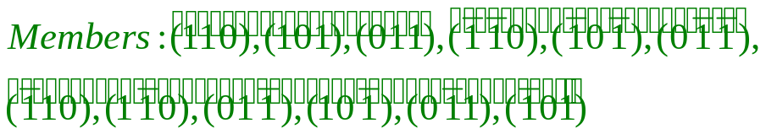
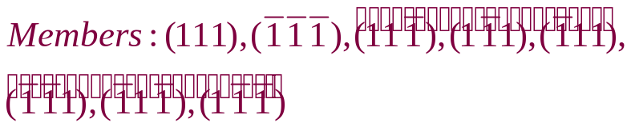
Let us consider a cubic lattice and important (low index) planes therein).
These planes are {100}, {110} & {111}.
Cubic lattice
Note: Do NOT pass plane through origin. Shift it by one unit in x,y,z or a combination.
Z
Y
Intercepts → 1 1 ∞
Plane → (110)
Family → {110} → 12 members
(reciprocal → 1 1 0)
X
For the orange plane
Intercepts → 1 ∞ ∞ (reciprocal → 1 0 0)
Plane → (100)
Family → {100} → 6 members
Obtained by using the point group symmetry: 4/m −3 2/m
Note: (100) and (−100) are identical in terms of Miller indices, as the common factor −1 can be ‘removed’. Also, the infinite set of (100) planes includes the (−100) plane. However, often we retain both these while writing out the members of the family.
Intercepts → 1 1 1
Plane → (111)
Family → {111} → 8
(Octahedral plane)
The purpose of using reciprocal of intercepts and not intercepts themselves in Miller indices becomes clear → the ∞ are removed
(reciprocal → 1 1 1)

Slide 20
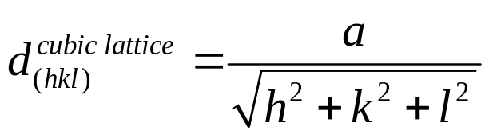
Points about planes and directions
Typical representation of an unknown/general direction → [uvw].
Corresponding family of directions → <uvw>.
Unknown/general plane → (hkl).
Corresponding family of planes → {hkl}.
Double digit indices should be separated by commas or spaces
→ (12,22,3) or (12 22 3).
In cubic lattices/crystals the (hkl) plane is perpendicular to the [hkl] direction (specific plane perpendicular to a specific direction)
➢ [hkl] ⊥ (hkl). E.g. [1−11] ⊥ (1−11).
However, this cannot be generalized to all crystals/lattices (though there are other specific examples).
Note: the correct way is to put a ‘bar’.
The inter-planar spacing can be computed knowing the Miller indices for the planes (hkl) and the kind of lattice involved. The formula to be used depends on the kind of lattice and the formula for cubic lattices is given below.
Interplanar spacing (d_{(hkl)}) in cubic lattice (& crystals)

Slide 21

Funda Checks
What does the ‘symbol’ (111) mean/represent?
The symbol (111) represents Miller indices for an infinite set of parallel planes, with intercepts 1, 1 & 1 along the three crystallographic axis (unit lattice parameter along these), which pass through lattice points.
(111) is the Miller indices for a plane (?) (to reiterate)
➢ It is usually for an infinite set of parallel planes, with a specific ‘d’ spacing. Hence, (100) plane is no different from a (–100) plane (i.e. a set consists of planes related by translational symmetry).
However, the outward normals for these two planes are different.
Sometimes, it is also used for a specific plane.
Are the members of the family of {100} planes: (100), (010), (001), (–100), (0–10), (00–1)?
➢ This is a meaningless question without specifying the symmetry of the crystal. The above is true if one is referring to a crystal with (say) symmetry. A ‘family’ is a symmetrically related set (except for translational symmetry– which is anyhow part of the symbol (100)).

Slide 22
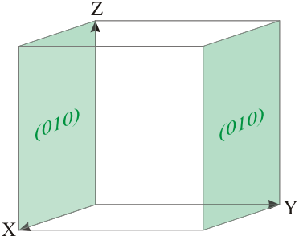
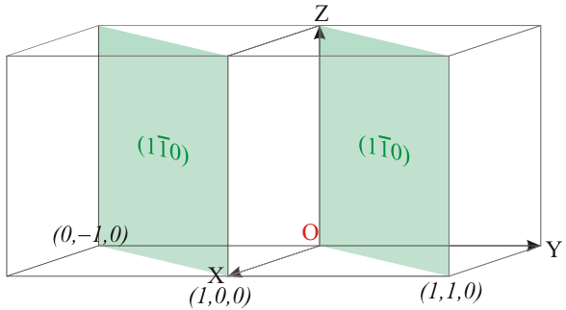
Funda Check
What about the plane passing through the origin?
The Miller indices refer to a whole set of parallel planes passing through lattice points. This implies that on of the planes of the infinite set actually passes through the origin.
As shown below, usually we do not take that particular plane for the determination of Miller indices; but a parallel one, which does not pass through the origin.
Plane passing through origin
Plane passing through origin
Intercepts → ∞ 0 ∞
Plane → (0 ∞ 0)
Hence use this plane
Intercepts → 0 0 ∞
Plane → (∞ ∞ 0)
We want to avoid infinities in Miller indices
In such cases the plane is translated by a unit distance along the non zero axis/axes and the Miller indices are computed
Intercepts → ∞ 1 ∞
Plane → (0 1 0)
Intercepts → 1 −1 ∞
Plane → (1 −1 0)

Slide 23
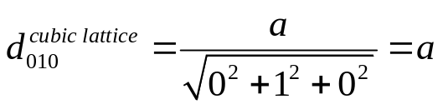
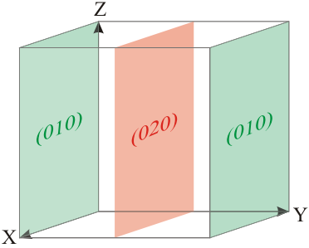
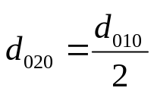
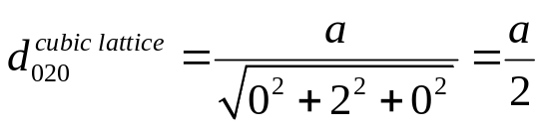
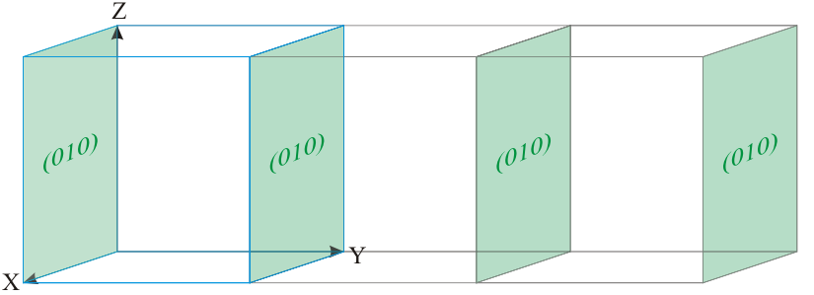
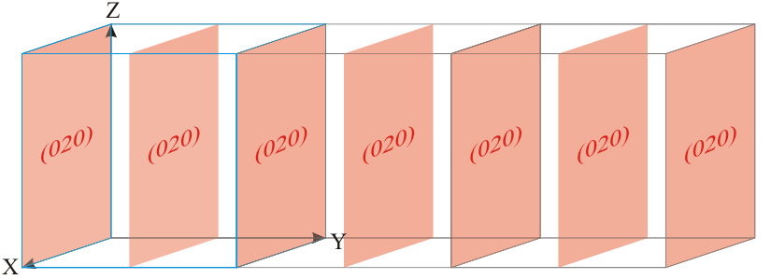
Funda Check
What about planes passing through fractional lattice spacings?
(We will deal with such fractional intersections with axes in X-ray diffraction).
(020) has half the spacing as (010) planes
Actually (020) is a superset of planes as compared to the set of (010) planes
Intercepts → ∞ ½ ∞
Plane → (0 2 0)
Note: in Simple cubic lattice this (i.e. every alternate plane in the set) plane will not pass through lattice points!! But then lattice planes have to pass through lattice points!
Why do we consider such planes? We will stumble upon the answer later.
This is an extended use of Miller indices.

Slide 24
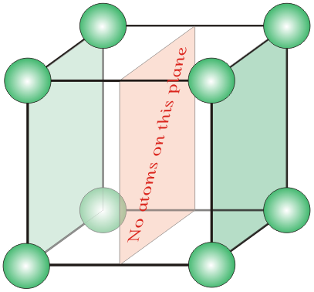
Funda Check
Why talk about (020) planes? Isn’t this the same as (010) planes as we factor out common factors in Miller indices?
Yes, in Miller indices we usually factor out the common factors.
Suppose we consider a simple cubic crystal, then alternate (020) planes will not have any atoms in them! (And this plane will not pass through lattice points as planes are usually required to do).
Later, when we talk about x-ray diffraction then second order ‘reflection’ from (010) planes are often considered as first order reflection from (020) planes. This is (one of) the reason we need to consider (020) {or for that matter (222) ≡ 2(111), (333), (220)} kind of planes.
Similarly we will also talk about ½[110] kind of directions. The ½ in front is left out to emphasize the length of the vector (given by the direction). I.e. we are not only concerned about a direction, but also the length represented by the vector.

Slide 25
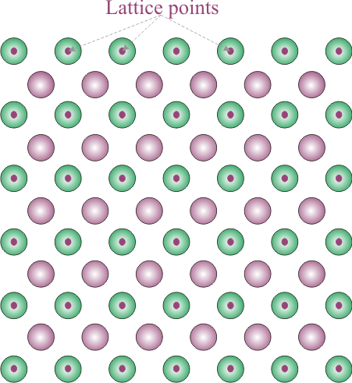
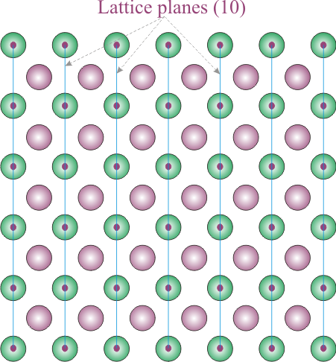
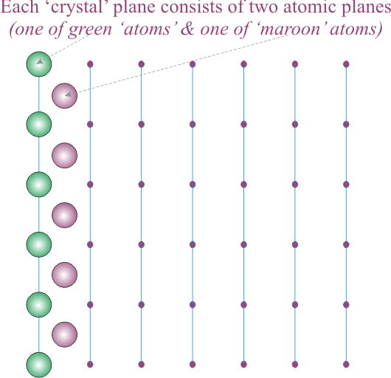
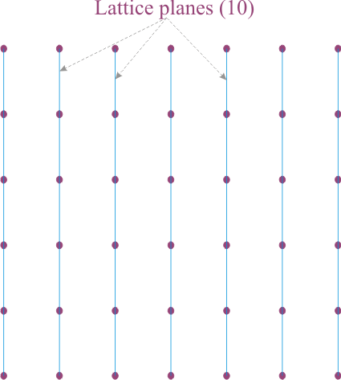
Funda Check
In the crystal below what does the (10) plane contain? Using an 2D example of a crystal.
The ‘Crystal’ plane (10) can be thought of consisting of ‘Lattice’ plane (10) + ‘Motif’ plane (10). I.e. the (10) crystal plane consists of two atomic planes associated with each lattice plane. The green plane and the maroon plane.
This concept can be found not only in the superlattice example give below, but also in other crystals. E.g. in the CCP Cu crystal (110) crystal plane consists of two atomic planes of Cu.
Note that this is a super-crystal (superlattice) with two interpenetrating sub-crystals (sublattices)→ one with green circle and origin at (0,0) & other with maroon circle and origin at (½, ½)
Crystal plane = lattice plane (01)
+ motif plane (two atomic rows: one green circles and one maroon circles)
Note all lattice planes pass through lattice points
Crystal plane consists of two atomic planes (green plane and maroon plane)
Note the the origin of these two planes
Note the origin of these two planes

Slide 26

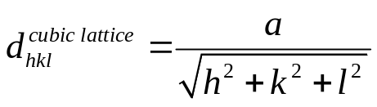
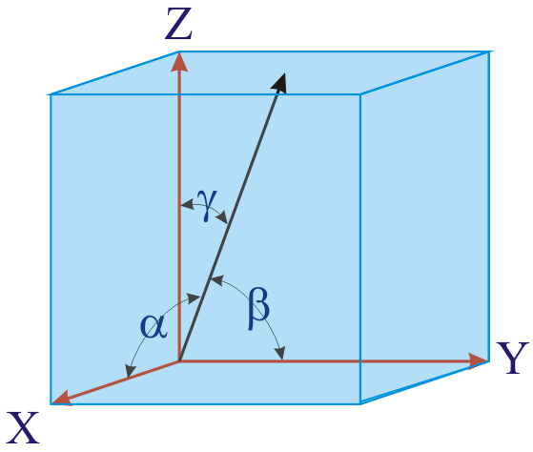

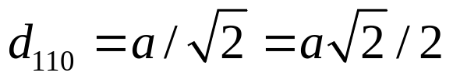
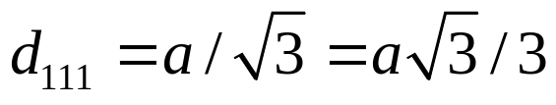
Funda Check
Why do we need 3 indices (say for direction) in 3-dimensions?
A direction in 3D can be specified by three angles- or the three direction cosines.
There is one equation connecting the three direction cosines:
This implies that we required only two independent parameters to describe a direction. Then why do we need three Miller indices?
The Miller indices prescribe the direction as a vector having a particular length (i.e. this prescription of length requires the additional index)
Similarly three Miller indices are used for a plane (hkl) as this has additional information regarding interplanar spacing. E.g.:

Slide 27
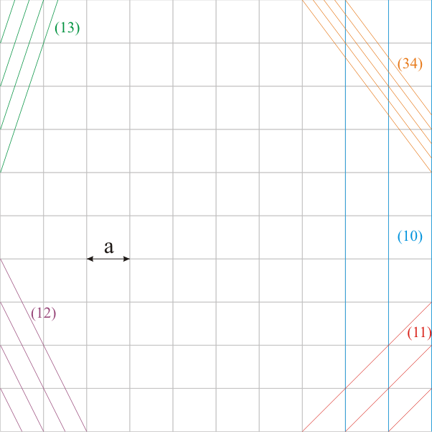
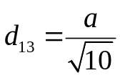
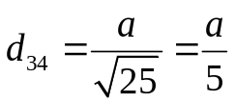
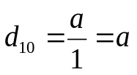
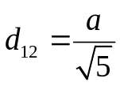
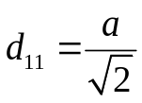
Funda Check
What happens to d_{hkl} with increasing hkl?
Can planes have spacing less than inter-atomic spacings?
What happens to lattice density (no. of lattice points per unit area of plane)?
What is meant by the phrase: ‘planes are imaginary’?
As h,k,l increases, ‘d’ decreases ⇒ we could have planes with infinitesimal spacing.
The above implies that inter-planar spacing could be much less than inter-atomic spacing.
With increasing indices (h,k,l) the lattice density (or even motif density) decreases.
(in 2D lattice density is measured as no. of lattice points per unit length).
• E.g. the (10) plane has 1 lattice point for length ‘a’, while the (11) plane has 1 lattice point for length a√2 (i.e. lower density).
Since we can draw any number of planes through the same lattice (as in the figure), clearly the concept of a lattice plane (or for that matter a crystal plane or a lattice direction) is a ‘mental’ construct (imaginary).
2D lattice has been considered for easy visualization.
Hence, planes look like lines!
With increasing indices the interplanar spacing decreases
Note: the grey lines do not mean anything (consider this to be a square lattice)

Slide 28
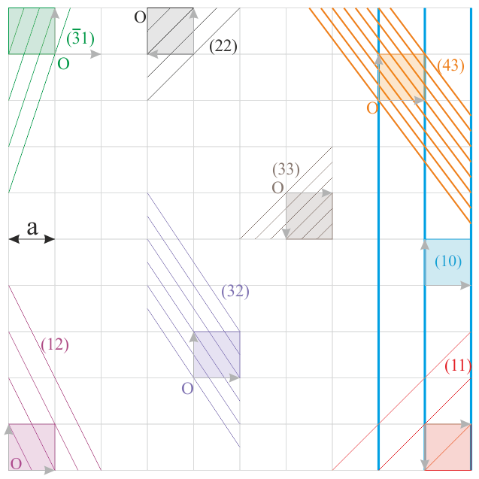
1 more view with more planes and unit cell overlaid
In an upcoming slide we will see how a (hkl) plane will divide the edge, face diagonal and body diagonal of the unit cell
In this 2D version you can already note that diagonal is divided into (h + k) parts
Note the axis is changing locally!

Slide 29




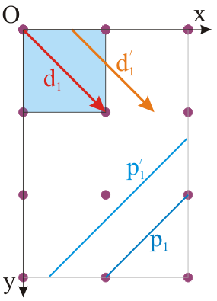
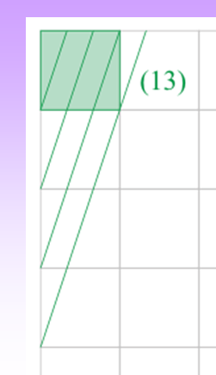

Funda Check
Do planes and directions have to pass through lattice points?
In the figure below a direction and plane are marked.
In principle and are identical vectorally- but they are positioned differently w.r.t to the origin.
Similarly planes and are identical except that they are positioned differently w.r.t to the coordinate axes.
In crystallography we usually use and (those which pass through lattice points) and do not allow any parallel translations (which leads to a situation where these do not pass through lattice points) .
We have noted earlier that Miller indices (say for planes) contains information about the interplanar spacing and hence the convention.
Sometimes it may seem to us that a given plane or direction is not passing through lattice points, if we consider the part within the unit cell only. E.g. the green planes (13) considered previously.
In such cases (where actually an intersection occurs, but not seen) we should extend the planes to see the intersection.
Extend to see the intersection
Seems like this green plane is not intersecting a lattice point

Slide 30
Funda Check
For a plane (11) what are the units of the intercepts?
Here we illustrate the concept involved using the (11) plane, but can be applied equally well to directions as well.
The (11) plane has intercepts along the crystallographic axis at (1,0) and (0,1).
In a given lattice/crystal the ‘a’ and ‘b’ axis need not be of equal length (further they may be inclined to each other). This implies that thought the intercepts are one unit along ‘a’ and ‘b’, their physical lengths may be very different (as in the figure below).
b
(11)
a

Slide 31
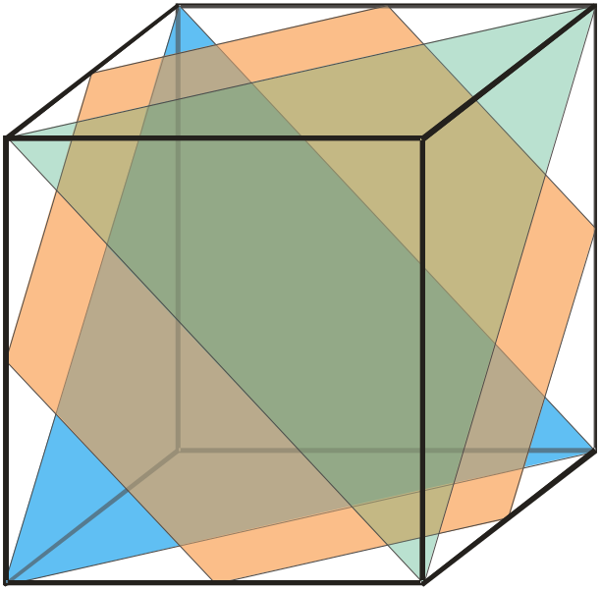
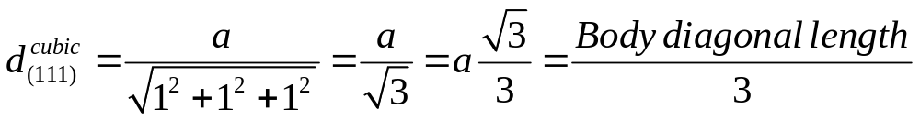


(111)
Further points about (111) planes
Family of {111} planes within the cubic unit cell
(Light green triangle and light blue triangle are (111) planes within the unit cell).
The Orange hexagon is parallel to these planes.
Orange plane NOT part of (111) set (does not pass through lattice points- also see next slide)
Blue and green planes are (111)
The (111) plane(s) {the blue and the orange ones} trisects the body diagonal
The Orange hexagon Plane cuts the cube into two polyhedra of equal volumes

Slide 32




Further points about (111) planes
The central (111) plane (orange colour) is not a ‘space filling’ plane!
Portion of the (111) plane not included within the unit cell
Suppose we want to make a calculation of areal density (area fraction occupied by atoms) of atoms on the (111) plane- e.g. for a BCC crystal.
Q) Can any of these (111) planes be used for the calculation?
A) If the calculation is being done within the unit cell then the central orange plane cannot be used as it (the hexagonal portion) is not space filling → as shown in the figure on the right.
The portion of the central (111) plane as intersected by the various unit cells
Video: (111) plane in BCC crystal
What is the true areal fraction of atoms lying in the (111) plane of a BCC crystal?
Solved
Example
Low resolution
Video: (111) plane in BCC crystal

Slide 33


Members of a family of planes in cubic crystal/lattice
Index | n*
{100} | 6
{110} | 12 | The (110) plane bisects the face diagonal
{111} | 8 | The (111) plane trisects the body diagonal
{210} | 24
{211} | 24
{221} | 24
{310} | 24
{311} | 24
{320} | 24
{321} | 48
Tetrahedron inscribed inside a cube with bounding planes belonging to the {111}_{cubic lattice} family (subset of the full family)
8 planes of {111}_{cubic lattice} family forming a regular octahedron
n* is the No. of members in a cubic lattice

Slide 34
Summary of notations
A family is also referred to as a symmetrical set
 | Symbol |  | Alternate symbols
Direction | [ ] | [uvw] |  | Particular direction
 | < > | <uvw> | [[ ]] | Family of directions
Plane | ( ) | (hkl) |  | Particular plane
 | { } | {hkl} | (( )) | Family of planes
Point | . . | .xyz. | [[ ]] | Particular point
 | : : | :xyz: |  | Family of points

Slide 35

Points about (hkl) planes
For a set of translationally equivalent lattice planes will divide:
Entity being divided (Dimension containing the entity) |  | Direction | Number of parts
Cell edge (1D) | a | [100] | h
 | b | [010] | k
 | c | [001] | l
Diagonal of cell face (2D) | (100) | [011] | (k + l)
 | (010) | [101] | (l + h)
 | (001) | [110] | (h + k)
Body diagonal (3D) |  | [111] | (h + k + l)
This implies that the (111) planes will divide the face diagonals into two parts and the body diagonal into 3 parts.
Some general points
Condition | (hkl) will pass through
h even | midpoint of ‘a’
(k + l) even | face centre (001) midpoint of face diagonal (001)
(h + k + l) even | body centre midpoint of body diagonal

Slide 36
Q & A
Write down the members of the family of planes {110} for the tetragonal lattice.
Let the ‘c’ axis be the unique axis for the tetragonal lattice. The tetragonal lattice has the highest symmetry possible for the tetragonal system (4/m 2/m 2/m).
The family of planes can be written as {1 1 0}. The first two indices can be permuted, while the third one cannot.
Hence, {1 1 0} ≡ (110), (−110), (1−10), (−1−10).
As we know (−1−10) ≡ −(110) ≡ (110). I.e. all these planes belong to the same set.

Slide 37
Hexagonal crystals → The Miller-Bravais Indices
Directions and planes in hexagonal lattices and crystals are designated by the
4-index Miller-Bravais notation. Note: in 3D we need only 3 indices.
The Miller-Bravais notation can be a little tricky to learn.
In the four index notation the following points are to be noted.
➢ The first three indices are a symmetrically related set on the basal plane.
➢ The third index is a redundant one (which can be derived from the first two as in the formula: i = −(h+k) and is introduced to make sure that members of a family of directions or planes have a set of numbers which are identical.
➢ This is because in 2D two indices suffice to describe a lattice (or crystal).
➢ The fourth index represents the ‘c’ axis (⊥ to the basal plane).
Hence the first three indices in a hexagonal lattice can be permuted to get the different members of a family; while, the fourth index is kept separate.
(h k i l)
i = −(h + k)
There is only one hexagonal lattice (in 3D) and this has 6-fold symmetry.
Hexagonal crystals on the other hand may or may not have pure 6-fold symmetry. However, they do have some form of a ‘6’ symmetry (roto-inversion or screw: −6, 6₁, 6₂, 6₃).
The hexagonal basis set is used to describe all hexagonal lattices and crystals.

Slide 38


Related to ‘l’ index
Related to ‘k’ index
Miller-Bravais Indices for the Basal Plane
Related to ‘i’ index
Related to ‘h’ index
Intercepts → ∞ ∞ ∞ 1
Plane → (0 0 0 1)
Basal Plane

Slide 39

Intercepts → 1 1 − ½ ∞
Plane → (1 1‾2 0)
(h k i l)
i = −(h + k)
a₃
a₂
Planes which have ∞ intercept along c-axis (i.e. vertical planes) are called Prism planes
a₁
The use of the 4 index notation is to bring out the equivalence between crystallographically equivalent planes and directions (as will become clear in coming slides)

Slide 40

Examples to show the utility of the 4 index notation
Obviously (related by 3-fold symmetry), the ‘green’ and ‘blue’ planes belong to the same family and first three indices have the same set of numbers (as brought out by the Miller-Bravais system)
a₃
a₂
a₁
Planes which have ∞ intercept along c-axis (i.e. vertical planes) are called Prism planes
Intercepts → 1 –1 ∞ ∞
Miller (3 index) → (1‾ 1 _ 0 )
Miller-Bravais → (1‾ 1 0 0 )
Intercepts → ∞ 1 –1 ∞
Miller (3 index) → (0 1 _ 0)
Miller-Bravais → (0 1‾1 0)

Slide 41

Examples to show the utility of the 4 index notation
a₃
Intercepts → 1 1 – ½ ∞
Plane → (1 1‾2 0)
a₂
a₁
Intercepts → 1 –2 –2 ∞
Plane → (2‾ 1‾1 0 )

Slide 42



Inclined planes which have finite intercept along c-axis are called Pyramidal planes
Intercepts → 1 1 - ½ 1
Plane → (1 1‾2 1)
Intercepts → 1 ∞ − 1 1
Plane → (1 0‾1 1)

Slide 43

Directions
One has to be careful in determining directions in the Miller-Bravais system.
Basis vectors a₁, a₂ & a₃ are symmetrically related by a six fold axis.
The 3rd index is redundant and is included to bring out the equality between equivalent directions (like in the case of planes).
In the drawing of the directions we use an additional guide hexagon 3 times the unit basis vectors (a_{i}).
Guide Hexagon

Slide 44



Directions
Trace a path along the basis vectors as required by the direction. In the current example move
1unit along a₁, 1unit along a₂ and −2 units along a₃.
Directions are projected onto the basis vectors to determine the components and hence the Miller-Bravais indices can be determined as in the table.
 | a₁ | a₂ | a₃
Projections | a/2 | a/2 | −a
Normalized wrt LP | 1/2 | 1/2 | −1
Factorization | 1 | 1 | −2
Indices | [1 1 ‾2 0]

Slide 45



We do similar exercises to draw other directions as well
Some important directions
 | a₁ | a₂ | a₃
Projections | 3a/2 | 0 | –3a/2
Normalized wrt LP | 3/2 | 0 | – 3/2
Factorization | 1 | 0 | −1
Indices | [1 0 –1 0]

Slide 46







Overlaying planes and directions
Note that for planes of the type (000l) or (hki0) are perpendicular to the respective directions [0001] or [hki0] → (000l) ⊥ [0001], (hki0) ⊥ [hki0].
However, in general (hkil) is not perpendicular to [hkil], except if c/a ratio is√(3/2).
The direction perpendicular to a particular plane will depend on the c/a ratio and may have high indices or even be irrational.
Transformation between 3-index [UVW] and 4-index [uvtw] notations
Directions in the hexagonal system can be expressed in many ways
3-indices:
By the three vector components along a₁, a₂ and c:
r_{UVW} = Ua₁ + Va₂ + Wc
In the three index notation equivalent directions may not seem equivalent; while, in the four index notation the equivalence is brought out.

Slide 47







Weiss Zone Law
If the Miller plane (hkl) contains (or is parallel to) the direction [uvw] then:
This relation is valid for all crystal systems (referring to the standard unit cell).
The red directions lie on the blue planes
Solved
Example

Slide 48

Zone Axis
The direction common to a set of planes is called the zone axis of those planes.
E.g. [001] lies on (110), (1−10), (100), (210) etc.
If (h₁ k₁ l₁) & (h₂ k₂ l₂) are two planes having a common direction [uvw] then according to Weiss zone law:
u.h₁ + v.k₁ + w.l₁ = 0 & u.h₂ + v.k₂ + w.l₂ = 0
This concept is very useful in Selected Area Diffraction Patterns (SADP) in a TEM.
Note: Planes of a zone lie on a great circle in the stereographic projection

Slide 49
Directions ⊥ Planes
Many a times (or sometimes if you like) a direction may be perpendicular to the plane represented by the same indices. E.g. in the cubic system, the [120] direction is perpendicular to the (120) plane. As evident from this statement, this is not always true. We list below the cases in which this is true.
Cubic system*: (hkl) ⊥ [hkl]
Tetragonal system*: only special planes are ⊥ to the direction with same indices:
[100] ⊥ (100), [010] ⊥ (010), [001] ⊥ (001), [110] ⊥ (110)
([101] not ⊥ (101))
Orthorhombic system*:
[100] ⊥ (100), [010] ⊥ (010), [001] ⊥ (001)
Hexagonal system*
► This is for a general c/a ratio only this is true: [0001] ⊥ (0001).
► For a Hexagonal crystal with the special c/a ratio = √(3/2)*
→ the cubic rule is followed (i.e. all planes are ⊥ to all directions).
Monoclinic system**: [010] ⊥ (010)
Other than these a general [hkl] is NOT ⊥ (hkl)
* This is called the Frank’s ratio and such crystals with this c/a ratio are called Frank’s pseudo-cubic phases.
** Here we are referring to the conventional unit cell chosen (e.g. a=b=c, α=β=γ=90° for cubic) and not the symmetry of the crystal.

Slide 50



Funda Check
Which direction is perpendicular to which plane?
In the cubic system all directions are perpendicular to the corresponding planes ((hkl) ⊥ [hkl]). 2D example of the same is given in the figure on the left (Fig.1).
However, this is not universally true. To visualize this refer to Fig.2 and Fig.3 below.
(Fig.2)
Note that plane normal to (11) plane is
not the same as the [11] direction
(Fig.1)
(Fig.3)

Slide 51


Q & A
What are the Miller indices of the green plane in the figure below?
Extend the plane to intersect the x,y,z axes.
The intercepts are: 2,2,2
Reciprocal: ½, ½, ½
Smallest ratio: 1,1,1
Enclose in brackets to get Miller indices: (111)
Another method.
Move origin (‘O’) to opposite vertex (of the cube).
Chose new axes as: −x, −y, −z.
The new intercepts will be: 1,1,1

Slide 52
Advanced Topic
Multiplicity factor
This concept is very useful in X-Ray Diffraction
Cubic | hkl | hhl | hk0 | hh0 | hhh | h00
 | 48* | 24 | 24* | 12 | 8 | 6
Hexagonal | hk.l | hh.l | h0.l | hk.0 | hh.0 | h0.0 | 00.l
 | 24* | 12* | 12* | 12* | 6 | 6 | 2
Tetragonal | hkl | hhl | h0l | hk0 | hh0 | h00 | 00l
 | 16* | 8 | 8 | 8* | 4 | 4 | 2
Orthorhombic | hkl | hk0 | h0l | 0kl | h00 | 0k0 | 00l
 | 8 | 4 | 4 | 4 | 2 | 2 | 2
Monoclinic | hkl | h0l | 0k0
 | 4 | 2 | 2
Triclinic | hkl
 | 2
* Altered in crystals with lower symmetry (of the same crystal class)

Slide 53









Q & A
What are the members of the family <110> & {111} for the point group 23?
Note that 23 is a cubic point group (the 3 occurs in the second place) and it lacks a 4 fold and a centre of inversion.
The point group has 3-fold operators along <111> directions and 2-fold along <100> directions.
Action of 2-fold along [001]: [110]→[−1−10] (Fig.1).
Action of 3-fold along [111]: [110] & [−1−10] → [011], [101] and their negatives (Fig.2).
Action of 3-fold along [−111]: [011] & [0−1−1] → [1−10], [−101] and their negatives (Fig.3).
Action of 3-fold along [1−11]: [101] & [−10−1] → [01−1]and its negative (Fig.4).
Hence, <110> ≡ [110], [−1−10], [011], [101], [0−1−1], [−10−1], [1−10], [−101], [−110], [10−1], [01−1], [0−11]
(12 members)
2-fold
3-fold
3-fold
Fig.3
Fig.1
Fig.2
3-fold
The {111} family forms the faces of the tetrahedron in the figures
Fig.4

