Slide 1
BERTserini
End-to-end open domain Question
Answering
Presented By:
Kowshic Roy ( 1705001)
Saem Hasan (1705027)

Slide 2
Open Domain Question
Cannot be answered with a simple ‘yes’ or ‘no’.
No context provided.
Example:
What is the victory Day of Bangladesh?
Who is the winner of 2014 FIFA Men’s world cup ?
What is the capital of Oklahoma ?

Slide 3
Question Answering Task
Two types of task. Given a context and a question,
Extractive : Extracting answer.
Abstractive : Generating an answer.

Slide 4
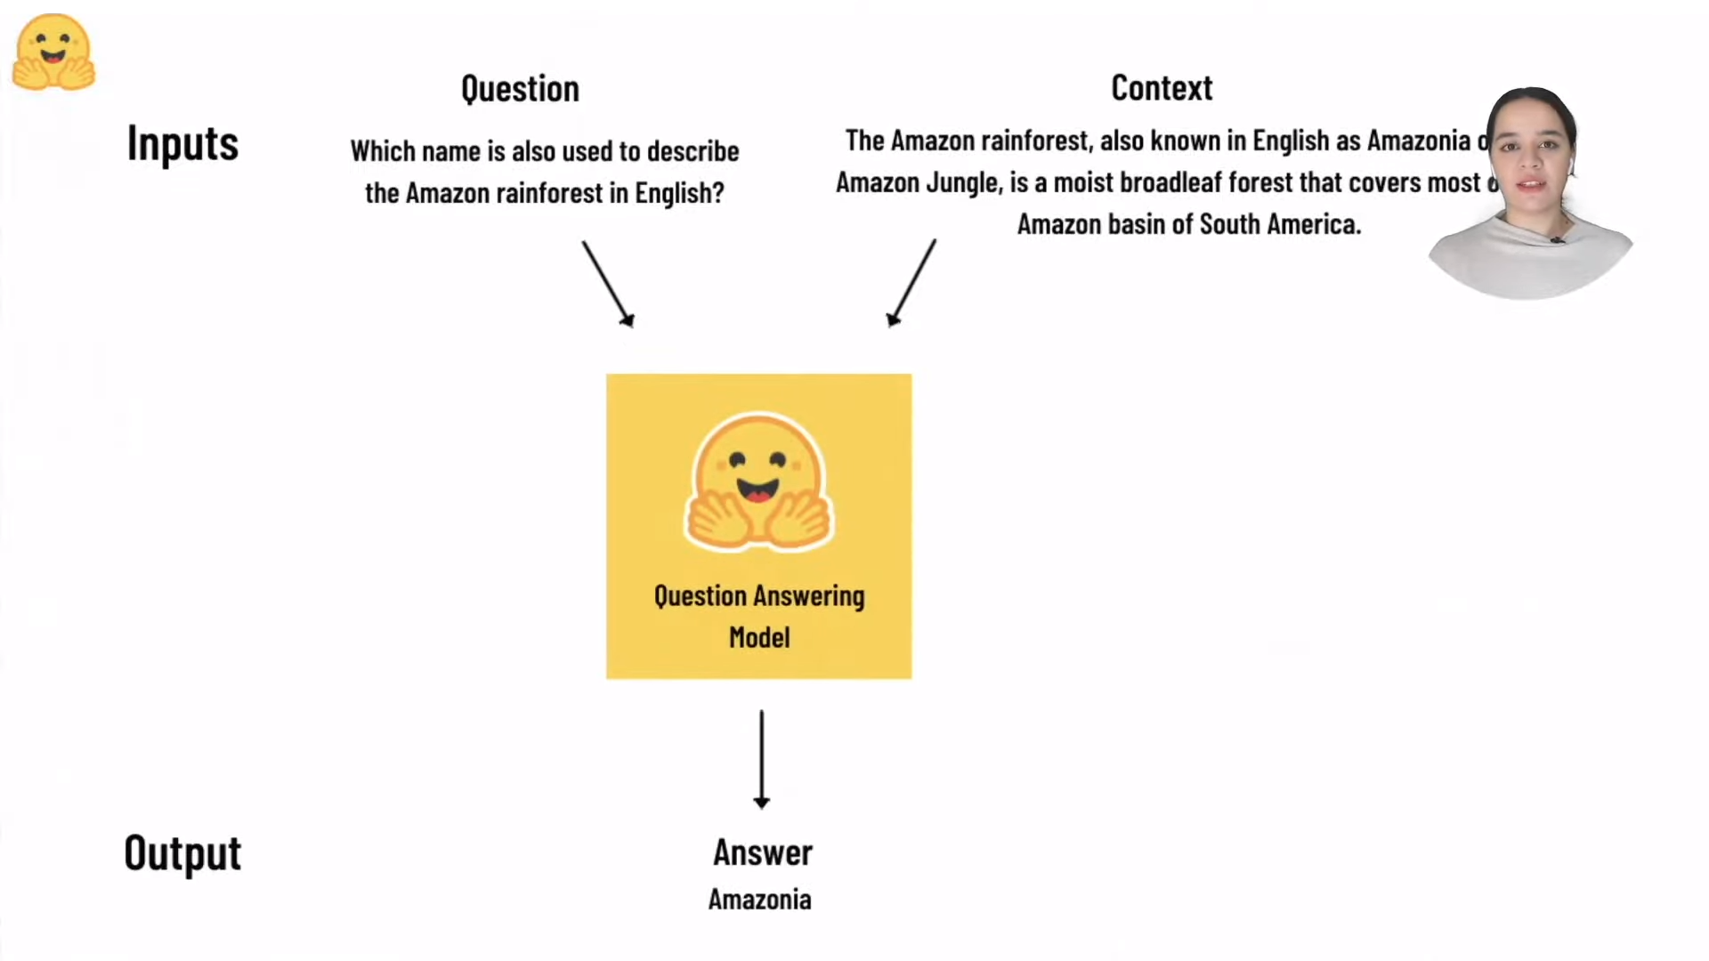
Bert For question answering
Where is our Context ?

Slide 5
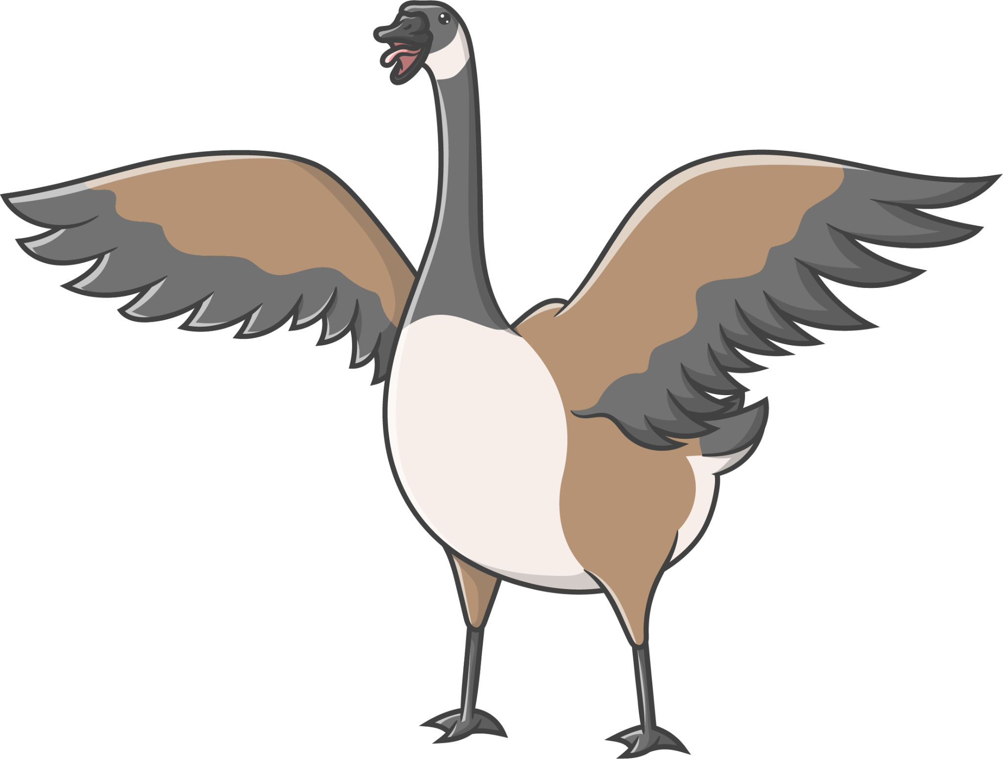
Introducing Anserini
Information Retrieval Toolkit.
Large corpus of documents to search from.
Wikipedia english paragraphs.

Slide 6
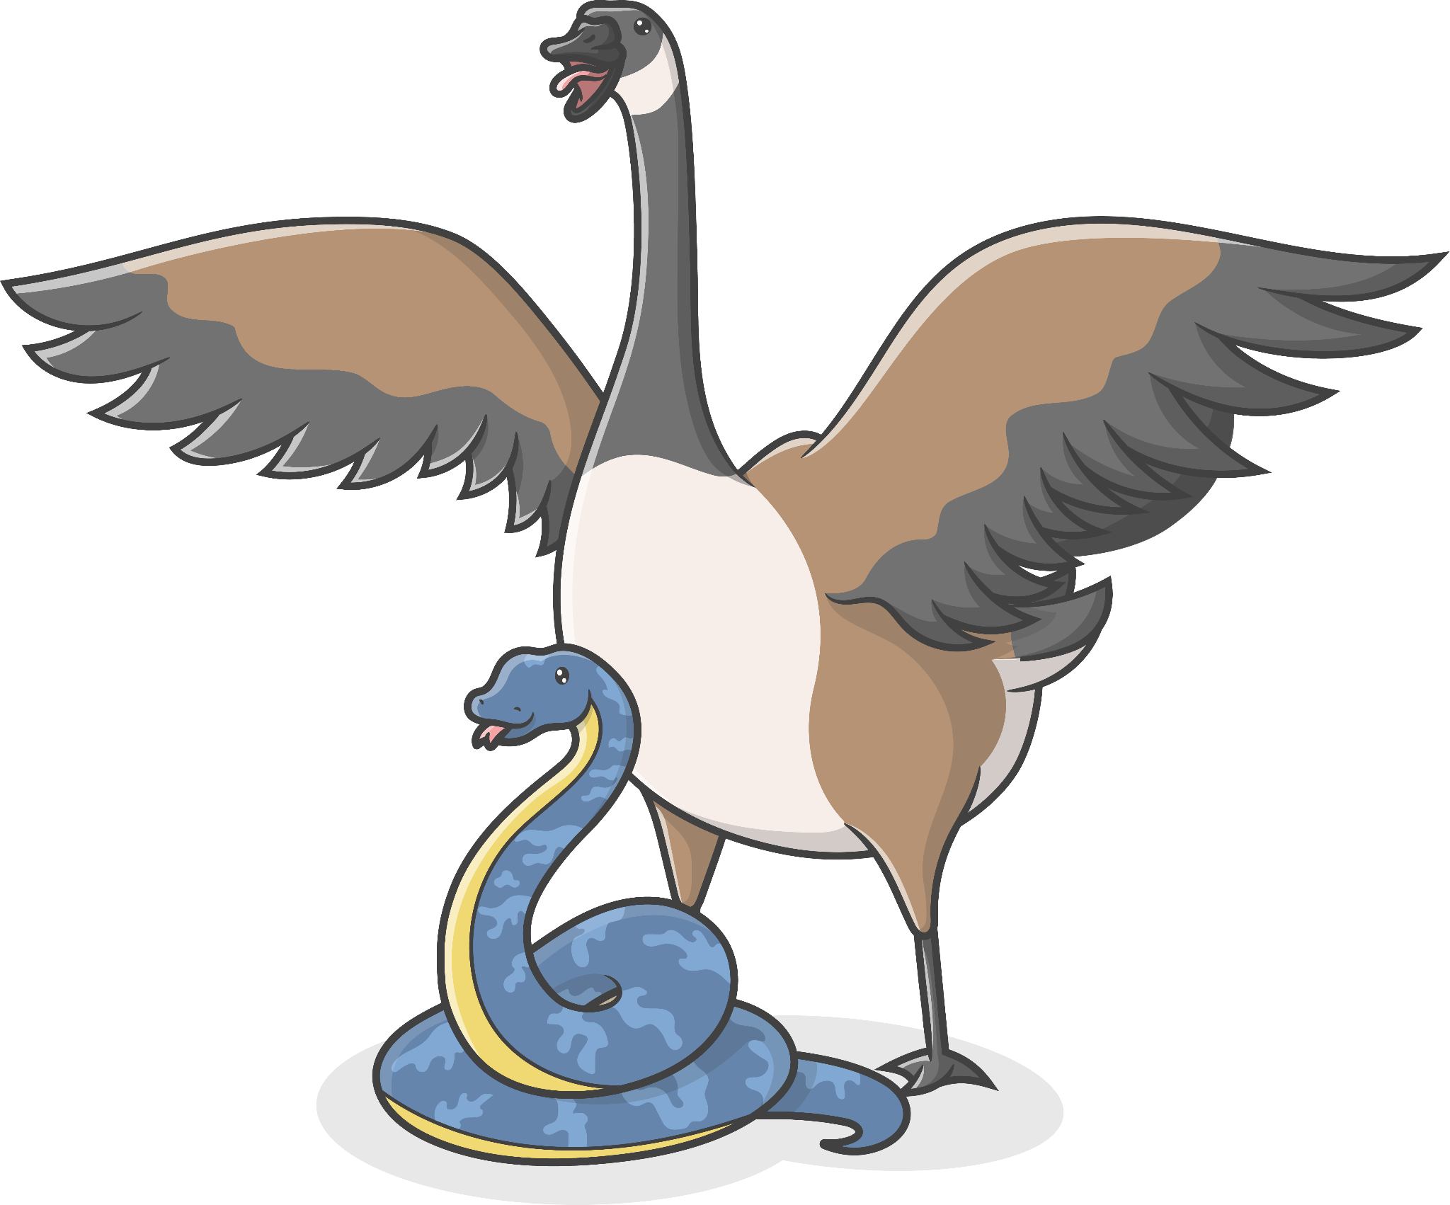
Pyserini
Python Wrapper over Anserini.

Slide 7
Pyserini Samples
Question : What is the capital of state of Oklahoma?
Top 3 relevant paragraphs by Pyserini.
Guthrie, Oklahoma . During the next six hours, about 10,000 people settled in what became the capital of the new Territory of Oklahoma.
Oklahoma's territorial capital and first state capital was located in the city of Guthrie.
The Governor's Mansion in Shawnee, Oklahoma was built in 1903, on the speculation that Shawnee would be selected as the state capital and that this structure would become the Governor's official residence when Oklahoma became a state. However, Oklahoma did not attain statehood until 1907, and the Legislature chose Guthrie as the first capital, before naming Oklahoma City as the permanent state capital in 1910.

Slide 8
Pyserini Limitations
Question : What is the Victory Day of Bangladesh?
Top 3 relevant paragraphs by Pyserini.
Victory day of Bangladesh . Victory day ( "Bijôy Dibôs") is a national holiday in Bangladesh celebrated on December 16 to commemorate the victory of the allied forces over the Pakistani forces in the Bangladesh Liberation War in 1971.
Bangladesh national cricket team . After their maiden Test victory, Bangladesh embarked on its first tour of England in May and June 2005.
Mashrafe Mortaza . In February 2007, Bangladesh again toured Zimbabwe for a one-day series, this time as a prelude to the 2007 World Cup. Bangladesh won the four match series 3–1, and Mortaza finished as Bangladesh's leading wicket-taker with 8 wickets at 16.50.

Slide 9
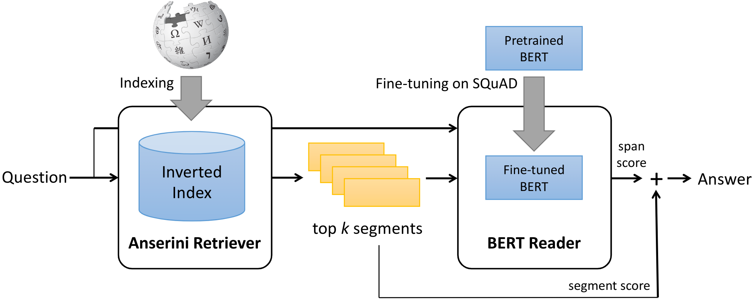
Architecture

Slide 10
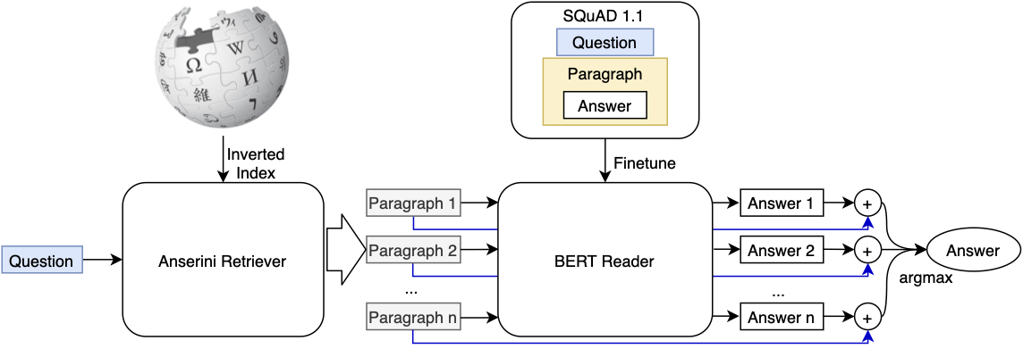
Architecture

Slide 11
Final Score Function
Score = ( 1 - mu ) * S_{anserini} + mu * S_{BERT}

Slide 12
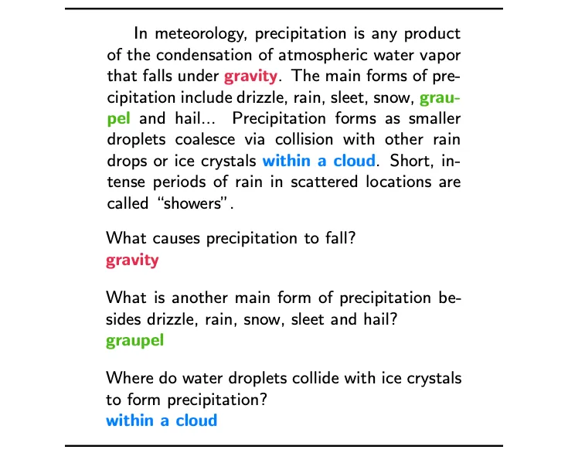
SQuAD : Training Dataset
SQuAD focuses on the task of question answering. It tests a model’s ability to read a passage of text and then answer questions about it.

Slide 13
SQuAD : Dataset Analysis
The creators explored three areas:
Categories of answers: Each answer was partitioned into one of the following categories: “date”, “other numeric”, “person”, “location”, “other entity”, “common noun phrase”, “adjective phrase”, “verb phrase”, “clause”, and “other”.
Reasoning required: The creators sampled questions from the development set and manually labeled questions into different categories of reasoning required to answer them.
Syntactic divergence: The creators measured the syntactic divergence between a question and the sentence containing the answer in order to measure the difficulty of a question.

Slide 14
SQuAD
What makes SQuAD so good?
SQuAD is big.
SQuAD is challenging.
SQuAD requires reasoning.

Slide 15
Runtime Configuration
Google provided free Colab runtime.
12.7 GB Ram
80 GB Hard disk
16 GB GPU
Each epoch needs around 70 minutes.

Slide 16
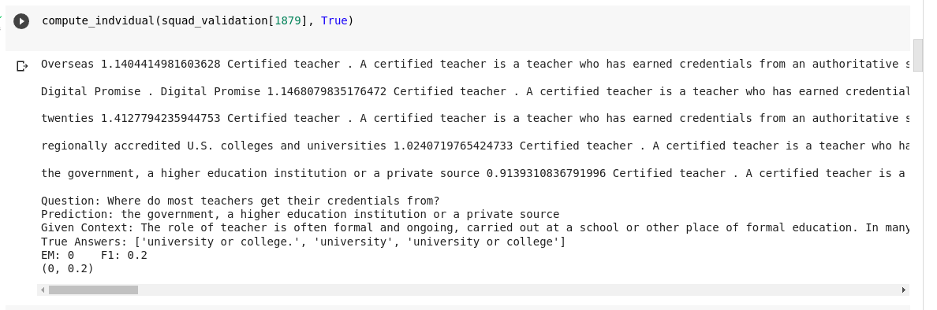
Some Demo Results

Slide 17
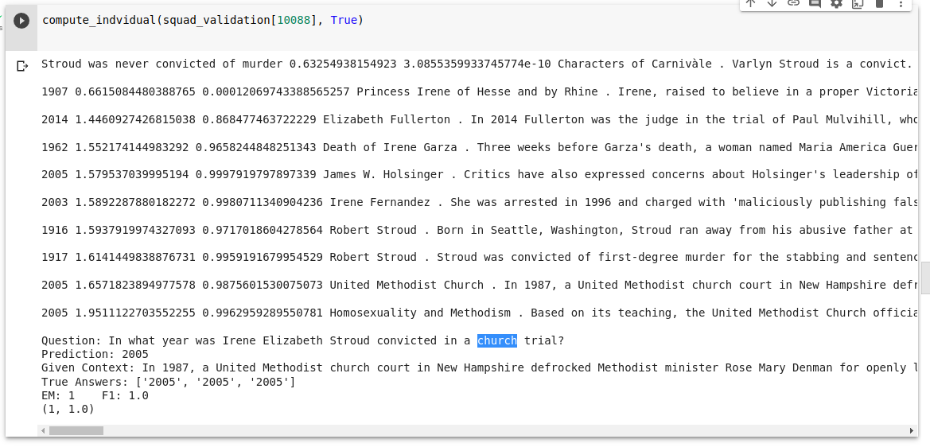
Some Demo Results

Slide 18
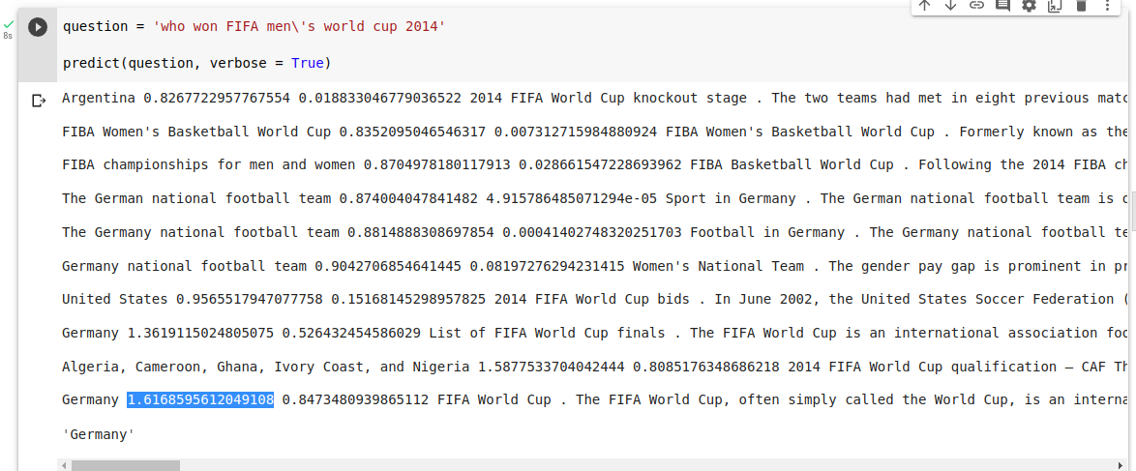
Some Demo Results

Slide 19
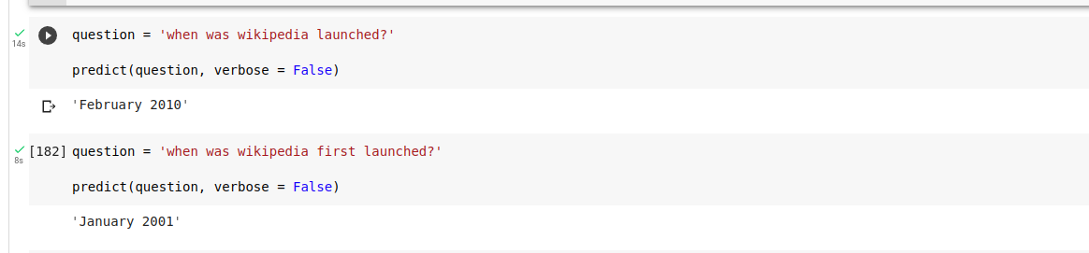
Some Demo Results

Slide 20
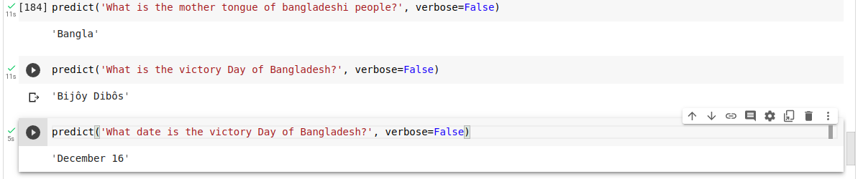
Some Demo Results

Slide 21
Performance Report
On validation set, ( in random 1000 data point)
 | Exact Matching Score | F1 score
BERT with Validation Context | 77.0 | 85.34
BERT with Pyserini provided Context | 5.89 | 10.42

Slide 22
Comparison of State-of-the-art method
Chat GPT
We are nowhere near chatGPT.

Slide 23
Challenges
Google Colab hardly provided GPU runtime.
Often time the runtime was disconnected.
Anserini index for wikipedia is of 17GB.
Pretrained model was used in place of distile-BERT.

Slide 24
Reference
Paper of bertserini. https://arxiv.org/abs/1902.01718
Paper of Anserini. https://dl.acm.org/doi/pdf/10.1145/3077136.3080721
Paper of BERT. https://arxiv.org/abs/1810.04805

Slide 25
Thank You

