Slide 1
Six underlying design dimension
Six design dimension & defied features
Length of feature vector : 12
Universal design characteristic
Elaborate
Harmony
Natural
Depth
Decorated
Inner-harmony
Writing tool
Orientation
64d -> 3d (PCA)
Typeface specific design characteristic
4. Flourish
5. Weight
6. Compressed
Serif / Sans
Pronounced ascender
Width-mean
Contrast
Black-runs
Done
Not-yet
-

Slide 2
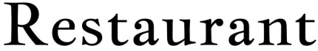
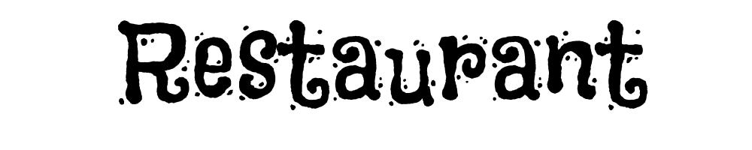


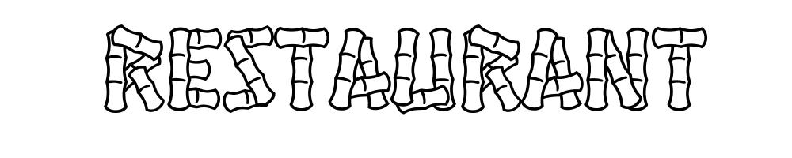
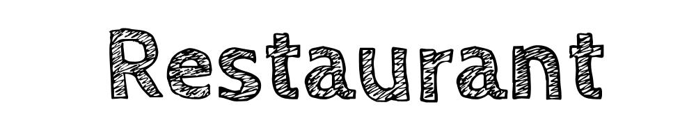

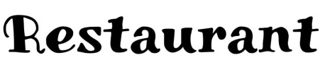

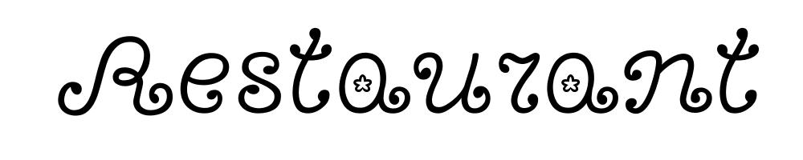
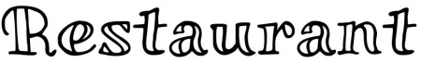
Six underlying design dimension
Elaborate
Harmony
Natural
Flourish
Weight
Compressed
Depth
Decorated

Slide 3
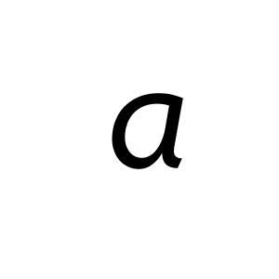
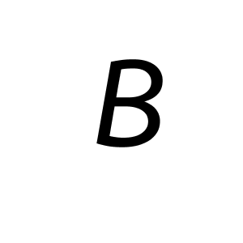
Six underlying design dimension : Features
Elaborate
Harmony
Natural
Flourish
Weight
Compressed
Depth
Calculation of Euler number on each character.
The Euler number is a measure of the topology of an image.
It is simply calculated by counting the number of black region and the number of white region and subtracting the latter from former.
Then calculate the mean, min, max, and var of the 52 Euler numbers
PREDICTED
KNOWN | 2D 3D
-------------------------------------
2D | 1.00 0.00
3D | 0.20 0.80
E(a) = 1-1 = 0
E(B) = 1-2 = -1
Decorated
Extract SURF feature descriptors from generated word images.
Create a 500 word visual vocabulary by K-Means clustering
57 train images and 25 test images for each class (decorated or non-decorated)
*LWL (locally weighted learning) Classifier
*SVM classifier (average accuracy = 0.9)
PREDICTED
KNOWN | Non-decorated decorated
-----------------------------------------------------
Non-decorated | 1.00 0.00
decorated | 0.20 0.80

Slide 4






Six underlying design dimension
Elaborate
Harmony
Natural
Flourish
Weight
Compressed
MountainsofChristmas
GloriaHallelujah
JollyLodger

Slide 5
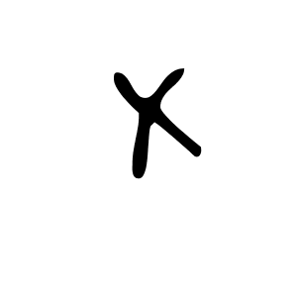





Six underlying design dimension : Features
Elaborate
Harmony
Natural
Flourish
Weight
Compressed
Inner-character harmony
Consider only 5 capital letters (H, X,N,R,K) and 4 small letters (h,x,n,k).
We divide a character image in half, then measured the lowest pixel’s y-value for nine characters.
Estimate the balance level of a typeface
$$h_{cap}$$
$$h_{small}$$
H | X | N | R | K | h | x | n | k
0 | 9 | 3 | 0 | 9 | 4 | 0 | 2 | 7
9px
Harmony feature vector
$$h$$
$$Balance Level={\left\|h_{small}\right\|}_{0}+{\left\|h_{small}\right\|}_{0}×\left(\frac{{\left\|h_{cap}\right\|}_{0}}{{\left\|h\right\|}_{0}}\right)=1+1×\left(\frac{2}{\left(2+1\right)}\right)≅1.66$$

Slide 6
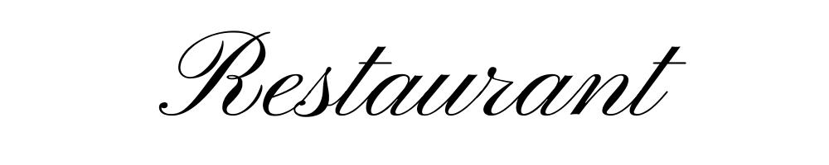





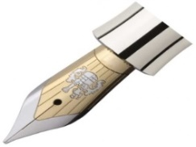
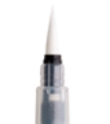
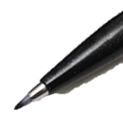
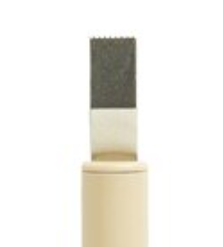
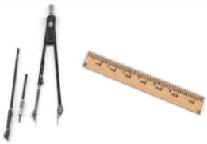



Six underlying design dimension
Elaborate
Harmony
Natural
Flourish
Weight
Compressed
Writing tools
Nib pen
Brush pen
Sign pen
Automatic pen
Geometric tool
Graphical tool
Orientation

Slide 7

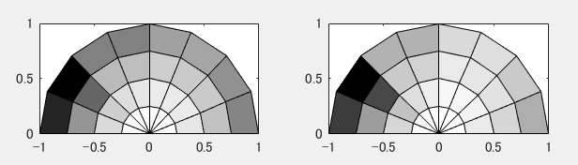
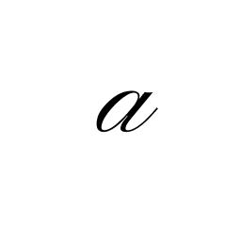
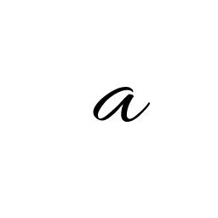
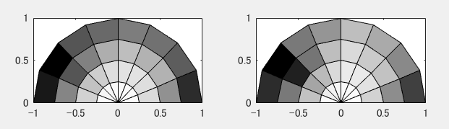


Six underlying design dimension : Features
Elaborate
Harmony
Natural
Flourish
Weight
Compressed
Writing tools [1]
Gabor features (used a total of 32 Gabor channels)
Transformed images through each channel
The mean value and the standard deviation of each channel forms a 64d feature vector
[1] Zhuang Y, Lu W, Wu J. Latent Style Model: Discovering writing styles for calligraphy works. Journal of Visual Communication and Image Representation. 2009
mean
std
Orientation
The vertical projection histogram and its entropy are calculated for a range of angels -45 to 45.
And then find the minimum entropy of that.
$$H=−\sum_{i=1}^{N}{p_{i}\log{ }p_{i}}$$
$$a_{m}=arg\min_{ac±45}{H}$$

Slide 8
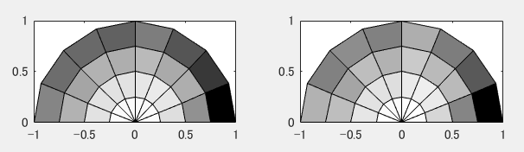

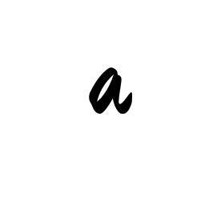
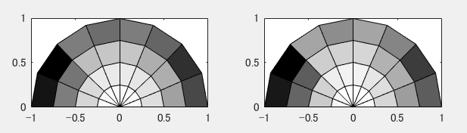
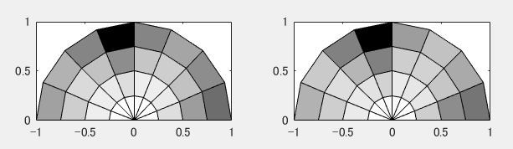

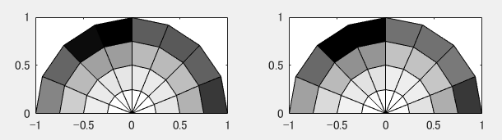


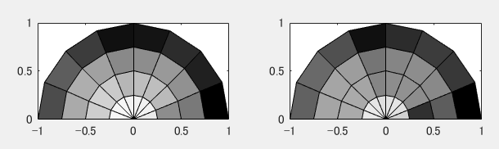

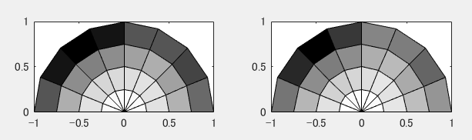
Typeface – writing tool classification
Feature : Gabor feature
Visualization of Gabor features
Brush 1
Nib 1
Brush 2
Nib 3
Double 1
Pen 2
Double 2
Pen 3
[1] Zhuang Y, Lu W, Wu J. Latent Style Model: Discovering writing styles for calligraphy works. Journal of Visual Communication and Image Representation. 2009

Slide 9



Six underlying design dimension
Elaborate
Harmony
Natural
Flourish
Weight
Compressed
Serif / Sans
Serif
Sans serif
Pronounced ascender
Restaurant
> More pronounced ascender

Slide 10


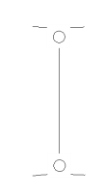
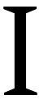



Six underlying design dimension : Features
Elaborate
Harmony
Natural
Flourish
Weight
Compressed
Serif / Sans
Estimate the number of junction points of letter capital ‘I’
Original image
Thin typeface image
Find junction point
Pronounced ascender
Estimate the height of ascender *ascend : the upward vertical stroke on h, b, d, k, f and l (1) measure x-height and average for 12 lower letter (a, c, e, n, m, o, r, s ,u, v, w, x). (2) measure height of 6 letters which have ascender (h, b, d, k, f, I) (3) divide (2) into (1)

Slide 11









Six underlying design dimension
Elaborate
Harmony
Natural
Flourish
Weight
Compressed
Width
Contrast

Slide 12

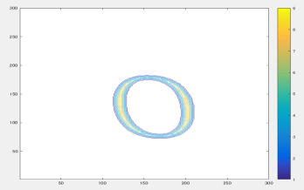

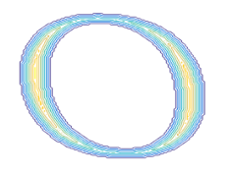
Six underlying design dimension : Features
Elaborate
Harmony
Natural
Flourish
Weight
Compressed
Width & Contrast
Introduced distance contour map based skeletonization algorithm [1]
Compute the mean and variance of the elements of the distance list
Find max and min values of the elements of the distance list.
..
8
8.1
8.2
9
..
Distance transform
Find local maxima
-> suppose to be middle of the line
List the distance transformed image value @local maxima
[1] Idder, Hassan Id Ben, and Nabil Laachfoubi. "Skeletonization Algorithm Using Discrete Contour Map. ICIAP 2015.

Slide 13






Six underlying design dimension
Elaborate
Harmony
Natural
Flourish
Weight
Compressed

Slide 14
Six underlying design dimension : Features
Elaborate
Harmony
Natural
Flourish
Weight
Compressed
Simply estimate compressed level by evaluating average width of horizontal black-runs.

