Slide 1
PSCS_83_Chatbot based helpdesk for government employees and departments
CSE7101- Capstone Project
Review-2
Batch Number:CSE_68
Under the Supervision of,
Ms.Shet Reshma Prakash
Assistant Professor
School of Computer Science and Engineering
Presidency University
Roll Number | Student Name
20221CSE0052 20221CSE0060 20221CSE0006 | Safia Fathima Pritha Baidya Sonika A
Name of the Program: B.Tech(Computer science and Engineering)
Name of the HoD: Dr. Asif Mohammed and Dr. Blessed Prince
Name of the Program Project Coordinator: Dr. Jayavadivel Ravi and Mr.Muthuraju V
Name of the School Project Coordinators: Dr. Sampath A K , Dr. Geetha A

Slide 2
Abstract
Government employees face delays due to scattered information across portals, circulars, and documents.
Proposed solution: centralized AI/NLP chatbot helpdesk.
Key Features:
  Instant access to policies, forms, and procedures.
  Automated routing of queries to the correct department.
  Ticketing system for unresolved issues.
  Multi-language & voice-enabled interaction.
Benefits:
  Increases productivity and coordination.
  Enhances employee satisfaction.
  Improves citizen services.

Slide 3
Literature Survey (10 papers, IEEE format)
[1] M. Sathishkumar et al., “Chat Bot based Helpdesk for Government Employees and Department,” Int. J. Sci. Res. Eng. Manag., vol. 8, no. 2, Feb. 2024.
[2] P. Shilpa Sri et al., “Chatbot For Government Employees in Education Department,” J. Inf. Syst. Eng. & Manag., vol. 10, no. 51s, May 2025.
[3] W. M. H. Sasmita, S. Sumpeno, and R. F. Rachmadi, “Improving Government Helpdesk Service with AI-Powered Chatbot Built on Rasa Framework,” J. RESTI, vol. 9, no. 2, pp. 393–403, Apr. 2025.
[4] I. Dube, “Chatbots: A Tool to Improve Public Service Delivery and Create Public Value,” J. Public Admin. Dev. Alternatives, vol. 9, no. 3, Dec. 2024.
[5] A. G. Larsen, “The impact of chatbots on public service provision,” Government Information Quarterly, 2024.
[6] J. Zhou et al., “Improving Public Service Chatbot Design and Civic Impact: Investigation of Citizens' Perceptions of a Metro City 311 Chatbot,” arXiv, Jun. 2025.
[7] A. Kaun, “Public sector chatbots: AI frictions and data infrastructures,” New Media & Society, 2025.
[8] Z. Lin, “How Generative-AI can be Effectively used in Government Chatbots,” arXiv, Nov. 2023.
[9] A Smart Chatbot for Government Services: Enhancing Citizen Experience, IEEE Access, 2022.
[10] AI in Public Administration: Chatbots for Citizen Support, Government Information Quarterly, 2021.

Slide 4
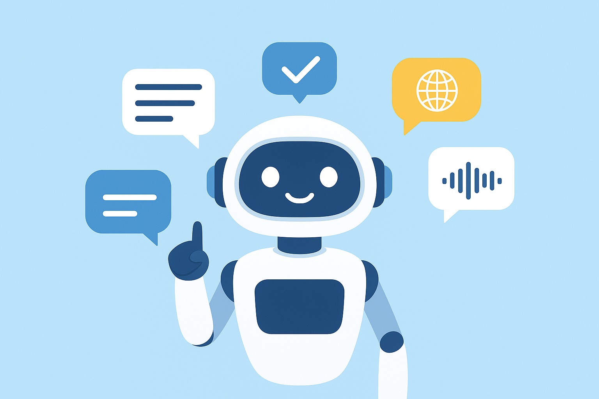
Objectives
To deliver accurate, instant responses to employee queries.
To reduce time spent finding documents, forms, and rules.
To increase efficiency by automating department classification.
To maintain a digital ticketing and query tracking system.
To enable employees to interact in multiple languages, including regional languages.
To provide voice-enabled support for accessibility.
To offer an analytics dashboard to decision-makers for process improvement.

Slide 5
Existing Methods & Drawbacks
Existing Methods:
Manual helpdesk (phone, emails)
Department-specific portals & FAQ pages
Early chatbots with limited features
Drawbacks:
Slow response times → employee frustration
Scattered information across platforms
Inconsistent and Unpersonalized responses
Scalability & security concerns

Slide 6
Proposed Method & Feasibility Study
Proposed Solution:
Centralized AI/NLP chatbot across all departments
Ticket tracking system for unresolved issues
Multi-language & voice-enabled support
Analytics dashboard for decision-makers
Feasibility:
Built with Python, spaCy, NLTK, Rasa/Dialogflow
Cloud deployment on AWS, Azure, GCP
Cost-effective using open-source frameworks
Minimal hardware requirements → accessible to employees

Slide 7
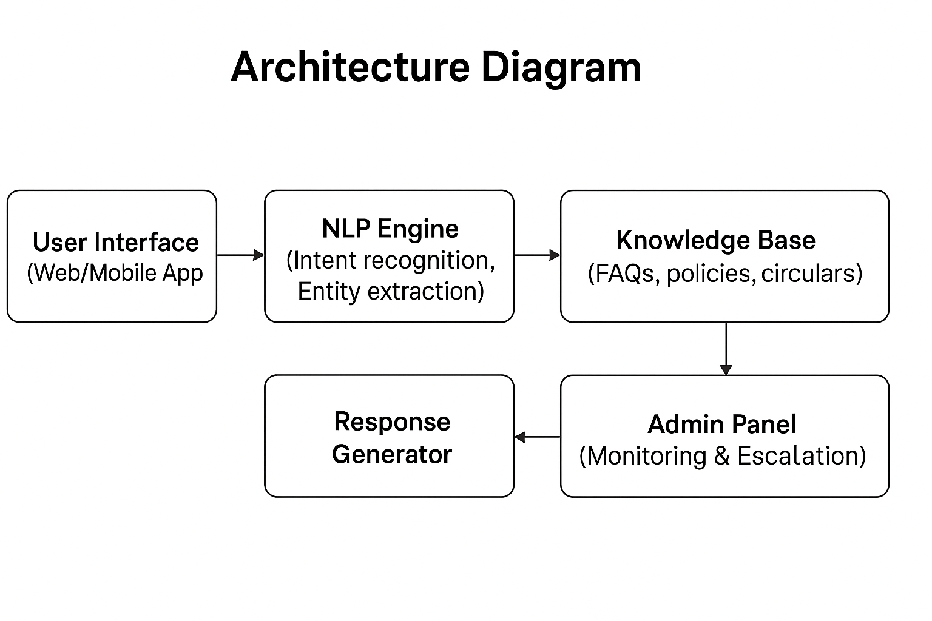
Architecture Diagram

Slide 8
Modules
User Interface Module – Web/mobile access
Query Processing Module – NLP-based interpretation
Department Routing Module – Classify & route queries
Ticketing & Tracking System – Track unresolved issues
Multi-language Support Module – English & regional languages
Voice Processing Module – Speech accessibility
Analytics Dashboard – Insights for policy makers

Slide 9
Hardware & Software Requirements
Software Requirements:
Python 3.x
Streamlit / Flask
TensorFlow / Keras
Scikit-learn
Pandas, NLTK/spaCy
SQLite / Supabase
SpeechRecognition
googletrans
GitHub for version control
Google Data Studio / Metabase for analytics
Hardware Requirements:
Desktop/Laptop with minimum 2GB RAM
Stable internet connection
Optional: Microphone for voice input feature testing

Slide 10
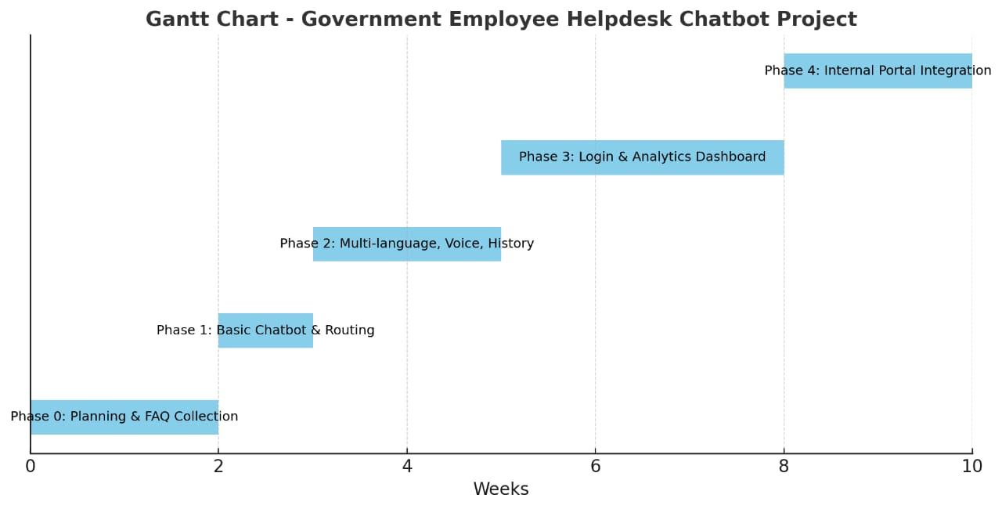
Timeline of the Project (Gantt Chart)

Slide 11
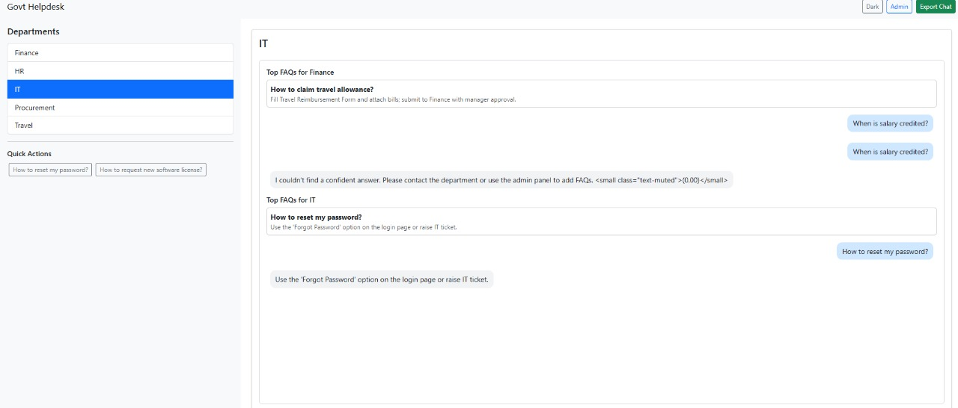
Chatbot Demo Screenshot

Slide 12
References
[1] M. Sathishkumar et al., “Chat Bot based Helpdesk for Government Employees and Department,” Int. J. Sci. Res. Eng. Manag., vol. 8, no. 2, Feb. 2024.
[2] P. Shilpa Sri et al., “Chatbot For Government Employees in Education Department,” J. Inf. Syst. Eng. & Manag., vol. 10, no. 51s, May 2025.
[3] W. M. H. Sasmita, S. Sumpeno, and R. F. Rachmadi, “Improving Government Helpdesk Service with AI-Powered Chatbot Built on Rasa Framework,” J. RESTI, vol. 9, no. 2, pp. 393–403, Apr. 2025.
[4] I. Dube, “Chatbots: A Tool to Improve Public Service Delivery and Create Public Value,” J. Public Admin. Dev. Alternatives, vol. 9, no. 3, Dec. 2024.
[5] A. G. Larsen, “The impact of chatbots on public service provision,” Government Information Quarterly, 2024.
[6] J. Zhou et al., “Improving Public Service Chatbot Design and Civic Impact: Investigation of Citizens' Perceptions of a Metro City 311 Chatbot,” arXiv, Jun. 2025.
[7] A. Kaun, “Public sector chatbots: AI frictions and data infrastructures,” New Media & Society, 2025.
[8] Z. Lin, “How Generative-AI can be Effectively used in Government Chatbots,” arXiv, Nov. 2023.
[9] A Smart Chatbot for Government Services: Enhancing Citizen Experience, IEEE Access, 2022.
[10] AI in Public Administration: Chatbots for Citizen Support, Government Information Quarterly, 2021.

Slide 13


