Slide 1

INTRODUCTION TO EMBEDDED SYSTEM
Smart Automated Agricultural Control & Telemetry System
with Edge AI and Telegram Integration
Team AgriTech Innovators
Mohammad Fahim 2023200000399
Fahad Ahmed 2023200000371
Safayet Hossain Bhuiyan Munna 2023200000648
Maria Iffat 2023200000366
Batch 65 | Southeast University
Notes:
1

Slide 2
Introduction
  This is a smart farming system.
  It uses an ESP32 board and sensors.
  Sensors check soil, temperature, humidity and light, and a digital variable that works as a pH sensor.
  AI on the board checks sensor data and predicts crop health.
  It turns the water pump, fan, grow lights ON/OFF by itself.
  Farmers can control it from Telegram or a small screen.
2
CPU cores: AI and Wi-Fi
3
Sensor types
2
Ways to control
AgriTech Innovators
2
Notes:
2

Slide 3
Motivation
1
2
3
Food Security
Save Resources
Farmer Comfort
  Crop disease can cause big yield loss.
  Signs are seen only when it is late.
  Early warning can save the crop.
  Manual watering wastes water.
  Extra water washes away nutrients.
  Pump runs only when soil is dry.
  Less manual work in the field.
  Control the farm from Telegram.
  Made for small farms.
AgriTech Innovators
3
Notes:
3

Slide 4
Problem Statement
Climate changes
  Farms check crops by hand, only now and then.
  Early signs of problems are missed.
  Disease harms crops before it is visible.
1
  Heat and humidity stress harm crops.
  Unwatched changes speed up crop diseases like fungal and bacterial growth.
Poor water use
2
  Over-watering wastes water.
  pH imbalance goes unnoticed.
Who needs this:
  Small farmers
  Greenhouse operators
  Garden managers and researchers
Late disease detection
3
  Disease spreads before leaves show signs.
  Late action causes big yield loss.
AgriTech Innovators
4
Notes:
4

Slide 5
Proposed Solution
Auto Watering
AI Crop Health
Telegram Control
  Pump ON when soil is dry.
  Saves water.
  Uses pH, temperature, humidity and soil data.
  Finds disease risk early.
  /status, /pump_on, /auto_on
  Control from anywhere.
Fan Cooling
Offline Screen
Easy Alerts
  Fan ON when temperature is high.
  Also ON if humidity is over 85%.
  Small color display.
  Joystick menu, no internet needed.
  Colored LED patterns.
  Different buzzer sounds.
AgriTech Innovators
5
Notes:
5

Slide 6
Hardware Used
Controller
Sensors
Actuators
Display & Alerts
  ESP32 Dev Board
  ESP32 Extension Board
  Breadboard, jumper wires and other parts
  DHT22 Temp & Humidity Sensor
  Capacitive Soil Moisture Sensor
  LDR Light Sensor Module
  4-Channel 5V Relay Module
  5V Submersible Water Pump
  5V DC Cooling Fan
  ST7735 1.44" SPI Color TFT Display
  2-Axis Analog Joystick Module
  WS2812B NeoPixel RGB LED Strip
  Active Buzzer
Total estimated cost: Tk 2,950
AgriTech Innovators
6
Notes:
6

Slide 7
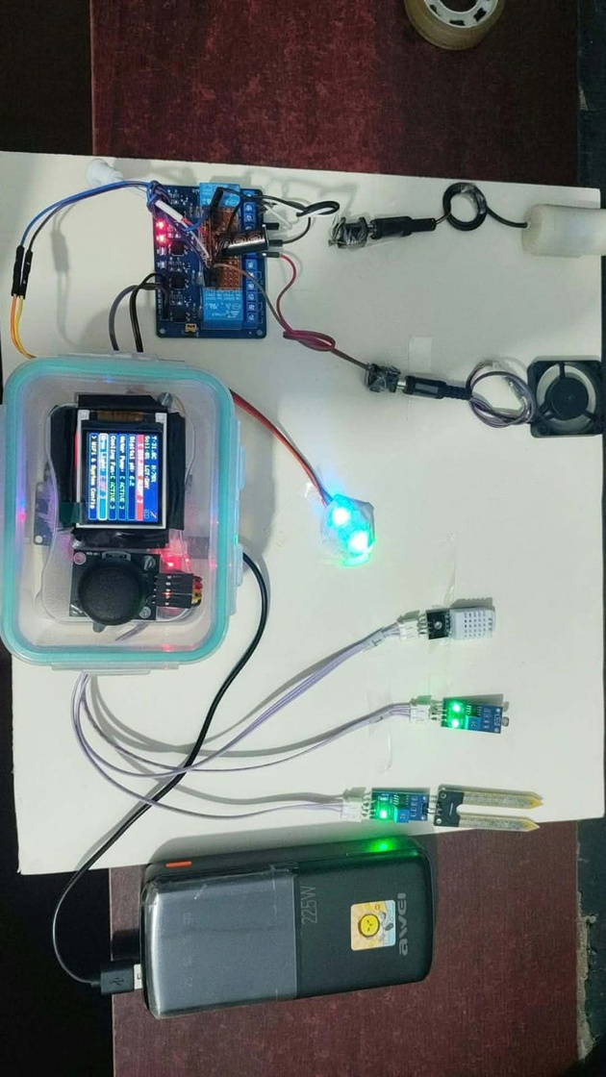
Hardware Implementation
INPUT
OUTPUT
Space for photo
DHT22 sensor
ESP32
Relay: pump and fan
Core 1
AI checks
Soil sensor
TFT display
LDR light sensor
Core 0
Wi-Fi, Telegram
NeoPixel LEDs
Joystick
Buzzer, Telegram
FreeRTOS + NVS
AgriTech Innovators
7
Notes:
7

Slide 8
Working Process
  If: soil moisture is below the set limit
  Then: pump (motor) turns ON
How it works
1
  Sensors read soil, temperature, humidity and light.
  AI on Core 1 predicts crop health.
  System compares readings with saved limits.
  Relay turns the pump or fan ON when needed.
  Screen and Telegram show status and alerts.
  Users can also switch ON or OFF by hand.
  If: temperature is above the set limit
  Then: cooling fan turns ON
2
  If: humidity is above 85%
  Then: cooling fan turns ON
3
  If: AI finds disease risk
  Then: alert by Telegram, LED and buzzer
4
AgriTech Innovators
8
Notes:
8

Slide 9
Problems Faced
  Multi-Core Race Conditions: Data sharing between ESP32 cores caused crashes; solved using mutex locks.
  Memory Limitations: ML inference required careful SRAM optimization to prevent stack overflow.
  Voltage Spikes: Relay switching caused electrical noise and reboots; optocouplers were used for isolation.
  Sensor Noise & Calibration: Soil moisture and DHT22 sensors needed filtering and threshold tuning to reduce false alerts.
  UI Responsiveness: TFT display and joystick inputs required optimized polling and deadzone tuning to avoid lag.
Notes:
9

Slide 10
Conclusion
  A smart farming system built on ESP32.
  Waters crops only when the soil is dry.
  Fan turns ON to protect crops from heat and humidity.
  AI finds disease risk early, so farmers can act in time.
  Control from Telegram or the local screen.
  Helps small farms save water and work.
Notes:
9

Slide 11
Thank You
Questions & Discussion
Team AgriTech Innovators
Notes:
10

