Slide 1
Time Series Analysis

Slide 2
Purpose of The project
Forecasting the traffic on a new form of transportation called JetRail for the next 7 months since Unicorn Investors wants to make an investment in it. JetRail uses Jet propulsion technology to run rails and move people at a high speed! The investment would only make sense, if the investors can get more than 1 Million monthly users with in next 18 months.

Slide 3

Modeling Techniques used for forcasting
Holt’s Linear Trend Model
Holt Winter’s Model
ARIMA model
SARIMAX model
Used Language For Analyzing and Forecasting
Python

Slide 4
Toturial
Understanding data
Forcasting

Slide 5
Understanding data
Hypothesis Generation
Dataset Structure and Content
Feature Extraction
Exploratory Analysis

Slide 6
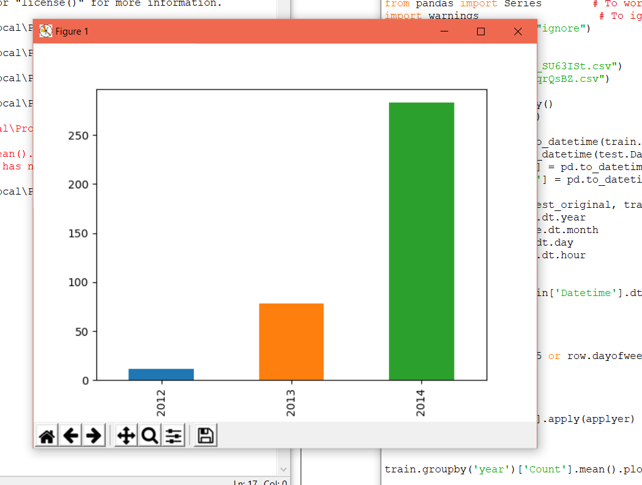
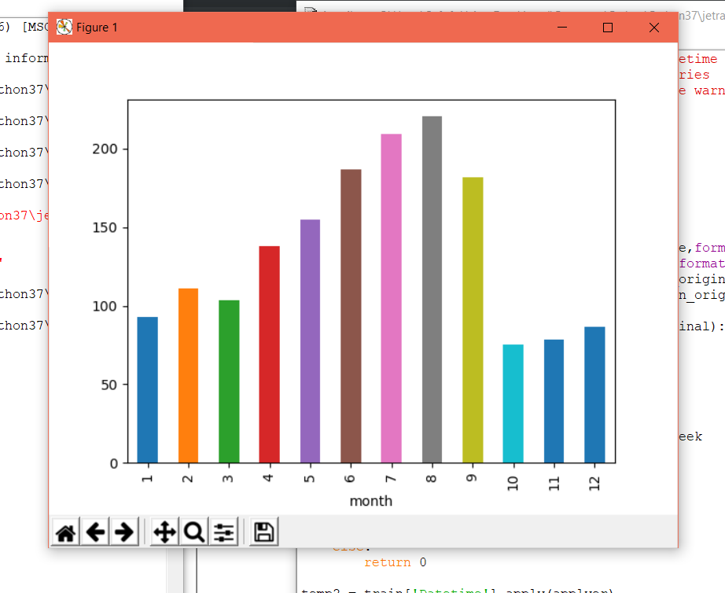
First hypothesis: traffic will increase as the years pass by.
Second hypothesis: traffic will increase from May to October

Slide 7
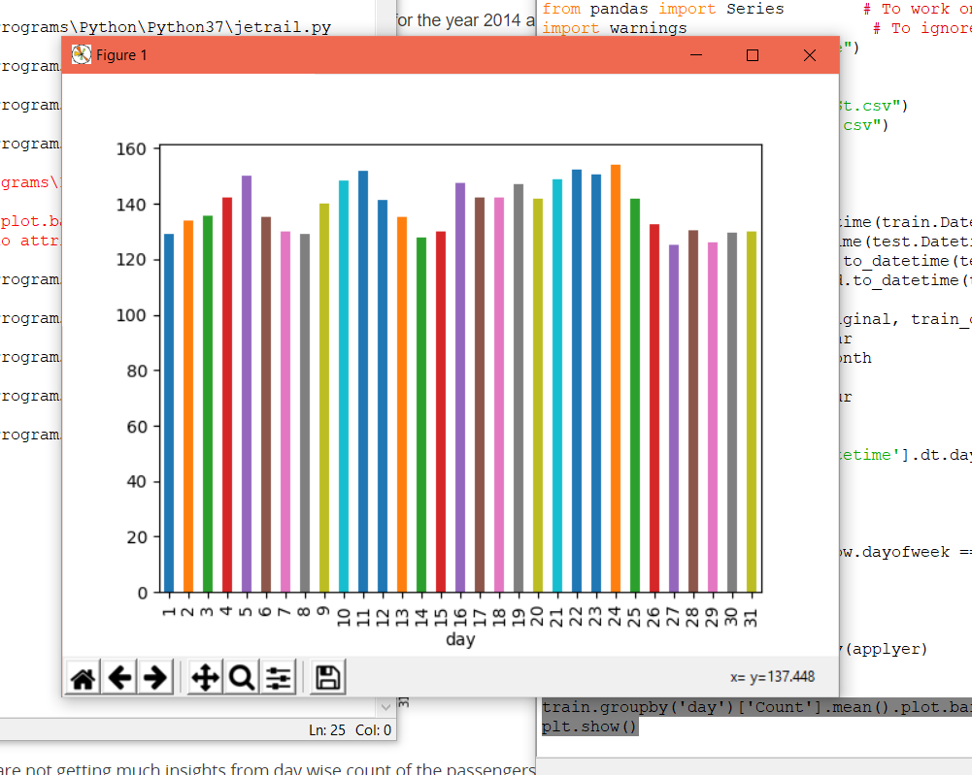
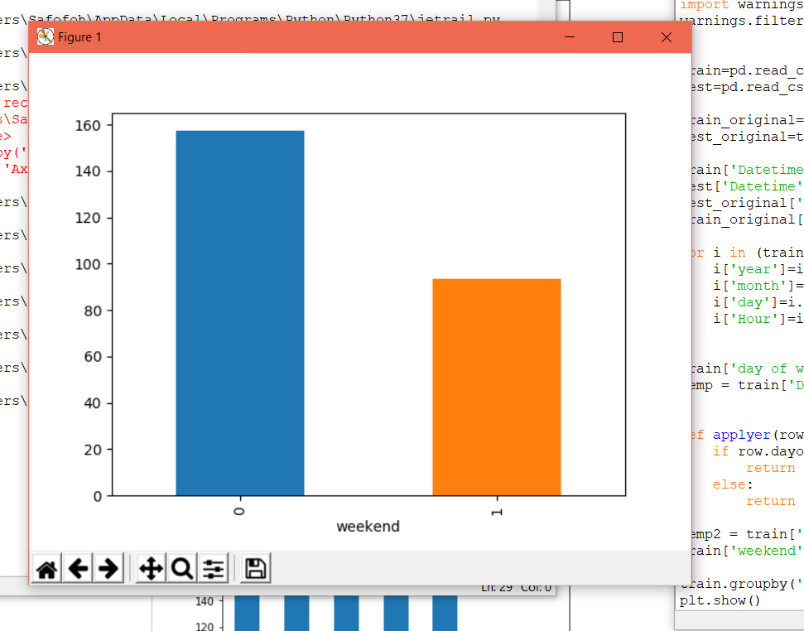
Third hypothesis: traffic will be more during peak hours.
Forth hypothesis: traffic will be more on weekdays.

Slide 8
Forcasting
Splitting Data
Divide the data into training and validation set. Last 3 months as the validation data and the rest for training data.
Modeling Techniques
Naive Approach
Moving Average
Simple Exponential Smoothing
Holt’s Linear Trend Model

Slide 9
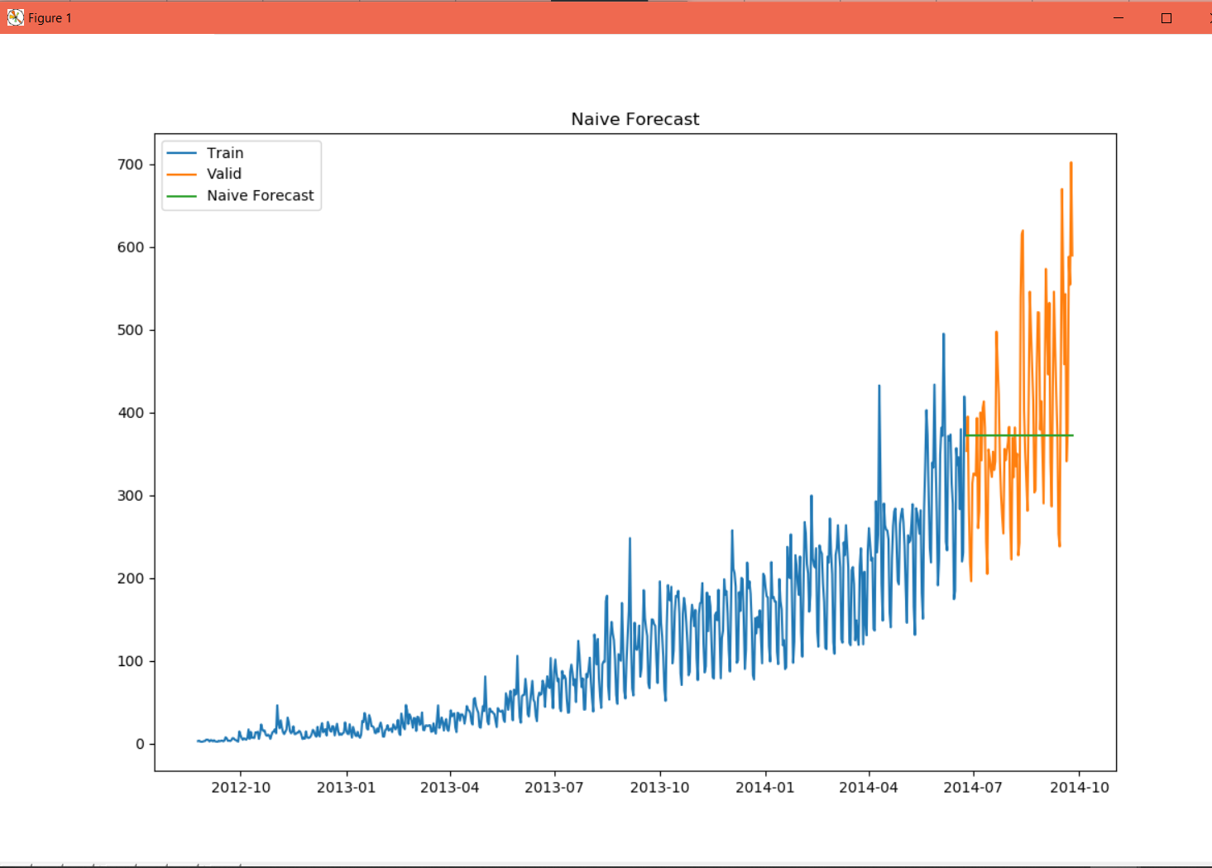
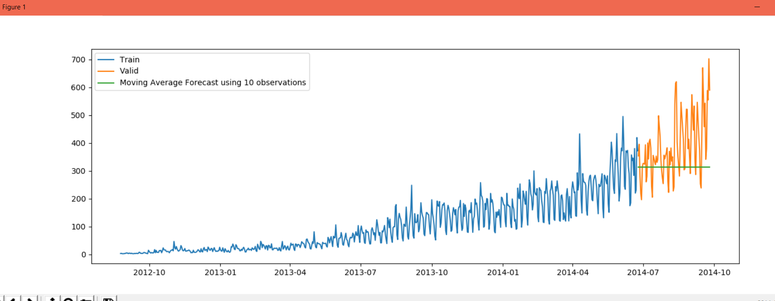
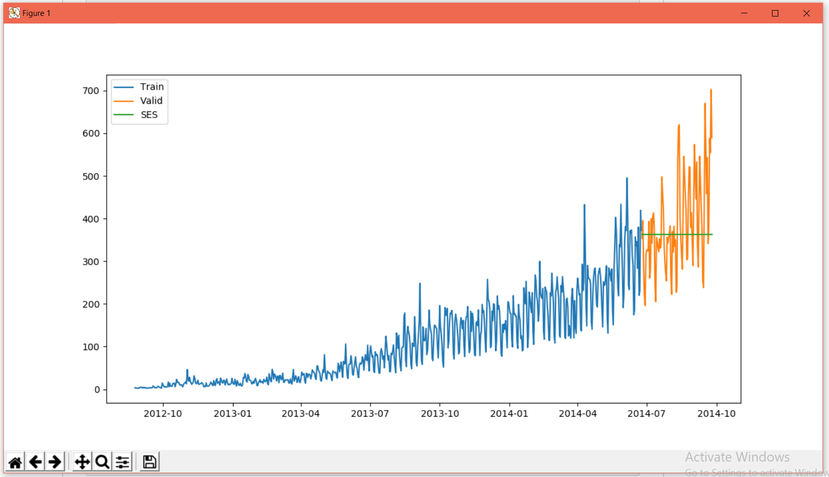
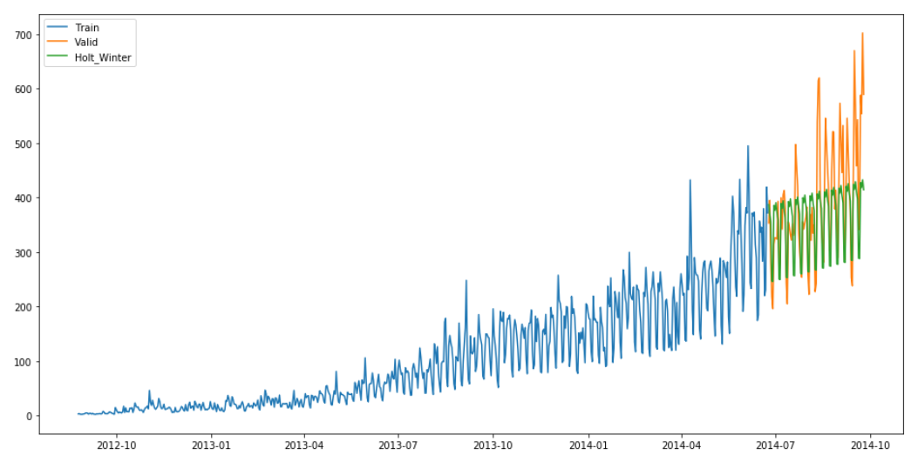
Modeling Techniques

Slide 10
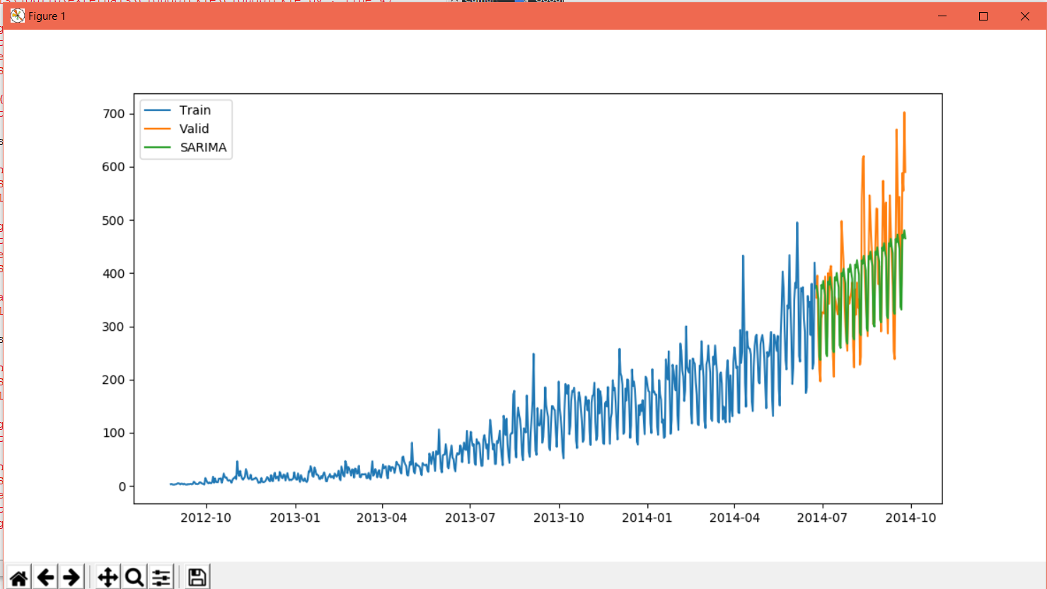
Sarimax Model

Slide 11
Changing Code
Holt Winter
We've used Holt Winter Model
Changing Seasonal Periods
We've changed the seasonal periods from 7 to 70 to get more accurate forcasting
Spiltting Data
We've taken 2 months instead of 3 for validation and the rest to train so it has more data to train on

Slide 12

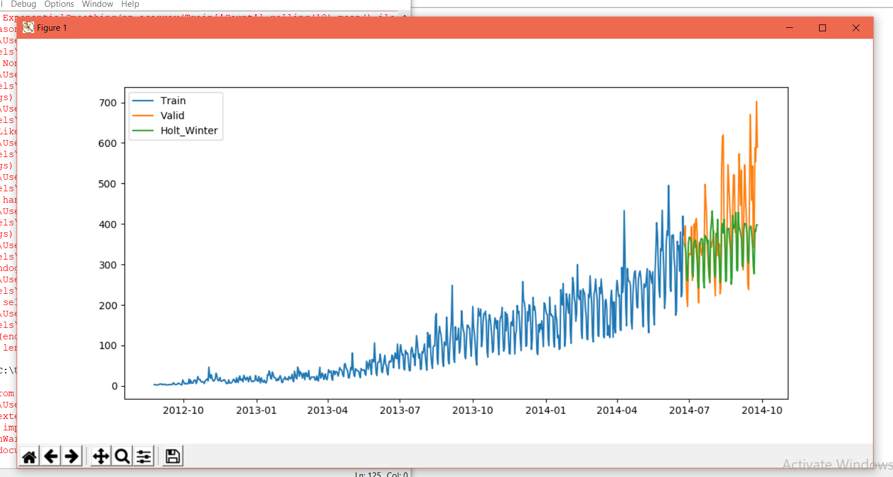
Final Results

Slide 13

THANKS!
Any questions?

