Slide 1

Hotel Booking Cancellation Analysis
EDA + KNN Model

Slide 2
Dataset Overview
Rows: 36285
Columns: 18
No missing values.
Target column: is_canceled

Slide 3
KNN Model Info
Features used: lead time, P-C, P-not-C, repeated, market segment type
k = 5
Distance: Euclidean

Slide 4
Model Performance
Accuracy: 0.75
Classification Report:
precision recall f1-score support
0 0.80 0.84 0.82 4855
1 0.63 0.57 0.60 2402
accuracy 0.75 7257
macro avg 0.71 0.70 0.71 7257
weighted avg 0.74 0.75 0.74 7257

Slide 5
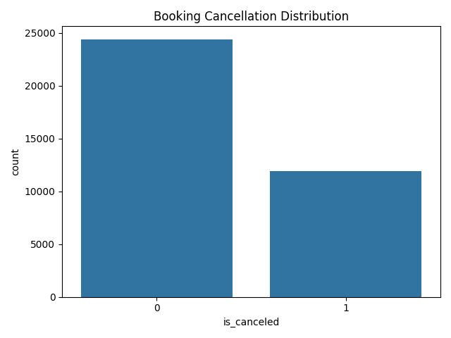
Booking Cancellation Distribution

Slide 6
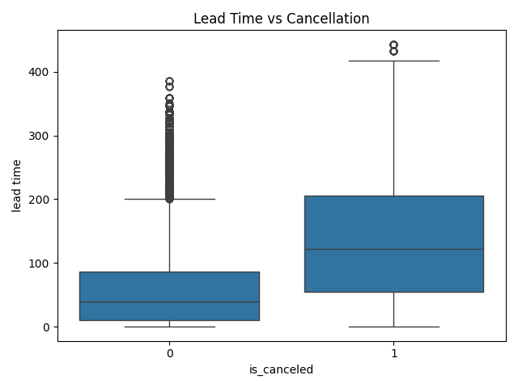
Lead Time vs Cancellation

Slide 7
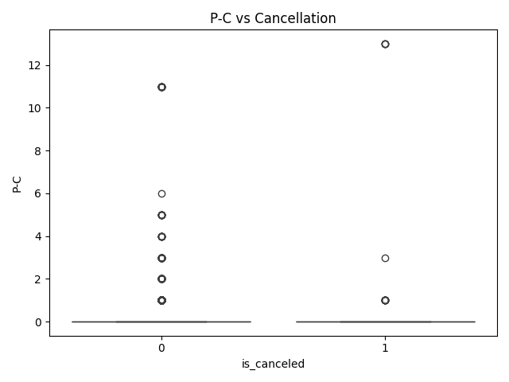
P-C vs Cancellation

Slide 8
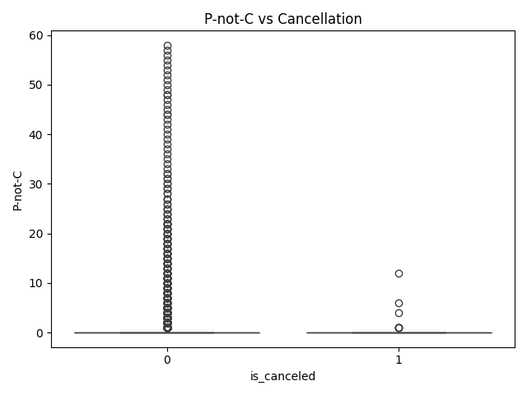
P-not-C vs Cancellation

Slide 9
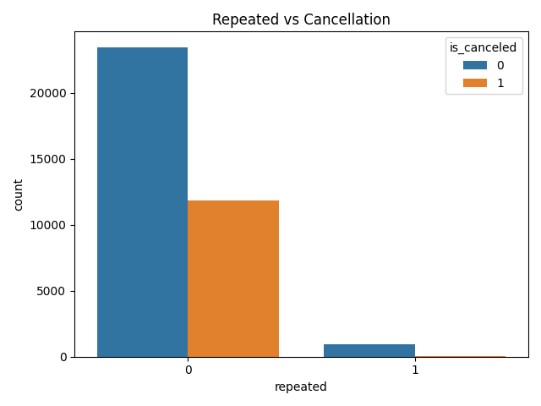
Repeated vs Cancellation

Slide 10
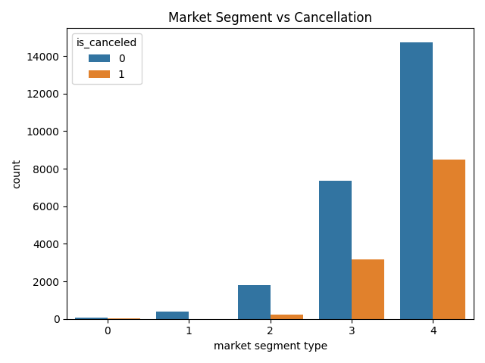
Market Segment vs Cancellation

Slide 11
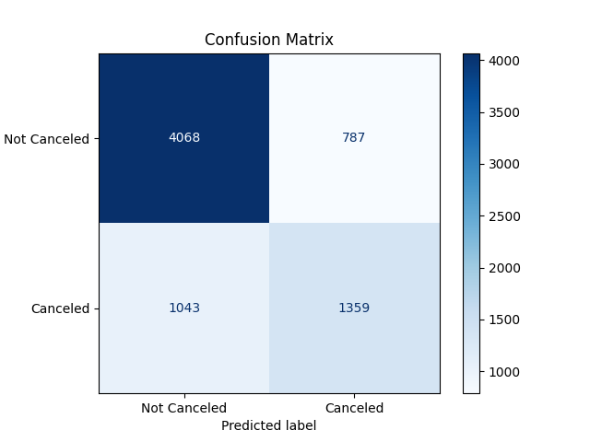
Confusion Matrix

