Slide 1


UI/UX Design Internship
at
IELTSGo Pvt.Ltd.
Prepared by: Safalta Shrestha

Slide 2

Table of Contents
Organization & Internship
Organization Hierarchy
Problem Statement & Objectives
Major Project
Wireframing Design
Roles, Responsibilities & Tools
Internship Progress/ Weekly Highlights
Technical & Professional Learning
Conclusion
1

Slide 3
Organization & Internship
IELTSGo Pvt. Ltd.
International education and language training organization established in 2003.
Internship Role
UI/UX Design Intern in the UI/UX Design Department.
Internship Details
Started: 8 May 2026
Monday-Friday
11 AM- 6 PM
Mentorship
Mr. Prajwol Chand
ProjectManager/Supervisor.
Primary Tool
Figma
2

Slide 4
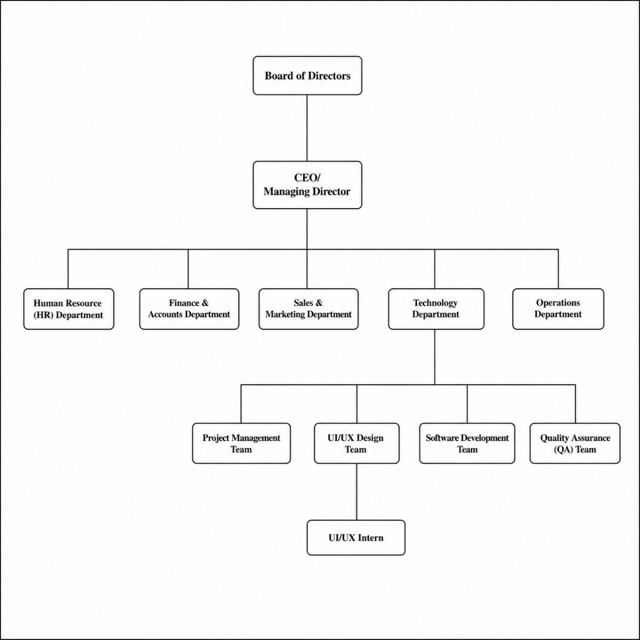
Organization Hierarchy
3

Slide 5
Problem Statement & Objectives
Problem Statement
Poor usability can result from complicated layouts, unclear navigation and inconsistent interfaces. The project fouces on creating an intuitive UI/UX that improves usability while maintaining visual consistency and aesthetic appeal.
4

Slide 6

Problem Statement & Objectives
Objectives
Apply UI/UX principles in a real project
Understand user-centered design
Create user flows, wireframes and prototypes
Design consistent high-fidelity interfaces in Figma
Improve usability and accessibility
5

Slide 7
Major Project
Coffee Shop Mobile Application
Goal: create a modern, user-friendly and visually appealing coffe shop mobile experience.
Users Experience: Allows users to browse products, customize orders and place orders conveniently.
Design Focus : simple navigation, visual consistency, usability and clear user flows.
Deliverable: High-fidelity model UI and interactive prototype developed in Figma.
6

Slide 8
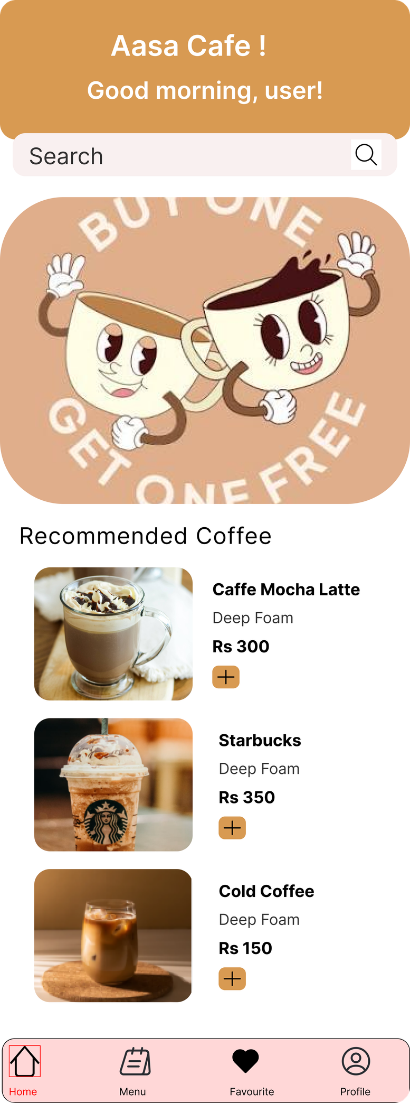
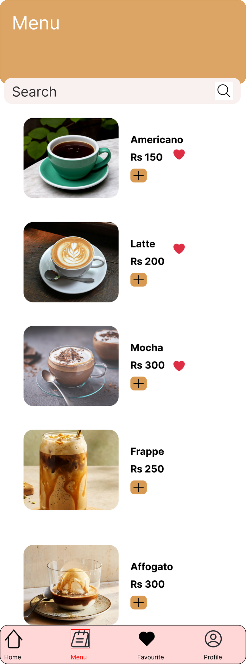
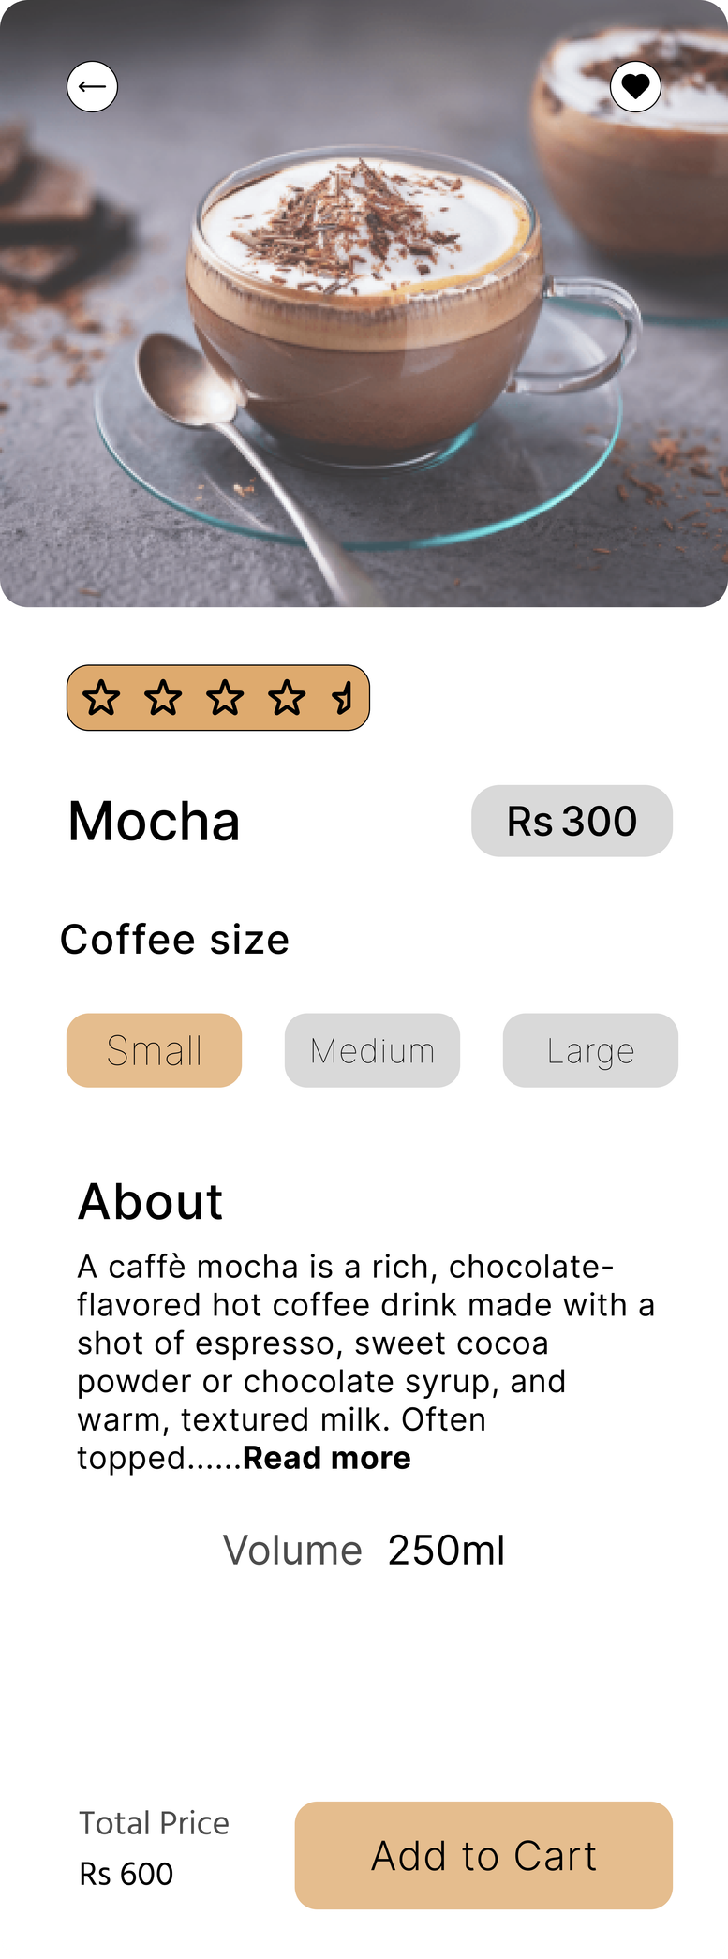
7

Slide 9
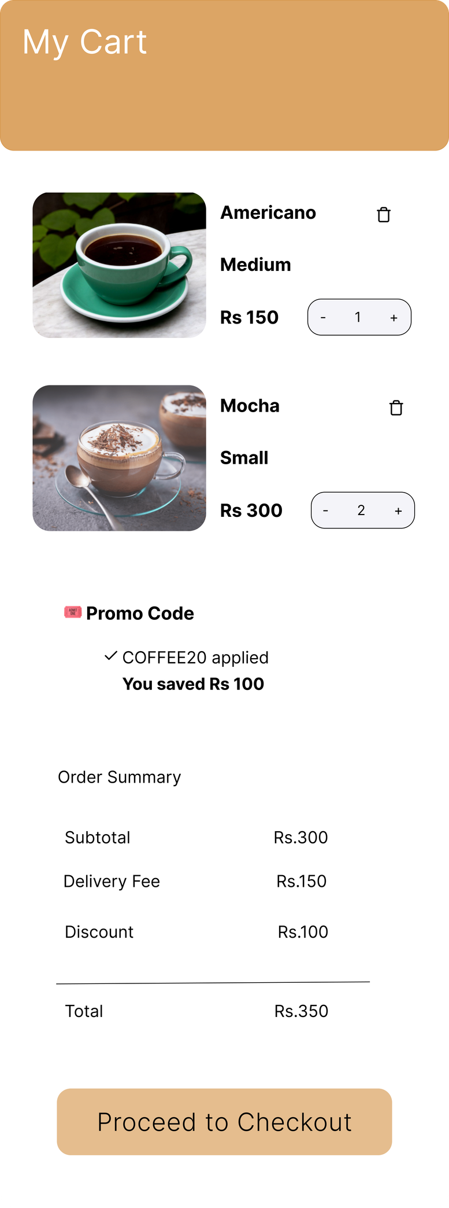
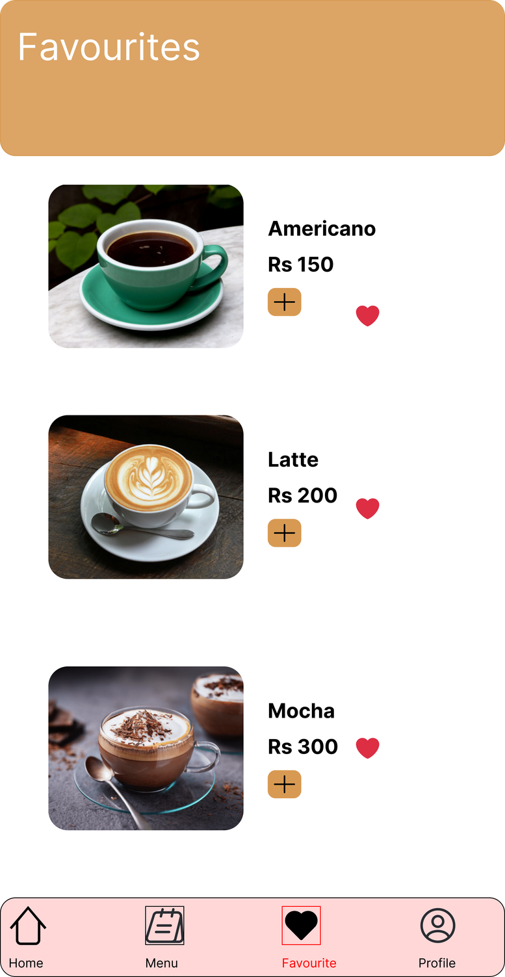
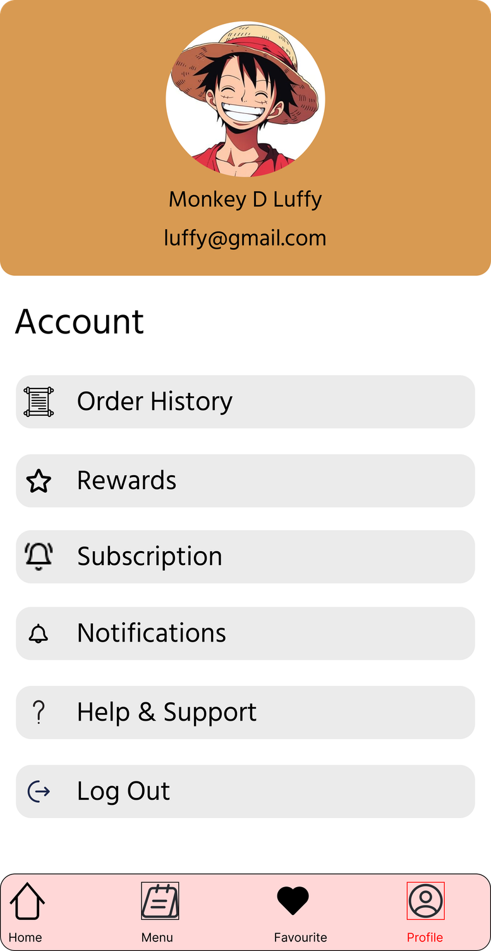
8

Slide 10
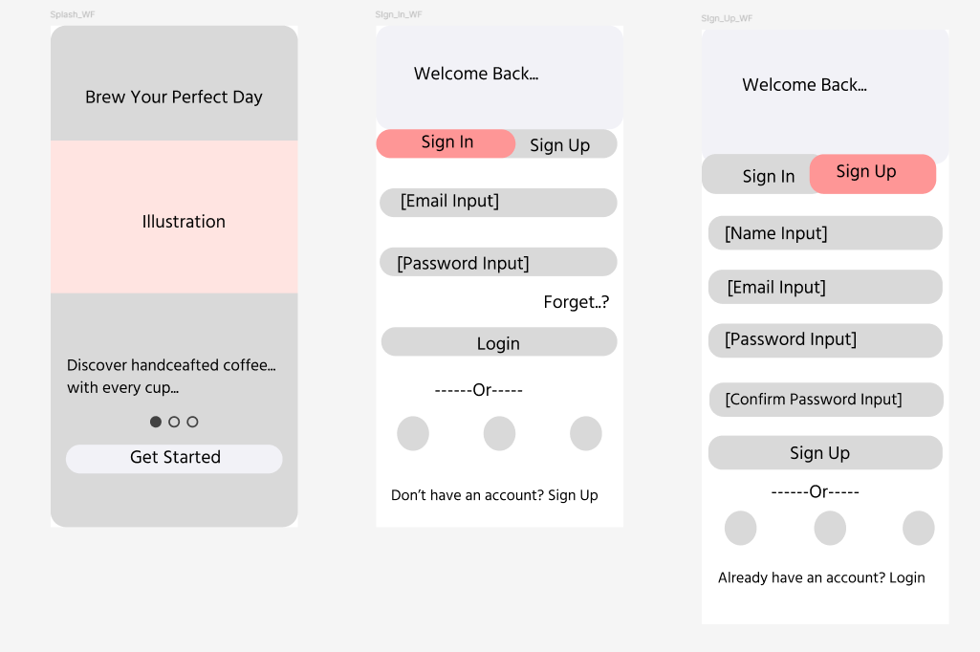
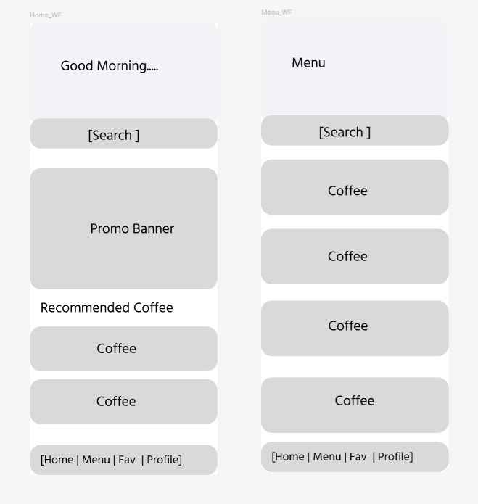
Wireframing Design
9

Slide 11
Roles, Responsibilities & Tools
Responsibilities
User research and requirements
User flows and wireframes
High-fidelity UI screens
Typography, colors, icons and spacing
Reusable components and design system
Interactive prototyping
Design reviews and revisions
10

Slide 12
Roles, Responsibilities & Tools
Tools & Practices
Figma
User-centered design
Design thinking
Responsive design principles
Prototyping
Interactive design
Mentor/team collaboration
11

Slide 13
Internship Progress: Weekly Highlights
Weeks 1-3
Orientation, Figma practice, typography/ color theory, logo work and educational website analysis.
Weeks 4-6
Logo/banner concepts, IELTSGo.uk mockup and IELTSGo TEFL UI/UX evaluation.
Weeks 7-9
Documentation, Coffee Shop app planning, website mockups and main mobile screens.
12

Slide 14
Internship Progress: Weekly Highlights
Weeks 10
Refined components, consistency, spacing, typography, colors and reusable elements.
Weeks 11
Finalized designs, organized assets/documentation and reviewed work with supervisor.
Status in Report
Some page like location, subscription,order history of coffee shop are remaining.
13

Slide 15
Technical & Professional Learning
User-centered UI/UX process
Wireframing, prototyping and high-fidelity UI design
Design systems and reusable components
Usability, accessibility and responsive design
Creativity and problem solving
Communication, collaboration and teamwork
Time management and adaptability
Presenting ideas and receiving feedback
Confidence in pratical UI/UX work
14

Slide 16
Conclusion
The internship cconnected acadenic UI/UX knowledge with practical industry work.
The Coffee Shop Mobile Application strengthened skills in wireframing, visual design, prototyping and design refining.
The experience improved technical, creative, communication and teamwork skills.
15

Slide 17


16

