Slide 1
ZOMATO
Behind every order, There’s a pattern

Slide 2
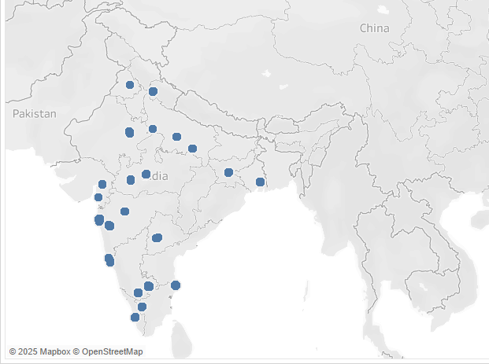
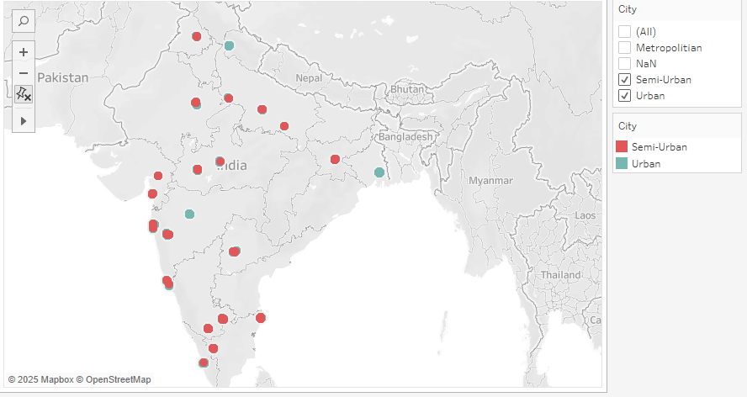
Restaurants Location
Restaurants in Metropolitan Area
Restaurants in Urban And Semi Urban

Slide 3
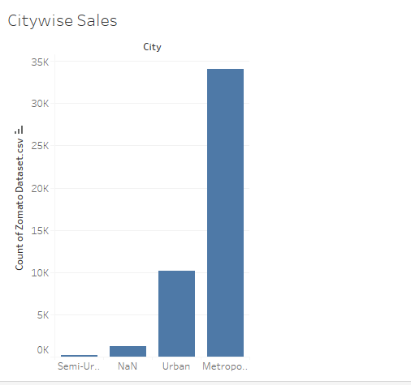
Citywise Orders
From the right side bar chart ,it is clearly noticed that Zomato gets it most of its orders from Metropolitan City.

Slide 4
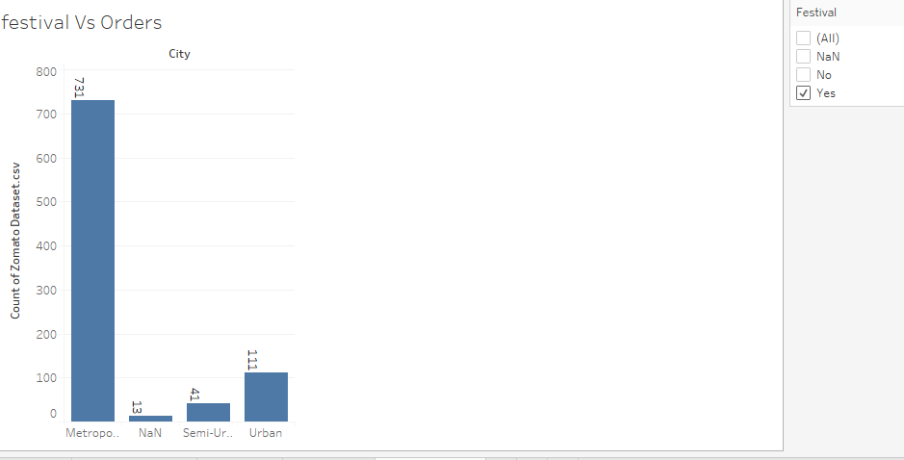
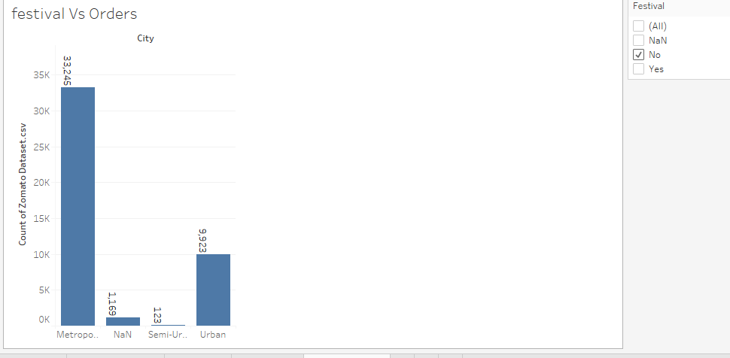
Impact of Festival on Orders
During Festival
Normal Condition
Zomato gets more orders during non-festive time

Slide 5
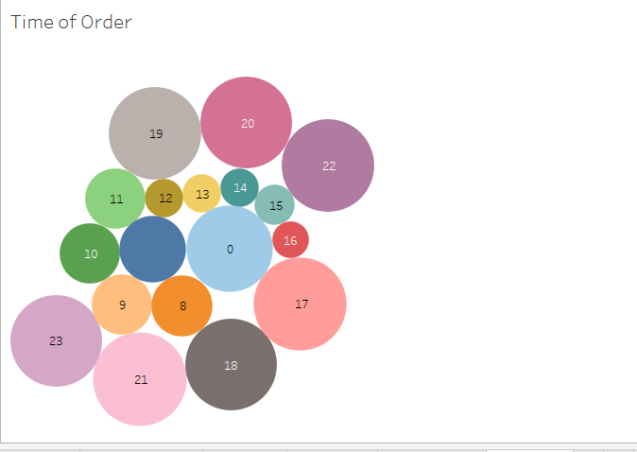
Time Vs Order
Highest Number of orders are placed At 9 PM.

Slide 6
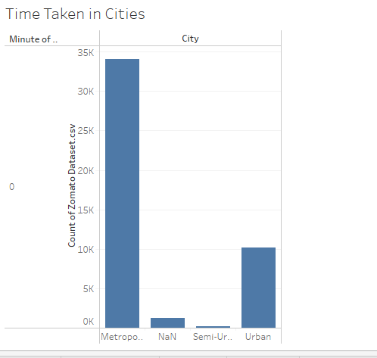
Time Taken in Different City Category

Slide 7
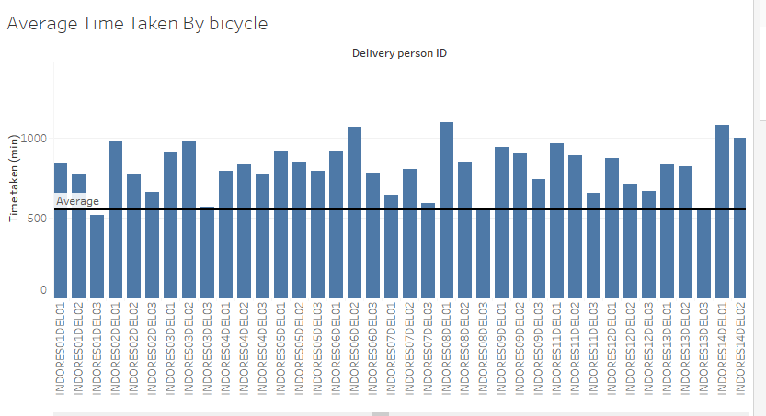
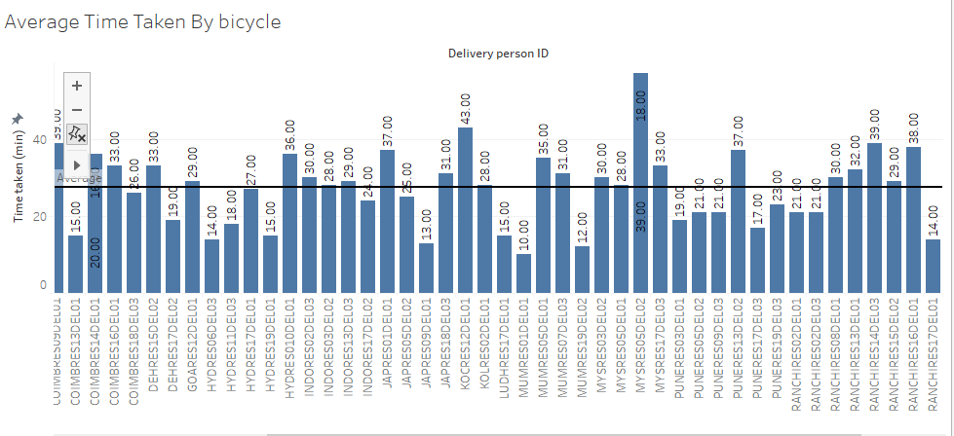
Time Taken by Types of Vehicle
AVERAGE TIME TAKEN BY MOTORCYCLE
AVERAGE TIME TAKEN BY BICYCLE
AVERAGE TIME : 9.2 MIN
AVG TIME : 27.65 MIN

Slide 8
Insights
Metropolitan Regions are the top source of orders.
Maximum Number of Restaurants are operating in Metropolitan Area.
During festivals,number of Orders get down.
It is often seen that after 9AM number of orders increase.

