Slide 1
Cafeteria Management System
CSE327
Group: 4

Slide 2
Group Members
Zubair Mahmood Sowrab 2011657042
Md. Zakaria Khan 2013412042
Md. Safayat Jabber 2012551642
Tanjim Imtial 2014215642

Slide 3
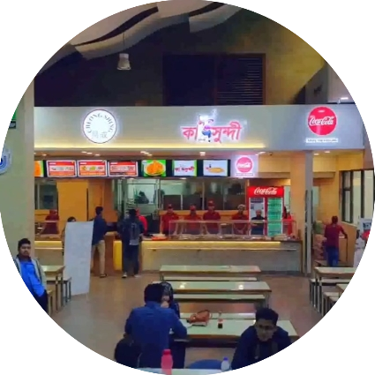
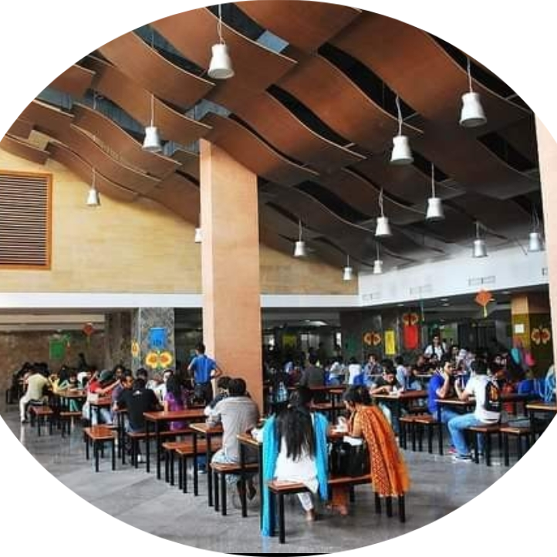
Project Description
Management System.
Comprehensive solution.
Feedback section.
Stock checking system.
Different login options with a verification system.
Different payment options.

Slide 4
Opportunities- Why we need this
Efficient and Convenient.
Increased customer satisfaction.
Better inventory management.
Environment-friendly.
Expansion opportunities.

Slide 5
Target Audience
Educational Institutions Canteens
Restaurant owners
Cafeteria owners
Food Courts
Private and Government offices

Slide 6
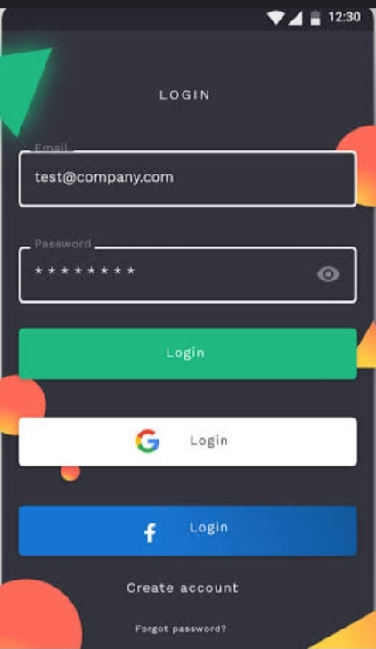
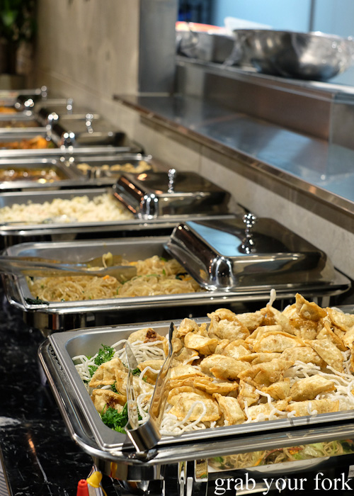


Functionality & Features
Different ordering options.
Recommendation system.
Feedback section.
Stock checking system.
Different login options with verification system.
Different payment options.

Slide 7
Rationale
Solves the following problems:
Availability of food.
Inefficient ordering process.
Poor inventory management.
Inefficient way of feedbacks.
Limited payment options.

Slide 8

Thank you!!
This Photo by Unknown Author is licensed under CC BY-SA-NC

