Slide 1
PrioPrivacy: A Local Recoding K-Anonymity Tool for Prioritised Quasi-Identifiers
Alexandros Bampoulidis, Ioannis Markopoulos, Mihai Lupu

Slide 2
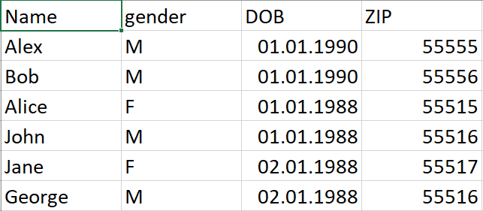
Personal Data
Removing direct identifiers is not enough to make data anonymous.
Why?

Slide 3
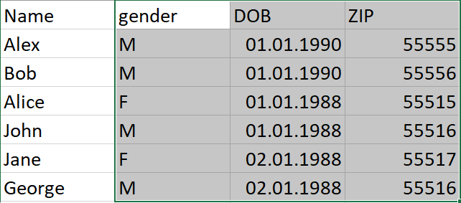
Quasi-Identifiers
Attributes who combination serves as a unique identifier
How to deal with this?

Slide 4
K-Anonymity
The most basic anonymity principle
Every individual in the dataset cannot be distinguished from at least k-1 other individuals
=> the maximum probability of de-anonymizing any individual is 1/k
How can this be achieved?

Slide 5
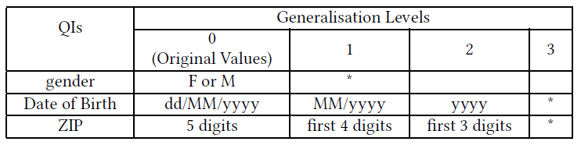
Generalization Hierarchies
Abstractions of the original values

Slide 6
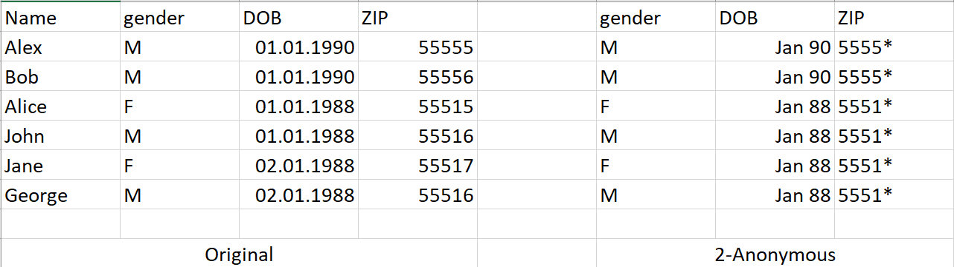
Example Solution

Slide 7
Global and Local Recoding
Global recoding
All the values of a QI belong to the same level of generalization
Local recoding
Different generalization levels for different subsets of the data

Slide 8
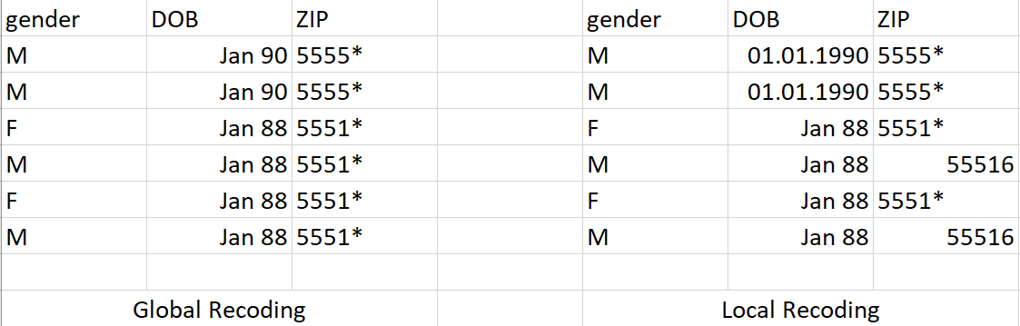
Global and Local Recoding
Less information less is achieved in local recoding

Slide 9
Motivation and Contribution
K-anonymization results in loss of information
Some attributes might be more important and should be distorted as little as possible
Currently, there is only one tool that utilizes local recoding and considers importance of attributes
Contribution: a local recoding k-anonymity tool that considers importance of attributes that utilizes a greedy algorithm capable of outperforming the state-of-the-art

