Slide 1



“Tianrui Hu led the experimental evaluation and analysis”
Beyond the Hype: Empirical Analysis of Matter Standard’s Security and Privacy
Andrew Losty, Tianrui Hu, Daniel J. Dubois, Narmeen Shafqat, Aanjhan Ranganathan, David Choffnes, Anna Maria Mandalari

Slide 2
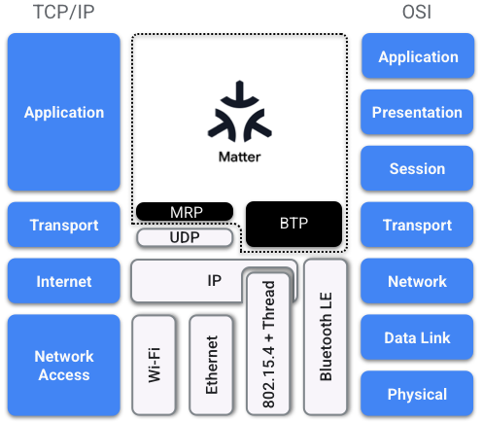
Matter
Pre-2022 smart home landscape: fragmented, insecure, proprietary
Isolated, incompatible ecosystems (Amazon, Google, Apple, Samsung)
Manufacturers separate device variants per ecosystem
No mandatory security baseline
Cloud-dependent operation – no local control without internet connectivity
Matter (2022): a unified standard
Open, royalty-free specification Connectivity Standards Alliance (CSA)
Matter Protocol Stack[2]
Application-layer protocol
IPv6 over TCP/UDP (primary UDP)
Wi-Fi · Thread (IEEE 802.15.4) · Ethernet
Bluetooth LE (commissioning only)
Native cross-platform operation — single device variant, single SDK
Mandatory certificate-based authentication and end-to-end encryption
Standardized – vendors can contribute to development
Predicted ~473 million devices in 2026, >50% by 2027 [1]
[1] ABI Research, 38 Technology Stats to Know for 2022
[2] Google Home Developers
Notes:
[1] https://www.visualcapitalist.com/wp-content/uploads/2022/03/ABI_Research_38_Technology_Stats_You_Need_to_Know_for_2022.pdf
[2] https://developers.home.google.com/matter/primer
(CSA 350+ member companies, 3,856+ certified devices)
UDP + BTP – BDX Transfer Protocol? Bulk data transfer between Matter devices firmware/software images or other bulk data
TCP + MRP – Message Reliability Protocol Provides reliability for Matter messages over UDP Communication, where the underlying transport (UDP) does not itself guarantee delivery
Matter 1.5 formally adds TCP support
Matter 1.5 introduces optional TCP transport for operational messaging:
“Matter 1.5 adds TCP support to the standard, but it remains to be seen how this will be implemented in practice.”
As of 2026, most ecosystems (Apple, Google, Amazon, SmartThings, HA) still use UDP for operational traffic.

Slide 3
Problems with Matter

Slide 4
Research Questions
RQ1: Do Matter-enabled devices offer improved security and privacy compared to similar non-Matter devices?
(Local protocol, encryption, Attestation, Service Discovery, Internet dependency)
RQ2: Do ecosystem-specific interpretations of the Matter standard introduce measurable vulnerabilities in device behavior?
(mDNS advertising, Rotating Device ID, Software Updates,Local Comms, Inferred Version)
RQ3: What are the implications of supporting both the Matter protocol and vendor-specific legacy protocols on IoT devices?
(security models, cloud connections, jurisdiction)
RQ4: How resilient are Matter devices to realistic adversarial actions, such as unauthorized connection attempts and traffic based inference?
(Operational inference, packet reply, commissioning)

Slide 5
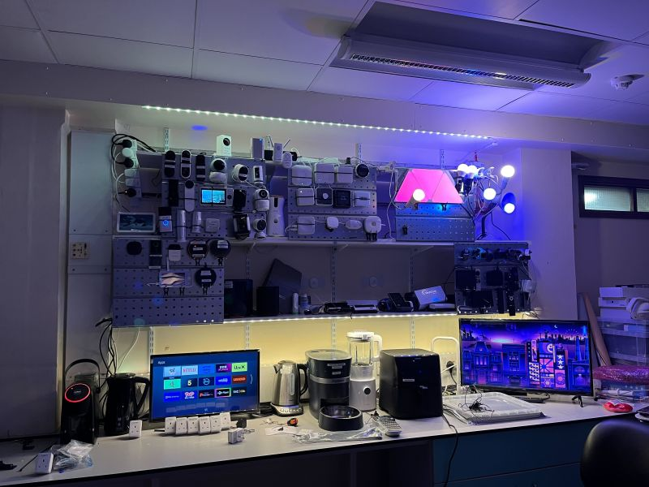
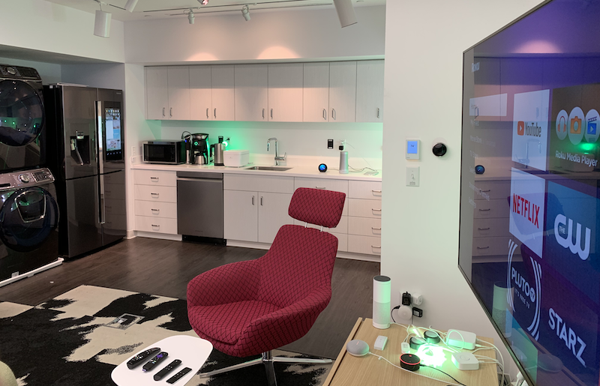
Testbeds
University College London
Northeastern University
25 Matter
Devices
Bulbs
LED-strips
Smart-plugs
Bridges
14 Legacy non-Matter devices
Bulbs
LED-strips
Smart-plugs
4 Matter Controllers
Apple
Google
Amazon
Aerotec
Smartphones
BluetoothLE commissioning
Apple
Android

Slide 6
Methodology RQ1
Factory-reset all 25 Matter + 14 legacy devices before testing.
Captured BLE commissioning traffic using a Nordic nRF Sniffer.
Commissioned Matter devices using QR codes or 11-digit PINs across Apple, Google, Amazon, and Aeotec ecosystems.
Commissioned legacy devices using manufacturer applications.
Captured Wi-Fi traffic during boot, idle, and active interaction - isolated networks.
Analyzed traffic in Wireshark, examining unicast, multicast service discovery, and IPv6 addressing.
Notes:
UDP + BTP – BDX Transfer Protocol? Bulk data transfer between Matter devices firmware/software images or other bulk data
TCP + MRP – Message Reliability Protocol Provides reliability for Matter messages over UDP Communication, where the underlying transport (UDP) does not itself guarantee delivery
Matter 1.5 formally adds TCP support
Matter 1.5 introduces optional TCP transport for operational messaging:
“Matter 1.5 adds TCP support to the standard, but it remains to be seen how this will be implemented in practice.”
As of 2026, most ecosystems (Apple, Google, Amazon, SmartThings, HA) still use UDP for operational traffic.

Slide 7
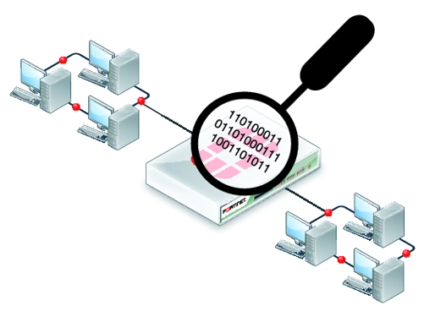
RQ1 Does Matter offer improved security
Aspect
Non-Matter Devices
Matter Devices
✓ Encrypted communication (all tested devices)
Local Protocol
Varies - often proprietary
Matter port 5540 UDP/TCP
Encryption
Varies - often absent
AES-128-CCM (mandatory)
AES-256-CCM (optional)
✓ No plaintext operational commands observed
Service Discovery
Various local protocols
UDP port 5353 (mDNS)
Attestation
Proprietary (if present)
X.509v3 Certificate (DAC)
Internet Dependency
Often required - operation & control
Not required - local-first design
✓ Device authentication via DAC (X.509v3) certificate
✗ Poor Logging verbosity and device visibility

Slide 8
Methodology RQ2
Re-analysed captures alongside a longitudinal dataset (June 2024–Nov 2025).
Examined mDNS advertisements for persistent service disclosure and RDI rotation.
Identified Matter versions using ClusterRevision and mDNS VID/PID fields.
Measured firmware update behavior, including version changes and update frequency.
Tested local-first operation after network isolation at reboot, 1 h, and 18 h.

Slide 9

RQ2 mDNS Advertisement vulnerability
✗ Persistent mDNS Advertisements Enable Device Fingerprinting
✗ Specification does not tightly define VID/PID advertisements
✗ mDNS advertisement intervals are implementation dependent
Tapo plug - mDNS post commissioning advertising
Vendor ID: 5010
Manufacturer, Model, SW version, Certificate ID
Product ID: 264
DCL Lookup
webui.dcl.csa-iot.org
Device Type: 266 Smart-plug
Device Name: Smart Wi-Fi Plug
Notes:
Manufacturer
Device fingerprinting — identifies the vendor, enabling targeted research into that vendor's known vulnerabilities, default configurations, and firmware quirks
Supply chain inference — some manufacturers OEM from common chipset vendors (Espressif, Nordic, Silicon Labs), so the real attack surface may be broader than the brand suggests
Model
CVE lookup — a specific model can be cross-referenced against public vulnerability databases immediately
Software Version
Precise vulnerability matching — narrows CVEs to confirmed-affected versions; removes guesswork
Patch gap identification — if the device is behind the current release, the adversary knows exactly which patched vulnerabilities are still exploitable

Slide 10
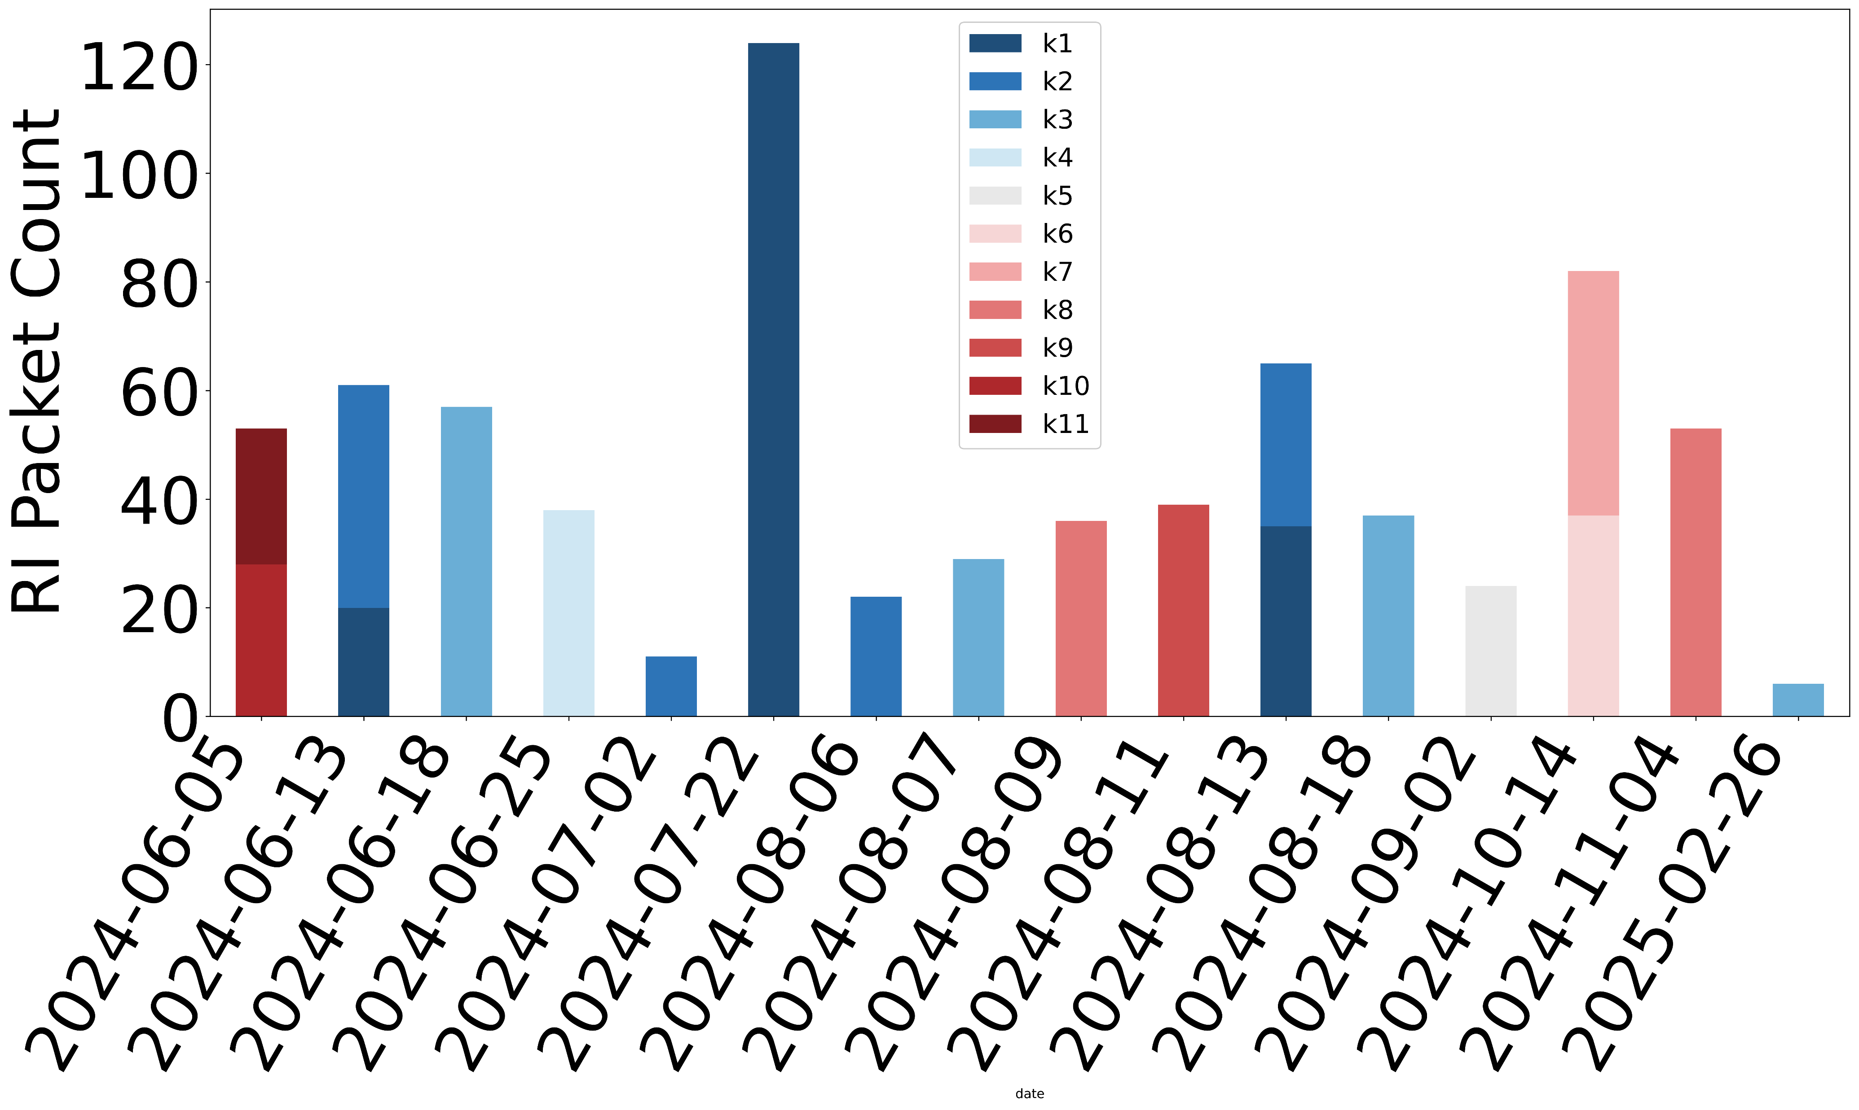
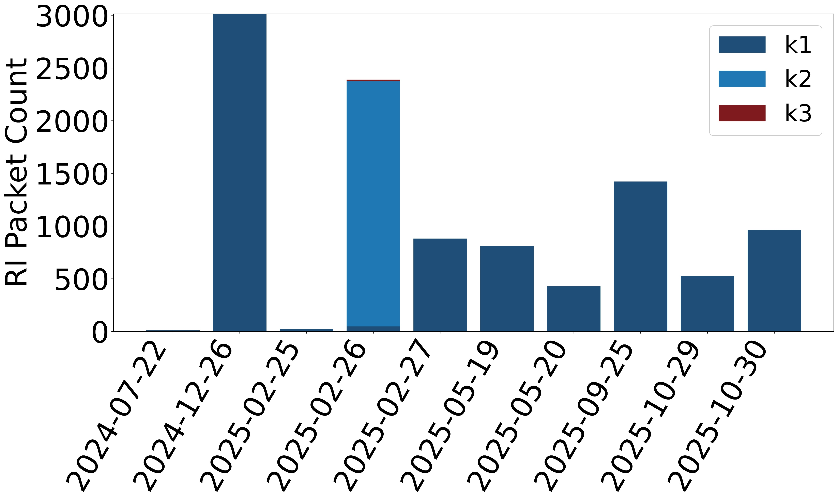
RQ2 Rotating Device Identifier - introduction of measurable vulnerabilities
✗ Inconsistent RDI rotation undermines privacy - enables device fingerprinting
✗ RDI exhibits extended lifespan
✗ RDI behavior varies across vendors
Linkind Matter Plug: 11 rotations over 266 days
Optional security mechanism to prevent long-term cross-network tracking (36‑hex‑digit string).
Key rotation based on advertising-session counter
(Rotating Device ID - Longitudinal study: June 2024-Nov 2025)
(b) Cync Matter Plug: 3 rotations, single key for 263 days

Slide 11

RQ2 Matter software version determination - “ClusterRevision” in network traffic
✗ Matter Versions indistinguishable
ClusterRevision values duplicated - Network traffic cannot distinguish.
✗ Mixed-version implementations
A device may report an older ClusterRevision while supporting newer attributes for backward compatibility.
Ver.
Date
Key Changes
New Device Types
1.0
Sep 22
Initial launch
Lights, Switches, Plugs, Locks
1.1
May 23
Battery devices + fixes
—
1.2
Oct 23
New device types
Fans, Vacuums, Detectors
Matter Basic Information Cluster’s ClusterRevision indicates the Matter specification version from captured traffic.
ClusterRevision = 1 ⇨ Matter 1.0
ClusterRevision = 2 ⇨ Matter 1.1,1.2
1.3
Apr 24
Energy + scenes grouping
EV Chargers, Appliances
1.4
Nov 24
Energy management expansion
Routers, Solar, Heat Pumps
1.4.1
May 25
Setup + NFC tag support
—
1.4.2
Aug 25
Security + Wi-Fi commissioning
—
1.5
Nov 25
New device types
Cameras, Closures, Soil Sensors
1.6
Jun 26
NFC commissioning, Multi-Admin
—
Notes:
Matter specification Basic Information ClusterRevision
Matter 1.0 1
Matter 1.1 2
Matter 1.2 2
Matter 1.3 3
Matter 1.4 5
Matter 1.5 5
Current development/master 6

Slide 12
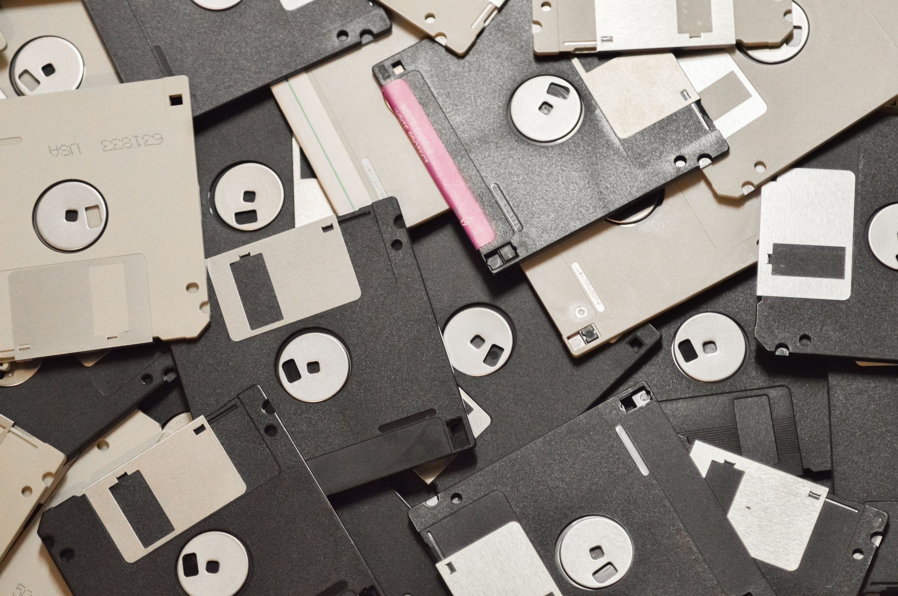
RQ2 Matter version Status
✗ Infrequent SW updates, few devices running latest SW.
18 Matter devices only 3 updated. (Consciot, Orein, Tapo)
6 Matter bridges only 3 updated
(device complexity, dual-protocol support, need for security patches,
42%
Devices running
1.0 firmware
(Sep 22)
11%
Devices running
1.4 firmware
(Nov 24)
16%
Devices Upgraded since launch
50%
Bridges Upgraded since launch

Slide 13
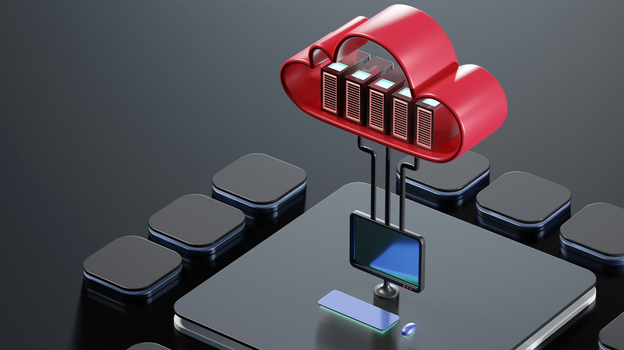
RQ2 Local-First Communications in practice
✓ Validation of Local-First Design
Most devices remained fully functional during offline operation, with no cloud dependency required for core control.
✗ Boot delays - cloud-first firmware
Device
Controllable offline
Post-reboot
After 1 hr
After 18 hrs
Sengled bulb
✓ Yes
✓ Yes (1/2)
✓ Yes (1/2)
✓ Yes
✗ Some vendors treat local operation as fallback, not primary mode
Tapo plug
✓ Yes
✓ Yes (1/2)
✓ Yes (1/2)
✓ Yes
Meross plug
✓ Yes
✓ Yes (1/2)
✓ Yes (1/2)
✓ Yes
✗ Boot delays add latency before local control becomes available
Linkind plug
✓ 2s delay
✓ 2s delay
✓ 2s delay
✓ 2s delay
Cync plug
✓ Yes
✓ 30s delay
✓ Yes
✓ Yes
✗ Inconsistent operation suggests some internet dependence
Aqara Bridge
Some features
✓ Yes
Some features
Some features
All other devices/bridges
✓ Yes
✓ Yes
✓ Yes
✓ Yes
Yes(1/2) = control succeeded in 1 of 2 post-reboot / timeout conditions

Slide 14
Methodology RQ3
Selected seven dual-stack devices — smart plugs, bulbs, and LED strips — supporting Matter and vendor-specific legacy protocols.
Captured network traffic during device operation on isolated test networks.
Analyzed destination domains and second-level domains (SLDs) to identify non-Matter cloud endpoints.
Identified persistent connections to cloud infrastructure operating outside the Matter trust model.
Assessed identified endpoints for parallel backend infrastructure, potential traffic-interception vectors, and data-jurisdiction implications.
Notes:
UDP + BTP – BDX Transfer Protocol? Bulk data transfer between Matter devices firmware/software images or other bulk data
TCP + MRP – Message Reliability Protocol Provides reliability for Matter messages over UDP Communication, where the underlying transport (UDP) does not itself guarantee delivery
Matter 1.5 formally adds TCP support
Matter 1.5 introduces optional TCP transport for operational messaging:
“Matter 1.5 adds TCP support to the standard, but it remains to be seen how this will be implemented in practice.”
As of 2026, most ecosystems (Apple, Google, Amazon, SmartThings, HA) still use UDP for operational traffic.

Slide 15
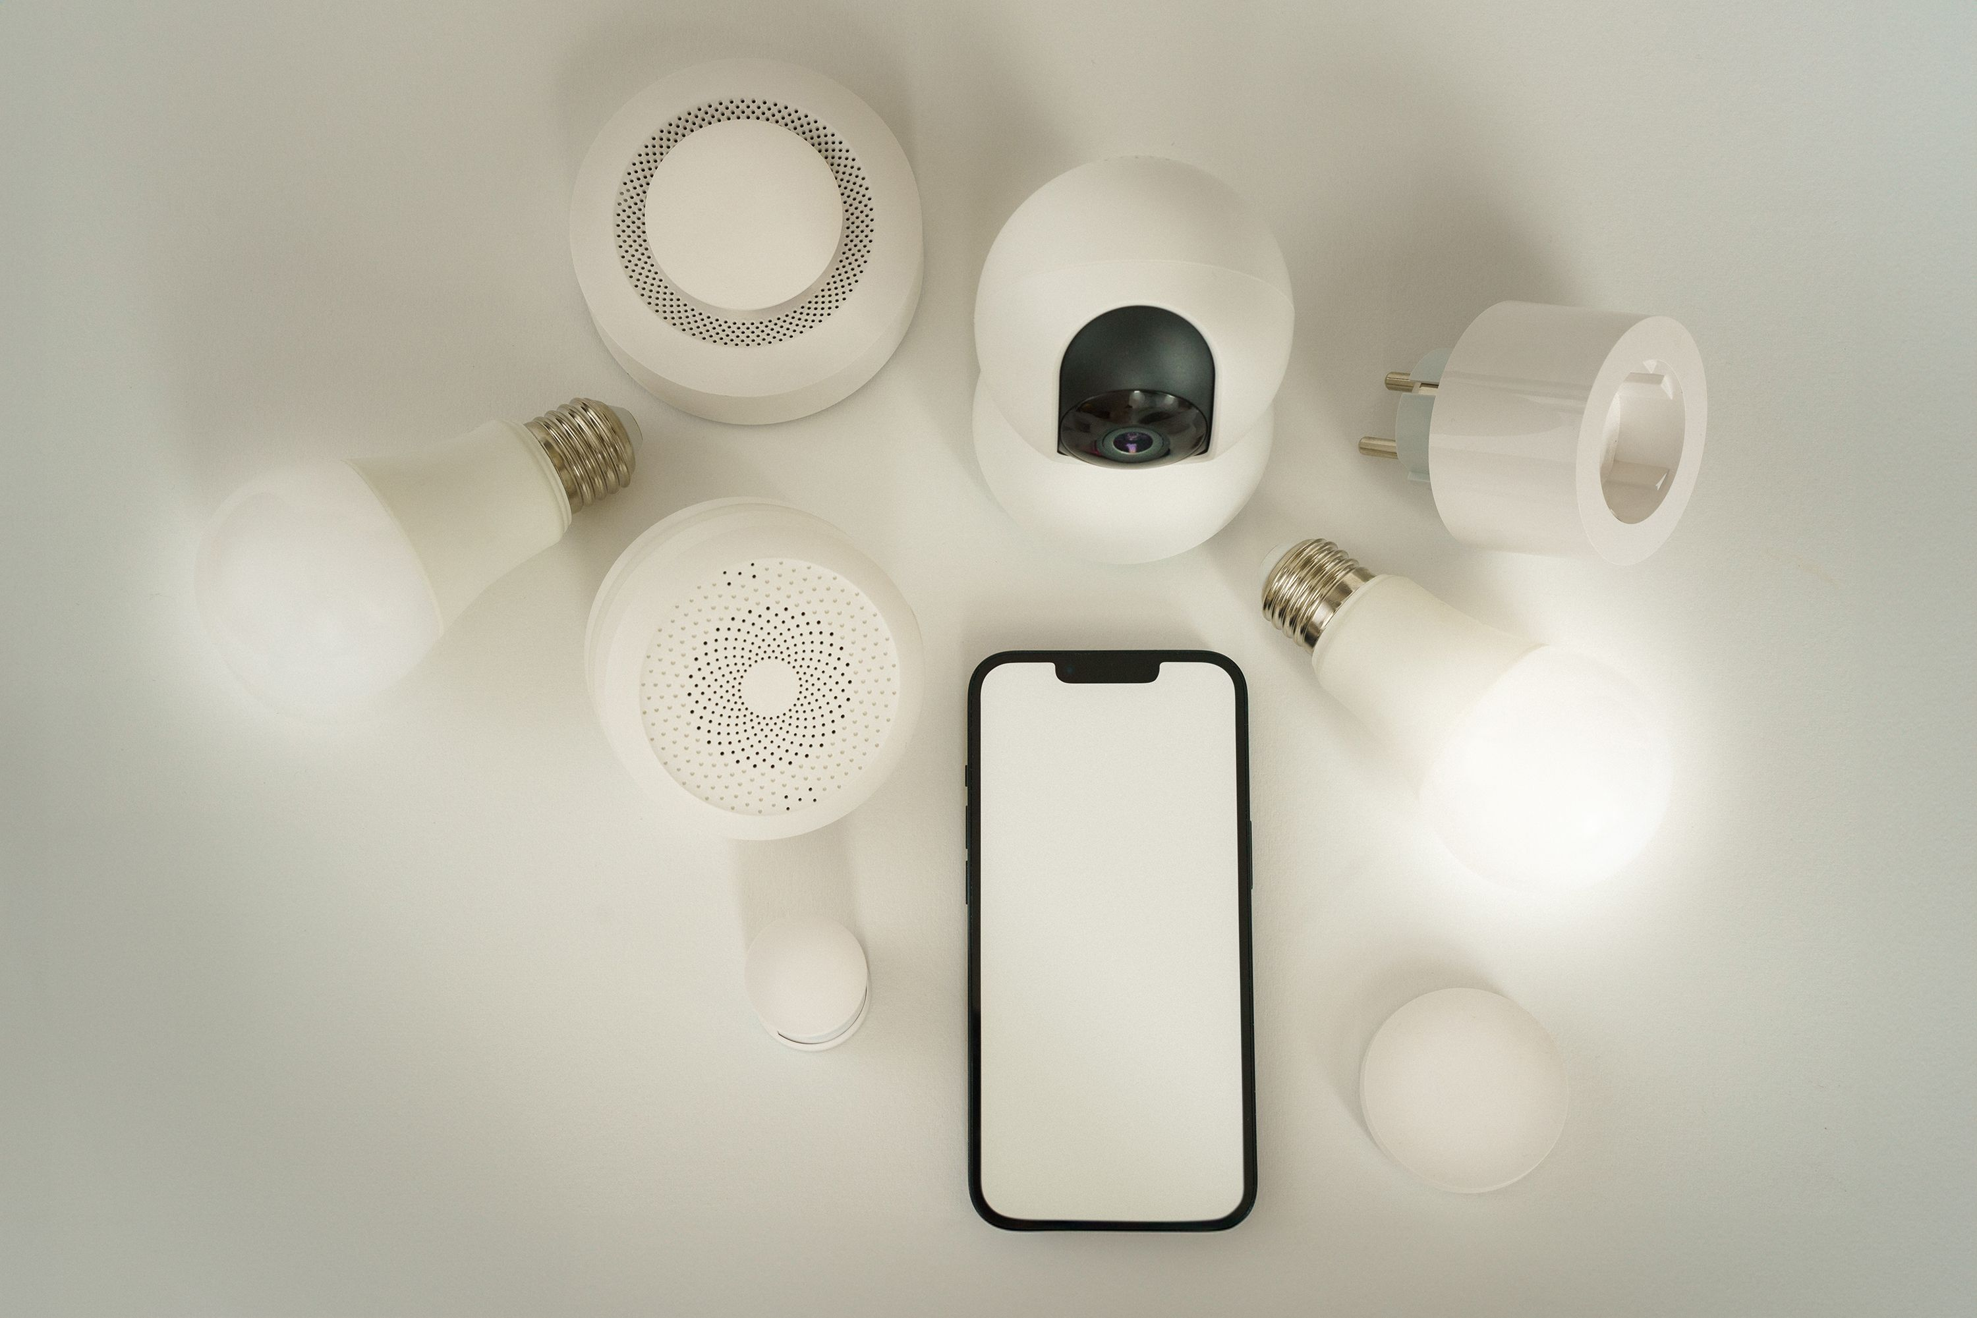
RQ3 Matter/non-Matter dual stack operation
✗ Persistent cloud connections outside Matter trust model
Parallel backend infrastructure.
✗ Non-Matter devices: cloud man-in-the-middle exposure.
Device
SLDs (Non-Matter)
SLDs (Matter)
TP-Link Bulb
tplinkcloud.com
tplinkra.com
tplinknbu.com
.
Non-Matter control path: App → Vendor Cloud → Device; cloud services can access device state and user activity
Sengled Bulb
sengled.com
amazon.com
amazonaws.com
TP-Link Plug
tplinkcloud.com
tplinkra.com
tplinknbu.com
✗ Dual-cloud routing - expands trust domains / attack surface (e.g., Govee).
Meross Plug
meross.com
meross.com
Tapo Plug
tplinkcloud.com
tplinknbu.com
✗ Cloud Dependance / Availability
Tuya Plug
tuyaus.com
N/A
✗ Jurisdiction - where user data is processed.
Govee Strip
amazonaws.com
govee.com
govee.com
Internet communication destinations (SLDs only)

Slide 16
Methodology RQ4
Captured encrypted Matter traffic over UDP port 5540 during controlled device interactions.
Analyzed traffic patterns to assess inference of device type, vendor identity, and device state (on/off/dim/hue).
Evaluated replay-attack resilience using tcpreplay and Scapy against captured control packets.
Tested unauthorized pairing across three defence layers: physical commissioning-window access, device credentials (QR code/PIN), and network credential requirements.
Notes:
UDP + BTP – BDX Transfer Protocol? Bulk data transfer between Matter devices firmware/software images or other bulk data
TCP + MRP – Message Reliability Protocol Provides reliability for Matter messages over UDP Communication, where the underlying transport (UDP) does not itself guarantee delivery
Matter 1.5 formally adds TCP support
Matter 1.5 introduces optional TCP transport for operational messaging:
“Matter 1.5 adds TCP support to the standard, but it remains to be seen how this will be implemented in practice.”
As of 2026, most ecosystems (Apple, Google, Amazon, SmartThings, HA) still use UDP for operational traffic.

Slide 17
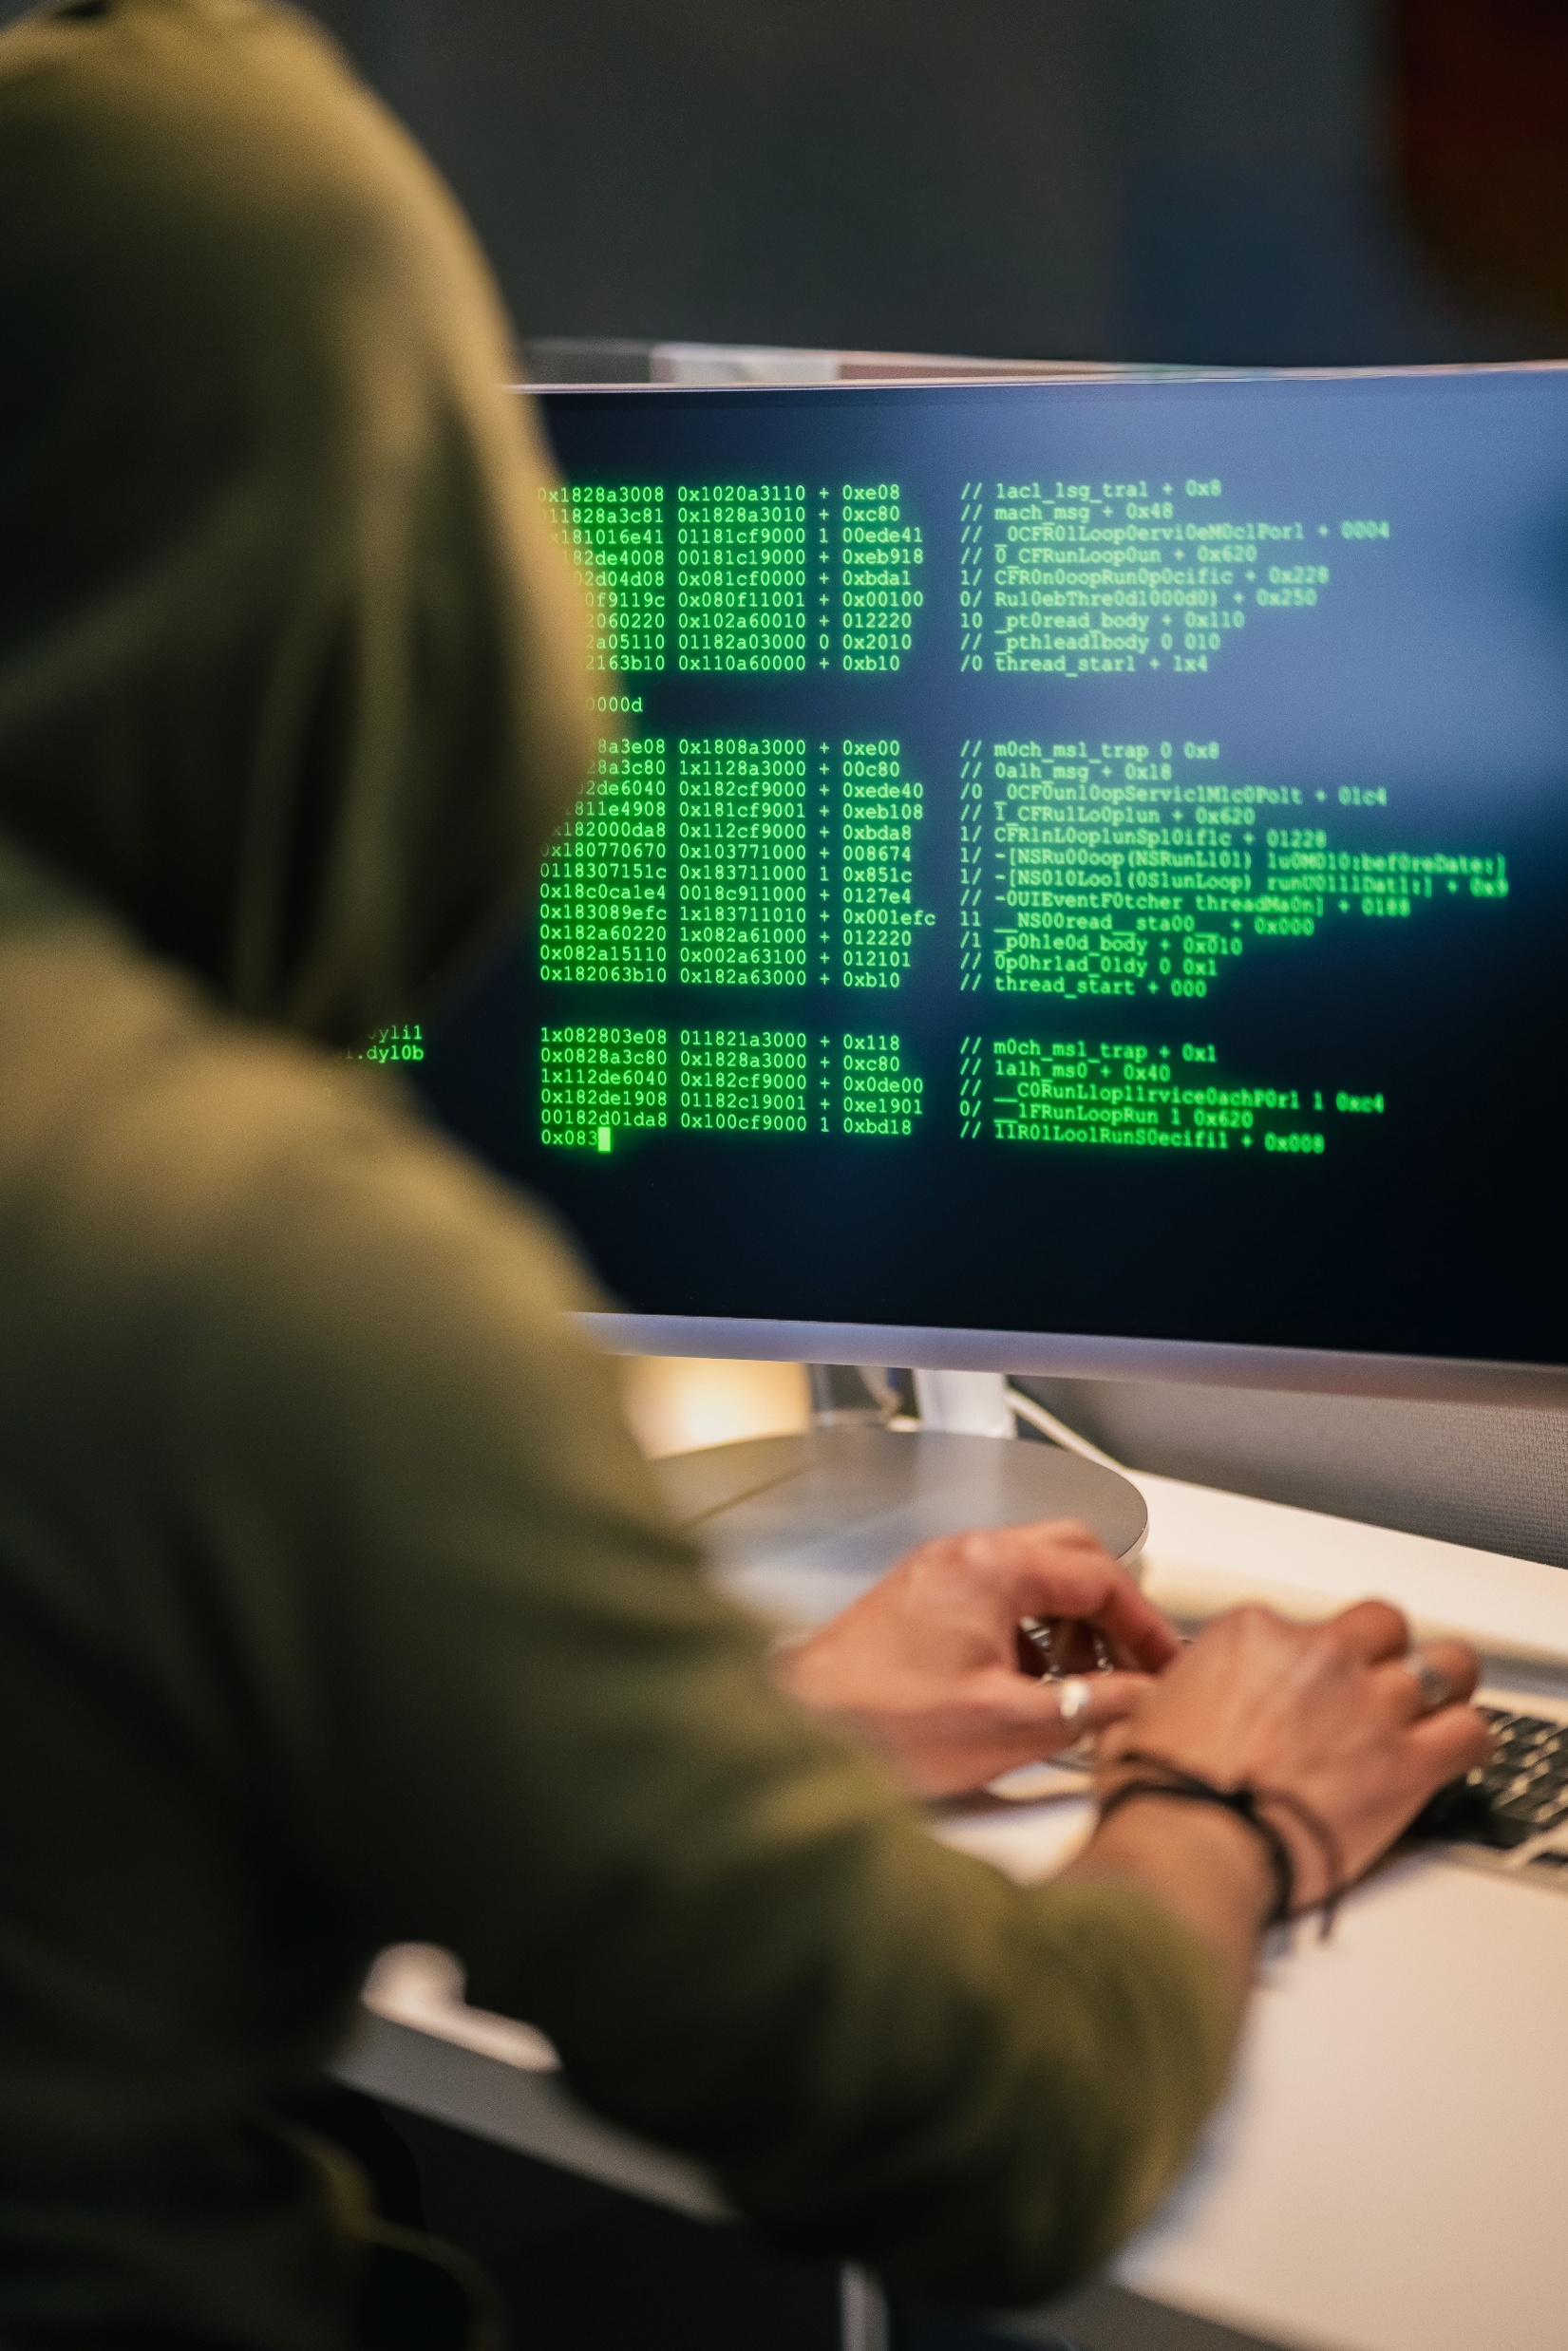
RQ4 Susceptibility of Matter traffic to inference analysis of Encrypted traffic
✗ Matter is susceptible to inference analysis
Traffic-pattern inference: Vendor-specific packet sizes / sequences - inference without decryption.
User activity inference: Timing patterns can reveal device state changes and user activity.
Method also successful for on-off, dim and color change actions.
Example — Off event packet sequence
On/Off events exhibit a consistent sequence of packet sizes, with X and Y being vendor-specific variations:
~94%
Distinguish Bulbs Vs Plugs
52.6%
Distinguish based on MAC OUI
121
129
X
96
104
96
Y
bytes per packet · X, Y = vendor-specific
Encrypted traffic exhibits sufficient operational uniformity to reveal detailed device behavior to an adversary.

Slide 18

RQ4 Susceptibility of Matter traffic to adversarial - Replay Attack
✓ Replay attempts failed across all evaluated Matter devices; no messages were accepted or unintended actions triggered.
An in-network adversary retransmits valid messages to trigger unintended device actions
Matter protection mechanisms
Per-session message counters
Counter values are cryptographically bound to the session key
Replay attack (Scapy): Captured Matter messages were retransmitted to test the protocol's replay protection.
Notes:
N. Shafqat and A. Ranganathan. 2024. Seamlessly Insecure: Uncovering
Outsider Access Risks in AiDot-Controlled Matter Devices. In IEEE
Security and PrivacyWorkshops (SPW), SafeThings. IEEE, San Francisco,
CA
Linkind bulb, Orein bulb, Consciot bulb, Linkind plug , USA.

Slide 19

RQ4 Susceptibility of Matter traffic to adversarial - Unauthorized Pairing Attacks
✓ Testing verified commissioning requires an active window and user interaction (e.g., physical access or setup code
An attacker attempts to commission a Matter device without authorization from the legitimate owner.
✗ AiDot-compatible devices permit unauthorized commissioning
Four devices vulnerable to unauthorized pairing via the AiDot APP after Matter commissioning, This is consistent with prior work *.
Matter's protection mechanism
Physical access Out-of-band action
Device credentials Setup (QR/number)
Commissioning window 15 minutes (Default)
Extended Commissioning 48 Hours (Pid/VID)
N. Shafqat and A. Ranganathan. 2024. Seamlessly Insecure:
Uncovering Outsider Access Risks in AiDot-Controlled Matter Devices.
Notes:
N. Shafqat and A. Ranganathan. 2024. Seamlessly Insecure: Uncovering
Outsider Access Risks in AiDot-Controlled Matter Devices. In IEEE
Security and PrivacyWorkshops (SPW), SafeThings. IEEE, San Francisco,
CA
Linkind bulb, Orein bulb, Consciot bulb, Linkind plug , USA.

Slide 20
Conclusions & Key Findings
Key Findings
Matter raises the IoT security baseline through enforced encryption and authentication — but some security and privacy properties remain heavily vendor-dependent
Real-world deployments show inconsistent specification adherence and measurable privacy exposure via mDNS.
For Manufacturers
Limit mDNS advertisements to discovery-required fields only; implement RDI rotation with short lifespans
Dual-stack devices must not allow non-Matter functionality to undermine Matter security guarantees
Provide timely Matter specification-version updates with clearly communicated support periods
Give users control over privacy-sensitive discovery broadcasts
For Standardization & Regulatory Bodies
Revise mDNS scoping and RDI rotation requirements in the Matter Specification
Mandate Specification-version currency as a condition of certification renewal

Slide 21

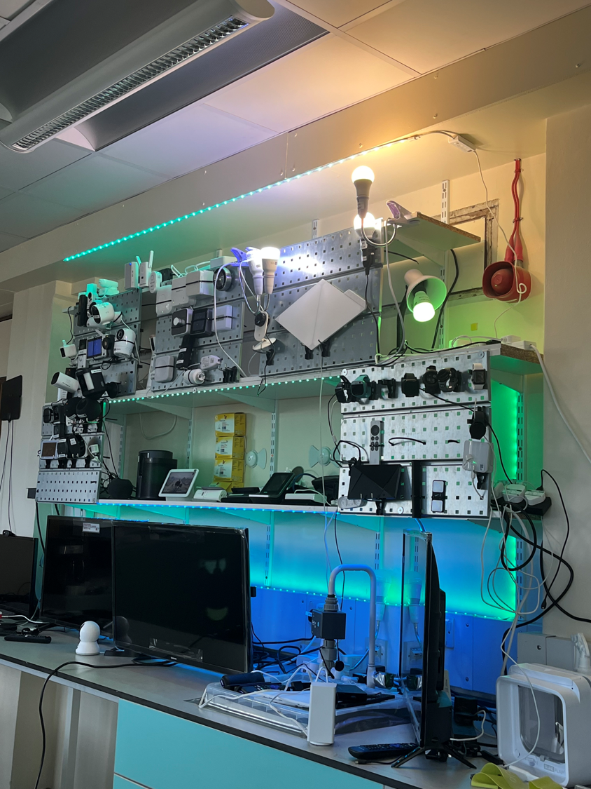
Beyond the Hype: Empirical Analysis of Matter Standard’s Security and Privacy
ACM ISBN 979-8-4007-2327-8/26/10
https://doi.org/10.1145/3777912.3809142
https://conferences.sigcomm.org/imc/2026/
Add here QR code to the website page of the paper and link : https://safenetiot.github.io/research/Mattersecpriv
In the website you are missing the link to github under resources
Conclusion: Our measurements show that Matter meaningfully improves long-standing IoT security weaknesses through enforced encryption and authentication — but practical security and privacy properties remain heavily dependent on vendor implementations. Stronger adherence to the specification and clearer regulatory mandates will be necessary if Matter is to deliver on its stated goals.
Follow us:
https://safenetiot.github.io/

