Slide 1
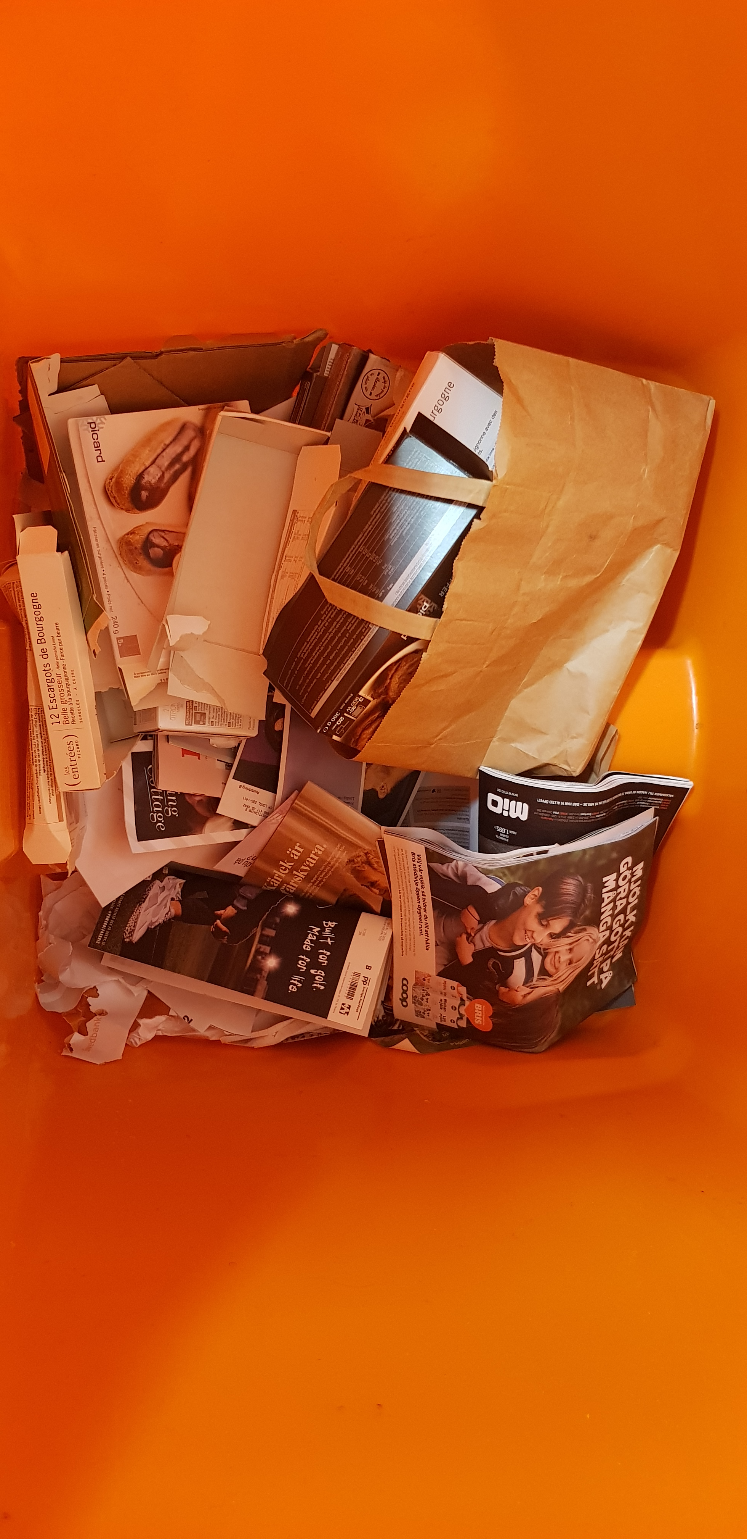
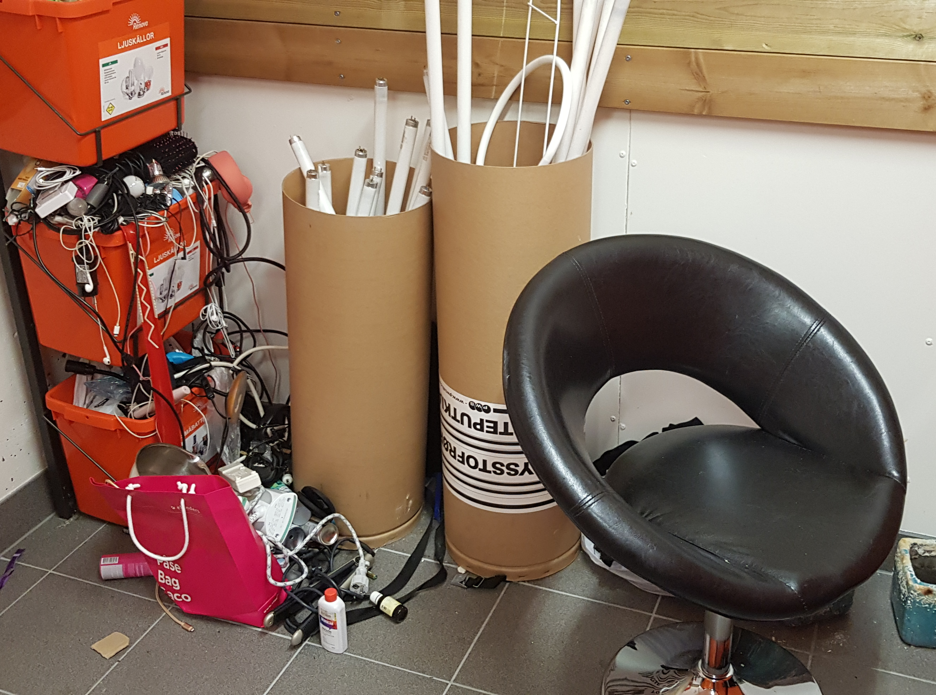
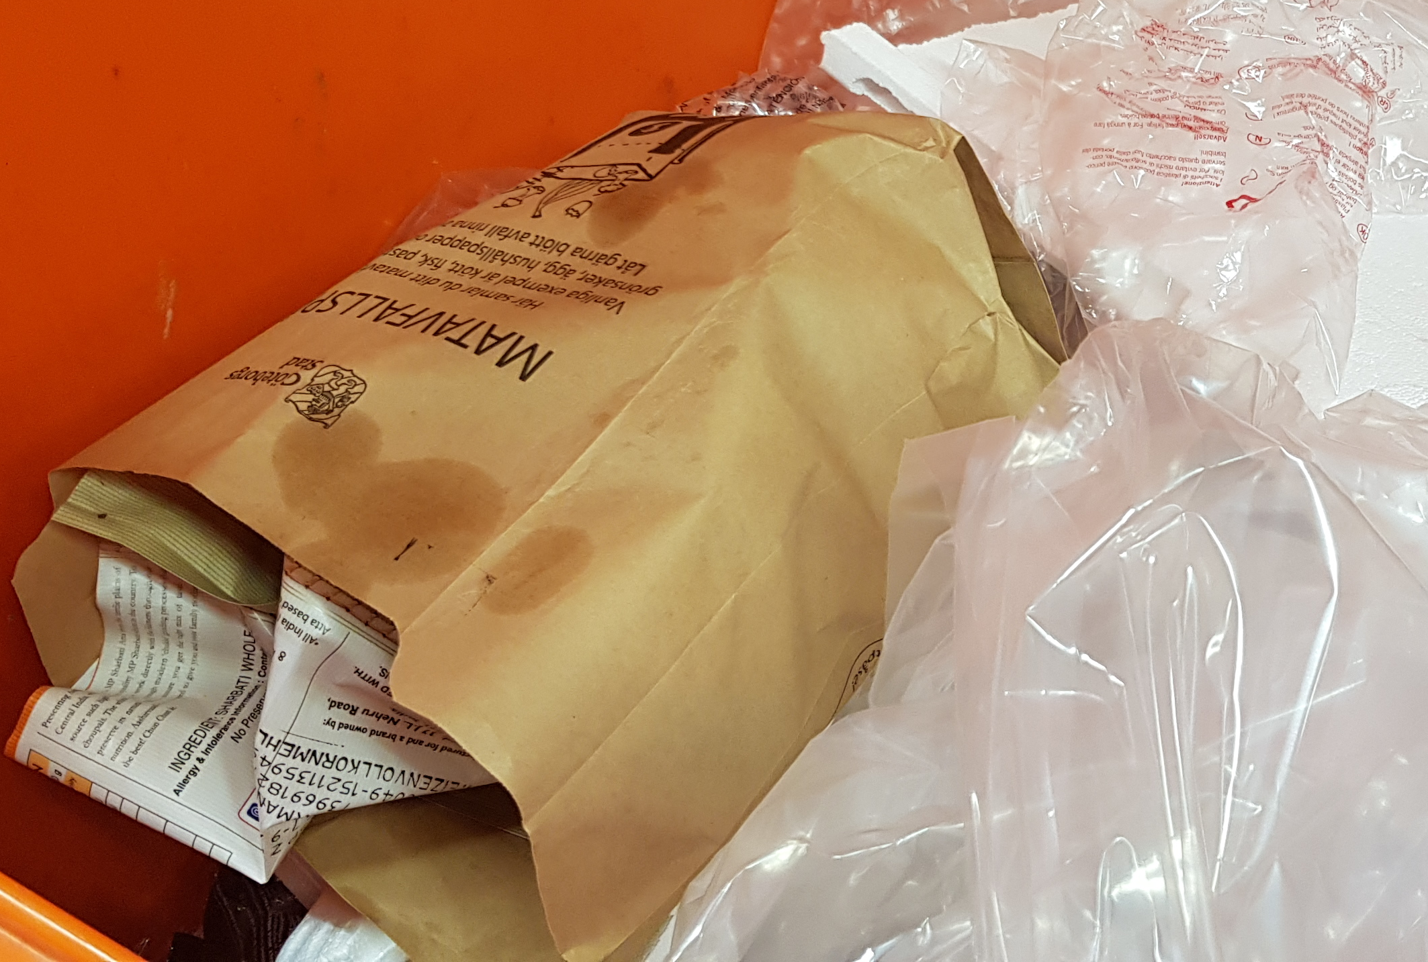
problem
“Light emitters”
“Newspapers”
“Soft plastics”

Slide 2
problem
Confused?
Use our new app!

Slide 3

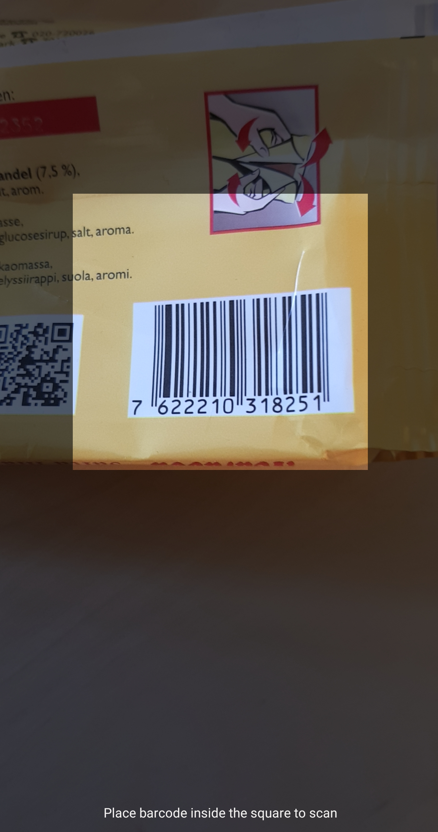
solution – core
Community driven
mobile
app

Slide 4
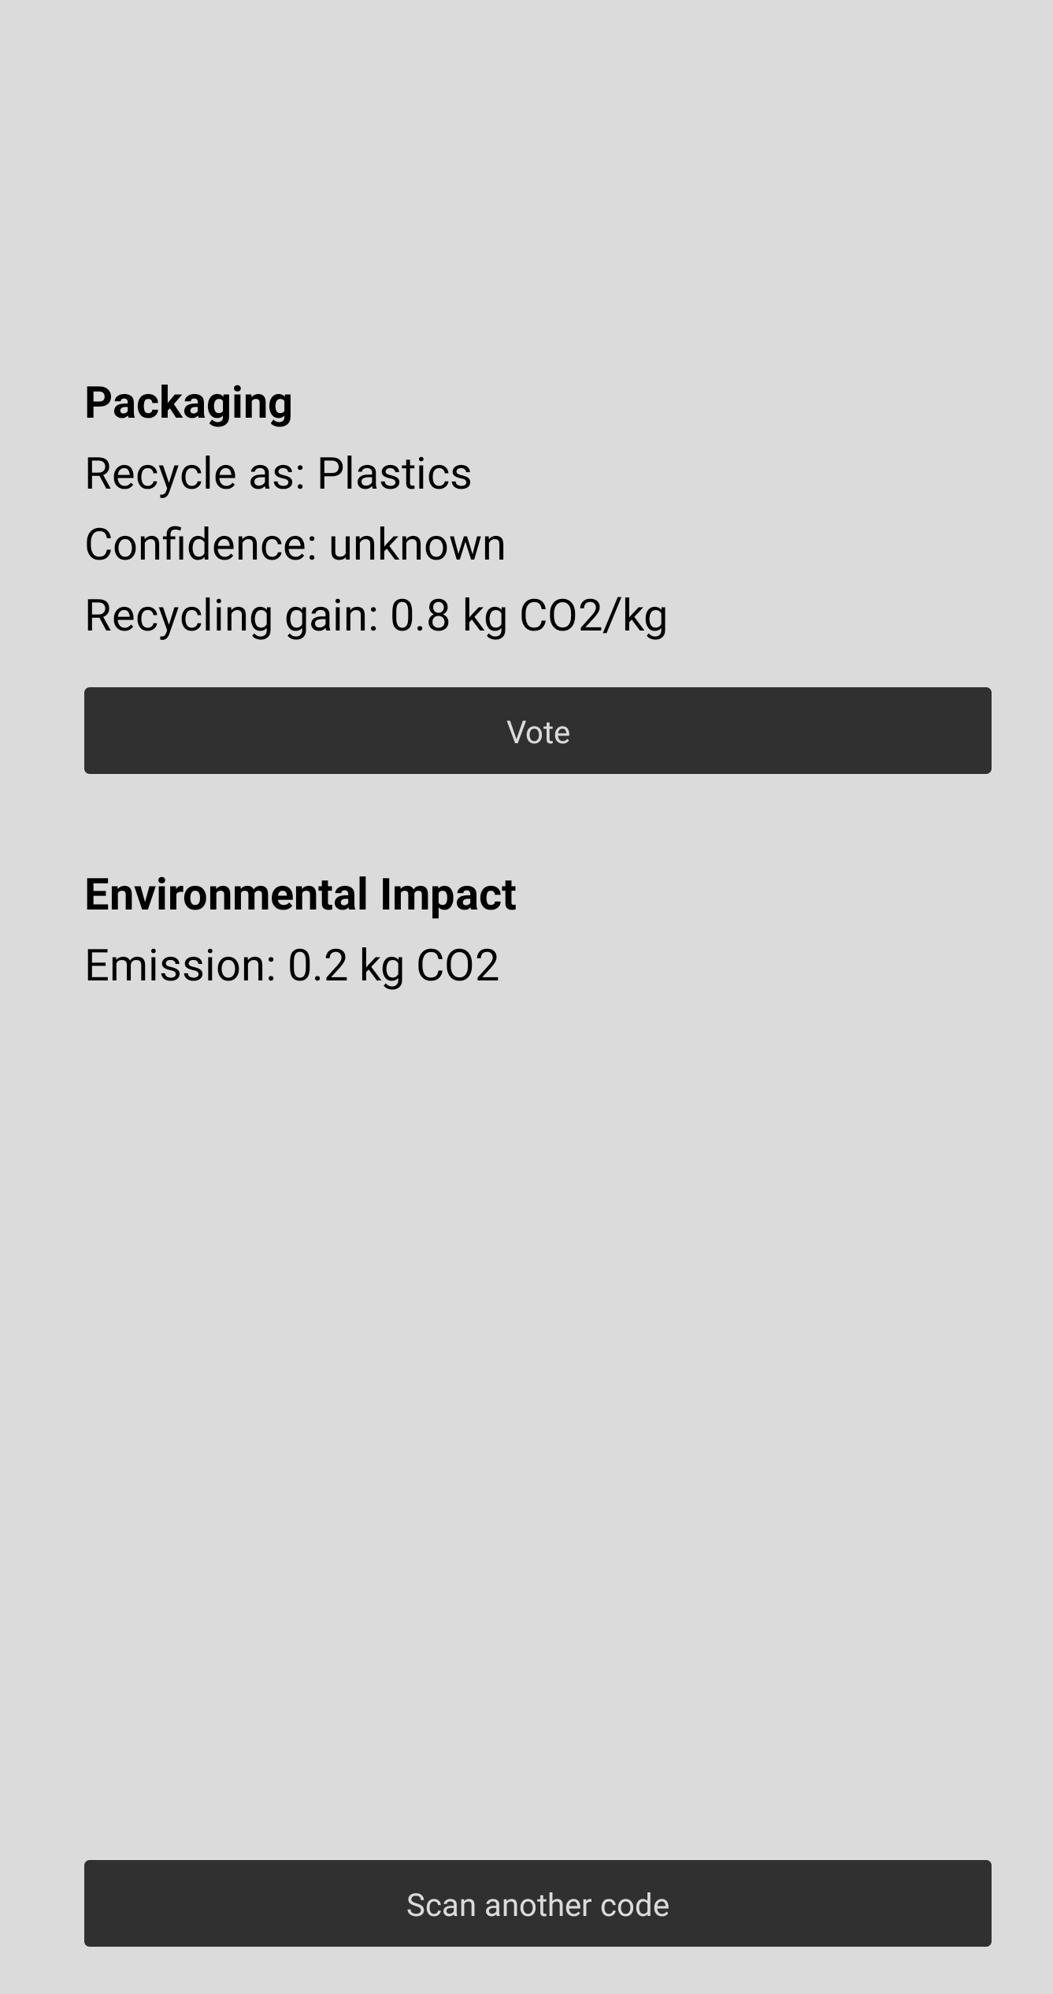
solution – core
Community driven
mobile
app

Slide 5
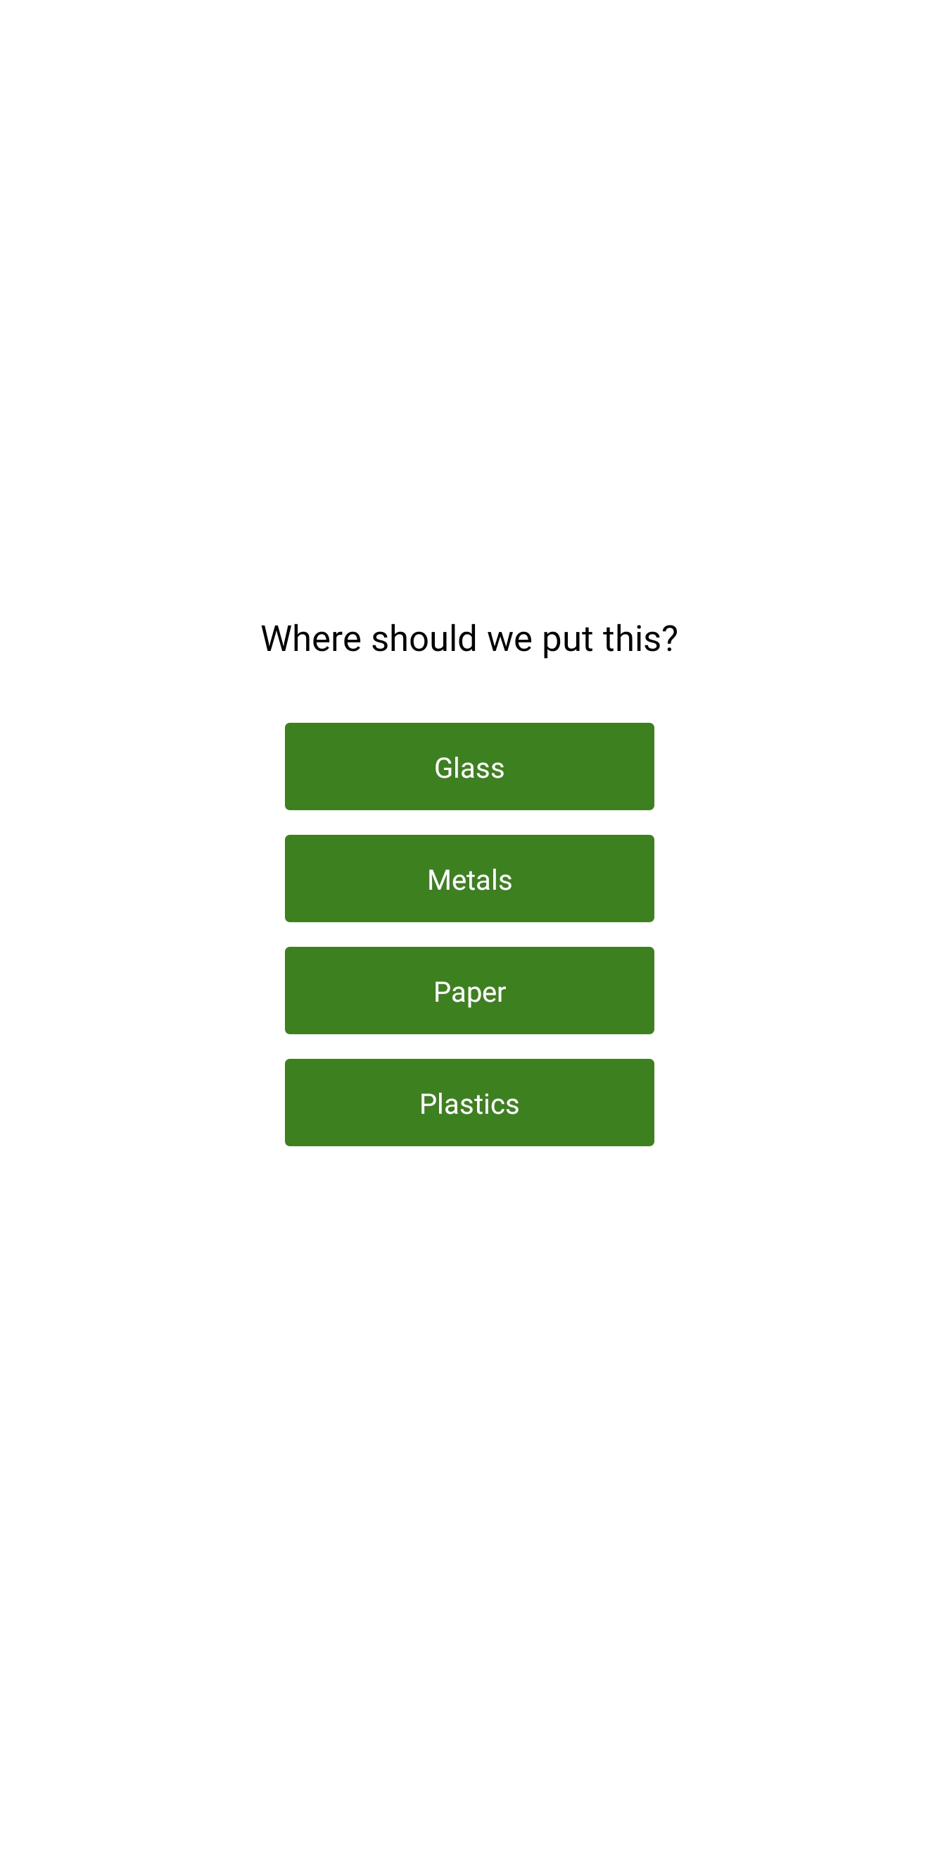
solution – core
Community driven
mobile
app

Slide 6


solution – Ecosystem
Producer Product data
Recycling information
Environmental data
marketplaces
External data
API
Mobile app

Slide 7
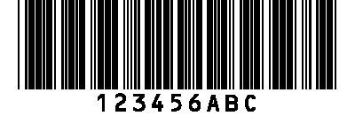
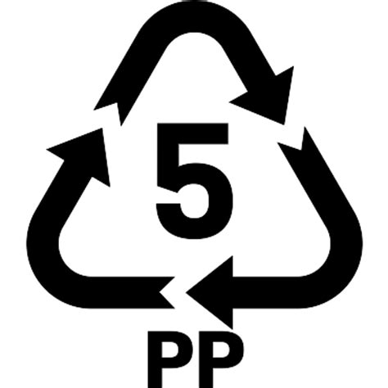
solution – Ecosystem example
API
Mobile app

Slide 8


solution – Ecosystem example
API
Mobile app

Slide 9


solution – Ecosystem example
API
Mobile app

Slide 10
solution – Ecosystem
Producer Product data
Recycling information
Environmental data
marketplaces
External data
Custom API
API
Other countries
Proprietary data
Other Uses (like allergies)
Custom Mobile app
Mobile app

