Slide 1
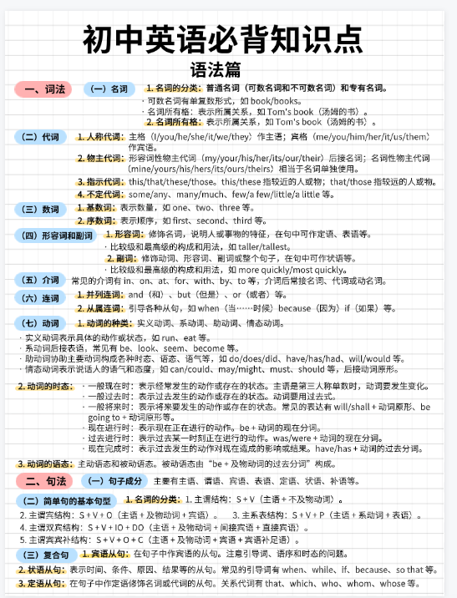
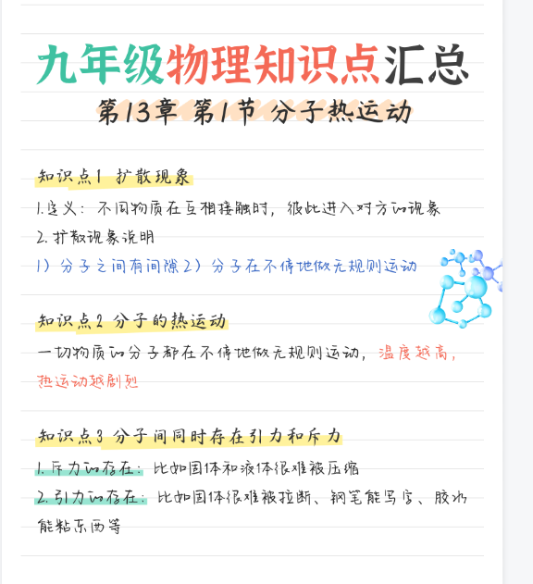
https://www.gaoding.com/editor/design?id=31761106003280027&mode=user
https://www.gaoding.com/editor/design?id=193840121

Slide 2
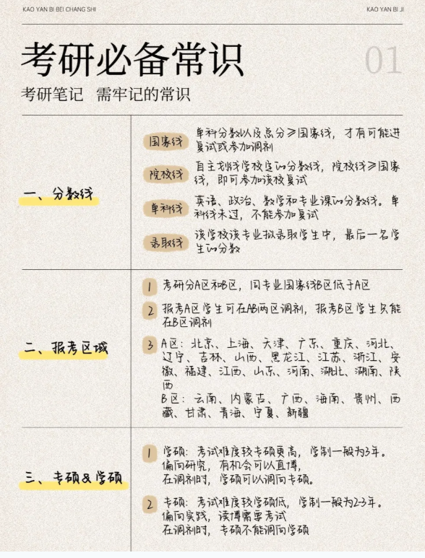
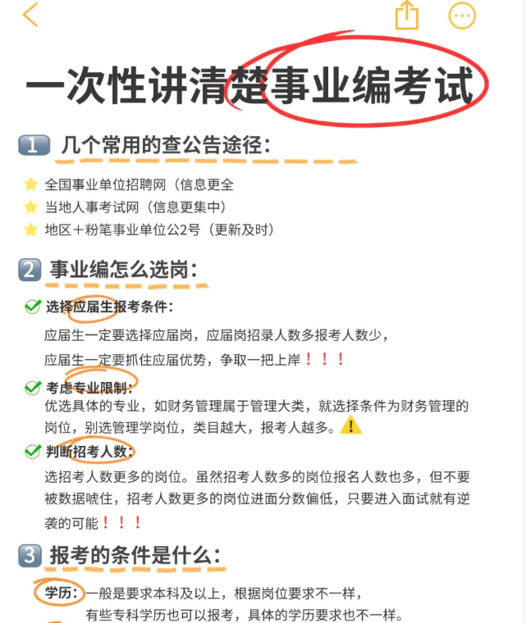
https://www.gaoding.com/template/193786464
https://www.gaoding.com/template/193524000

Slide 3
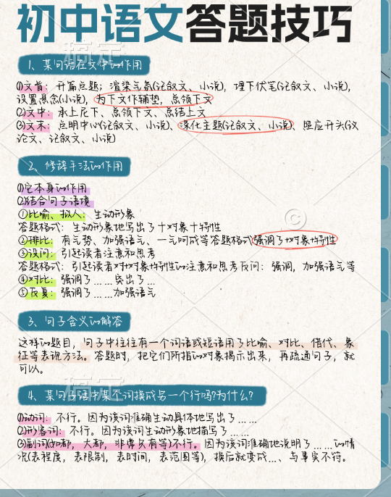

https://www.gaoding.com/editor/design?id=193794291
https://www.gaoding.com/editor/design?id=193649192

Slide 4
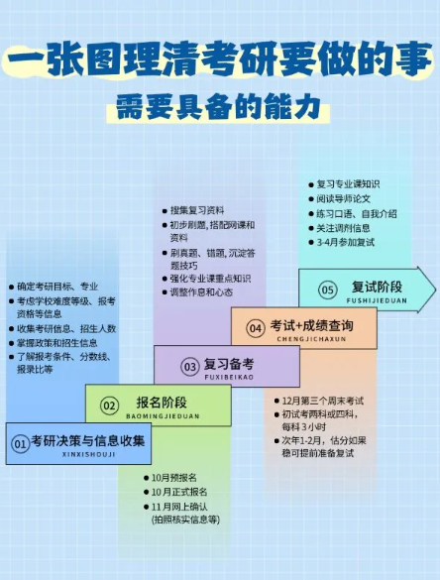
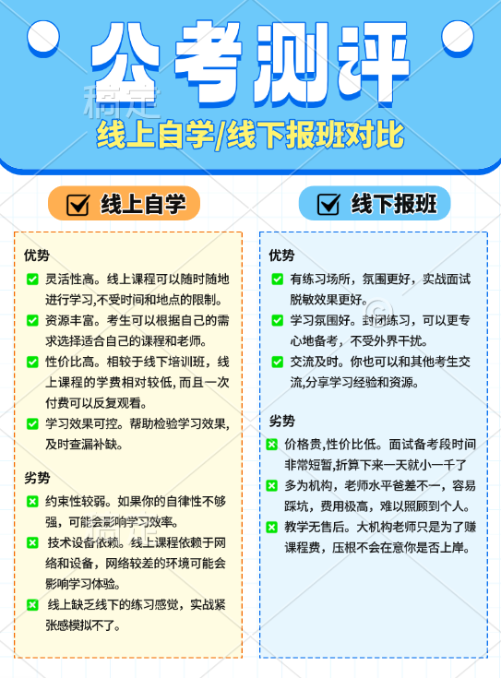
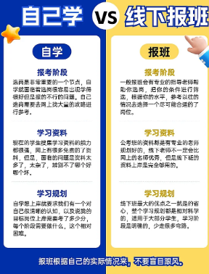
https://www.gaoding.com/editor/design?id=193836598
https://www.gaoding.com/template/193786381
https://www.gaoding.com/editor/design?id=193800707

Slide 5
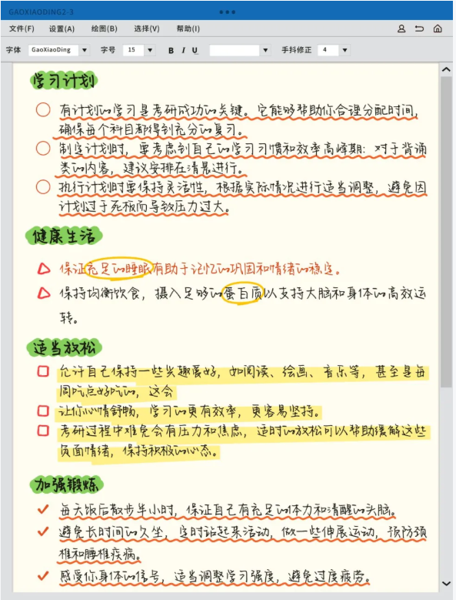

https://www.gaoding.com/template/193661414
https://www.gaoding.com/template/193664550

