Slide 1


PYTHON
Level 1

Slide 2
Lesson 17: string

Slide 3
Character Encoding 1（字符编码）
Character encoding is the process of assigning numbers to characters allowing them to be stored, transmitted, and transformed.
Encoding 编码
Decoding 解码
hello
10100…11011
hello
transmit
Sender
Receiver

Slide 4
Character Encoding 2（字符编码）
Character encoding is the process of assigning numbers to characters allowing them to be stored, transmitted, and transformed.
Encoding 编码
Write
Storage Space
Some Text
10100…11011
Read
Decoding 解码

Slide 5
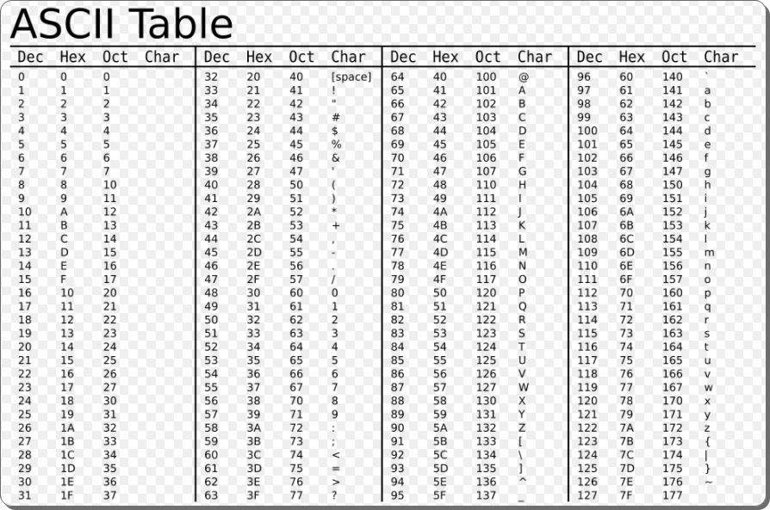
The first major character encoding standard — — ASCII
American Standard Code for Information Interchange (ASCII) is a code for representing English characters as numbers, with each letter assigned a number from 0 to 127. It has both the encoding rule and charset.
Encoding Rule +
Charset
‘A’ - 65
‘a’ - 97
‘0’ - 48

Slide 6
Unicode
Unicode is a standard which defines the internal text coding system in almost all operating systems used in computers at present, whether it is Windows, Unix, Macintosh, Linux or whatever
Unicode can handle characters for almost all modern languages and even some ancient languages at the same time, as long as the client has fonts for the particular language installed in his system.
Strings in python are sequences of unicode characters.
https://home.unicode.org/

Slide 7
UTF-8 Character Encoding
UTF-8 is a variable-length character encoding standard used for electronic communication.
Defined by the Unicode Standard, the name is derived from Unicode (or Universal Coded Character Set) Transformation Format – 8-bit.

Slide 8


UTF-8 Character Encoding
message = 'hello 👋 你好!😊'
print(message)
send_msg = message.encode('utf-8')
print(send_msg)
receive_msg = send_msg.decode('utf-8')
print(receive_msg)
Normal
message = 'hello 👋 你好!😊'
print(message)
send_msg = message.encode('utf-8')
print(send_msg)
receive_msg = send_msg.decode('utf-16')
print(receive_msg)
Garbled

Slide 9
Operations on string - ascii
ord() – function returns the ASCII code of the character.
chr() – function returns character represented by a ASCII number.
ch = 'b'
print(ord(ch))
print(chr(97))
print(chr(ord(ch)-1))

Slide 10
练习
已知 'a' 的 ASCII 码是97，请打印26个小写英文字母
for i in range(26):
print(chr(97 + i))
为什么很多编程语言包括 Python 会区分大小写？ 'a' 和 'A' 的ASCII 码相差多少？
print(ord('a') - ord('A'))

Slide 11
String in Python
A string is a sequence of characters.
"Hello World"
H
e
l
l
o
W
o
r
l
d

Slide 12
String in Python
A string is a sequence of characters.
Index of Character
0
1
2
3
4
5
6
7
8
9
10
-11
-10
-9
-8
-7
-6
-5
-4
-3
-2
-1

Slide 13



Create a String
s1 = "hello world"
print(s1)
s2 = 'hello world'
print(s2)
We can also create a multiline string:
s3 = """hello
world"""
print(s3)
Output:
hello
world

Slide 14
str()

Slide 15
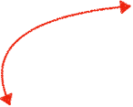




SyntaxError: invalid syntax
Matching
Not Matching
Matching
s1 = "He said, "what's there?""
Not between double quotes
Use \ to correct errors
s1 = "He said, \"what\'s there?\""

Slide 16

Accessing value in a String
s1 = "python string is an sequence"
print("length of this string : ", len(s1))
# gives the third character
print(s1[3])
# gives the second character from end
print(s1[-2])
len(sequence):
Return the length of a sequence.

Slide 17


String Slicing
s1 = "string slicing example"
print(s1[1:3]) # from index 1 to index 2
print(s1[-5:-1]) # from index -5 to index -2
print(s1[:4]) # from the start to index 3
print(s1[8:]) # from index 8 to the end
print(s1[-3:]) # # from index -3 to the end
Syntax: string[start:end:steps]
Output: tr
ampl
stri
licing example
ple
excluded

Slide 18

String Slicing(reversely)
s1 = "string slicing example"
print(s1[3:1:-1]) # from index 3 to index 2
print(s1[-1:-5:-1]) # from index -1 to index -4
print(s1[4::-1]) # from index 4 to start
print(s1[8::-1]) # from index 8 to the start
print(s1[-3::-1]) # # from index -3 to the start
Output: ir
elpm
nirts
ls gnirts
pmaxe gnicils gnirts

Slide 19

String Slicing with Steps
print(s1[1:10:3]) # from index 1 to index 10 with steps 3
print(s1[-5:-1:2]) # from index -5 to index -2 with steps 2
print(s1[:4:2]) # from index 0 to index 3 with steps 2
print(s1[8::2]) # from index 8 to the end with steps 2
print(s1[-5::3]) # # from index -5 to the end with steps 3
Output: tns
ap
sr
lcn xml
al

Slide 20

Reverse a String
string = "hello world"
print(string[::-1])
print(string)
Output: dlrow olleh
hello world
Note that slicing does not change the original string

Slide 21


Python Strings are immutable
In Python, strings are immutable. That means the characters of a string cannot be changed. For example：
message = "hello world"
message[0] = "H"
print(message)
message = "hello world"
message[:5] = "Hello"
TypeError: 'str' object does not support item assignment

Slide 22
Python Strings are immutable
Reassigning a string variable does not modify the original string, but discards it and re-points to a new string value.

Slide 23

Python Strings are immutable
……
❌
"hello world"
message
……
"Hello world"
……
message = "hello world"
print(message)
message = "Hello world"
print(message)
Output: hello world
Hello world

Slide 24


String Concatenation
Python string concatenation means combining or merging two strings. This can be achieved using the “+” operator.
s1 = "Hello"
s2 = "World"
s1 = s1 + s2
print(s1)
s1 = "My age is "
s2 = 22
s1 = s1 + s2
print(s1)
✅
❌
Note that we can’t use the + operator to combine string and number.

Slide 25

Repeat a String
What happens when you multiply a string with any number?
==>the string gets concatenated together by N number of time.
n = int(input())
s1 = "go" * 3
s2 = (s1+"!") * n
print(s2)

Slide 26

Check if two strings have the same value
we need to use the “==” operators.
s1 = "hello world"
s2 = "Hello world"
s3 = "hello world"
if s1 == s2:
print("s1 is same as s2")
else:
print("s1 is different from s2")
if s1 == s3:
print("s1 is same as s3")
else:
print("s1 is different from s3")

Slide 27

Check if a string contains a specific substring
To check the presence of a substring in a string we can use the “in” operator. If a substring is present in the string the operator will return True otherwise False.
s1 = "hello world"
print("world" in s1) # => True
print("word" in s1) # => False
s1 = "hello world"
print("hello" not in s1) # => False
print("Hello" not in s1) # => True

