Slide 1


PYTHON
Level 1

Slide 2
Lesson 18: String2

Slide 3
Methods of string

Slide 4

Methods of string - s.strip()
The strip() method removes any whitespace from the beginning or the end:
a = " Hello, World! "
print(len(a))
print(a.strip())
print(len(a.strip()))
print(a.lstrip())
print(len(a.lstrip()))
print(a.rstrip())
print(len(a.rstrip()))

Slide 5


Methods of string - s.split()
The split() method splits the string into substrings if it finds instances of the separator:
s = "Hello, World"
print(s.split(","))
If this method dose not takes any parameter, it will split the string when it finds any blank characters by default.
s = "Hello World"
print(s.split())

Slide 6

Methods of string - s1.find(s2)
find() 方法检测字符串中是否包含子字符串 s2 ，如果包含指定索引值，返回的是索引值在字符串中的起始位置。如果不包含索引值，返回-1。
s1.find(s2, beg=0, end=len(string))
str1 = "Python is awesome"
str2 = "om"
print(str1.find(str2))
print(str1.find(str2, 2, 5))
print(str1.find(str2, 10))
There exist rfind, which does the same thing from the right

Slide 7


Methods of string - join
The str.join() method will concatenate two strings, but in a way that passes one string through another.
print(",".join(["sharks", "crustaceans", "plankton"]))
balloon = "Sammy has a balloon."
print(" ".join(balloon))
str = "hello"
print("".join(reversed(str)))

Slide 8
Methods of string - replace
The str.replace() method can take an original string and return an updated string with some replacement.
balloon = "Sammy has a balloon."
print(balloon.replace("has","had"))

Slide 9
Methods of string - upper/lower
The functions str.upper() and str.lower() will return a string with all the letters of an original string converted to upper- or lower-case letters.
ss = "Sammy Shark"
print(ss.upper())
print(ss.lower())
print(ss.capitalize())
The str.upper() and str.lower() functions make it easier to evaluate and compare strings by making case consistent throughout.

Slide 10
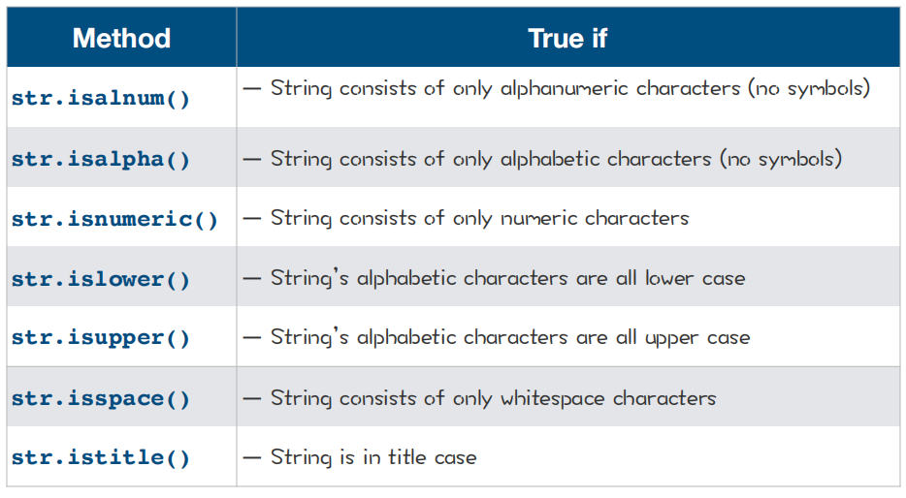
Methods of string - boolean

Slide 11
Methods of string - boolean
number = "5"
letters = "abcdef"
print(number.isnumeric())
print(letters.isnumeric())

Slide 12
Methods of string - boolean
movie = "2001: A SAMMY ODYSSEY"
book = "A Thousand Splendid Sharks"
poem = "sammy lived in a pretty how town"
print(movie.islower())
print(movie.isupper())
print(book.istitle())
print(book.isupper())
print(poem.istitle())
print(poem.islower())

Slide 13
length of last word
Given a string, return the length of last word in the string.
If the last word does not exist, return 0.
Note: A word is defined as a character sequence consists of non-space characters only.
Example:
Input: "Hello World"
Output: 5

Slide 14
def length_of_lastWord(s):
words = s.split()
if len(words):
word = words[len(words)-1]
return len(word)
else:
return 0
print(length_of_lastWord("hello world"))

Slide 15
def length_of_lastWord(s):
s = s.strip()
if len(s) == 0:
return 0
else:
index = s.rfind(" ")
return len(s.strip())-1-index
print(length_of_lastWord("hello world"))

Slide 16
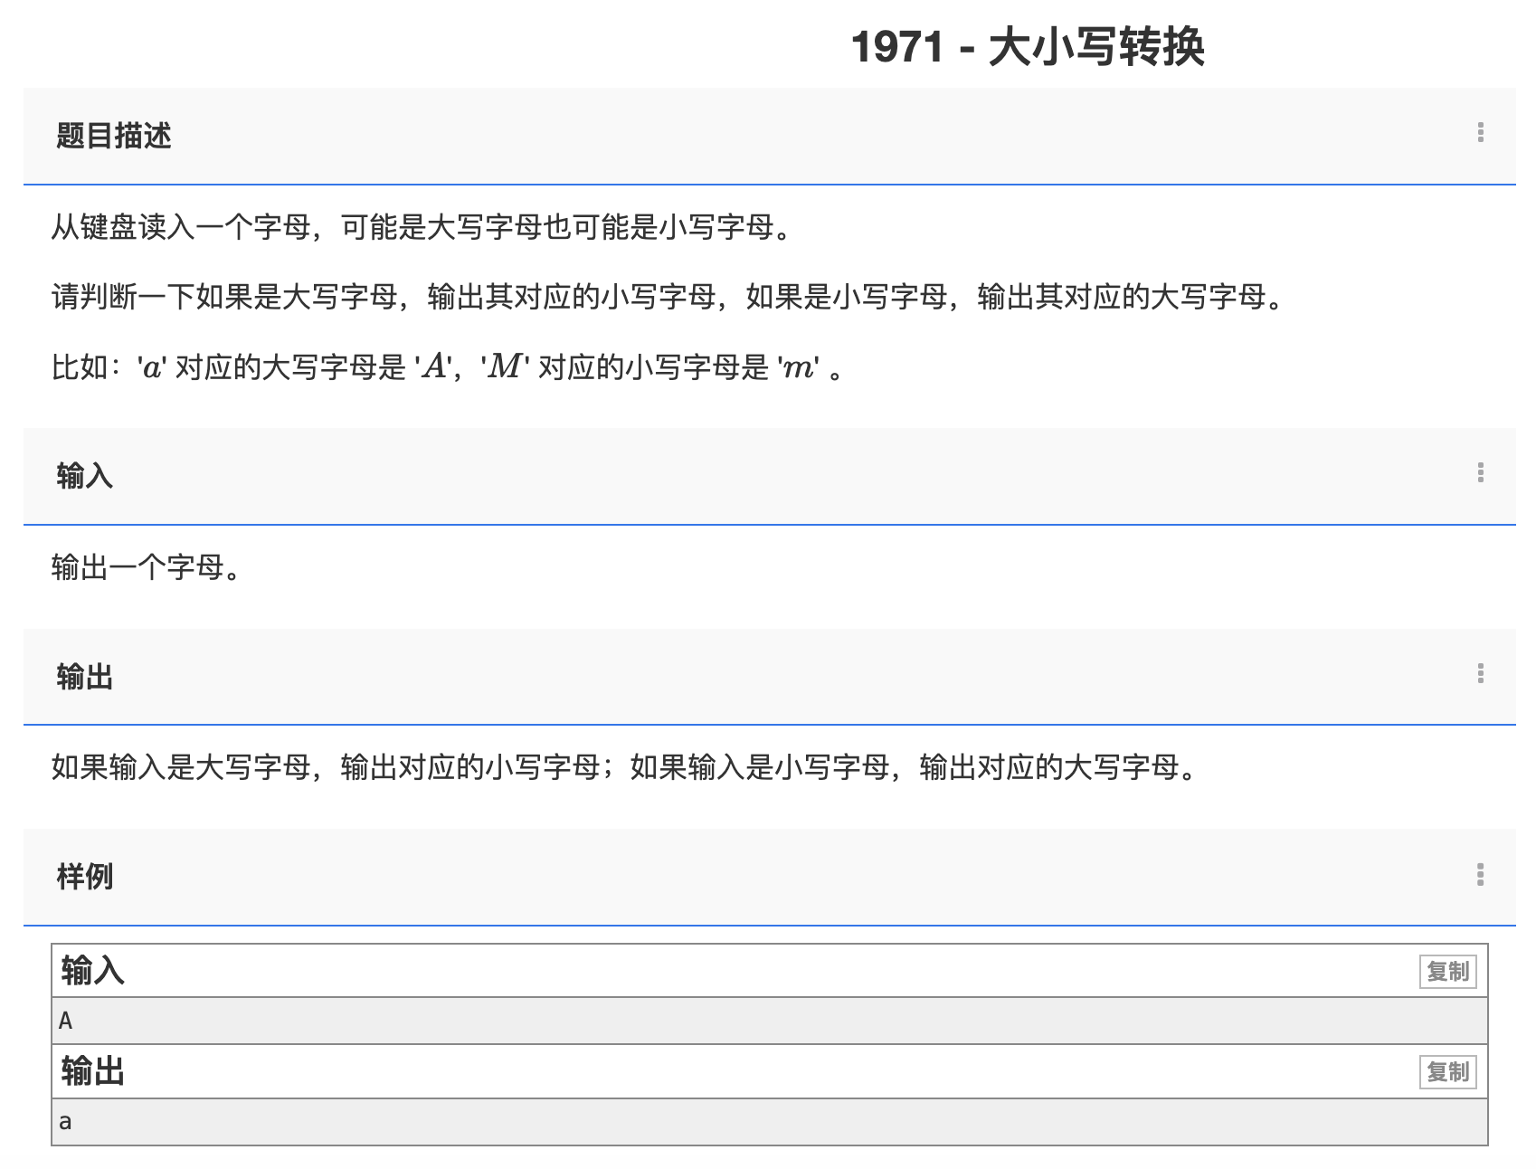

Slide 17
s = input()
offset = ord("a") - ord("A")
if "A" <= s <= "Z":
print(chr(ord(s) + offset))
else:
print(chr(ord(s) - offset))

Slide 18
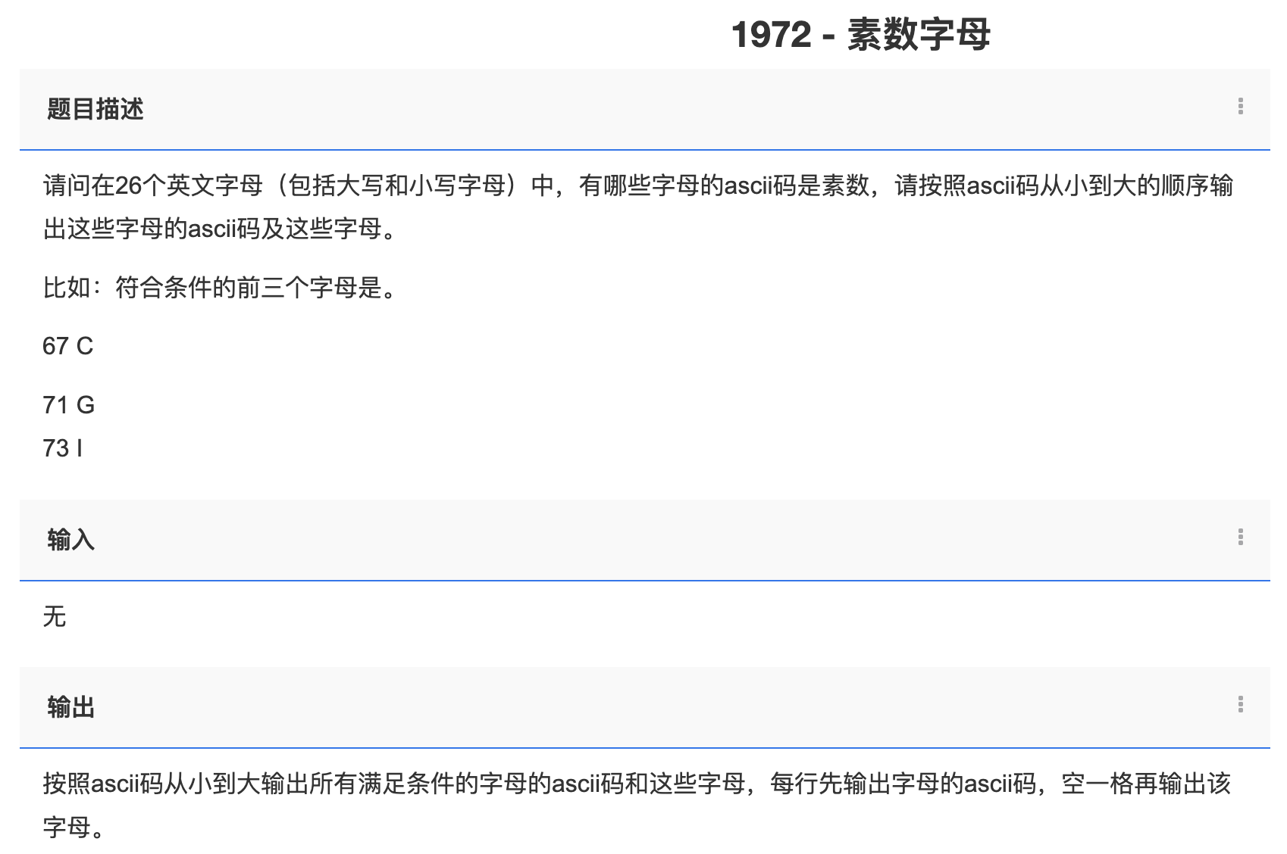

Slide 19
def is_prime(n):
for i in range(2, int(math.sqrt(n)) + 1):
if n % i == 0:
return False
return True
for i in range(ord('A'), ord('Z')):
if is_prime(i):
print(i, chr(i))
for i in range(ord('a'), ord('z')):
if is_prime(i):
print(i, chr(i))

Slide 20
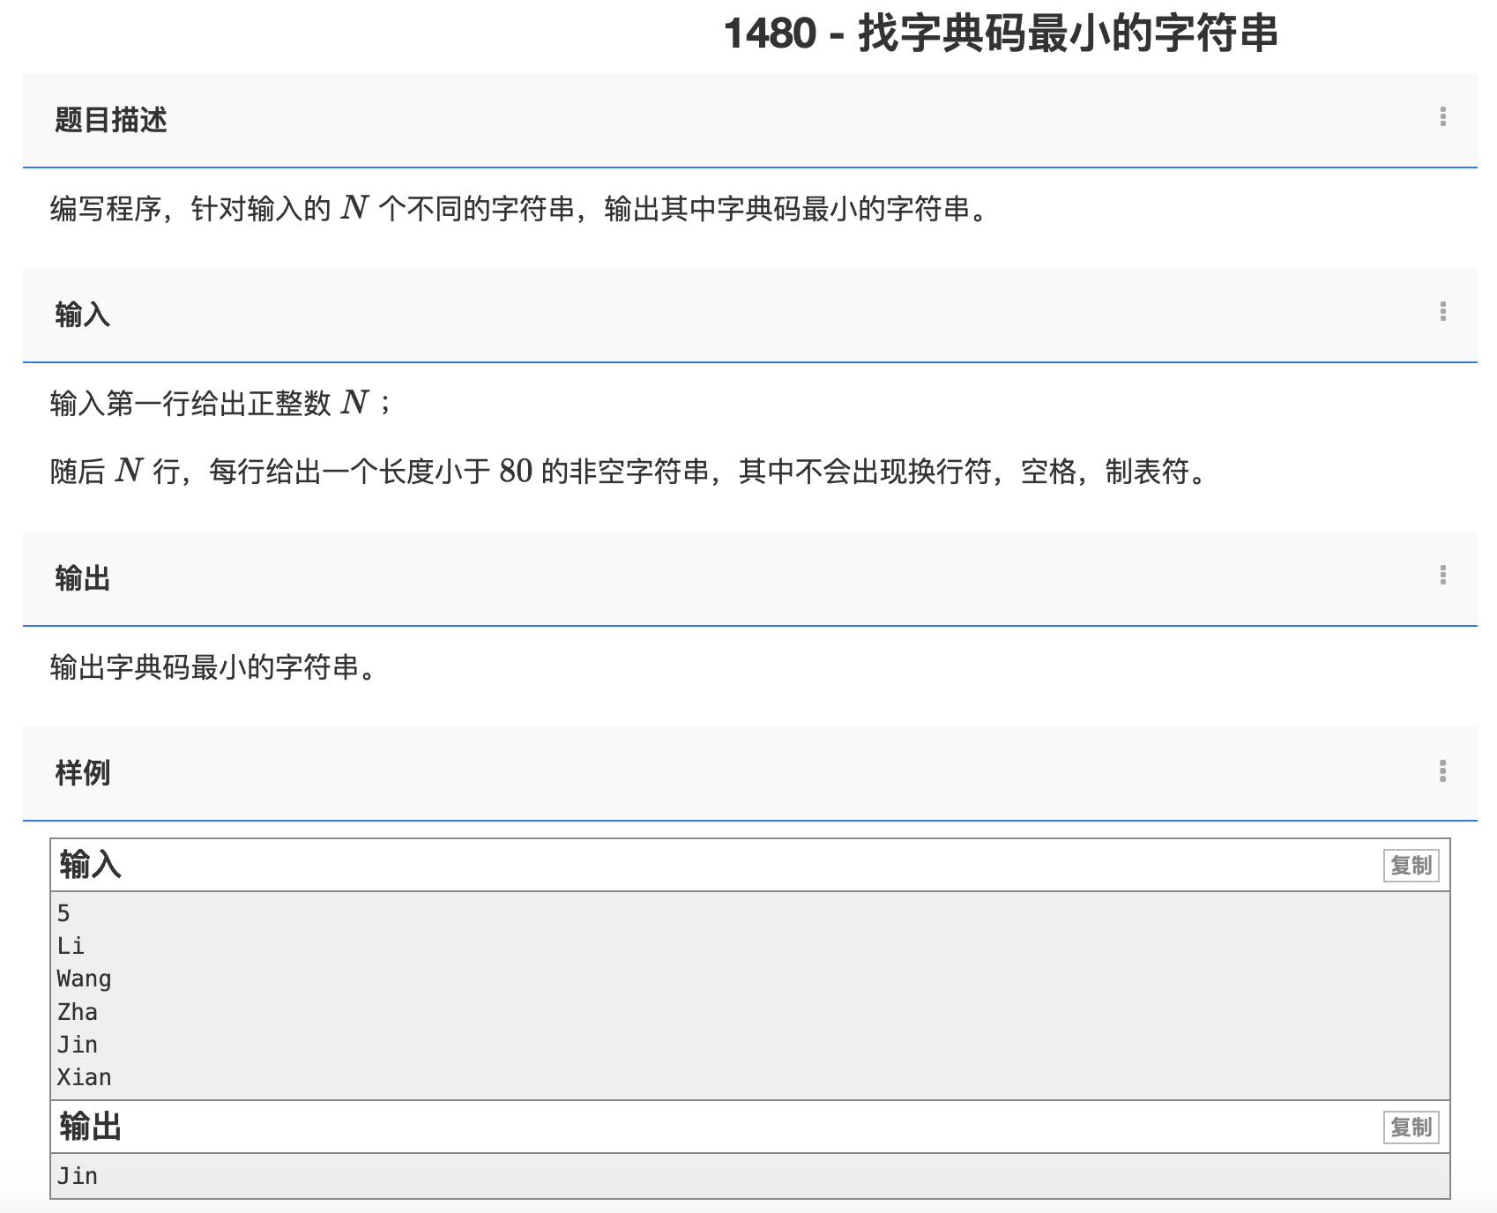

Slide 21
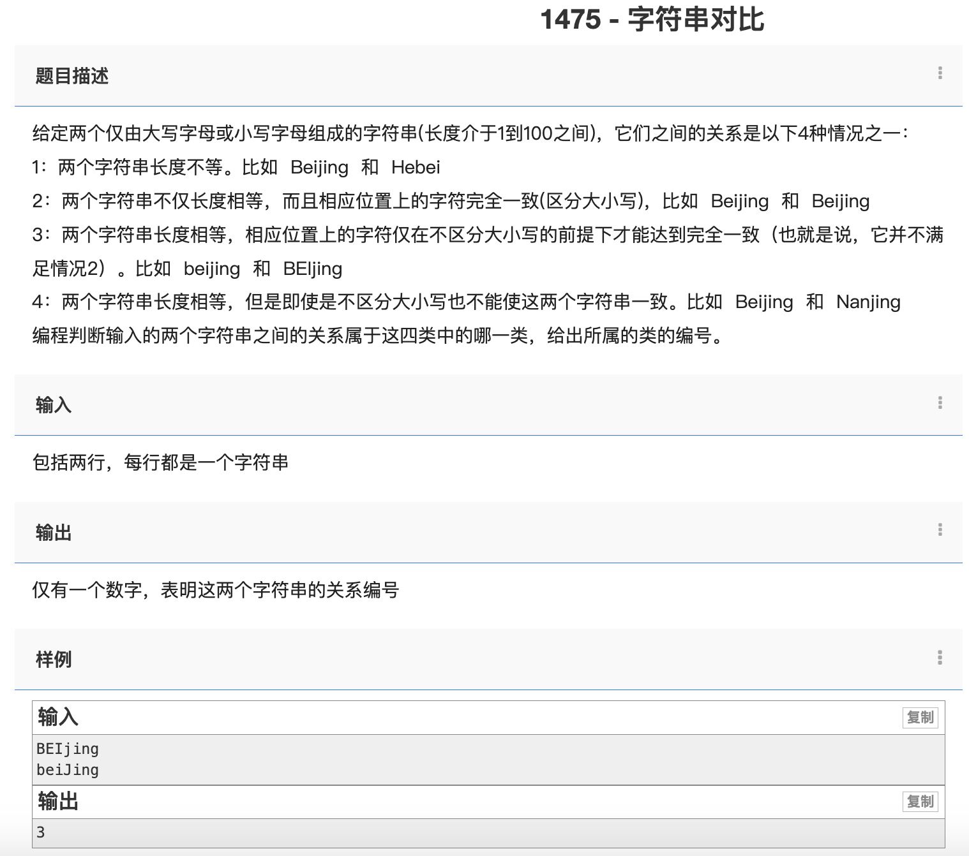

Slide 22
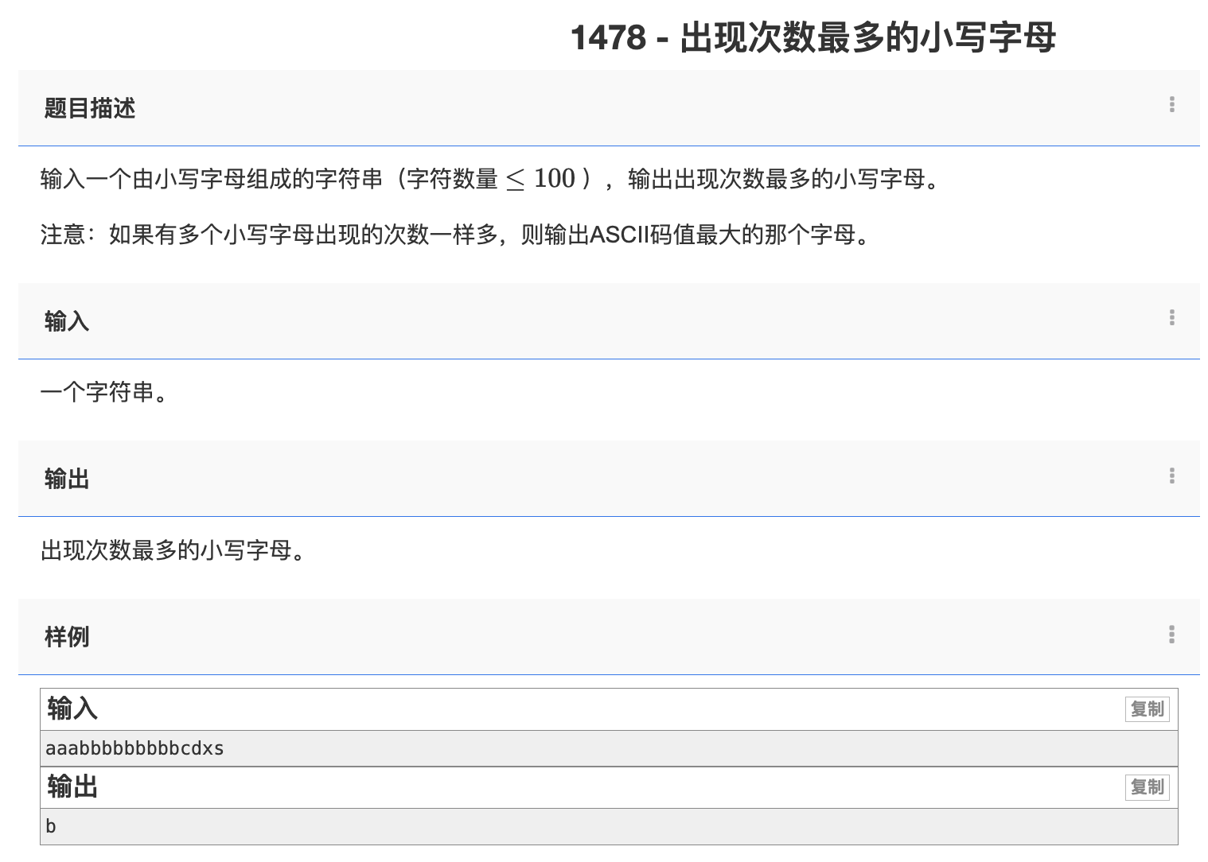

Slide 23
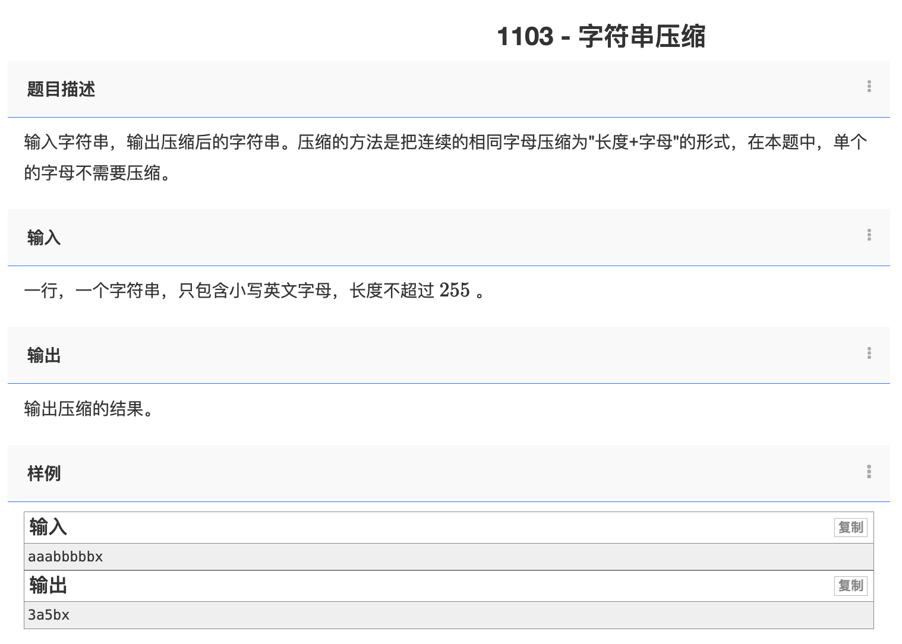

Slide 24
Palindrome （回文判断）
Given a string, determine if it does not change either reading from left or right.
Example 1: malayalam
Output: True
Example 2: hello
Output: False

Slide 25


def is_palindrome(s):
for i in range(0, len(s) // 2):
if s[i] != s[len(s) - i - 1]:
return False
return True
def is_palindrome(s):
left = 0
right = len(s) - 1
while left < right:
if s[left] != s[right]:
return False
left += 1
right -= 1
return True

Slide 26
Homework
Given a non-empty string s, you may delete at most one character. Judge whether you can make it a palindrome.
Example 1:
Input: "aba"
Output: True
Example 2:
Input: "abca"
Output: True
Explanation: You could delete the character 'c'.

