Slide 1
Camp Quality
Felicity the medication management app

Slide 2
The mobile App

Slide 3
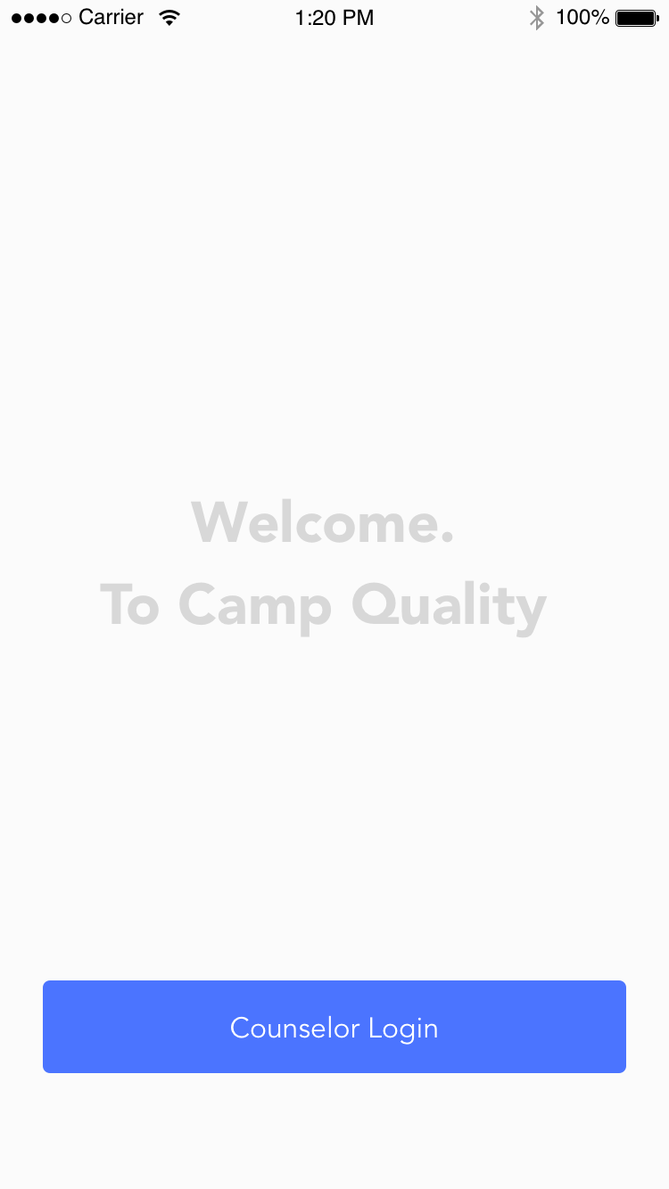
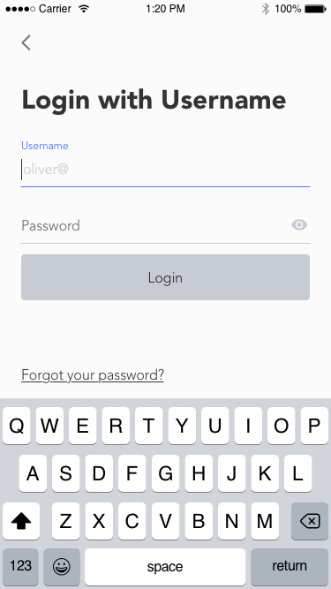
Landing page and Login

Slide 4
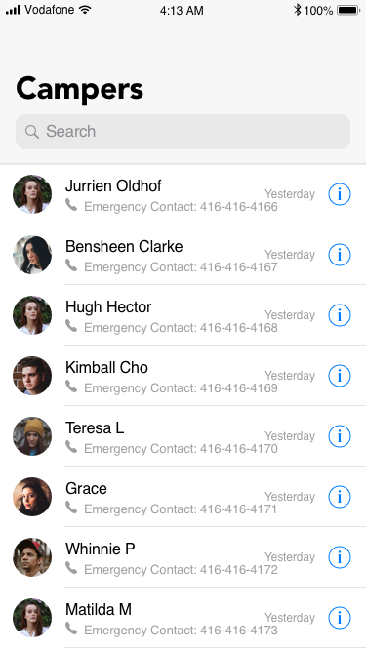
Camper Search
Allows the counselor to search through campers by name.
In case of possible emergencies the Emergency Contact number is made visible right away
To the left of each panel a ‘yesterday’ indicates the last time the persons page was viewed
Clicking on the “i”-icon will take the user to the medical information page for that camper

Slide 5
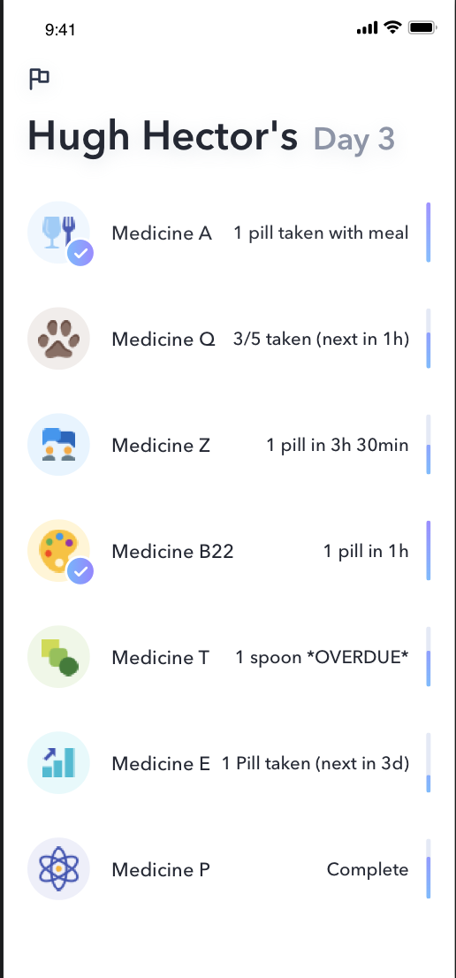
Medical Information Page
At the top of the page is the name of the camper, followed by the number of days spent at camp
The medical information page lists the medication name followed by information regarding the next dosage.
If dosage has a time requirement (i.e, take twice daily) then the countdown is noted as “in Xh (Ymin)”
When medication is overdue it is flagged *OVERDUE*

