Slide 1

On This Day
Created by: Andrew, Brian, Carrie & David

Slide 2
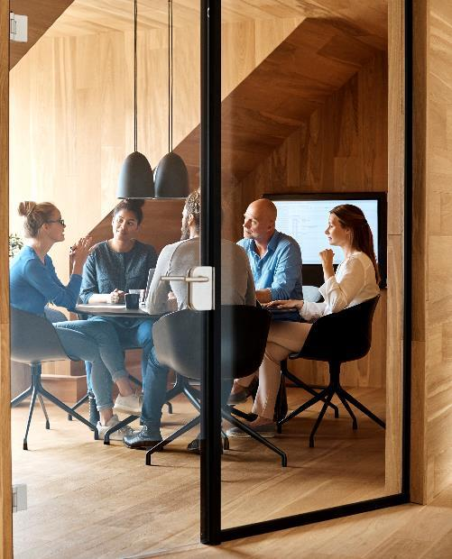



PITCH
Have you ever wondered what types of things have happened on specific day like your birthday? With “On This Day” its possible. Here you will get a picture taken from that day of space, important events, and deaths/births.

Slide 3



CONCEPT
Topic ne
Topic two
Topic three
Topic four
Topic five

Slide 4

screenshot

Slide 5

FUTURE DIRECTION
Try to get saved to save all info currently on page.
Default to current date.

Slide 6




Team
Name
Name
Name
Name
Title
Title
Title
Title

Slide 7


Thank You
LINKS

