Slide 1
safetyGraphics
An open source framework for evaluation of clinical trial safety
Links: CRAN | GitHub | Demo

Slide 2
Vignettes
Intro Vignette - Introductory vignette providing the overview of the package.
Chart Configuration Vignette - Details about the charting process including technical specifications and step-by-step instructions.
Cookbook Vignette - A series of examples showing how to initialize the safetyGraphics Shiny app in different scenarios.
Technical FAQ Vignette - Vignette discussing security, validation and other technical issues.
Today
Link: https://github.com/safetygraphics/safetygraphics/wiki

Slide 3
Package Ecosystem
The {safetyGraphics} platform displays charts from {safetyCharts}.
{safetyGraphics} – Reusable Shiny App for safety monitoring
{safetyCharts} – Reusable stand-alone charts for safety monitoring
{safetyData} – sample AdAM and SDTM datasets from PhUSE used for examples and testing.

Slide 4
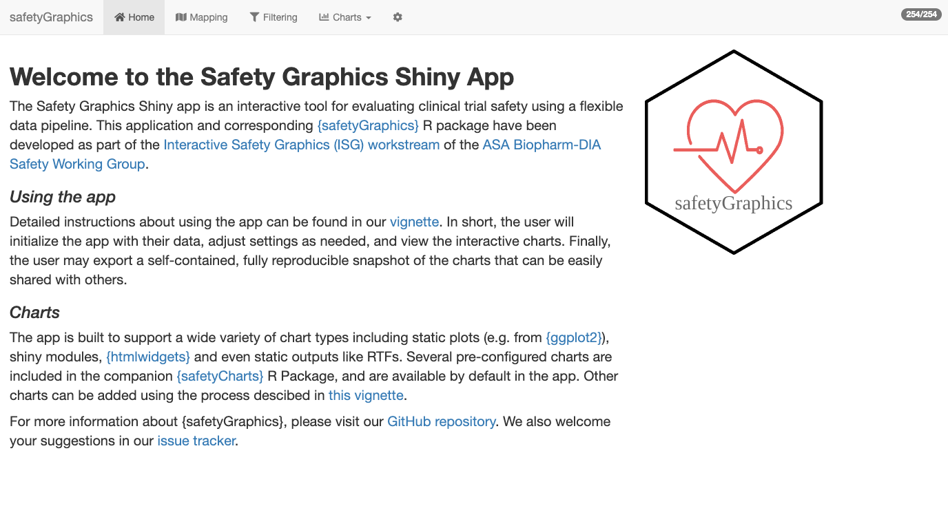
Hello World
install.packages('safetyGraphics’)
library(safetyGraphics)
safetyGraphicsApp()

Slide 5
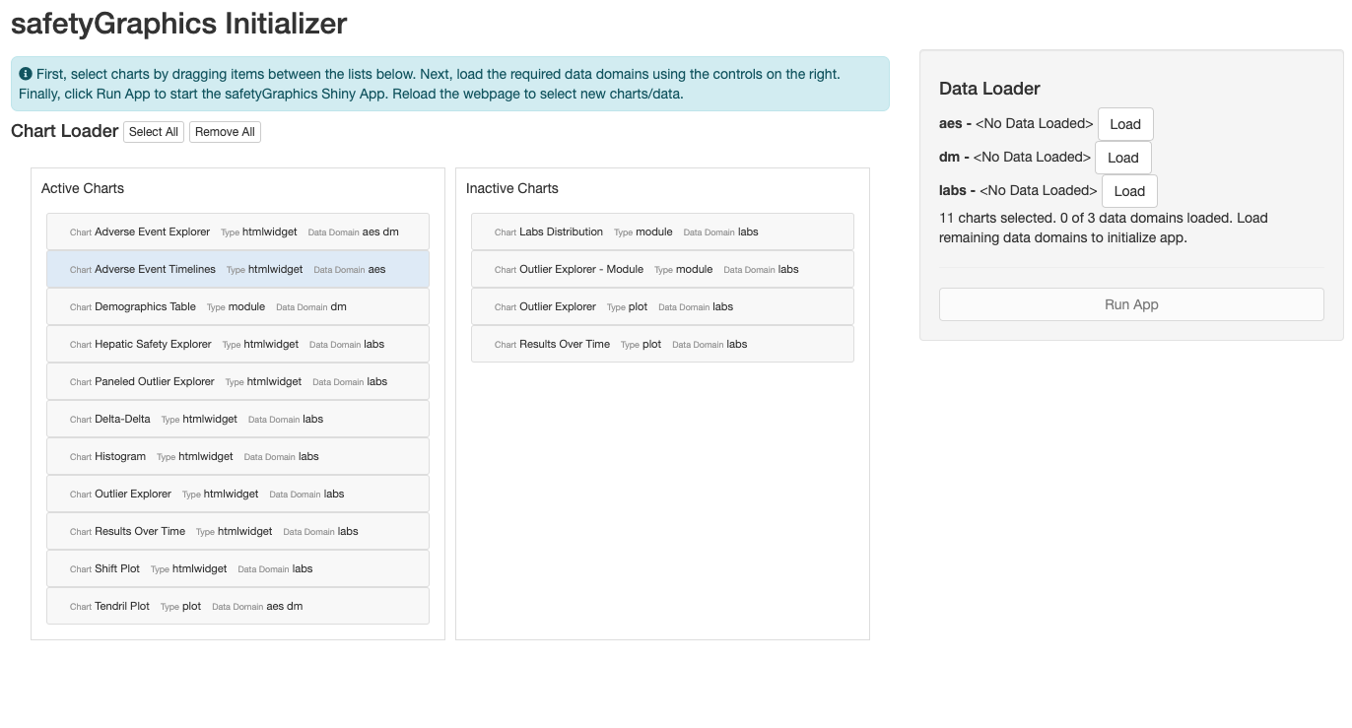
Hello World, Again
install.packages('safetyGraphics’)
library(safetyGraphics)
safetyGraphicsInit()

Slide 6
Configurable App Inputs
Charts – Default library in safetyCharts. See Chart Configuration Vignette
Data – Study data provided by the user as a named list.
Mapping – List identifying the key columns/fields in your data.
Meta – Metadata table with information about key data columns/fields used in charts. Saved as `safetyGraphics::meta`

Slide 7
?safetyGraphicsApp docs
safetyGraphicsApp(
domainData = list(
labs = safetyData::adam_adlbc,
aes = safetyData::adam_adae,
dm = safetyData::adam_adsl
),
meta = safetyGraphics::meta,
charts = NULL,
mapping = NULL,
autoMapping = TRUE,
filterDomain = "dm",
chartSettingsPaths = NULL
)
domainData | named list of data.frames to be loaded into the app. Sample AdAM data from the safetyData package used by default
charts | list of charts in the format produced by safetyGraphics::makeChartConfig()
mapping | list specifying the initial mapping values for each data mapping for each domain (e.g. list(aes= list(id_col='USUBJID', seq_col='AESEQ')).
autoMapping | boolean indicating whether the app should attempt to automatically detect data standards and generate mappings for the data provided. Values specified in the mapping parameter overwrite automatically generated mappings when both are found. Defaults to true.
meta | data frame containing the metadata for use in the app. See the preloaded file (?safetyGraphics::meta) for more data specifications and details. Defaults to safetyGraphics::meta.
filterDomain | domain used for the data/filter tab. Demographics ("dm") is used by default. Using a domain that is not one record per participant is not recommended.
chartSettingsPaths | path(s) where customization functions are saved relative to your working directory. All charts can have initialization (e.g. myChart_Init.R) and static charts can have charting functions (e.g. myGraphic_Chart.R). All R files in this folder are sourced and files with the correct naming convention are linked to the chart. See the Custom Charts vignette for more details.

