Slide 1
jRisk 2:
Electric BoogAloo

Slide 2
About jRisk
jRisk is an almost complete Java Implementation of Risk the board game.
Implements almost everything, except for Cards, Full Territory Bonuses, and Graphics.

Slide 3
What Was Planned
Create an “AI” that will choose the best possible path.

Slide 4
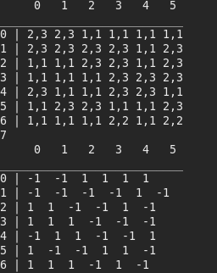
How I Did It
First Steps:
Research! Tons and Tons of research.
For a basic start I decided to mimic pathfinding and copy over the Territory Array into something more readable for myself and the Computer.
-1 is Computers, Positive values are opponents armies.

Slide 5
How I Did it (cont.)
Figuring out weighting:
Decided on dividing Computers Armies by Opponents Armies
Subtracted that total by .10
The closer to 1 (Or Above 1 in cases would be a better move)
Keeping track of moves:
Created a LinkedList, best value is stored along with starting coordinates, and a list is created off of that.

Slide 6

How I Did It (cont.):
A Massive recursive call:
57 Lines in fact.

Slide 7
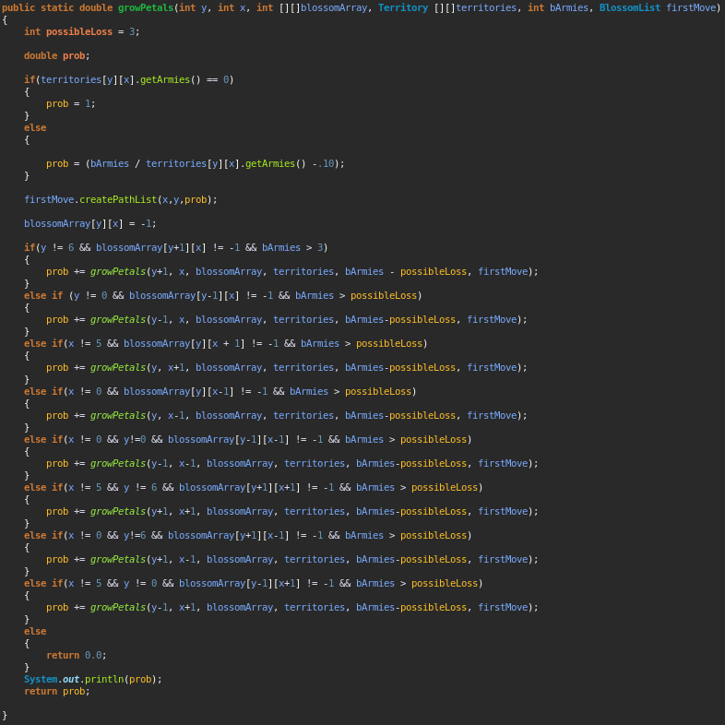

Lots of copy and pasting, over and over again.

Slide 8
Problems:
“AI” is hard! Who knew.
Weighting if it was changed too much it would be way to careful, and too hard would make it stretch itself a little too thin.
Finding optimal attack amount (At 3 currently) and move amount (Armies / 2).

Slide 9
Questions?

